Slide 1

Design and Analysis of Algorithms
Week 2
Basics of Algorithm Analysis
CS3230
Arnab Bhattacharyya
Rahul Jain

Slide 2
Tentative Schedule of Lectures
Date | Topic
15/08 | Stable matching
22/08 | Basics of Algorithm Analysis
29/08 | Graphs
05/09 | Greedy algorithms
12/09 | Divide & Conquer
19/09 | Dynamic programming
03/10 | Max flow
10/10 | Midterm
17/10 | Intractability
24/10 | NP-completeness
31/10 | Approximation
07/11 | Local search
14/11 | Randomized algorithms

Slide 3
Online Portal
Canvas (https://canvas.nus.edu.sg/courses/45767)
Home
Announcements
Assignments
Discussions
Syllabus
Grades
Files
Visit Canvas frequently

Slide 4
Assessment
Midterm Assessment: 20% (10th October 2023, 10 am-12 pm)
Endterm Assessment: 40% (27th November 2023, 9-11:30 am)
Weekly problem sets: 20%
Tutorial participation: 10%
Programming assignments: 10%

Slide 5
Problem Sets
There will be 12 written assignments, released 1 week after the corresponding lecture.
Problem set released by 6 pm on Monday, due by 6 pm on the the following Monday
Exception for Problem Set 6; see schedule on Canvas.
Submit on Canvas
Graded by your TA.

Slide 6
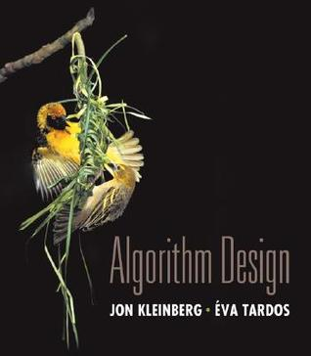
References
Slides and Lecture Notes
Textbook: Algorithm Design,
by Kleinberg & Tardos
Read online: https://ebookcentral.proquest.com/lib/nus/detail.action?docID=5173481

Slide 7



Purchase your module’s chosen Pearson textbook
Module | CS3230 Design and Analysis of Algorithms
Title | Algorithm Design: Pearson New International Edition 1st Edition
eBook | https://shopee.sg/product/849371650/22352080786
Available at

Slide 8
Academic Policy (on Plagiarism)
Do your work YOURSELF
If you are REALLY stuck,
Approach instructor/tutor for help
If you want to discuss with fellow students
Discuss general approach (not detailed answers)
You MUST write up YOUR OWN answers
You MUST write down names of collaborators
Do NOT copy/compare answers!
If you do so, you will get direct F (due to our school policy).
My personal opinion does not matter.
Please do not post assignment questions and put your code in public repositories
For example, should NOT post anything on stackoverflow,….
You can ask question on Canvas
Resource: https://www.comp.nus.edu.sg/cug/plagiarism/

Slide 9


Chapter 2 Basics of Algorithm Analysis
Slides by Kevin Wayne. Copyright © 2005 Pearson-Addison Wesley. All rights reserved.

Slide 10
Introduction
What is an algorithm?
A finite sequence of “well-defined” instructions to solve a given computational problem
A prime objective of the course: Design of efficient algorithms
Focus on running time

Slide 11
How to analyze running time?
Simulation: Run the algorithm many times and measure the running time
Mathematical analysis
Machine dependent
Input dependent

Slide 12

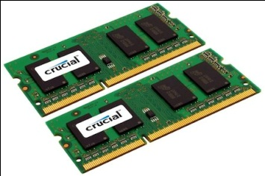

Let us open a desktop/laptop
A processor (CPU)
speed = few GHz
(a few nanoseconds to execute an instruction)
Internal memory (RAM)
size = a few GB (Stores a billion bytes/words)
speed = a few GHz( a few nanoseconds to read a byte/word)
External Memory (Hard Disk Drive)
size = a few tera bytes
speed : seek time = miliseconds
transfer rate= around billion bits per second

Slide 13



Model of Computation
(Mathematical) Model of Computation
Simple
Close to real computers

Slide 14
Word-RAM model
Data
Processor
Program
RAM

Slide 15
How does an instruction execute?
Decoding instruction
Fetching operands
Performing arithmetic/logical operations
Storing the results back into RAM
Processor
Each instruction takes a few cycles to get executed
Assume a few nanoseconds
RAM

Slide 16
Word-RAM model
Word is the basic storage unit of RAM. Word is a collection of few bytes.
Each input item (number, name) is stored in binary format.
RAM can be viewed as a huge array of words.
Any arbitrary location of RAM can be accessed in the same time irrespective of the location.
Data as well as Program reside fully in RAM.
Each arithmetic or logical operation (+, -, *, /, OR, AND, NOT) involving a constant number of words takes constant number of cycles (steps) by the CPU.

Slide 17
How to measure Running Time?
This is what we will count (mathematically)
Number of instructions taken in word-RAM model
Machine dependent constant
Number of instructions executed in word-RAM model
Directly proportional
Actual running time in real life
Variation among instructions
Will ignore
Architecture : 32 vs 64
Other factors
Compiler optimization
Multitasking due to OS

Slide 18
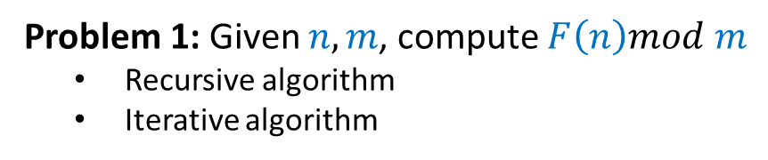
Example - Fibonacci Number F(n)
F(0) = 0
F(1) = 1
F(n) = F(n-1) + F(n-2) for n>1
Problem 1: Given $n,m$, compute $F\left(n\right)mod m$
Recursive algorithm
Iterative algorithm

Slide 19
Two algorithms for Fibonacci numbers (mod m)
Recursive Algorithm
Iterative Algorithm
IFIB(n,m) {
if n=0 return 0;
else if n=1 return 1;
else {
a ← 0; b← 1;
For(i=2 to n) do
{
temp ← b;
b← (a+b) mod m;
a← temp; }
}
return b;}
RFIB(n,m) {
if n=0 return 0;
else if n=1 return 1;
else return((RFIB(n-1) + RFIB(n-2)) mod m);
}b

Slide 20
Analyze algorithms for F(n) mod m
First analyze the Recursive Algorithm
RFIB(n,m)
{
if n=0 return 0;
else if n=1 return 1;
else return((RFIB(n-1,m) + RFIB(n-2,m)) mod m);
}
Let R(n) be the number of instructions executed by RFIB(n,m)
R(0) = 2

Slide 21
Analyze algorithms for F(n) mod m
First analyze the Recursive Algorithm
RFIB(n,m)
{
if n=0 return 0;
else if n=1 return 1;
else return((RFIB(n-1,m) + RFIB(n-2,m)) mod m);
}
Let R(n) be the number of instructions executed by RFIB(n,m)
R(0) = 2
R(1) = 3

Slide 22

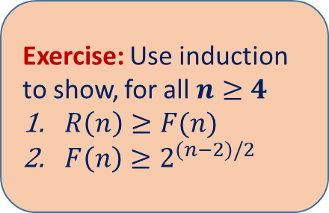
Analyze algorithms for F(n) mod m
First analyze the Recursive Algorithm
RFIB(n,m)
{
if n=0 return 0;
else if n=1 return 1;
else return((RFIB(n-1,m) + RFIB(n-2,m)) mod m);
}
Let R(n) be the number of instructions executed by RFIB(n,m)
R(0) = 2
R(1) = 3
R(n) = 6 + R(n-1) + R(n-2) for n>1
Exercise: Use induction to show, for all $n≥4$
$R\left(n\right)≥F(n)$
$F\left(n\right)≥2^{(n−2)/2}$
No. of instructions $≥2^{(n−2)/2}$

Slide 23
Analyze algorithms for F(n) mod m
Now analyze the Iterative Algorithm
No. of instructions =
IFIB(n,m) {
if n=0 return 0;
else if n=1 return 1;
else { a ← 0; b← 1;
For(i=2 to n) do
{ temp ← b;
b← (a+b) mod m ;
a← temp; }
}
return b;}

Slide 24
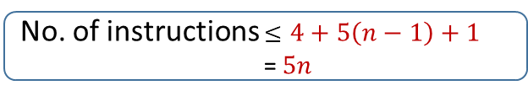
Example: Analyze algorithms for F(n) mod m
Now analyze the Iterative Algorithm
No. of instructions $≤$ $4+5\left(n−1\right)+1$
=$5n$
IFIB(n,m) {
if n=0 return 0;
else if n=1 return 1;
else { a ← 0; b← 1;
For(i=2 to n) do
{ temp ← b;
b← (a+b) mod m ;
a← temp; }
}
return b;}
Worst-case time
4 instructions
n-1 iterations
5 instructions
The final instruction

Slide 25
2.1 Computational Tractability
"For me, great algorithms are the poetry of computation. Just like verse, they can be terse, allusive, dense, and even mysterious. But once unlocked, they cast a brilliant new light on some aspect of computing." - Francis Sullivan

Slide 26
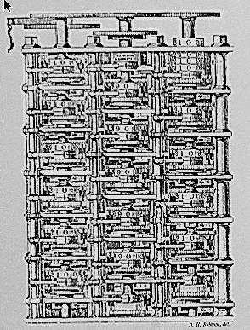
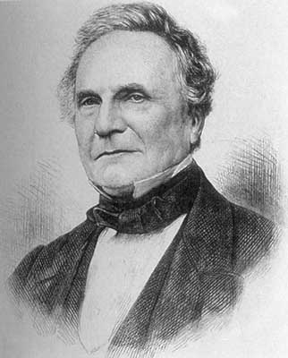
Computational Tractability
As soon as an Analytic Engine exists, it will necessarily guide the future course of the science. Whenever any result is sought by its aid, the question will arise - By what course of calculation can these results be arrived at by the machine in the shortest time? - Charles Babbage
Charles Babbage (1864)
Analytic Engine (schematic)

Slide 27
Polynomial-Time
Brute force. For many non-trivial problems, there is a natural brute force search algorithm that checks every possible solution.
Typically takes 2^{N} time or worse for inputs of size N.
Unacceptable in practice.
n ! for stable matching with n men and n women
Notes:
focusing on worst-case poly-time is a subtle modeling decision - we try to justify it here

Slide 28
Polynomial-Time
Brute force. For many non-trivial problems, there is a natural brute force search algorithm that checks every possible solution.
Typically takes 2^{N} time or worse for inputs of size N.
Unacceptable in practice.
Desirable scaling property. When the input size doubles, the algorithm should only slow down by some constant factor C.
n ! for stable matching with n men and n women
Notes:
focusing on worst-case poly-time is a subtle modeling decision - we try to justify it here

Slide 29
Polynomial-Time
Brute force. For many non-trivial problems, there is a natural brute force search algorithm that checks every possible solution.
Typically takes 2^{N} time or worse for inputs of size N.
Unacceptable in practice.
Desirable scaling property. When the input size doubles, the algorithm should only slow down by some constant factor C.
Def. An algorithm is poly-time if the above scaling property holds.
n ! for stable matching with n men and n women
There exists constants c > 0 and d > 0 such that on every input of size N, its running time is bounded by c N^{d} steps.
choose C = 2^{d}
Notes:
focusing on worst-case poly-time is a subtle modeling decision - we try to justify it here

Slide 30
Worst-Case Analysis
Worst case running time. Obtain bound on largest possible running time of algorithm on input of a given size N.
Generally captures efficiency in practice.
Draconian view, but hard to find effective alternative.

Slide 31
Worst-Case Analysis
Worst case running time. Obtain bound on largest possible running time of algorithm on input of a given size N.
Generally captures efficiency in practice.
Draconian view, but hard to find effective alternative.
Average case running time. Obtain bound on running time of algorithm on random input as a function of input size N.
Hard (or impossible) to accurately model real instances by random distributions.
Algorithm tuned for a certain distribution may perform poorly on other inputs.

Slide 32
Worst-Case Polynomial-Time
Def. An algorithm is efficient if its running time is polynomial.

Slide 33
Worst-Case Polynomial-Time
Def. An algorithm is efficient if its running time is polynomial.
Justification: It really works in practice!
Although 6.02 × 10²³ × N²⁰ is technically poly-time, it would be useless in practice.
In practice, the poly-time algorithms that people develop almost always have low constants and low exponents.
Breaking through the exponential barrier of brute force typically exposes some crucial structure of the problem.

Slide 34
Worst-Case Polynomial-Time
Def. An algorithm is efficient if its running time is polynomial.
Justification: It really works in practice!
Although 6.02 × 10²³ × N²⁰ is technically poly-time, it would be useless in practice.
In practice, the poly-time algorithms that people develop almost always have low constants and low exponents.
Breaking through the exponential barrier of brute force typically exposes some crucial structure of the problem.
Exceptions.
Some poly-time algorithms do have high constants and/or exponents, and are useless in practice.
Some exponential-time (or worse) algorithms are widely used because the worst-case instances seem to be rare.
simplex method Unix grep

Slide 35
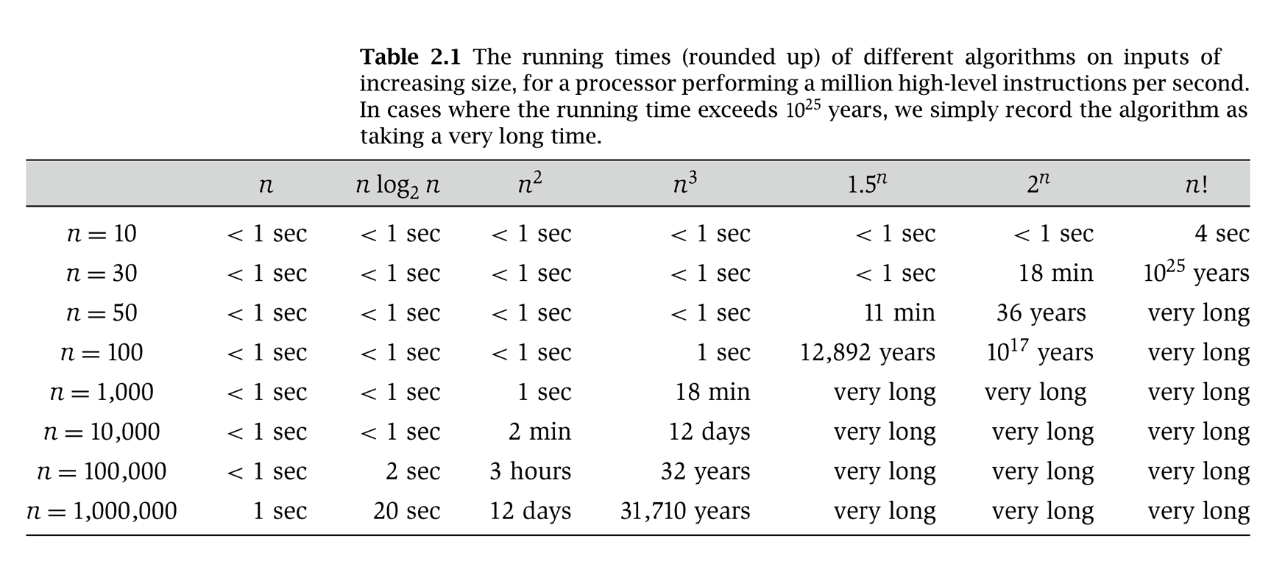
Why It Matters
Notes:
table taken from More Programming Pearls, p. 82, 400MhZ Pentium II scaled up
one step takes one nanosecond
msec = millisecond

Slide 36
2.2 Asymptotic Order of Growth

Slide 37
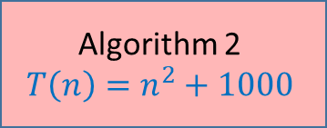
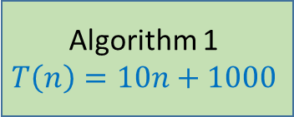
Comparing efficiency of two algorithms
Algorithm 1
$$T\left(n\right)=10n+1000$$
Algorithm 2
$$T\left(n\right)=n^{2}+1000$$
Which one is more efficient?

Slide 38
Comparing efficiency of two algorithms
Algorithm 1
$$T\left(n\right)=10n+1000$$
Algorithm 2
$$T\left(n\right)=n^{2}+1000$$
Which one is more efficient?
Algorithm 2 when n < 10
Algorithm 1 when n > 10
Time complexity really matters only for large-sized input

Slide 39
Comparing efficiency of two algorithms
Algorithm 1
$$T\left(n\right)=10n+1000$$
is more efficient than
Algorithm 2
$$T\left(n\right)=n^{2}+1000$$
Only compare for asymptotically large values of input size

Slide 40
Asymptotic analysis for running time
Different machines have different running time.
We do not measure actual run-time.
We estimate the rate-of-growth of running time by asymptotic analysis.
Example: 0.01n³ grows faster than 1000n²!
To compare running time of two different algorithms we see which is more efficient (or fast) for large inputs in the worst case.
Machine Independent

Slide 41
Central Mantra of Asymptotic Analysis
Suppress constant factors and lower-order terms

Slide 42
Asymptotic Order of Growth
Upper bounds. T(n) is O(f(n)) if there exist constants c > 0 and n₀ ≥ 0 such that for all n ≥ n₀ we have T(n) ≤ c · f(n).
Lower bounds. T(n) is Ω(f(n)) if there exist constants c > 0 and n₀ ≥ 0 such that for all n ≥ n₀ we have T(n) ≥ c · f(n).
Tight bounds. T(n) is Θ(f(n)) if T(n) is both O(f(n)) and Ω(f(n)).
Ex: T(n) = 32n² + 17n + 32.
T(n) is O(n²), O(n³), Ω(n²), Ω(n), and Θ(n²) .
T(n) is not O(n), Ω(n³), Θ(n), or Θ(n³).

Slide 43
Notation
Slight abuse of notation. T(n) = O(f(n)).
Asymmetric:
f(n) = 5n³; g(n) = 3n²
f(n) = O(n³) = g(n)
but f(n) ≠ g(n).
Better notation: T(n) ∈ O(f(n)).
Meaningless statement. Any comparison-based sorting algorithm requires at least O(n log n) comparisons.
Statement doesn't "type-check."
Use Ω for lower bounds.

Slide 44
Example
We write f(n) = O(g(n)) if there exist constants c > 0, n₀ > 0 such that 0 ≤ f(n) ≤ cg(n) for all n ≥ n₀.
Claim: 2n² = O(n³)
Proof: Let f(n)=2n².
Note that f(n)=2n² ≤ n³ when n≥2.
Set c=1 and n₀=2.
We have f(n)=2n² ≤ c·n³ for n ≥ n₀.
By definition 2n² = O(n³).

Slide 45
Proof Practice #1
Let f(n)=3n²+100n+5.
Let g(n)=n³+10.
We want to prove that f(n) = O(g(n)) by showing that f(n) ≤ cg(n) for all n ≥ n₀.
What should be c and n₀? (There may be more than one correct answer.)
(A) c=2, n₀=10
(B) c=1, n₀=12
(C) c=5, n₀=2
(D) c=1, n₀=10

Slide 46
Solution for Proof Practice #1
Let f(n)=3n²+100n+5.
Let g(n)=n³+10.
(C) is false
When c=5, n₀=2,
f(2)=3·2²+100(2)+5=217 and g(2)=2³+10=18
Hence, f(n) > c g(n) when n=n₀=2 and c = 2.
(D) is false
When c=1, n₀=10,
f(10)=3·10²+100(10)+5=1305 and g(10)=10³+10=1010
Hence, f(n) > c g(n) when n=n₀=10 and c = 1.

Slide 47
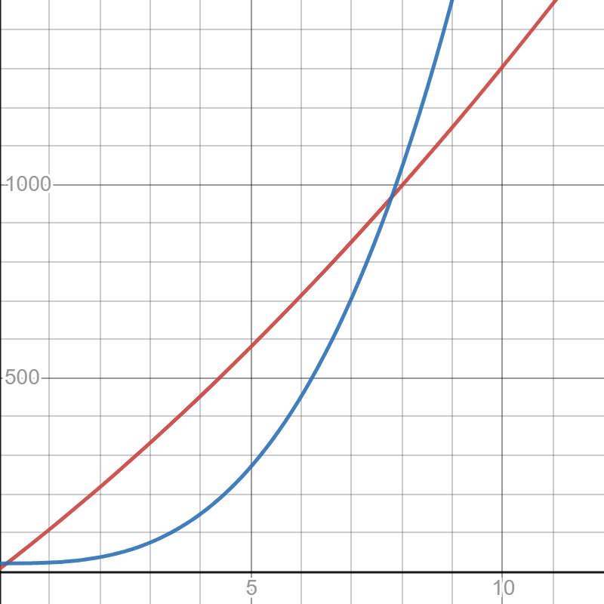
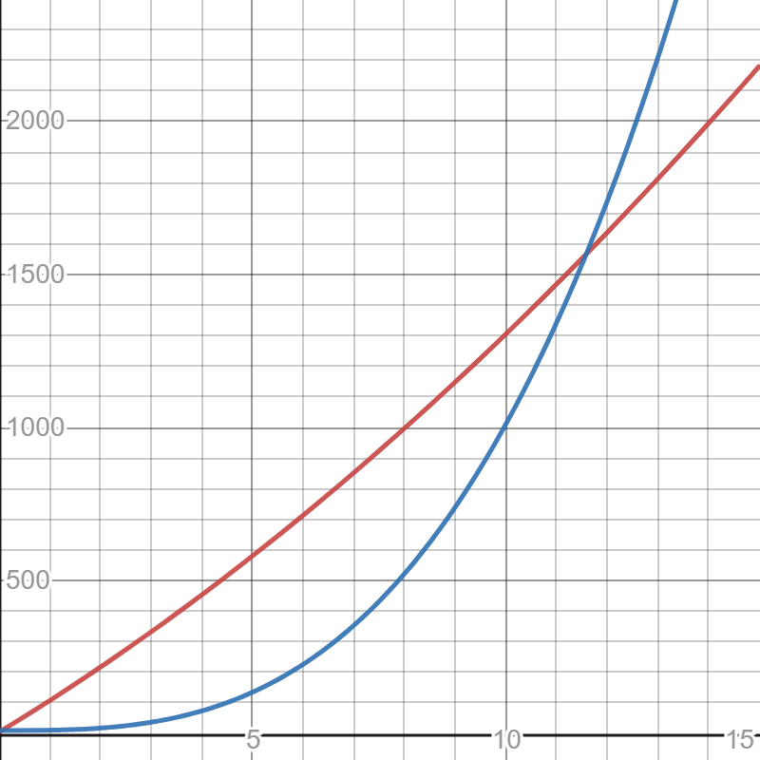



Solution for Proof Practice #1
(B) is true
Let f(n)=3n²+100n+5.
Let g(n)=n³+10.
(A) is true
$$n^{3}+10$$
$$2(n^{3}+10)$$
$$3n^{2}+100n+5$$
$$3n^{2}+100n+5$$

Slide 48








Think of it like a game!
$$f\left(n\right)=O\left(g\left(n\right)\right)?$$
Numbers $c$ and $n_{0}$
You
Challenger
Number $n$ bigger than $n_{0}$
Win if $f\left(n\right)≤c⋅g(n)$
Win if $f\left(n\right)>c⋅g(n)$
$f\left(n\right)=O(g\left(n\right))$ iff you have a winning strategy for above game.

Slide 49
Properties
Transitivity.
If f = O(g) and g = O(h) then f = O(h).
If f = Ω(g) and g = Ω(h) then f = Ω(h).
If f = Θ(g) and g = Θ(h) then f = Θ(h).
Additivity.
If f = O(h) and g = O(h) then f + g = O(h).
If f = Ω(h) and g = Ω(h) then f + g = Ω(h).
If f = Θ(h) and g = O(h) then f + g = Θ(h).

Slide 50
Asymptotic Bounds for Some Common Functions
Polynomials. a₀ + a₁n + … + a_{d}n^{d} is Θ(n^{d}) if a_{d} > 0.
Polynomial time. Running time is O(n^{d}) for some constant d independent of the input size n.
Logarithms. O(log _{a} n) = O(log _{b} n) for any constants a, b > 0.
Logarithms. For every x > 0, log n = O(n^{x}).
Exponentials. For every r > 1 and every d > 0, n^{d} = O(r^{n}).
can avoid specifying the base
log grows slower than every polynomial
every exponential grows faster than every polynomial

Slide 51

Common confusions
$2^{n+5}=O(2^{n})$, because $2^{n+5 }=32⋅2^{n}$.
But, $2^{5n}$ is not $O(2^{n})$. Check this!
$\max\left(f\left(n\right),g\left(n\right)\right)=Θ\left(f\left(n\right)+g\left(n\right)\right)$.

Slide 52
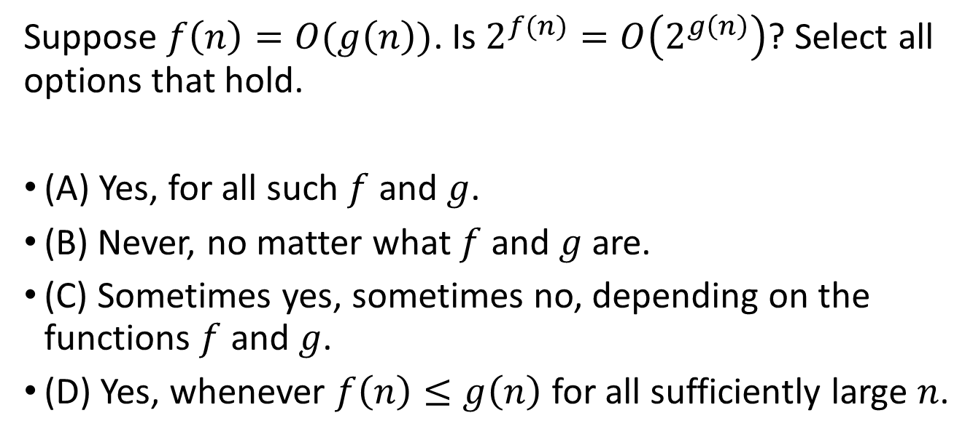
Proof Practice #2
Suppose $f\left(n\right)=O(g\left(n\right))$. Is $2^{f(n)}=O\left(2^{g\left(n\right)}\right)$? Select all options that hold.
(A) Yes, for all such $f$ and $g$.
(B) Never, no matter what $f$ and $g$ are.
(C) Sometimes yes, sometimes no, depending on the functions $f$ and $g$.
(D) Yes, whenever $f\left(n\right)≤g\left(n\right)$ for all sufficiently large $n$.

Slide 53
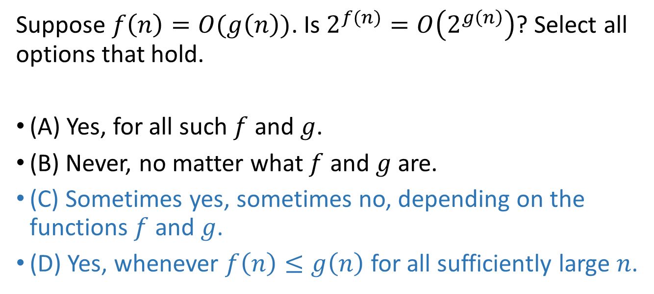
Solution for Proof Practice #2
Suppose $f\left(n\right)=O(g\left(n\right))$. Is $2^{f(n)}=O\left(2^{g\left(n\right)}\right)$? Select all options that hold.
(A) Yes, for all such $f$ and $g$.
(B) Never, no matter what $f$ and $g$ are.
(C) Sometimes yes, sometimes no, depending on the functions $f$ and $g$.
(D) Yes, whenever $f\left(n\right)≤g\left(n\right)$ for all sufficiently large $n$.

Slide 54
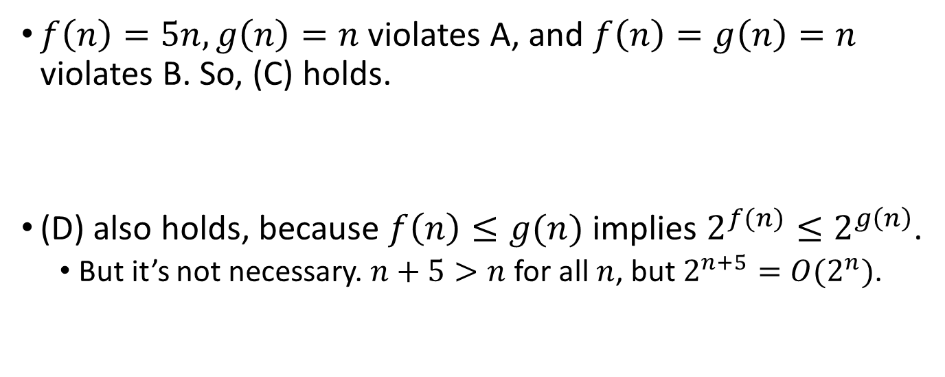
Solution for Proof Practice #2
$f\left(n\right)=5n, g\left(n\right)=n$ violates A, and $f\left(n\right)=g\left(n\right)=n$ violates B. So, (C) holds.
(D) also holds, because $f\left(n\right)≤g(n)$ implies $2^{f(n)}≤2^{g\left(n\right)}$.
But it’s not necessary. $n+5>n$ for all $n$, but $2^{n+5}=O(2^{n})$.

Slide 55
2.4 A Survey of Common Running Times

Slide 56
Linear Time: O(n)
Linear time. Running time is at most a constant factor times the size of the input.
Computing the maximum. Compute maximum of n numbers a₁, …, a_{n}.
max ← a₁
for i = 2 to n {
if (a_{i} > max)
max ← a_{i}
}

Slide 57
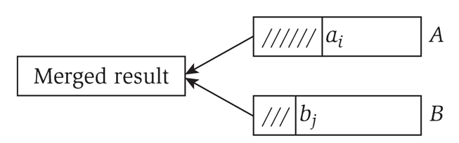
Linear Time: O(n)
Merge. Combine two sorted lists A = a₁,a₂,…,a_{n} with B = b₁,b₂,…,b_{n} into sorted whole.
Claim. Merging two lists of size n takes O(n) time.
Pf. After each comparison, the length of output list increases by 1.
i = 1, j = 1
while (both lists are nonempty) {
if (a_{i} ≤ b_{j}) append a_{i} to output list and increment i
else(a_{i} ≤ b_{j})append b_{j} to output list and increment j
}
append remainder of nonempty list to output list

Slide 58
O(n log n) Time
O(n log n) time. Arises in divide-and-conquer algorithms.
Sorting. Mergesort and heapsort are sorting algorithms that perform O(n log n) comparisons.
Largest empty interval. Given n time-stamps x₁, …, x_{n} on which copies of a file arrive at a server, what is largest interval of time when no copies of the file arrive?
O(n log n) solution. Sort the time-stamps. Scan the sorted list in order, identifying the maximum gap between successive time-stamps.
also referred to as linearithmic time

Slide 59
Quadratic Time: O(n²)
Quadratic time. Enumerate all pairs of elements.
Closest pair of points. Given a list of n points in the plane (x₁, y₁), …, (x_{n}, y_{n}), find the pair that is closest.
O(n²) solution. Try all pairs of points.
Remark. Ω(n²) seems inevitable, but this is just an illusion.
min ← (x₁ - x₂)² + (y₁ - y₂)²
for i = 1 to n {
for j = i+1 to n {
d ← (x_{i} - x_{j})² + (y_{i} - y_{j})²
if (d < min)
min ← d
}
}
don't need to take square roots
see chapter 5

Slide 60
Cubic Time: O(n³)
Cubic time. Enumerate all triples of elements.
Set disjointness. Given n sets S₁, …, S_{n} each of which is a subset of 1, 2, …, n, is there some pair of these which are disjoint?
O(n³) solution. For each pairs of sets, determine if they are disjoint.
foreach set S_{i} {
foreach other set S_{j} {
foreach element p of S_{i} {
determine whether p also belongs to S_{j}
}
if (no element of S_{i} belongs to S_{j})
report that S_{i} and S_{j} are disjoint
}
}

Slide 61
Polynomial Time: O(n^{k}) Time
Independent set of size k. Given a graph, are there k nodes such that no two are joined by an edge?
O(n^{k}) solution. Enumerate all subsets of k nodes.
Check whether S is an independent set = O(k²).
Number of k element subsets =
O(k² n^{k} / k!) = O(n^{k}).
k is a constant
foreach subset S of k nodes {
check whether S in an independent set
if (S is an independent set)
report S is an independent set
}
}
poly-time for k=17, but not practical

Slide 62
Exponential Time
Independent set. Given a graph, what is maximum size of an independent set?
O(n² 2^{n}) solution. Enumerate all subsets.
S* ← φ
foreach subset S of nodes {
check whether S in an independent set
if (S is largest independent set seen so far)
update S* ← S
}
}

