Slide 1


Design and Analysis of Algorithms
Week 1
Introduction
CS3230
Arnab Bhattacharyya
Rahul Jain

Slide 2


Arnab Bhattacharyya
Rahul Jain

Slide 3
Welcome!
Excited to welcome you to CS3230, Design & Analysis of Algorithms!
Please view Lecture 0 (video on Canvas) for organizational details that will be released later this week.

Slide 4
About you #1
You should have received an email (check your spam folder!) inviting you to an archipelago session.
Please join the session and answer the “About you #1” question.
Technical issues with archipelago? Email me after class.

Slide 5

Why bother with algorithms?
Become a better coder
Learn about amazingly fast algorithms and data structures to process data
Understand “algorithmic design paradigms” that can help you come up with new algorithms for your problems

Slide 6

Why bother with algorithms?
Improve analytical skills
Learn how to precisely reason about algorithms
Become familiar with mathematical tools that are useful to analyze algorithms.

Slide 7

Why bother with algorithms?
Think like a computer scientist
Algorithms are everywhere – your watch, refrigerator, stock market, flock of birds, your brain!
Ideas presented here will be increasingly relevant as the world becomes algorithmicized.

Slide 8

Why bother with algorithms?
Become familiar with the greatest hits of CS
Cultural knowledge you must have to be called a CS major
Course contents will span over 60 years of work

Slide 9

Why bother with algorithms?
Get jobs ☺
Technical interviews will be a breeze if you master the contents of CS3230!

Slide 10
What we expect from you
Stay engaged in lectures. Answer questions on archipelago. Ask questions.
For questions during lecture, ask over Zoom chat or send a personal message to Ling Yan Hao (lingyh@nus.edu.sg)
For questions later, talk to us after lecture or during office hours or post on the discussion forum on Canvas.

Slide 11
What we expect from you
Complete weekly problem sets. Practice on additional optional material.
Please see lecture 0 for how problem sets will be evaluated.
Meant as a formative assessment to give you a chance to put the lecture material in action.

Slide 12
What we expect from you
Stay engaged in tutorials. Complete in-class work over archipelago.
Tutorials (like problem sets) meant to get your hands dirty with the lecture material.
Only face-to-face. If you can’t attend in person, you must let us know in advance.

Slide 13
Feel overwhelmed?
Try to get on top of the course material before it comes on top of you!
The topics we’ll be discussing are pretty standard, and there are hundreds of places on the web with relevant notes/slides. The “Supporting Material” page on Canvas lists a few we like.
Please schedule a meeting with one of us if you want to talk.

Slide 14
Final Comments
Embrace the material! Think for yourself, and try to get at the roots of why algorithms work.
Don’t be scared of mathematical proofs! Nothing here will be too abstract. Math will let us describe ideas with precision.
We are here to help. Reach out to the staff anytime you feel you need support.

Slide 15
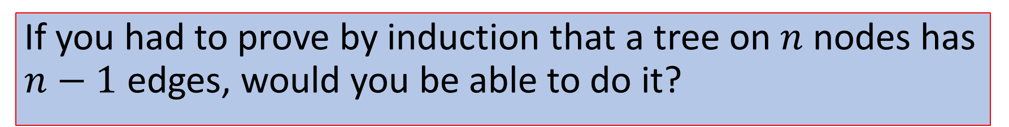
About you #2
If you had to prove by induction that a tree on $n$ nodes has $n−1$ edges, would you be able to do it?

Slide 16
Design and Analysis of Algorithms
Week 1
Stable Matching
CS3230
Arnab Bhattacharyya
Prashant Nalini Vasudevan

Slide 17


The Problem
Matchmaker must match $n$ men and $n$ women. Each man ranks all the women, and each woman ranks all the men. How to pair them up?

Slide 18



The Problem
There are $n$ med school graduates and $n$ hospitals. Each candidate ranks all the hospitals and vice versa. How to pair them up?

Slide 19





What makes a matching good?
A matching is stable if no unmatched man and woman both prefer each other to their current partners.

Slide 20
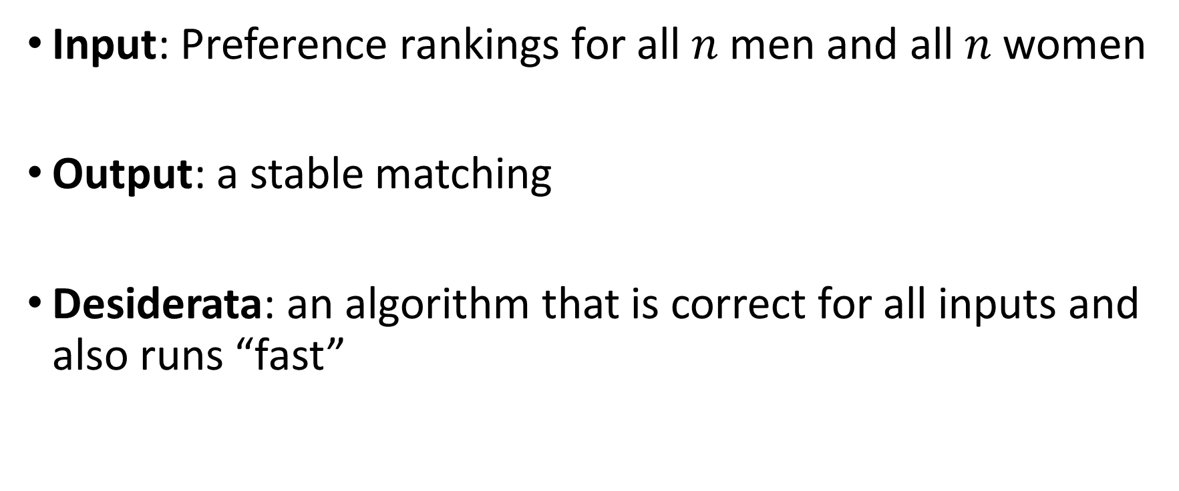
Problem Summary
Input: Preference rankings for all $n$ men and all $n$ women
Output: a stable matching
Desiderata: an algorithm that is correct for all inputs and also runs “fast”

Slide 21



Example
Ashish | Xinyu | Yashoda | Zuzu
Bao | Yashoda | Xinyu | Zuzu
Charlie | Xinyu | Yashoda | Zuzu
Xinyu | Bao | Ashish | Charlie
Yashoda | Ashish | Bao | Charlie
Zuzu | Ashish | Bao | Charlie

Slide 22
Stable Matching #1
Ashish | Xinyu | Yashoda | Zuzu
Bao | Yashoda | Xinyu | Zuzu
Charlie | Xinyu | Yashoda | Zuzu
Xinyu | Bao | Ashish | Charlie
Yashoda | Ashish | Bao | Charlie
Zuzu | Ashish | Bao | Charlie
Is the matching (Ashish, Zuzu), (Bao, Yashoda), (Charlie, Xinyu) stable?

Slide 23
Stable Matching #2
Ashish | Xinyu | Yashoda | Zuzu
Bao | Yashoda | Xinyu | Zuzu
Charlie | Xinyu | Yashoda | Zuzu
Xinyu | Bao | Ashish | Charlie
Yashoda | Ashish | Bao | Charlie
Zuzu | Ashish | Bao | Charlie
Is (Ashish, Yashoda), (Bao, Xinyu), (Charlie, Zuzu) stable?

Slide 24
Stable Matching #3
Ashish | Xinyu | Yashoda | Zuzu
Bao | Yashoda | Xinyu | Zuzu
Charlie | Xinyu | Yashoda | Zuzu
Xinyu | Bao | Ashish | Charlie
Yashoda | Ashish | Bao | Charlie
Zuzu | Ashish | Bao | Charlie
Is (Ashish, Xinyu), (Bao, Yashoda), (Charlie, Zuzu) stable?

Slide 25
Hmm…
Do stable matchings always exist?
Idea: Start with any matching. Keep identifying rogue couples and match them with each other.
But do you ever end up at a stable matching this way? Hmm…not clear.

Slide 26
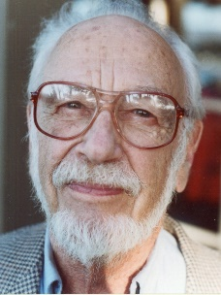

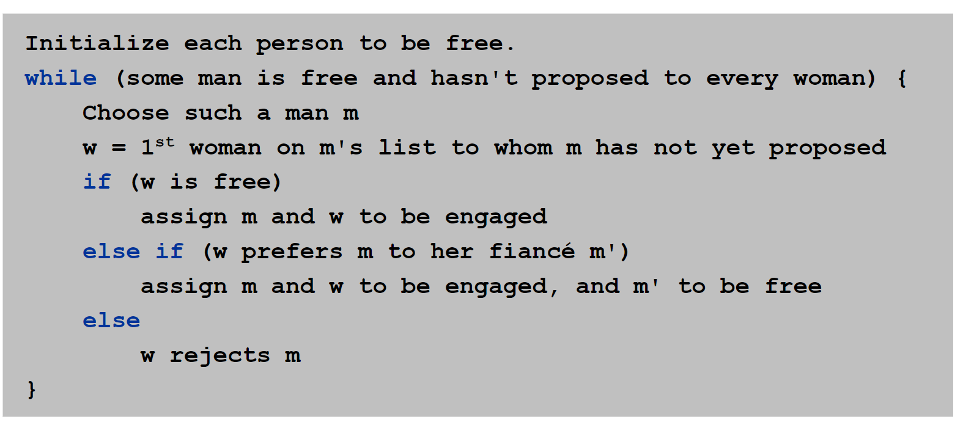
Gale-Shapley Algorithm (1962)

Slide 27


Example
Ashish | Xinyu | Yashoda | Zuzu
Bao | Yashoda | Xinyu | Zuzu
Charlie | Xinyu | Yashoda | Zuzu
Xinyu | Bao | Ashish | Charlie
Yashoda | Ashish | Bao | Charlie
Zuzu | Ashish | Bao | Charlie
A
X
B
Y
C
Z

Slide 28
Example
Ashish | Xinyu | Yashoda | Zuzu
Bao | Yashoda | Xinyu | Zuzu
Charlie | Xinyu | Yashoda | Zuzu
Xinyu | Bao | Ashish | Charlie
Yashoda | Ashish | Bao | Charlie
Zuzu | Ashish | Bao | Charlie
A
X
B
Y
C
Z

Slide 29
Example
Ashish | Xinyu | Yashoda | Zuzu
Bao | Yashoda | Xinyu | Zuzu
Charlie | Xinyu | Yashoda | Zuzu
Xinyu | Bao | Ashish | Charlie
Yashoda | Ashish | Bao | Charlie
Zuzu | Ashish | Bao | Charlie
A
X
B
Y
C
Z

Slide 30
Seems like
Gale-Shapley seems to always output a stable matching
Gale-Shapley seems to always output the same stable matching!
But why? Let’s start with small observations.

Slide 31
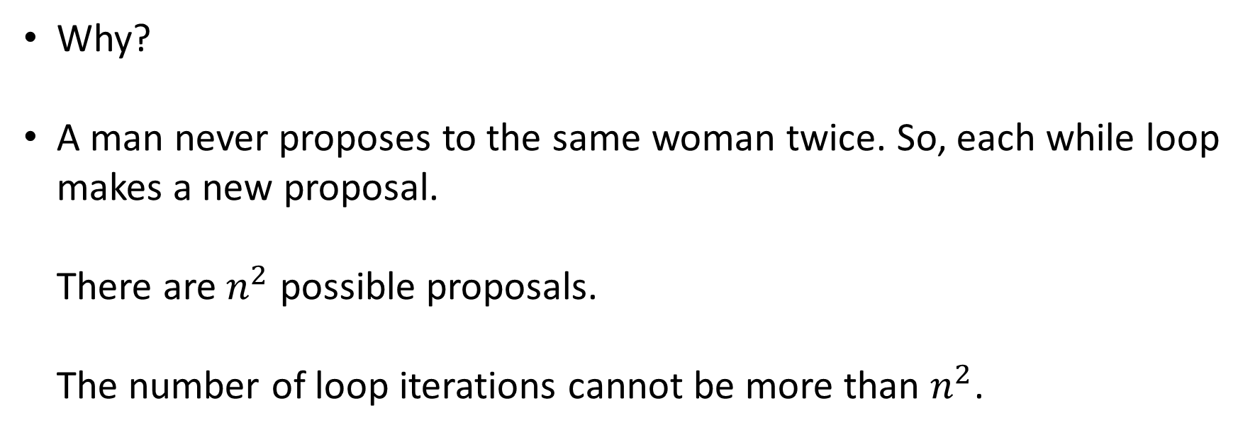
Gale-Shapley terminates
Lemma: The while loop in Gale-Shapley runs $≤n^{2}$ times.
Why?
A man never proposes to the same woman twice. So, each while loop makes a new proposal. There are $n^{2}$ possible proposals. The number of loop iterations cannot be more than $n^{2}$.
Recurring idea in algorithm analysis: Find a progress measure that keeps strictly increasing.

Slide 32
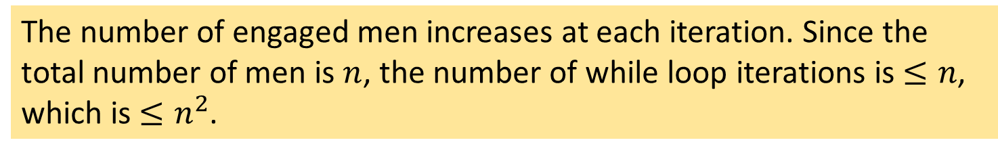
Gale-Shapley #1
Lemma: The while loop in Gale-Shapley runs $≤n^{2}$ times.
Consider this argument:
Is it also a valid proof?
The number of engaged men increases at each iteration. Since the total number of men is $n$, the number of while loop iterations is $≤n$, which is $≤n^{2}$.

Slide 33
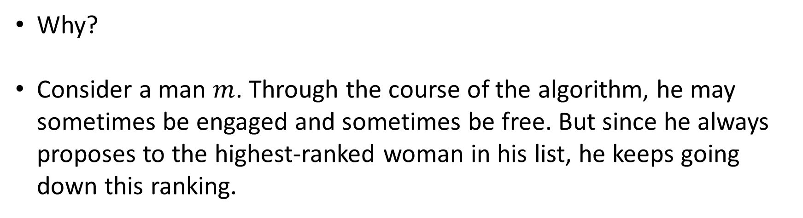
Men keep making worse proposals
Lemma: Men propose to women in decreasing order of preference.
Why?
Consider a man $m$. Through the course of the algorithm, he may sometimes be engaged and sometimes be free. But since he always proposes to the highest-ranked woman in his list, he keeps going down this ranking.

Slide 34
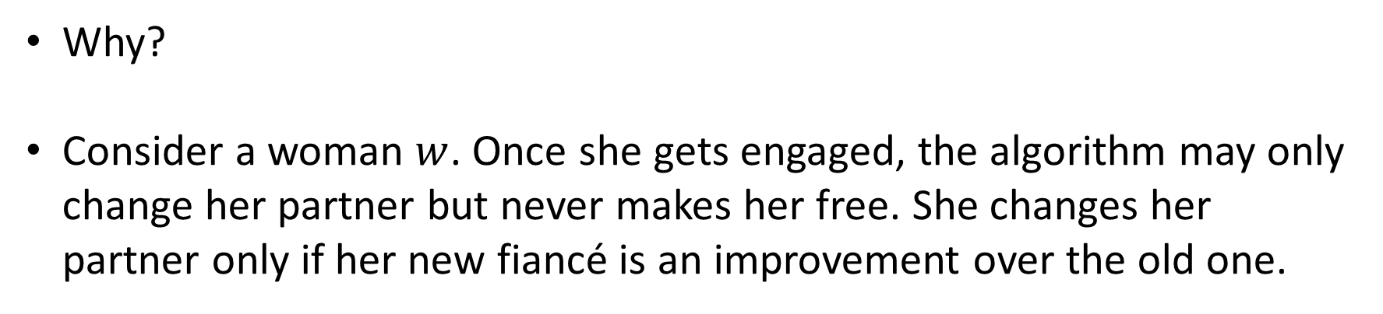
Women’s partners keep getting better
Lemma: A woman stays engaged after the first time she gets engaged. Her sequence of partners keeps getting better according to her preference list.
Why?
Consider a woman $w$. Once she gets engaged, the algorithm may only change her partner but never makes her free. She changes her partner only if her new fiancé is an improvement over the old one.

Slide 35
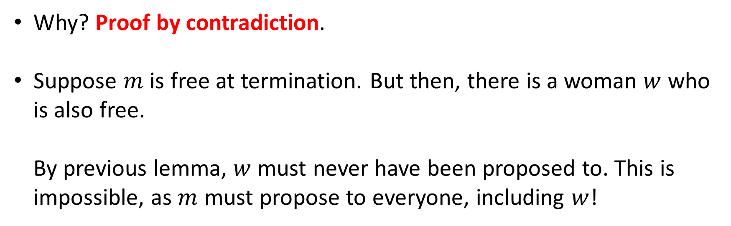
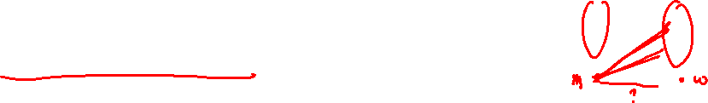
Everyone matched
Lemma: When the algorithm terminates, each man is engaged to a unique woman.
Why? Proof by contradiction.
Suppose $m$ is free at termination. But then, there is a woman $w$ who is also free. By previous lemma, $w$ must never have been proposed to. This is impossible, as $m$ must propose to everyone, including $w$!

Slide 36
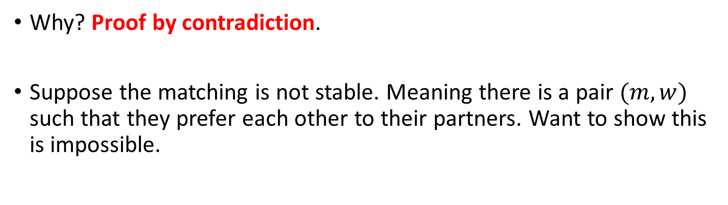
Output is stable
Lemma: When the algorithm terminates, the matching between men and women is stable.
Why? Proof by contradiction.
Suppose the matching is not stable. Meaning there is a pair $(m,w)$ such that they prefer each other to their partners. Want to show this is impossible.

Slide 37

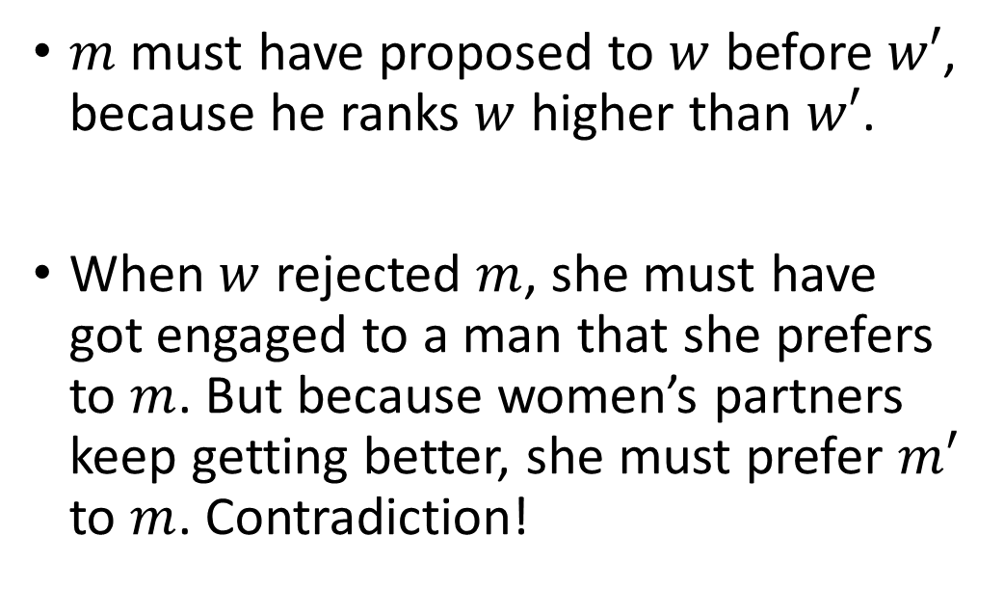



Output is stable
Lemma: When the algorithm terminates, the matching between men and women is stable.
$m$ must have proposed to $w$ before $w′$, because he ranks $w$ higher than $w′$.
When $w$ rejected $m$, she must have got engaged to a man that she prefers to $m$. But because women’s partners keep getting better, she must prefer $m′$ to $m$. Contradiction!
$$m′$$
$$w$$
$$m$$
$$w′$$

Slide 38
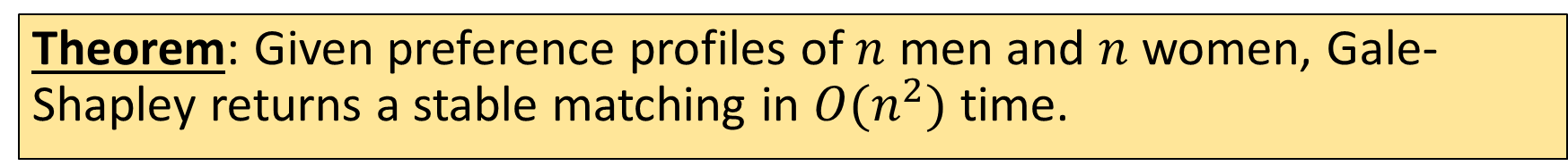
Summarizing
Theorem: Given preference profiles of $n$ men and $n$ women, Gale-Shapley returns a stable matching in $O(n^{2})$ time.
Not totally immediate. Think through how you’d implement the algorithm!

Slide 39
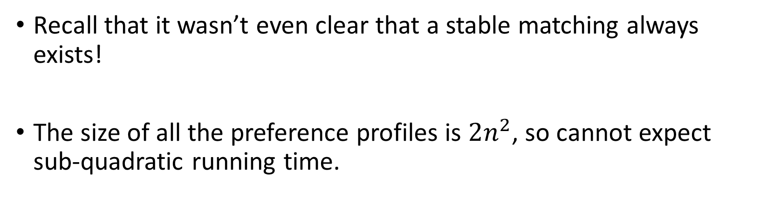
Summarizing
Theorem: Given preference profiles of $n$ men and $n$ women, Gale-Shapley returns a stable matching in $O(n^{2})$ time.
Recall that it wasn’t even clear that a stable matching always exists!
The size of all the preference profiles is $2n^{2}$, so cannot expect sub-quadratic running time.

Slide 40
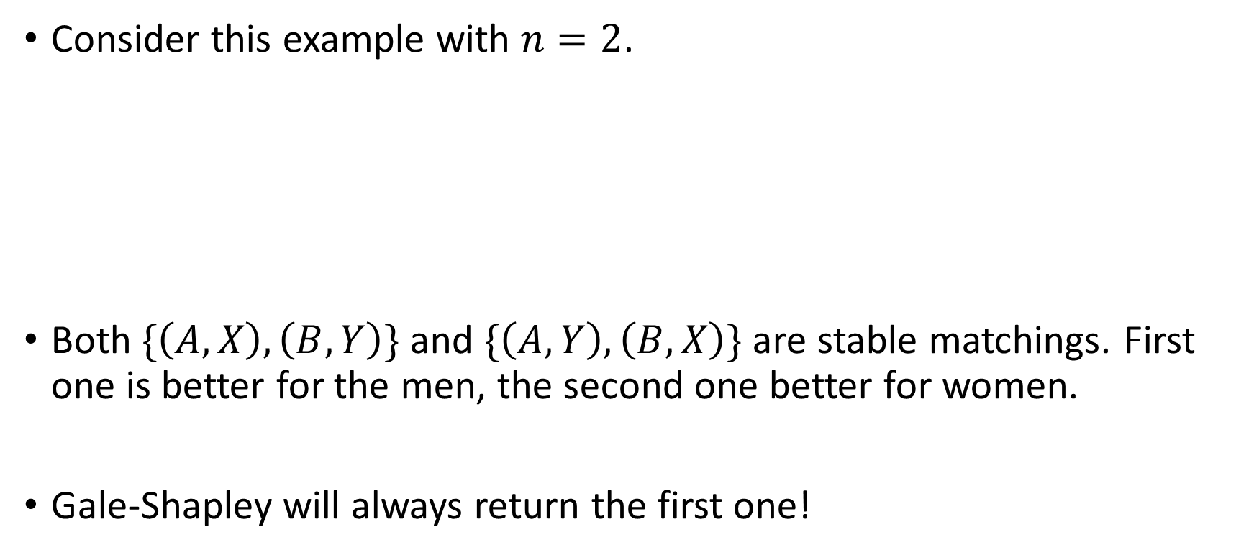
Unfairness in the algorithm
Consider this example with $n=2$.
Both $\{\left(A, X\right), \left(B,Y\right)\}$ and $\{\left(A, Y\right), \left(B,X\right)\}$ are stable matchings. First one is better for the men, the second one better for women.
Gale-Shapley will always return the first one!
A | X | Y
B | Y | X
X | B | A
Y | A | B

Slide 41
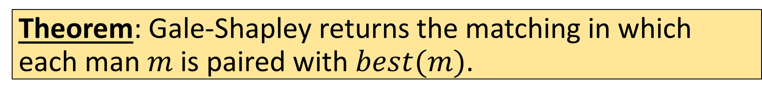

Men-optimality
For a man $m$, let $best(m)$ be the highest ranked woman on his list who could be his partner in some stable matching.
In example, $best\left(A\right)=X$, $best\left(B\right)=Y$.
Theorem: Gale-Shapley returns the matching in which each man $m$ is paired with $best(m)$.
No two men have the same optimal partner!
Gale-Shapley optimizes all the men’s wishes simultaneously!
The order of proposals does not matter!

Slide 42

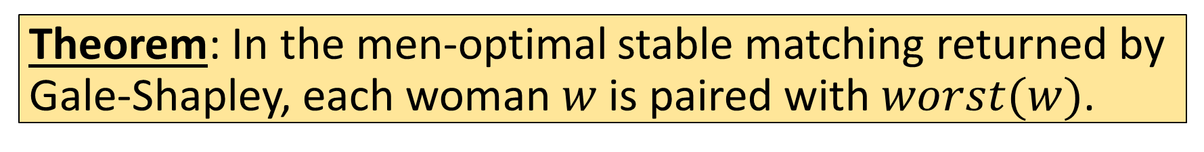

Women-pessimality
For a woman $w$, let $worst(w)$ be the lowest ranked man on her list who could be her partner in some stable matching.
Theorem: In the men-optimal stable matching returned by Gale-Shapley, each woman $w$ is paired with $worst(w)$.
Lesson?

Slide 43
Conclusion
Gale-Shapley is remarkably flexible! Extends to when there are some forbidden pairs, more than one student can be assigned to a hospital, unequal numbers of students and hospitals, etc.
Variants used in settings where stable matchings may not exist, e.g., when married couples want to be assigned to the same hospital.
Alvin Roth won the Nobel Prize in 2012 for related work.
Complete Problem Set 1 to test your understanding of today’s lecture.

Slide 44
Bonus Material (optional)

Slide 45


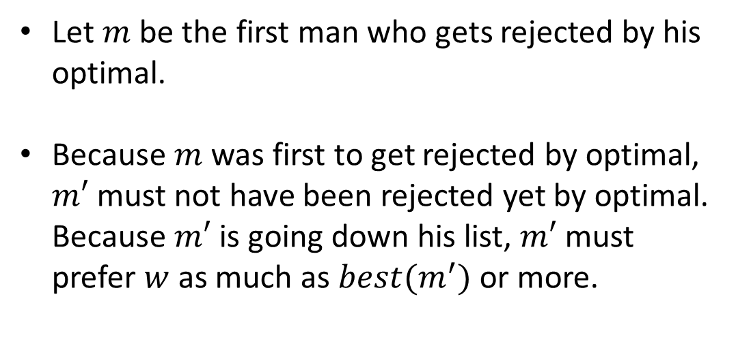



Proof of Men-Optimality
Theorem: Gale-Shapley returns the matching in which each man $m$ is paired with $best(m)$.
Another proof by contradiction!
Let $m$ be the first man who gets rejected by his optimal.
Because $m$ was first to get rejected by optimal, $m′$ must not have been rejected yet by optimal. Because $m′$ is going down his list, $m′$ must prefer $w$ as much as $best(m^{′})$ or more.
$$m$$
$$w=best(m)$$
$$m′$$

Slide 46
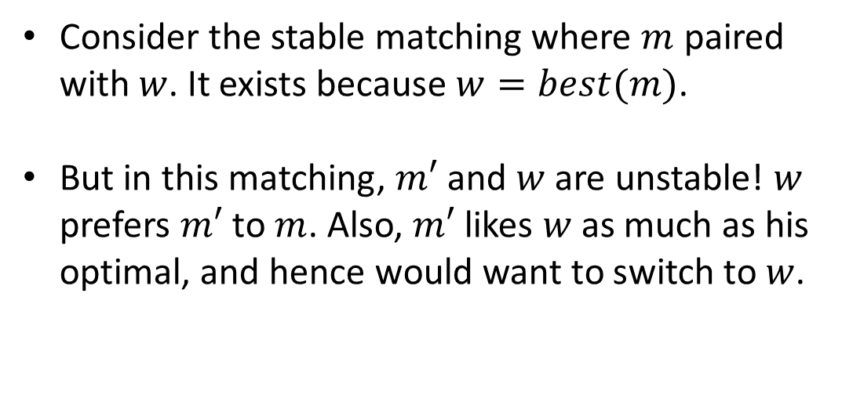

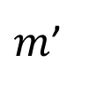

Proof of Men-Optimality
Theorem: Gale-Shapley returns the matching in which each man $m$ is paired with $best(m)$.
Another proof by contradiction!
Consider the stable matching where $m$ paired with $w$. It exists because $w=best(m)$.
But in this matching, $m′$ and $w$ are unstable! $w$ prefers $m′$ to $m$. Also, $m′$ likes $w$ as much as his optimal, and hence would want to switch to $w$.
$$m$$
$$w$$
$m$’

Slide 47
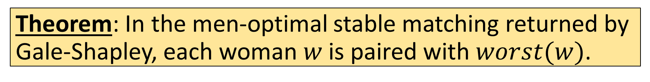
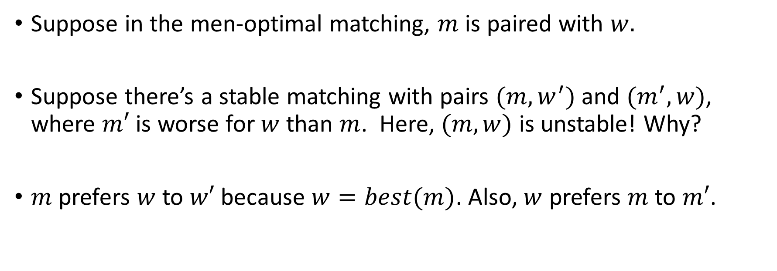
Proof of Women-Pessimality
Theorem: In the men-optimal stable matching returned by Gale-Shapley, each woman $w$ is paired with $worst(w)$.
Suppose in the men-optimal matching, $m$ is paired with $w.$
Suppose there’s a stable matching with pairs $(m,w^{′})$ and $(m^{′},w)$, where $m′$ is worse for $w$ than $m$. Here, $(m,w)$ is unstable! Why?
$m$ prefers $w$ to $w′$ because $w=best(m)$. Also, $w$ prefers $m$ to $m′$.

