Slide 1
LAB ACTIVITY · TEAM ORIENTEERING PROBLEM
Savings, GRASP and local search
for the team orienteering problem
The heuristic of Panadero et al. (2021), rebuilt in Rust and run on all 387 instances of Chao et al. (1996)
Jesús Inurria Porrero · Javier Salvatierra Corchado
Notes:
Presentamos la práctica del TOP: implementamos la heurística de ahorros de Panadero (PJS), la convertimos en GRASP y añadimos una búsqueda local. Todo en Rust, sobre las 387 instancias de Chao.

Slide 2
The team orienteering problem
Vehicle 1
Every customer carries a reward.
m vehicles leave the origin and must reach the end depot.
Left out: no time
Each route must fit in a time limit tmax, so some customers stay unvisited.
Origin
End depot
Maximise reward, not coverage.
Vehicle 2
Benchmark: 387 instances of Chao et al. (1996) in 7 sets, 21 to 102 nodes, 2 to 4 vehicles. In 34 of them no customer fits even alone, so 353 count.
Notes:
El TOP: cada cliente tiene recompensa, m vehículos, límite de tiempo por ruta. Se maximiza la recompensa recogida. Origen y destino son distintos en p1-p6 y coinciden en p7.

Slide 3
The PJS savings heuristic
ENRICHED SAVING OF ARC (i, j)
s′ᵢⱼ = α · sᵢⱼ + (1 − α) · (uᵢ + uⱼ)
sᵢⱼ = time saved by joining two routes
uᵢ + uⱼ = reward the joined route collects
1 Dummy solution
2 Sort the arcs
3 Merge greedily
4 Keep m routes
one route origin → i → end per customer
by s′ᵢⱼ, highest first, both directions
join two routes if the result fits in tmax
the m with the most reward
α trades distance against reward. The paper gives no value for it.
Panadero et al. (2021), section 4. With origin ≠ end depot, sᵢⱼ ≠ sⱼᵢ, so both directions are kept, as in Li et al. (2022).
Notes:
Heurística PJS: solución dummy, ahorro enriquecido, fusión voraz y selección de las m mejores rutas. Usamos arcos en los dos sentidos porque con origen y destino distintos el ahorro depende del sentido.

Slide 4
The paper's rule for α does not hold here
Panadero: “α close to zero with heterogeneous rewards and close to one with homogeneous rewards.”
BEST α (MEAN OF THE TIES), BY SET · REWARDS MORE UNEVEN →
+0.19
correlation between reward CV and best α over 285 instances: weak, and with the wrong sign
68 %
of the best reward is all α = 0 reaches in p4, the most uneven set
So we run all 21 values α = 0, 0.05, …, 1 and keep the best per instance.
Deterministic PJS. The 68 instances where all α tie are left out. Rewards are fixed per set, so there are only 7 distinct CVs.
Notes:
El paper no da valor de alfa, solo la regla cualitativa. En Chao no se cumple: el CV es el mismo en todo un conjunto y el alfa óptimo no baja al subir el CV. Las reglas basadas en el CV que probamos no superaron a un alfa fijo, así que usamos una rejilla de 21 valores.

Slide 5
GRASP: the same heuristic, slightly random
Instead of always taking the arc with the highest saving, pick one at random, biased towards the top of the list. Repeat the construction many times and keep the best solution.
Geometric (Panadero)
Softmax (our proposal)
k ~ Geom(β), β = 0.3
P(arc) ∝ exp(s′ / τ), τ = 1
Take the k-th remaining arc. Rank matters, the size of the gap between savings does not.
Each arc in proportion to its saving. Close savings get close chances.
BUDGETS TESTED, PER RUN (ONE RUN = ONE THREAD OF PANADERO'S ALGORITHM 1)
10 iterations
100 iterations
1 second
main grid: 21 α × 20 runs
same seeds, 10× longer
like the paper: ~40,000–56,000 iterations
Every run starts from the deterministic solution and is seeded once, so results are reproducible (except the 1 s runs).
Notes:
Una iteración es una construcción aleatorizada completa; una ejecución es el multiarranque. Probamos la geométrica del paper y un softmax. Dentro de GRASP no hay búsqueda local.

Slide 6
Local search, applied to the elite at the end
Which solutions get it
What it does, in a loop
The deterministic solutions of the 3 best α.
For each α and randomisation, the best solution of the 3 best runs.
Ties at third place all enter. Duplicates (same set of customers) are dropped.
About 53 elite per instance; all 18,757 take 0.4 s in total.
2-opt
shorten every route
Insert
highest-reward customer that fits
while a customer was inserted
The time 2-opt frees is spent on the next insertion. Neither move can lose reward, so there is no acceptance rule.
Every elite is kept as a starting point: the best one before local search is often not the best after it.
Insertion: cheapest position in any route; ties in reward go to the smallest added time.
Notes:
La búsqueda local va al final, no dentro de GRASP. Élite por recompensa con empates y sin duplicados. Bucle de 2-opt e inserción: tras acortar las rutas se intenta meter el cliente de mayor recompensa que quepa.

Slide 7
The whole method, per instance
PER INSTANCE · EACH RUN AND EACH ELITE IS A PARALLEL TASK
LOCAL_SEARCH(S)
for α in 0, 0.05, …, 1: // 21 values
det[α] ← PJS(α) // greedy
for rule in {geometric, softmax}:
for r in 1 … 10: // 1 run = 1 task
rng ← seed(α, rule, r) // once per run
best ← det[α]
repeat 10 times: // in series
S ← PJS(α, rule, rng)
if u(S) > u(best): best ← S
run[α, rule, r] ← best
elite ← det of the 3 best α
∪ 3 best runs per (α, rule)
− duplicates // same customers
for e in elite: e ← LOCAL_SEARCH(e) // parallel
return the elite with the most reward
repeat:
for each route R of S:
2-OPT(R)
// reverse a segment
// while R gets shorter
k ← unvisited customer
with most reward
that fits in a route
// tie: least time added
if no k: return S
insert k at its
cheapest position
u(S) = total reward. rayon spreads the tasks (21 per instance and α) over 12 threads; the iterations of a run go in series.
Notes:
Pseudocódigo completo. Por instancia: 21 alfas; en cada uno, la construcción determinista y 10 ejecuciones de cada aleatorización. Cada ejecución es una tarea paralela: siembra su generador una vez y hace 10 iteraciones en serie, cada una una construcción aleatoria completa. Después se eligen las élite, se quitan los duplicados y se aplica la búsqueda local. La búsqueda local alterna 2-opt e inserción hasta que no cabe ningún cliente más.

Slide 8
Why Rust and not Python
Compute speed
Parallelism with rayon
Compiled to native code, no interpreter in the inner loop. We did not time a Python version, but the main grid, about 1.6 million constructions plus local search, runs in 140 s.
Going parallel is a one-word change, and the compiler rejects data races:
files.iter().map(load) // 1 thread
files.par_iter().map(load) // all 12
The code is written mostly by AI
The compiler guides the AI
Python's big advantage is that people write it faster. When an AI writes most of the code, that advantage mostly disappears, and the faster language costs nothing extra.
rustc names the exact line, explains the error and often suggests the fix. Type and ownership errors show up at compile time, not halfway through a two-minute run.
Fast enough to run every α, every run and every elite on all 387 instances in about two minutes.
Release build: fat LTO, one codegen unit, target-cpu=native. Python was used once, as an independent check: 0 differences in 38,700 runs.
Notes:
Por qué Rust. Velocidad: es compilado; no lo hemos medido contra Python, pero la rejilla completa tarda 140 s. Paralelismo: con rayon basta cambiar iter por par_iter, y el compilador impide las carreras de datos. Como el código lo escribe sobre todo una IA, la ventaja de Python de escribirse más rápido apenas cuenta. Y los mensajes del compilador de Rust son muy descriptivos, lo que ayuda a la IA a corregir sus errores.

Slide 9
Each layer adds reward: +20 % over plain PJS
TOTAL REWARD, 353 FEASIBLE INSTANCES
+8.0 %
GRASP alone over the best deterministic α
93.6 %
of the elite improve with local search, +18 % on average
163 / 353
instances where the winner was not the best solution before local search
Axis starts at 140,000
Grid: 21 α × (1 deterministic + 10 geometric + 10 softmax runs of 10 iterations) per instance, then elite and local search. 140 s for all 387 instances on 12 threads.
Notes:
Resultados de la rejilla principal sobre las 353 instancias factibles. GRASP añade un 8 %, la búsqueda local sobre las élite lleva el total a +20 %. En 163 instancias la mejor final no salía de la mejor élite previa: por eso aplicamos la búsqueda local a muchas soluciones y no solo a la mejor.

Slide 10
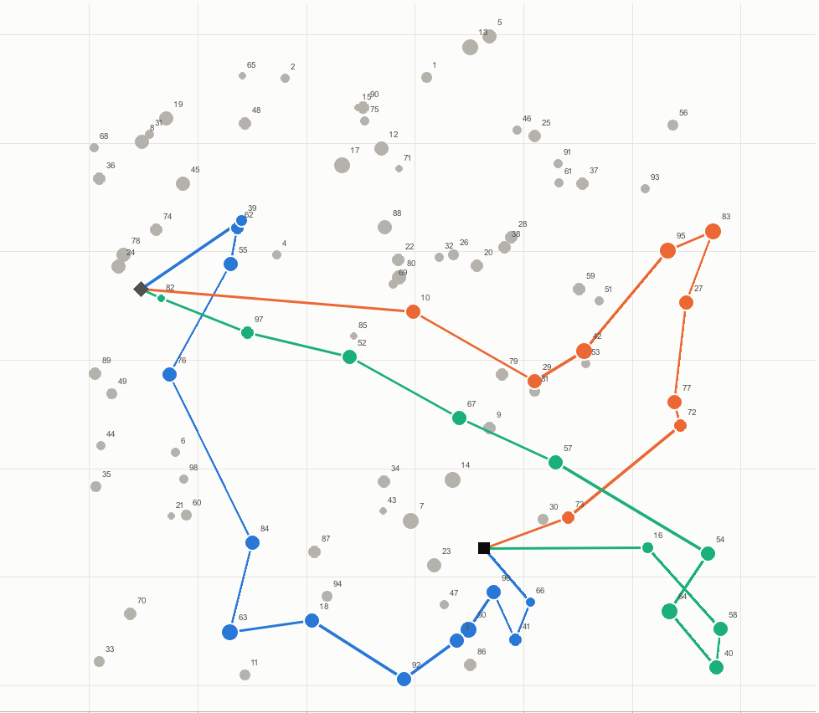
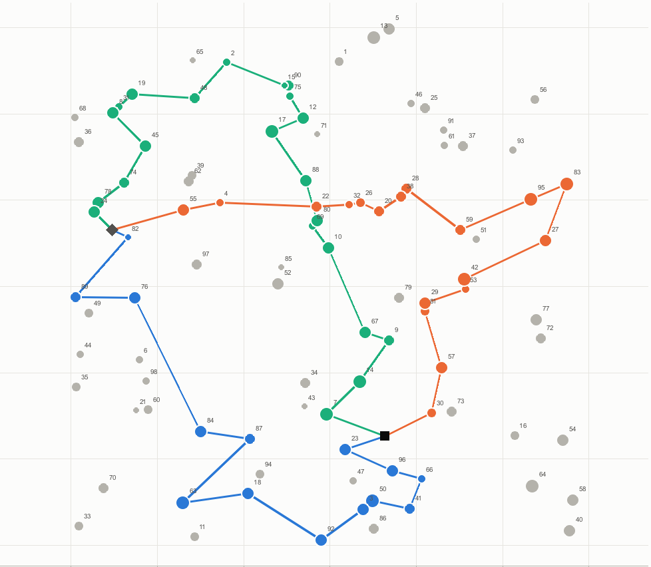
One instance, before and after: p4.3.k
PJS, best α = 0.40
GRASP + local search
reward 614 · 32 of 98 customers
reward 874 · 54 of 98 customers
+42 %: same three vehicles, same time limit, 22 more customers.
m = 3, tmax = 50. Final solution from a geometric run with α = 0.45: reward 625 before local search, 19 customers inserted. Marker area ∝ reward.
Notes:
Ejemplo: p4.3.k. La determinista recoge 614. La mejor élite (una ejecución geométrica con alfa 0.45) tenía 625 y la búsqueda local le inserta 19 clientes hasta 874.

Slide 11
The gain grows with the instance
FINAL SOLUTION OVER PLAIN PJS, TOTAL REWARD PER SET
Small sets: little room
p1–p3 have 21 to 33 nodes, so few customers are left to insert.
p4 and p7: about 100 nodes
Long routes, many customers left out. Local search inserts up to 49 customers in one solution.
Panadero et al. tabulate instance by instance only p1 and p2, where the margin is smallest; for p3–p7 they give set means.
Notes:
Por conjunto: en p1-p3 hay poco margen. Donde más aporta es en p4 y p7, de 100 nodos. El paper solo publica instancia a instancia p1 y p2; de p3 a p7 da medias por conjunto, que vemos dos diapositivas después.

Slide 12
p1 and p2, instance by instance: ahead of Panadero
MEAN GAP TO THE BEST KNOWN SOLUTION, 81 INSTANCES OF p1–p2, LOWER IS BETTER
BEST KNOWN SOLUTION REACHED
69 / 81
Panadero, 128 threads
73 / 81
Ours, 10 it + local search
77 / 81
Ours, 1 s + local search
None of our solutions beats a best known value.
Gap = 100 · (BKS − ours) / BKS, averaged over instances, as in the paper's Tables 3 and 4 (p2.4.a is printed there as “p2.4.1”).
Notes:
Comparación con las tablas 3 y 4 de Panadero (p1 y p2). Sin búsqueda local, ni la mejor variante de GRASP alcanza a Panadero con 128 hilos. Con búsqueda local, todas las variantes con rejilla le ganan. La mejor, 1 s con la rejilla, queda a un 0,15 % y alcanza el BKS en 77 de 81.

Slide 13
All seven sets: below Panadero's gap in every one
MEAN GAP TO THE BEST KNOWN SOLUTION PER SET, LOWER IS BETTER
2.04 %
our mean gap over the 353 instances, against 2.85 % for Panadero with 128 threads
0 / 353
final solutions above the best known value: no sign of an infeasible route in any set
189 / 353
best known value reached, 33 of 33 in p2, 5 of 56 in p4
BKS from the PSOiA results of Dang, Guibadj and Moukrim (equal to Panadero's on p1–p2). Panadero's “All”: Figure 4 weighted by instances.
Notes:
Agregados por conjunto. Panadero solo publica, en su figura 4, la distancia media al BKS de cada conjunto con 128 hilos. Para compararnos conseguimos el BKS de las 387 instancias de los resultados públicos de PSOiA, que coinciden con los de Panadero en p1 y p2. Con la rejilla barata, de 10 iteraciones, más la búsqueda local, quedamos por debajo de Panadero en los siete conjuntos: 2,04 % frente a 2,85 % de media. Y ninguna de las 353 soluciones supera el BKS, otra señal de que las rutas son factibles.

Slide 14
Trying many α beats iterating longer with one
1 s with the single best α
100 iterations on the α grid
≈ 900,000
42,000
constructions per instance
20 runs × ~45,000 iterations
constructions per instance
21 α × 20 runs × 100 iterations
Mean gap to BKS, no local search: 1.49 %
Mean gap to BKS, no local search: 1.45 %
Same quality with about 20 times less work.
A small change in α reorders the savings list and the greedy merge builds different routes. Spreading the budget over α explores more than spending it on one.
One 1 s run of ours alone averages 2.3–2.4 % against 1.73 % for one thread of Panadero.
Notes:
La rejilla de 100 iteraciones hace unas 42 000 construcciones por instancia y empata con 1 s del mejor alfa, que hace unas 900 000. Diversificar alfa rinde más que iterar más con uno solo. Ojo: una ejecución nuestra de 1 s rinde algo menos que una de Panadero.

Slide 15
TAKEAWAY
Diversity first, then local search.
21 α and two randomisations give the elite; 2-opt and insertion turn them into the final routes.
WHAT WE FOUND
+20 % reward over plain PJS on all 353 feasible instances.
Below Panadero with 128 threads in all 7 sets: 2.04 % from the best known values, against 2.85 %.
The paper's rule for α does not hold on these sets.
WORTH ASKING ABOUT
Not equal compute: the 1 s grid spends ~420 CPU-seconds per instance, more than Panadero's 128.
1 s runs depend on the machine's load, so they are not exactly reproducible.
Moves between routes and swaps are still open. For p3–p7 the paper only publishes set means.
Thank you — questions?
Notes:
Conclusión: la diversidad (rejilla de alfa y aleatorización) da buenas élite y la búsqueda local las convierte en la solución final. Quedamos por debajo de Panadero con 128 hilos en los siete conjuntos. Limitaciones: cómputo no igualado, 1 s no reproducible, y de p3 a p7 el paper solo da medias por conjunto. Pendiente: movimientos entre rutas e intercambios.

Slide 16
BACKUP
All variants against Panadero et al.
Method | Mean gap | BKS reached | vs Panadero 128 (better / equal / worse)
PJS, best α | 4.82 % | 44 | 0 / 45 / 36
GRASP 10 it, α grid | 1.99 % | 53 | 1 / 56 / 24
Panadero, 1 thread | 1.73 % | 52 | —
GRASP 1 s, best α | 1.49 % | 56 | 2 / 60 / 19
GRASP 100 it, α grid | 1.45 % | 57 | 3 / 57 / 21
GRASP 1 s, α grid | 0.71 % | 65 | 4 / 67 / 10
GRASP 1 s, best α + local search | 0.71 % | 63 | 7 / 62 / 12
Panadero, 128 threads | 0.44 % | 69 | —
GRASP 10 it, α grid + local search | 0.34 % | 73 | 10 / 65 / 6
GRASP 100 it, α grid + local search | 0.29 % | 74 | 12 / 62 / 7
GRASP 1 s, α grid + local search | 0.15 % | 77 | 12 / 65 / 4
Sources: docs/comparacion_panadero*.md and results/best_solution.csv. Panadero rows from Tables 3 and 4 of the paper.

