Slide 1
LAB ACTIVITY · SIMHEURISTICS · STOCHASTIC TEAM ORIENTEERING
A simheuristic for the team orienteering
problem with stochastic travel times
The biased-randomised simheuristic of Juan et al. (2019), rebuilt in Python + Numba and run on the 141 feasible instances of Chao's p1–p3 at three levels of uncertainty
Jesús Inurria Porrero · Javier Salvatierra Corchado
Notes:
Presentamos la práctica de simheurísticas: el TOP con tiempos de viaje aleatorios. Implementamos la simheurística de Juan et al. (2019): PJS con aleatorización sesgada, búsqueda local y simulación Monte Carlo rápida e intensiva. Python + Numba, 141 instancias de p1-p3 con tres niveles de incertidumbre. El SAA con CPLEX del paper no se implementa.

Slide 2
Team orienteering with random travel times
m vehicles leave the origin and must reach the end depot; each customer pays its reward once.
A MINIMAL EXAMPLE · ONE VEHICLE, TMAX = 10
Route A
E[time] 9.8 · reward 30
Each route has a time limit tmax, but the travel time of every arc is random.
Route B
E[time] 8 · reward 25
A route that arrives after tmax loses all its reward.
tmax
DETERMINISTIC
HIGH UNCERTAINTY
Maximise the expected reward.
A wins: 30 > 25
A late ~45 % of days: ≈ 16.5
B almost never late: ≈ 25
Already NP-hard when deterministic; now the value of a solution is an expectation, so it has to be estimated by simulation.
Under uncertainty, slack pays.
Illustrative example: the 45 % failure rate is assumed, not simulated. Fail rule from Juan et al. (2019), §3.
Notes:
TOP estocástico: m vehículos de origen a destino, recompensa por cliente una sola vez, límite tmax por ruta, tiempos de viaje aleatorios. Si una ruta llega tarde pierde toda su recompensa. Se maximiza la recompensa esperada. Ejemplo: A (9,8 / 30) gana en determinista, pero si falla el 45 % de los días vale unos 16,5, menos que B (8 / 25). Con incertidumbre, dejar holgura compensa.

Slide 3
Chao's instances with lognormal travel times
TRAVEL TIME OF ARC (I, J) · JUAN ET AL. (2019), P. 1913
141
Tᵢⱼ ~ LogNormal, E[Tᵢⱼ] = tᵢⱼ, Var[Tᵢⱼ] = c · tᵢⱼ
instances of Chao et al. (1996): p1, p2, p3, all below 35 nodes; tmax 3.8–55
tᵢⱼ = Euclidean distance; Tᵢⱼ = Tⱼᵢ; arcs independent between arcs and replicas (our assumption: the paper does not say).
× 3 levels
THREE UNCERTAINTY LEVELS
423 stochastic cases; each run with α = 0.25, 0.5, 0.75: 1 269 runs
Level | c | CV of one arc with t = 10
L (low) | 0.05 | 7.1 %
M (medium) | 0.25 | 15.8 %
H (high) | 0.75 | 27.4 %
On the fly
scenarios are drawn with a fixed seed and never stored; data/ is unchanged
Six p1 instances with no reachable customer are left out (48 + 33 + 60 remain). σ² = ln(1 + c/t), μ = ln t − σ²/2. Reference: deterministic best-known solutions (BKS) of Dang et al. (2013).
Notes:
El paper no crea instancias nuevas: toma las de Chao y hace aleatorio el tiempo de cada arco, lognormal con media la distancia y varianza c por la distancia. Tres niveles: 0,05, 0,25 y 0,75. Arcos independientes: supuesto nuestro. 141 instancias factibles de p1-p3, tres niveles y tres alfas: 1 269 ejecuciones. Escenarios generados al vuelo con semilla fija.

Slide 4
Same c, very different uncertainty
Variances add along a route: Var[T_{d}] = c · E_{d}, so the relative sd is √(c / E_{d}): the same c weighs more on short routes.
RELATIVE SD OF A ROUTE THAT FILLS TMAX (%) AGAINST TMAX
25.6 %
6.7 %
full route, c = 0.25, tmax = 3.8 (smallest in p1–p3)
the same c, tmax = 55 (largest in p1–p3)
47.18 %
of 20 000 days late for a route whose expected time equals tmax (4 arcs of 2.5, tmax = 10, c = 0.25): the lognormal's median lies below its mean
tmax
Slack is worth reward.
Chart: √(c / tmax) for a route that fills tmax, computed from the model (not a result). Independent arcs are our assumption.
Notes:
Dos propiedades del modelo. Las varianzas se suman: la desviación relativa de una ruta es raíz de c entre su tiempo esperado; con c = 0,25 y una ruta llena, 25,6 % si tmax = 3,8 y 6,7 % si tmax = 55. Y una ruta cuyo tiempo esperado es tmax llega tarde casi la mitad de los días: 47,18 % en 20 000 réplicas. La holgura vale recompensa.

Slide 5
The simheuristic: one run per (instance, c, α)
DETERMINISTIC PHASE · EXPECTED TIMES
51 candidates
Local search
Drop duplicates
Keep 7
1 greedy PJS + 50 PJS with
geometric BR (β = 0.3)
2-opt + insertion of the
highest-reward customer
same routes, in any order
highest deterministic reward
(all if fewer than 7)
STOCHASTIC PHASE · MONTE CARLO
Fast simulation
Keep 3
Intensive simulation
Winner
200 days, common to the 7
(common random numbers)
highest fast mean
1 000 new days,
common to the 3
highest intensive mean;
reported: expected reward,
% of failed routes
Biased randomisation explores; simulation evaluates. Two different random streams.
Per run, SeedSequence([2019, instance, c, α]) gives three independent generators: BR, fast and intensive simulation. PJS, local search and simulation loops are Numba kernels; random numbers come from numpy.
Notes:
Una ejecución: 51 candidatas (la PJS greedy más 50 con aleatorización sesgada geométrica), búsqueda local a todas, quitamos duplicados y nos quedamos con las 7 de más recompensa determinista. Simulación rápida de 200 días comunes a las 7; pasan las 3 mejores medias; simulación intensiva con 1000 días nuevos, comunes a las 3; gana la de mayor media intensiva. La BR explora, la simulación evalúa.

Slide 6
How the candidates are built
PREFERENCE OF ARC (I, J), BOTH DIRECTIONS (ORIGIN ≠ END DEPOT)
s′ᵢⱼ = α · sᵢⱼ + (1 − α) · (uᵢ + uⱼ)
sᵢⱼ = time saved by joining the two routes
uᵢ + uⱼ = reward of the two customers
PJS savings
Geometric BR
Local search
One route origin → i → end per customer. Merge routes in order of s′ while the expected time fits tmax. Keep the m routes with the most reward.
Take the k-th remaining arc, P(k) ≈ β(1−β)ᵏ with β = 0.3: the top arc 30 % of the time. Each construction gives a different, good solution.
2-opt with first improvement on every route, then insert the unvisited customer of highest reward that fits, at its cheapest position. Repeat until none fits.
Everything uses expected times, so merges and insertions fill tmax.
PJS of Panadero et al. (2021); BR as in Grasas et al. (2017). Check: the greedy PJS gives exactly the reward of our TOP assignment for the three α on the 141 instances.
Notes:
Las candidatas: PJS con preferencia mezcla de ahorro de tiempo y recompensa, ponderada por alfa; arcos en los dos sentidos. BR geométrica con beta 0,3. Búsqueda local de la práctica de TOP: 2-opt e inserción del cliente de mayor recompensa que quepa. Todo con tiempos esperados: las fusiones y las inserciones llenan tmax. Esto es clave para los resultados.

Slide 7
Common days to compare, new days to measure
Fast: 200 days, the same for the 7
Intensive: 1 000 new days, shared by the 3
Goal: rank 7 candidates with few replicas.
With their own draws, one candidate could get lucky days and look better than it is.
With common days, a difference can only come from the routes.
Goal: an unbiased estimate of the finalists.
They were chosen because they did well on the 200 days: re-using those days would inflate their mean (winner's curse).
1 000 days from another generator; they do not include the 200.
Var(A − B) = Var(A) + Var(B) − 2 Cov(A, B)
A, B: 200-day mean rewards of two candidates
Each finalist is measured on days that did not select it.
Common is not the same as reused.
Common: candidates compared in the same phase see the same days — fair, and Cov > 0 lowers the variance.
Reused: the days that chose a solution also measure it — the estimate is inflated.
A small bias remains: the reported mean is the largest of three. With 1 000 replicas and similar finalists it is negligible; removing it would need a third simulation of the winner.
Notes:
Por qué CRN en la rápida: queremos ordenar 7 candidatas con 200 réplicas; con los mismos días la covarianza es positiva y la varianza de la diferencia baja. Por qué días nuevos en la intensiva: las 3 finalistas se eligieron por su suerte en esos 200 días; medirlas otra vez con ellos inflaría la media (maldición del ganador). Comunes no es lo mismo que reutilizados. Sesgo residual del máximo de 3: despreciable.

Slide 8
Two parameters from the paper, the rest ours
Parameter | Value | Origin
Uncertainty level c | 0.05 / 0.25 / 0.75 | paper, p. 1913
Replicas, fast / intensive | 200 / 1 000 | paper, p. 1912
α of the preference | 0.25, 0.5, 0.75, all three run | ours: sᵢⱼ and uᵢ + uⱼ have different scales
Biased randomisation | geometric, β = 0.3 | ours, as in our TOP assignment
Stopping rule | 50 BR constructions + 1 greedy | ours, for reproducibility (paper: time limit)
Filters | 7 by deterministic reward → 3 | ours, to keep a run within seconds
Local search | 2-opt + insertion (TOP) | ours (paper: destruction–reconstruction + 2-opt)
Random numbers | common in fast, new in intensive | ours
Arcs | independent | ours: the paper does not state it
Seeds | one run per (instance, c, α) | ours: SeedSequence([2019, i, k, l])
The paper describes its simheuristic in one paragraph, without parameter values.
The greedy candidate guarantees that the best candidate in deterministic reward is no worse than PJS + local search, not that the final solution is: the winner is chosen by simulation.
Notes:
Del paper solo salen los niveles de c y las réplicas, 200 y 1000. El resto es nuestro, cada cosa con su motivo en la tercera columna.

Slide 9
α hardly matters; the uncertainty level does
GAP TO THE DETERMINISTIC BKS, MEAN / MEDIAN %, 141 INSTANCES PER CELL
142 / 138 / 143
α | c = 0.05 (L) | c = 0.25 (M) | c = 0.75 (H)
0.25 | 16.69 / 16.90 | 26.92 / 27.52 | 31.78 / 33.02
0.50 | 16.86 / 16.94 | 26.83 / 28.56 | 31.97 / 32.42
0.75 | 16.29 / 17.07 | 26.90 / 28.77 | 31.94 / 33.45
times α = 0.25 / 0.5 / 0.75 is the best of the 423 (instance, c) cases
14.65 < 25.02 < 30.51
mean gap (%) with the best α per case: L < M < H
The mean gap of each fixed α varies by less than 0.6 points within each level. Keeping the best α per case lowers it by 1.3–2.2 points, partly through selection bias.
From here on: the best α of each (instance, c), 423 cases; levels are never mixed.
Gap = 100 (BKS − R) / BKS, with R the intensive mean of the winner and BKS the deterministic best-known solution. 1 269 runs over 141 instances.
Notes:
Alfa casi no importa: menos de 0,6 puntos entre alfas en cada nivel y el mejor se reparte 142/138/143. Quedarse con el mejor baja el gap 1,3-2,2 puntos, en parte por sesgo de selección. Con el mejor alfa: 14,65 / 25,02 / 30,51 %.

Slide 10
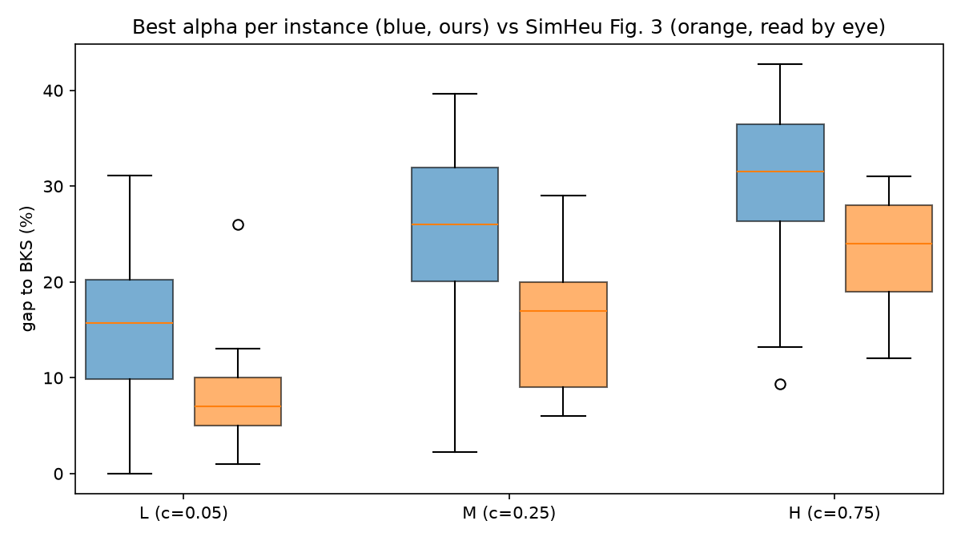
Fig. 3: same ordering, 7–9 points higher
MEDIAN GAP % (BOX)
Level | Ours (Q1–Q3) | Paper ≈
L | 15.69 (9.90–20.23) | 7 (5–10)
M | 26.02 (20.04–31.97) | 17 (9–20)
H | 31.56 (26.35–36.44) | 24 (19–28)
At L and M our lower quartile is about their upper one. Our deterministic gap is only 2.4–3.2 points.
PLAUSIBLE CAUSE (NOT CHECKED)
Juan et al. simulate inside the search loop and stop by time (up to ~400 s); we simulate only 7 candidates chosen with expected times.
Blue: ours, best α. Orange: SimHeu-L/M/H of Fig. 3.
Paper values read by eye from Fig. 3 (±1–2 points). The paper says neither which instances enter each box (we assume p1–p3, the only sets solved by the SAA) nor how the gap is computed.
Notes:
Fig. 3 leída a ojo (±1-2 puntos); el paper no dice qué instancias ni qué fórmula del gap. Mismo orden, medianas 7-9 puntos por encima. Nuestro gap determinista es de solo 2,4-3,2 puntos. Causa plausible, no comprobada: ellos simulan dentro del bucle y paran por tiempo; nosotros simulamos 7 candidatas.

Slide 11
Most of the gap is the price of uncertainty
MEAN GAP TO THE BKS (%), BEST α · TOTAL 14.65 / 25.02 / 30.51
≈ 80 % · 90 %
of the gap is loss due to uncertainty (L · M and H)
72 / 72 / 82
of 141 winners reach the BKS in deterministic terms: the median deterministic gap is 0
11.86 / 22.72 / 28.79 %
the same loss over the winner's own deterministic reward, 100 (det − R) / det
gap = deterministic gap 100 (BKS − det) / BKS + loss due to uncertainty 100 (det − R) / BKS, both over the BKS (means of the best-α rows). Part of the loss no solution can avoid.
Notes:
El gap se suma: gap determinista más pérdida por incertidumbre, las dos sobre la BKS. Determinista 3,15/2,96/2,41; pérdida 11,50/22,06/28,10: en torno al 80 % del gap en L y al 90 % en M y H. 72/72/82 ganadoras alcanzan la BKS en determinista. Sobre su propia recompensa determinista, la pérdida es 11,86/22,72/28,79 %.

Slide 12
Why: candidates are built up to tmax
BEST α, MEANS (%): A LATE ROUTE LOSES EVERYTHING
0.93 · tmax
median expected time of the winners' routes, at every level
4 / 6 / 8 %
of those routes within 1 % of tmax, where a route fails almost half of the time
27.1 %
of the 1 269 runs have fewer than 7 distinct candidates, so the filter does not act (9.0 %: only one)
Merges and insertions fill tmax, and the filter keeps the fullest: simulation can only choose among routes built without slack.
Faithful to the paper, which also plans routes with expected times (its Eq. 3).
Notes:
Causa probable: la PJS fusiona mientras quepa el tiempo esperado, la búsqueda local rellena la holgura y el filtro se queda con las más llenas. Mediana 0,93 tmax; 4/6/8 % a menos de un 1 % de tmax. La pérdida sobre la recompensa determinista casi coincide con el % de rutas tardías. Y en un 27,1 % de ejecuciones hay menos de 7 candidatas distintas (9,0 %: una sola).

Slide 13
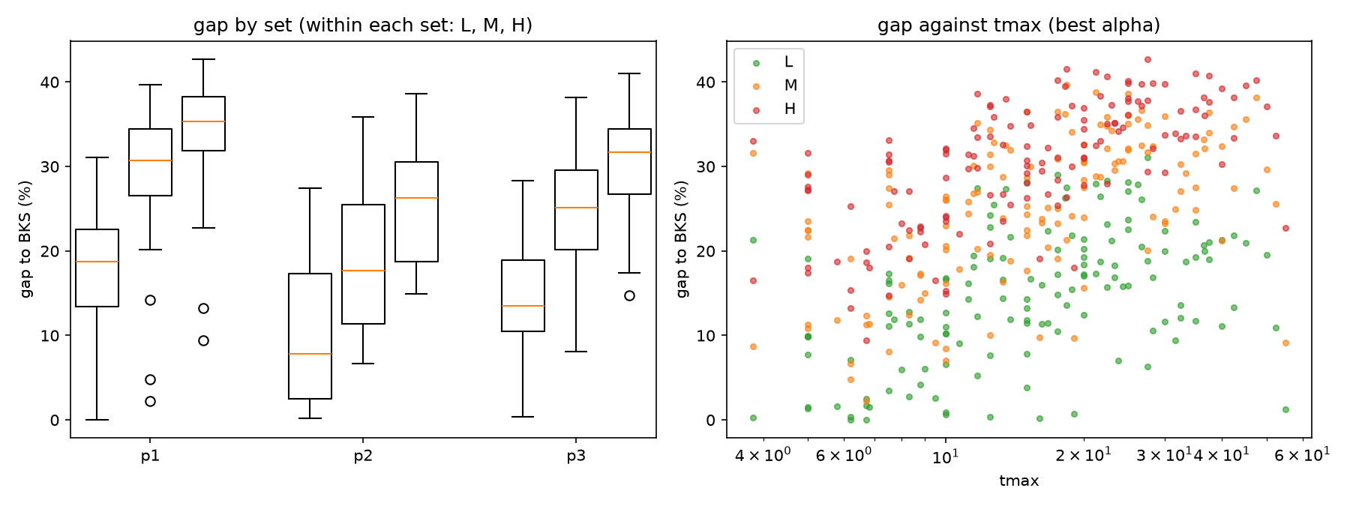
Larger tmax, larger gap — despite Var = c·t
0.49 / 0.56 / 0.67
10.4 / 19.3 / 25.2 %
0.56 / 0.54 / 0.59
Spearman of tmax and gap, L / M / H
mean gap in p2, the set with the smallest tmax (median 10)
Spearman of tmax and the deterministic gap, more than the loss (0.30 / 0.39 / 0.44)
Best α; loss due to uncertainty over the BKS. Set and tmax are confounded (p2 has only 21 nodes): an observation, not an explanation.
Notes:
Esperaríamos más gap con tmax pequeño y pasa lo contrario (Spearman 0,49/0,56/0,67; p2 el menor). Pero el gap determinista también crece con tmax, más que la pérdida (0,30/0,39/0,44), y conjunto y tmax están confundidos. Es una observación, no una explicación.

Slide 14
Fast enough: 1 269 runs in about 25 seconds
≈ 25 s
0.05–0.23 s
0.07 · 0.16 s
for all 1 269 runs on 12 threads of a 6-core AMD Ryzen 5 5500U
per run, after loading the Numba kernels
mean per run in p2 · in p1 and p3 (0.16–0.17)
Python 3.14 + NumPy + Numba
The paper's Fig. 4
PJS merges, local search and the loop over replicas are Numba kernels; random numbers come from NumPy. Each day is an N × N matrix of symmetric times read by all the candidates of a phase. 18 sanity checks.
A few seconds to about 400 s, in Java on a 3.7 GHz Xeon with a time limit. Different language, machine and stopping rule: only a qualitative comparison.
Cheap enough to run every α at every level instead of tuning one.
Time of one call to the simheuristic once the Numba kernels are loaded; a process pool spreads the runs over the 12 threads.
Notes:
Unos 25 s para las 1 269 ejecuciones en 12 hilos de un Ryzen 5 5500U de 6 núcleos; 0,05-0,23 s por ejecución. La Fig. 4 del paper: de segundos a 400 s en Java: solo comparación cualitativa.

Slide 15
Limitations and next step: a safety margin
Limitations
Next step: a safety margin
No SAA: it needs a commercial solver (CPLEX), so only the simheuristic is compared.
Fig. 3 read by eye: we assume its boxes cover p1–p3, and the paper does not give the gap formula.
Two small selection biases: the reported mean is the largest of three finalists, and the best of three α is kept with that mean.
Candidates built with expected times, as in the paper: no slack.
Build with tmax − δ while simulating with the true tmax. δ from:
1
A grid: e.g. tmax − δ = k · tmax, k ∈ {0.80, 0.85, …, 1}; simulation picks the best.
2
The route variance: accept a route only if E_{d} + z √(c E_{d}) ≤ tmax: a margin per route and per c.
3
Adaptive: tuned to the failure rate of the fast simulation.
Motivated by 13–29 % of winning routes arriving late, more as c grows.
Notes:
Limitaciones: sin SAA; Fig. 3 a ojo; dos sesgos de selección pequeños; candidatas sin holgura. Siguiente paso: margen de seguridad, construir con tmax - delta y simular con el tmax real; delta de una rejilla, de la varianza de la ruta (Ed + z raíz(c Ed) <= tmax) o adaptado a los fallos de la simulación rápida.

Slide 16
TAKEAWAY
Simulation can only choose among routes built without slack.
WHAT WE FOUND
Mean gaps 14.65 / 25.02 / 30.51 % (L / M / H): the ordering of Juan et al., medians 7–9 points above theirs (read by eye).
Winners usually match the BKS deterministically, but the median route fills 0.93 tmax and 13–29 % of routes arrive late.
A fraction of a second per run; α hardly matters.
WORTH ASKING ABOUT
No SAA: only the simheuristic is compared.
Fig. 3 read by eye; instances per box assumed.
Next: a safety margin, tmax − δ.
Thank you — questions?
Notes:
La simulación solo puede elegir entre rutas construidas sin holgura. Gaps 14,65/25,02/30,51 %, el orden del paper, 7-9 puntos por encima. Siguiente paso: margen de seguridad.

Slide 17
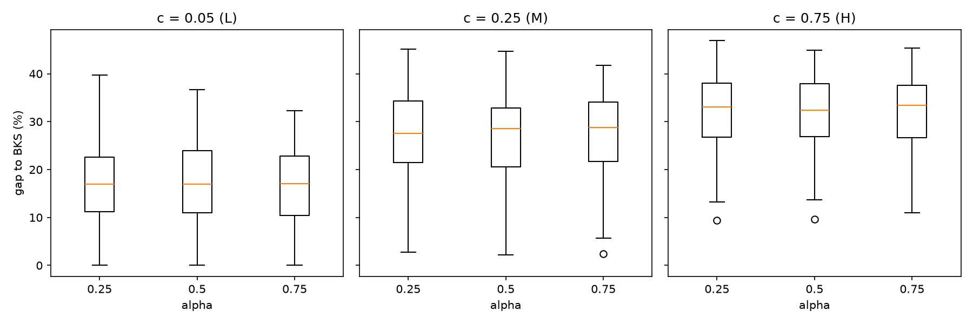
BACKUP
Gap by α and level, all 1 269 runs
results/gap_alpha_c_matrix.csv; 141 instances per box. Medians 16.9–17.1 (L), 27.5–28.8 (M), 32.4–33.5 (H).
Notes:
Reserva: cajas del gap por alfa y nivel con las 1 269 ejecuciones. Las tres alfas se solapan casi por completo en cada nivel.

