Slide 1
HEURISTIC ALGORITHMS · TSPLIB 95
Two greedy heuristics for the travelling salesman problem
Nearest neighbour against greedy edge, run on all 111 TSPLIB instances.
Jesús Inurria Porrero · Javier Salvatierra Corchado
Notes:
One problem, two constructive heuristics, the whole TSPLIB benchmark. No local search, on purpose.

Slide 2
One rule, impossible arithmetic
2 / 10
Visit every city once, come back to the start, and make the round trip as short as possible.
NP-hard
no polynomial algorithm is known
min Σ dᵢⱼ · xᵢⱼ total length
s.t. each city entered once
each city left once
no subtours exponentially many
(n−1)!/2
distinct tours
10⁶²
That last family of constraints is what stops the answer from falling apart into separate loops — and what makes the problem hard.
of them for just 51 cities
Constructive — build a tour from nothing. Both of ours.
Local improvement — 2-opt, Lin–Kernighan. Left out on purpose: we want to see what each construction is worth on its own.
Notes:
The subtour elimination constraints are the hard part: exponentially many of them. 51 cities already give about 10^62 tours, so exact methods are out and we go constructive.

Slide 3
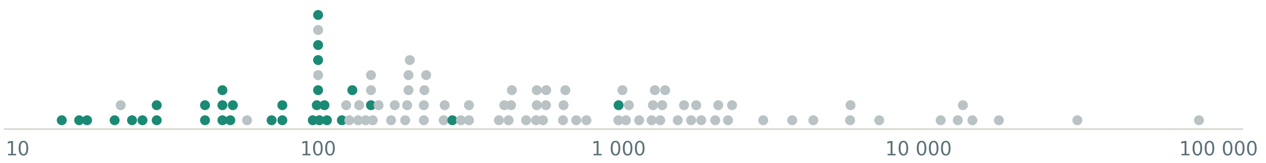
TSPLIB 95 — the benchmark
3 / 10
111
32
14 → 85,900
5
.tsp files - the problems
.opt.tour files - optima
cities, burma14 to pla85900
distance types, all integer
Every instance by size. Only the green ones ship a known optimal tour, so they are the only ones where a true gap can be measured.
.tsp - the problem
.opt.tour - the answer
NAME: eil51
DIMENSION: 51
EDGE_WEIGHT_TYPE: EUC_2D
NODE_COORD_SECTION
1 37 52 node, x, y
COMMENT : Optimal tour (426)
TOUR_SECTION
1
22 ...
-1 end of tour
Notes:
111 problems, only 32 with a proven optimum. Sizes run over four orders of magnitude, and five different distance formulas all rounded to integers.

Slide 4
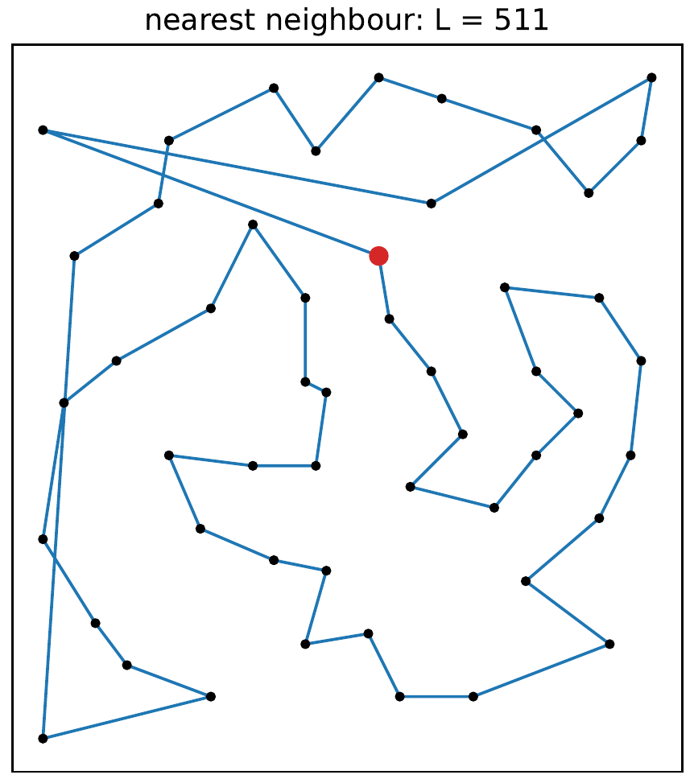
Nearest neighbour
4 / 10
Always move to the closest city you have not visited yet.
current ← start
repeat n−1 times:
next ← nearest unvisited city
current ← next
close the loop
O(n²), near-linear with a sorted candidate list.
It only ever looks at the edges leaving one city.
Change the starting city and the whole tour changes.
eil51, 51 cities: one path growing from one end. The long crossings at the top are the cities it walked past and had to come back for.
Notes:
Cheap and intuitive, but greedy in the narrowest sense: it only compares the edges leaving the city it is standing on.

Slide 5
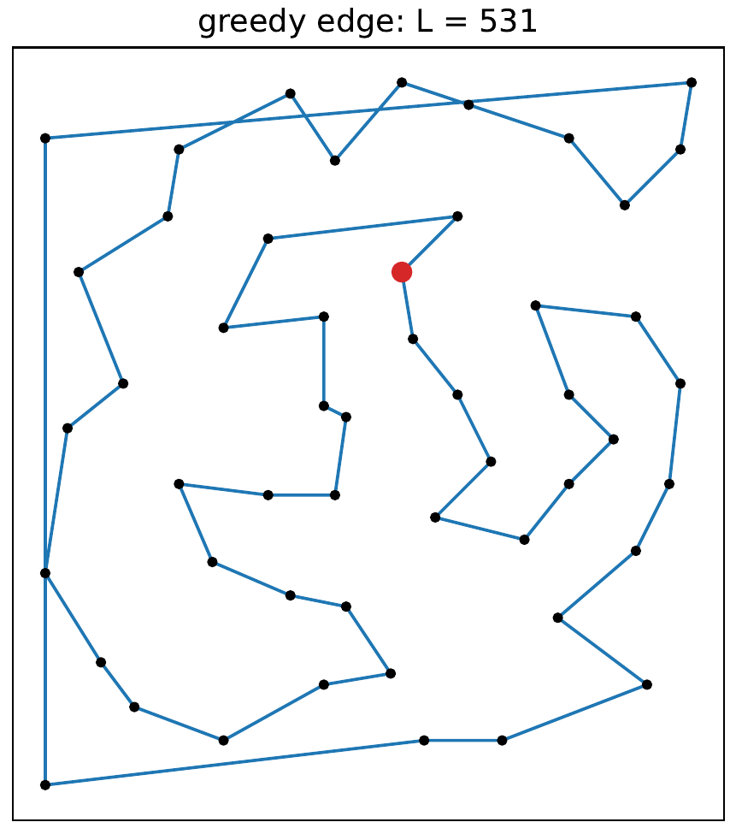
Greedy edge (multi-fragment)
5 / 10
Forget paths. Sort every edge by length and accept the short ones, wherever on the map they happen to be.
for each edge, shortest first:
skip if an endpoint has degree 2
skip if both ends share a fragment
else accept it and merge
until n−1 edges; close the loop
O(n² log n) - the sort dominates.
Exact up to n = 2500; above that only the 10 nearest neighbours of each city compete, which is what makes 85,900 cities possible at all.
The same 51 cities: short edges are taken all over the map at once, and the fragments are only joined at the end.
Notes:
Multi-fragment: a union-find keeps the accepted edges from closing a premature loop, and degrees are capped at two.

Slide 6
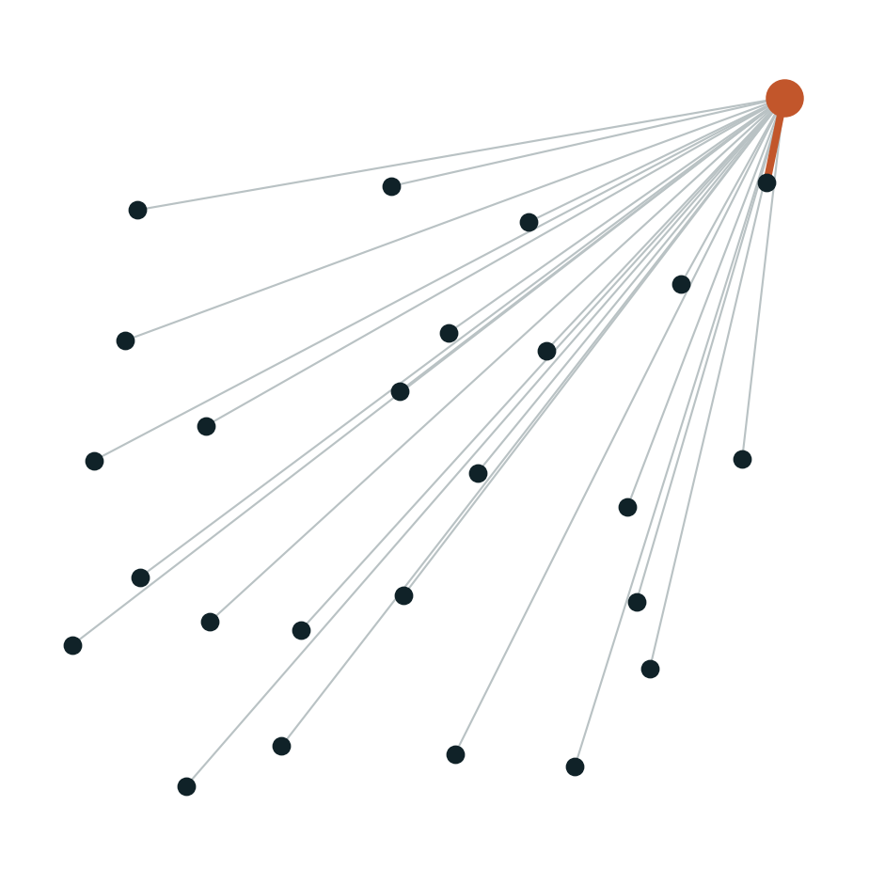
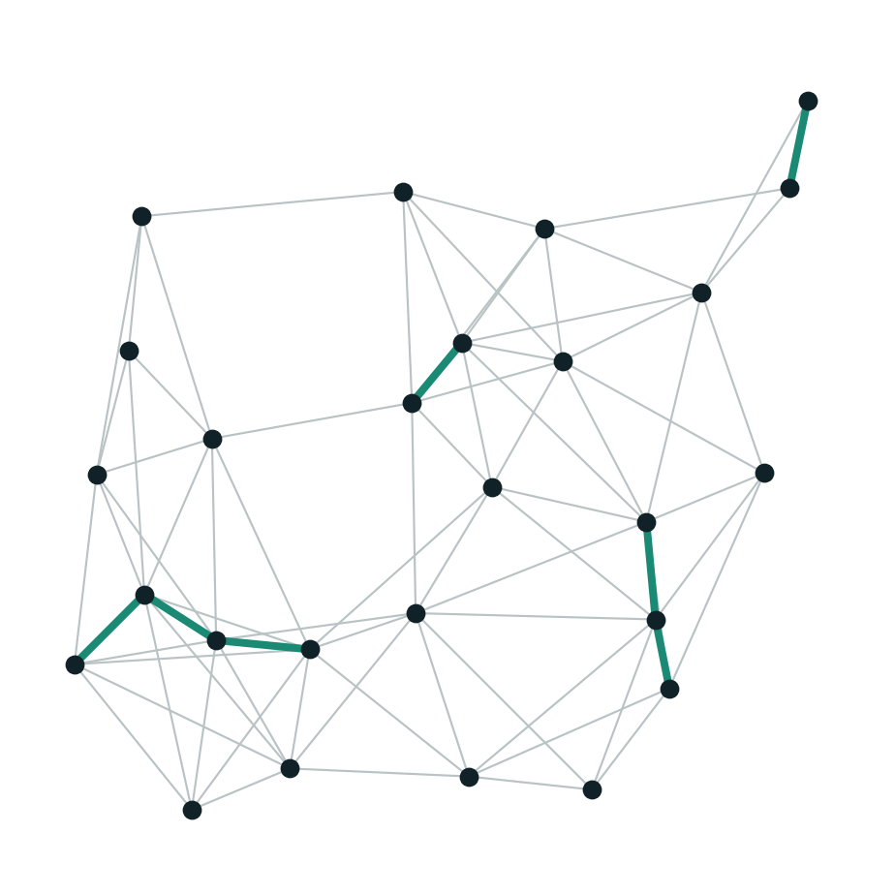
Same greed, different menu
6 / 10
Nearest neighbour picks a local minimum
Greedy edge picks a global minimum
It can only choose among the edges leaving the city it is standing on. A great edge on the other side of the map has to wait its turn — and may be gone by then.
Every edge competes against every other edge. Isolated cities get hooked up early, while they still have good neighbours free, and long edges are left for last by construction.
The worst case does not separate them. Both are bounded by about ½ log₂ n (Rosenkrantz, Stearns and Lewis, 1977). The difference is empirical — and greedy pays for it by sorting ~n² edges.
Notes:
Same greedy principle, different menu of candidates at each decision. That is the whole argument of the comparison.

Slide 7
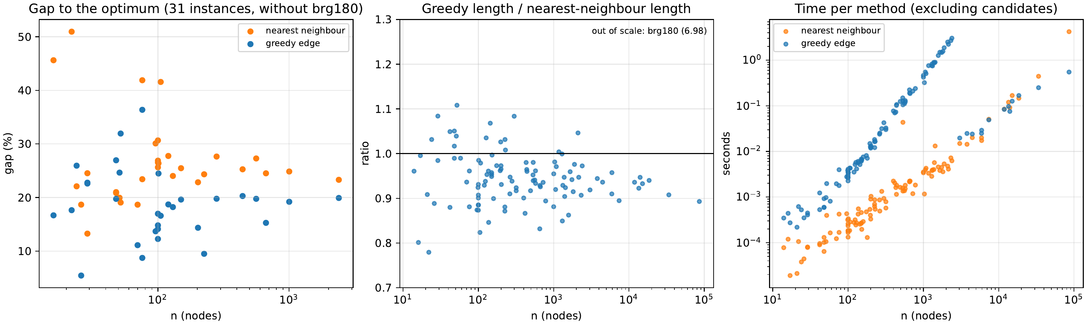
What the numbers say
7 / 10
95 / 111
18.7%
26.6%
0.940
instances where greedy edge wins
mean gap to the optimum, greedy
mean gap, nearest neighbour
median length ratio, greedy / NN
Gap against the 31 comparable optima, length ratio on all 111 instances, and time per method — every axis logarithmic in n.
Notes:
Middle panel is the clearest: almost every point sits below 1.0, so greedy is shorter on almost every instance, at every size.

Slide 8
Head to head by size
8 / 10
Mean gap to the optimum, lower is better · 31 instances
n | inst. | greedy wins | median ratio | NN time | greedy time
≤ 100 | 28 | 21 | 0.934 | 0.000 s | 0.002 s
101–500 | 38 | 31 | 0.955 | 0.001 s | 0.025 s
501–1000 | 12 | 12 | 0.934 | 0.005 s | 0.188 s
1001–5000 | 23 | 21 | 0.944 | 0.006 s | 1.122 s
> 5000 | 10 | 10 | 0.928 | 0.537 s | 0.145 s
all | 111 | 95 | 0.940 | 0.050 s | 0.275 s
nearest neighbour
26.6%
greedy edge
18.7%
Mean seconds to build one tour, lower is better
nearest neighbour
0.050 s
greedy edge
0.275 s
Roughly five times slower on average, and still half a second for the 85,900 cities of pla85900.
brg180 is left out of the gap: six distinct weights and thousands of ties send greedy to 37,830 against an optimum of 1,950.
The ratio is greedy length over nearest-neighbour length, so 0.940 means a tour 6% shorter at the median. No size bracket escapes it, and above 500 cities greedy wins every single instance.
Notes:
The win is structural rather than a size effect: the median ratio stays between 0.93 and 0.96 in all five brackets.

Slide 9
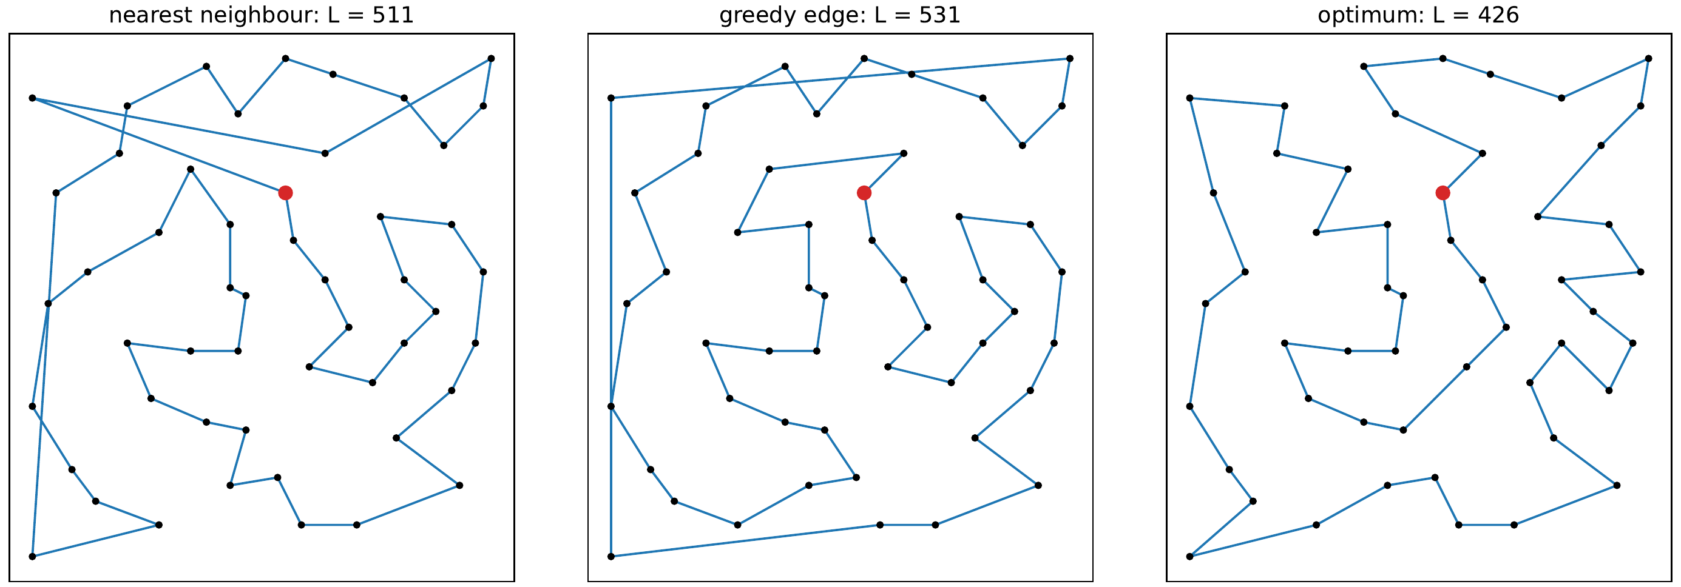
eil51: where nearest neighbour wins
9 / 10
The same 51 cities solved three ways. Both heuristics land well above the optimum of 426.
Nearest neighbour wins 16 of the 111 instances, and this is one of them: 511 against 531. At 51 cities the three long crossings that close greedy’s fragments cost more than the good edges it collected along the way.
Notes:
Useful counterexample to have ready: greedy is better on average, not everywhere, and its weak spot is exactly the final fragment joins.

Slide 10
TAKEAWAY
Choosing the globally shortest edge beats choosing the closest neighbour.
By 4 to 7% on every size range, for roughly five times the time. Still half a second at 85,900 cities.
Structural, not a size effect: median ratios stay between 0.93 and 0.96 in all five brackets.
Nearest neighbour pays at the end for every city it abandoned along the way.
An 18% gap is normal for pure construction. 2-opt or Or-opt is the obvious next step.
Notes:
Close on the trade-off: better tours for more time, and a clear next step in local search.

