Slide 1

Ajay Babu Chebrolu
https://github.com/Inv1nc/key_logger
Final Project
1

Slide 2

Keylogger and Security
2

Slide 3


AGENDA
Introduction to the Keylogger and Security Project.
Problem statement and project objectives.
Detailed project overview.
Identification of end users.
Proposed solutions and their value.
Unique aspects of the solution (wow factor).
Modelling approach.
Results and conclusions.
3/21/2024 Annual Review
3

Slide 4
PROBLEM STATEMENT
Increasing keylogger threats compromising security
Challenges in detecting and preventing keyloggers
Need for better protection of sensitive information
4

Slide 5
PROJECT OVERVIEW
Develop a security system against keyloggers
Implement real-time monitoring and alerts
Create user-friendly security management interfaces
3/21/2024 Annual Review
5

Slide 6

END USERS
Individuals worried about personal data security
Organizations protecting sensitive information
IT professionals maintaining network security
6

Slide 7
SOLUTION AND ITS VALUE
Advanced keylogger detection algorithms
Real-time threat alerts and automatic mitigation
Increased user awareness and education
7

Slide 8
THE WOW IN YOUR SOLUTION
Machine learning for accurate detection
Seamless integration with existing security systems
Real-time threat analytics and insights
3/21/2024 Annual Review
8

Slide 9
MODELLING
Machine learning model trained on keylogger patterns
Simulation of keylogging scenarios
Continuous refinement based on real-world data
9

Slide 10
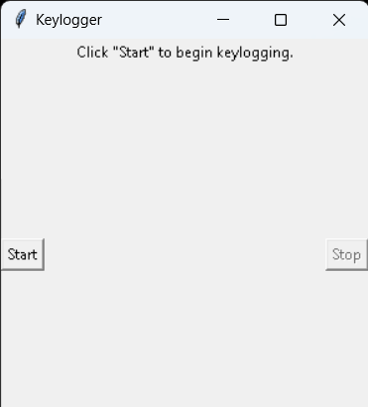
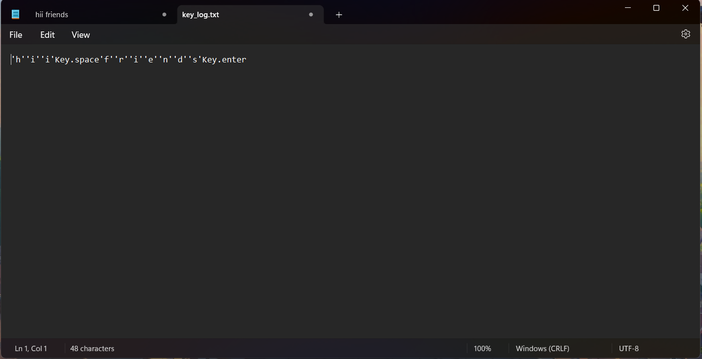
RESULTS
10

Slide 11
Project Link
https://github.com/Inv1nc/key_logger.git

