Slide 1

Notes:
Hello Ladies and Gentlemen, I am Hnu Thaper and along side me is Elijah Tyson….

Slide 2
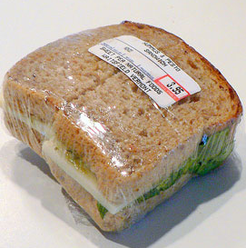
The Problem
Notes:
Abid/Hnu Script
Elijah: MENTION THE SINGLE PROBLEM (food storage)…….then the parent and student are worried

Slide 3
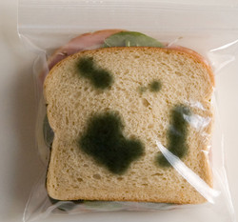
The Problem
Notes:
Abid/Hnu Script
Elijah: MENTION THE SINGLE PROBLEM (food storage)…….then the parent and student are worried

Slide 4

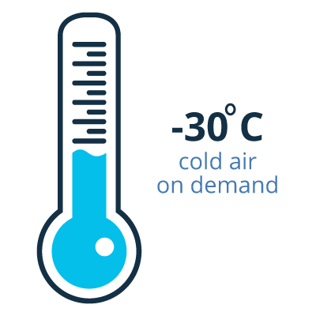

The Solution
Personalized
Refrigerated
Food Storage Compartments
Notes:
Our technology is very unique but for now I just want you to picture a vending machine that sells personal fridge space instead of food items.
(Neubert) Solution- don’t have the solution be coldsppace, make it
story.
PERSONALIZED..
REFRIDGERATED..
FOOD STORAGE COMAPARTMENTS

Slide 5
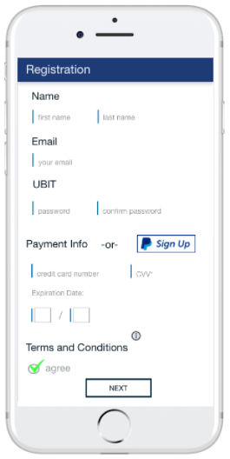

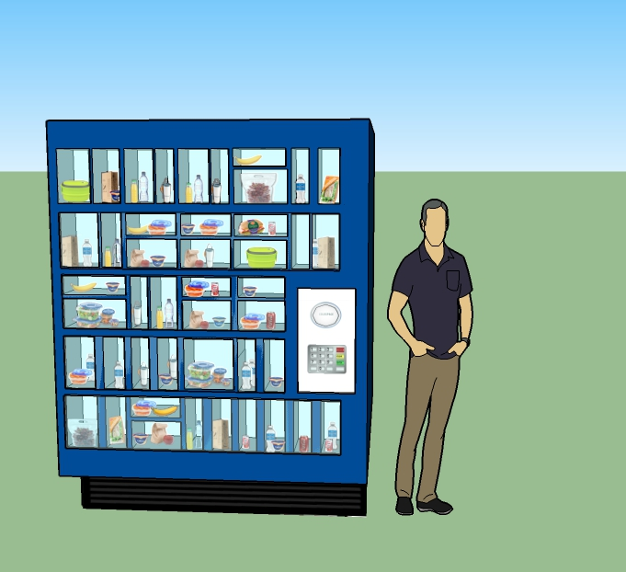

How It Works
Notes:
Customer fills out registration
Login to mobile friendly website
Website
-find and allocate a coldspace
-generate a code
-view how much time they currently have left in their space
-user settings

Slide 6

What we are looking for
Computer Science Engineers
Electrical Engineers
Mechanical/Industrial Engineers
-Build the backend could-based webserver database and front end user interface (CSE)
-Assist with Prototype V.3 development (EE/ME)

Slide 7
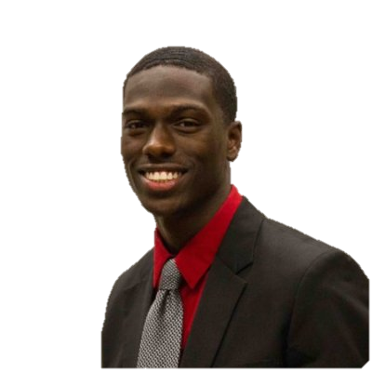

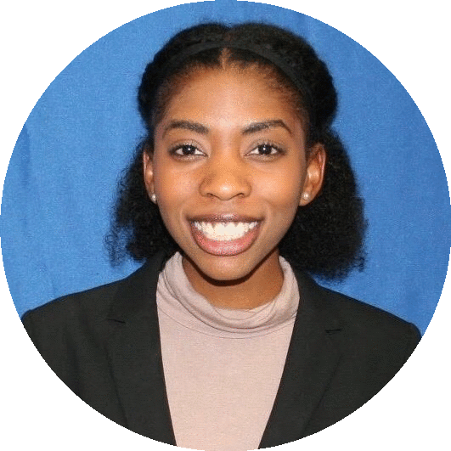

Meet the team
Elijah Tyson
Hnu Thaper
Abid Alam
Ann-Previl Isabel
Founder & CEO
Western New York Prosperity Fellow
Founder of Hustle Aesthetic Fitness
Co-Founder and COO
Risk Associate at PricewaterhouseCoopers (PwC)
Former Risk Analyst at Morgan Stanley
Chief Financial Officer
Financial Analyst at Fiserv
Former Tax Analyst at Gibraltar Industries
Campus Ambassador
Marketing Intern at ColdSpace
Former intern at Peace for Seeds
Notes:
The team executing this plan is US……

Slide 8

Extraordinary Food Storage Locker
Visit us at www.mycoldspace.com

