Slide 1
Staging Dutch magnet summary
2018/7/1, ver. 1
Kei Nakamura

Slide 2
Revision
2018/7/1
  Staging Dutch is now Moore Dutch 1 (2 after undulator planned)
2014/3/25
  Cam1 was removed for cross calibration. Before and after this operation, camera position was saved in
  Before: 3/21 scan4
  After: 3/25 scan1
  Before data is to confirm the drift since installation (2011). After is to measure the change due to removal and re-installation.

Slide 3
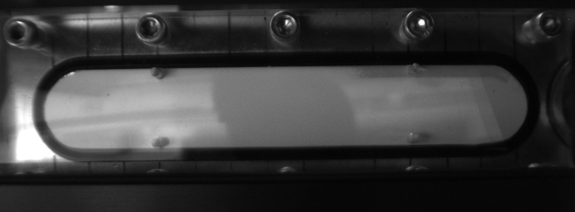
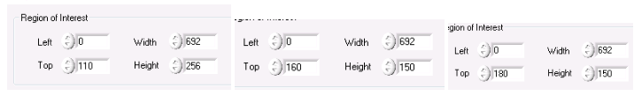
7/1/2018 CCD camera 1 (front)
21.5 mm
10 mm
X=634 pix
Beam tube center
130mm/555pixel, 0.234 mm/pixel
Field of view (692pix) = 162.1 mm
Image right edge = 7.9 mm
Range: 7.9 – 170 mm
Data: 2018_0628 scan 11 and 12
Notes:
X63 – 618, 130 mm, right: 58 pixels from 21.5mm, 7.9 mm

Slide 4
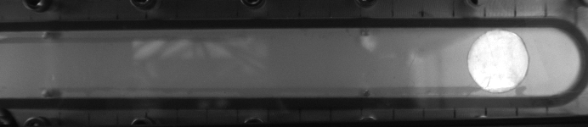
7/1/2018 CCD camera 2 (downstream, side)
150.2 mm from center of magnet
X=683 pix
332.4 mm from center
160mm/573pixel, 0.279 mm/pixel
Field of view = 193.2 mm
Range: 141.7 – 334.9 mm
Data: 2018_0628 scan 11 and 12
Notes:
X: 644, 71, 160 mm, right: 9 pixel from 332.4

Slide 5
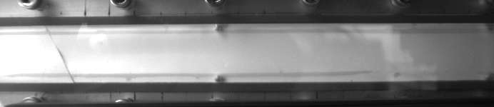
7/1/2018 CCD camera 3 (upstream, side)
X=657 pix
150.2 mm from center of magnet
160mm/573pixel, 0.279 mm/pixel
Field of view = 193.2 mm
Range: -33.2 – 160 mm
Save ROI: top 184, height 130
Data: 2018_0628 scan 11 and 12
Notes:
658-85=573 pixel, 160mm, 0.279

Slide 6
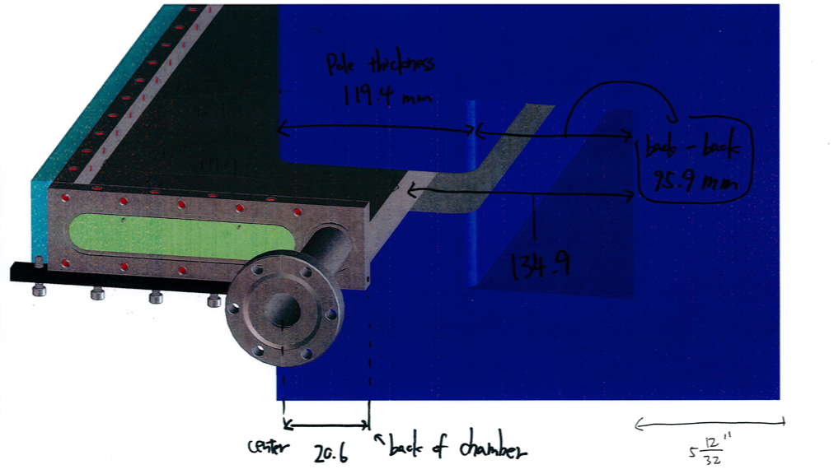
Chamber is 5.7 mm too deep in the yoke
Designed
Measured
Probe holder
129.2mm
Notes:
Measured on 7/10/2018, Jeroen

Slide 7
Beam line and screen wrt the magnet
Yoke wall
129.2 (134.9mm when
beam line = magnet center)
20.5 (chamber wall)
Pole
Beam line
Chamber (screen)
-354.6
-240
0
240
354.6
Z[mm]
Xm=5.7
Magnet center
21.5
170 mm
157.2
-332.4
332.4
+x
Notes
Magnet can float with respect to the chamber (magnet center can have offset with respect to the beam line).
The chamber defines the beam line and screen location.
Front screen is at z =354.6 mm, and side screen is at x = 170 mm.
The chamber end-end is 27.925” = 709.3mm

Slide 8
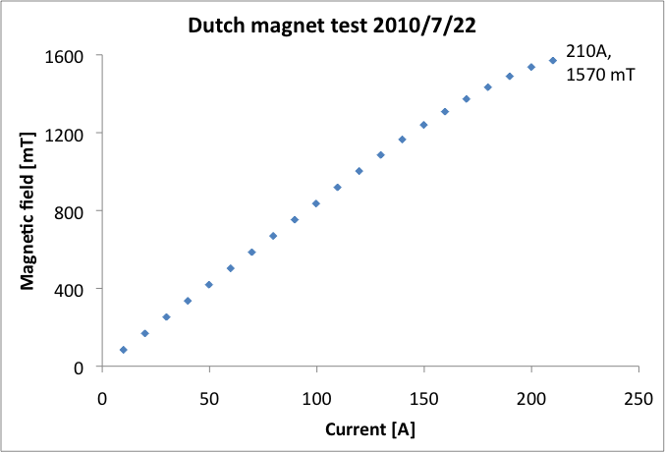
Peak field ~1600 mT
NOT updated
Magnetic field is always monitored/recorded by a Hall probe.
Control for the power supply is …
Data: server/TREXResources/calibration/DutchMag/100722BIScan.xlsx

Slide 9
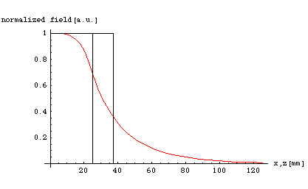
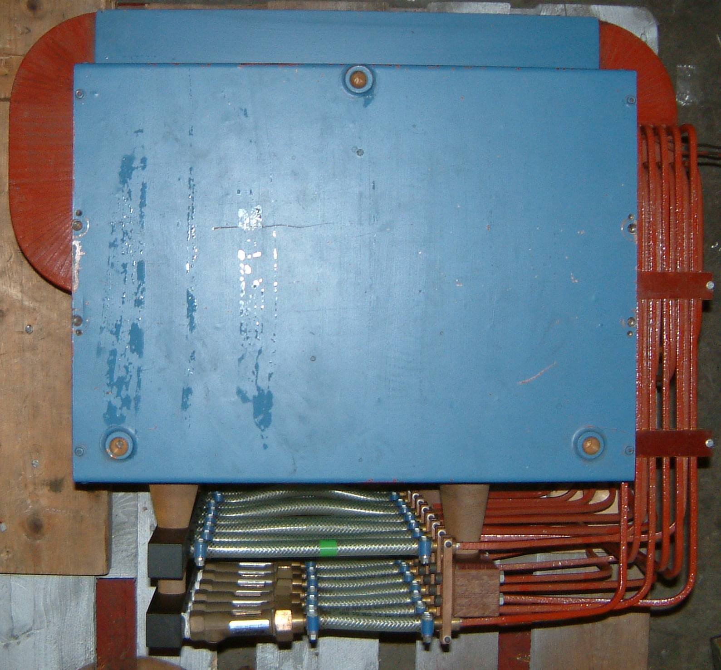
Effective field size 144.4 x 504.4 mm^2
Pole size is 120 mm x 480 mm,
Effective field size is 144.4 mm x 504.4 mm.
Effective boundary
Magnet edge
12 cm × 48 cm
Effective boundary
g
x
r
Data: server/TREXResources/calibration/DutchMag/040330BXZScan.xlsx

Slide 10
Archives

Slide 11
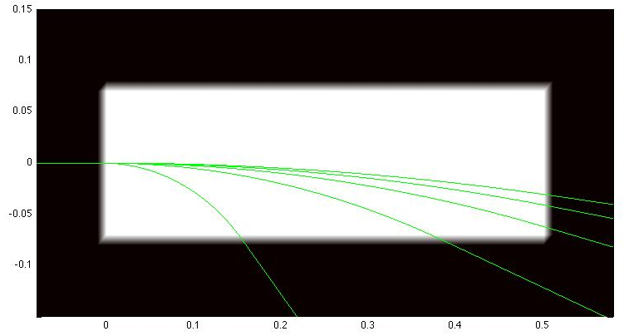
2 GeV, 7.0256 degree, 41 mm
NOT updated
Coil
Field
Displacement @ outside of the coil
With 1.7 T, it bends 2 GeV beam 7 degree.
Program: server/software/matlab/Kei/programs/elcTrajectory/dutch/dutchTrjV01.m

Slide 12
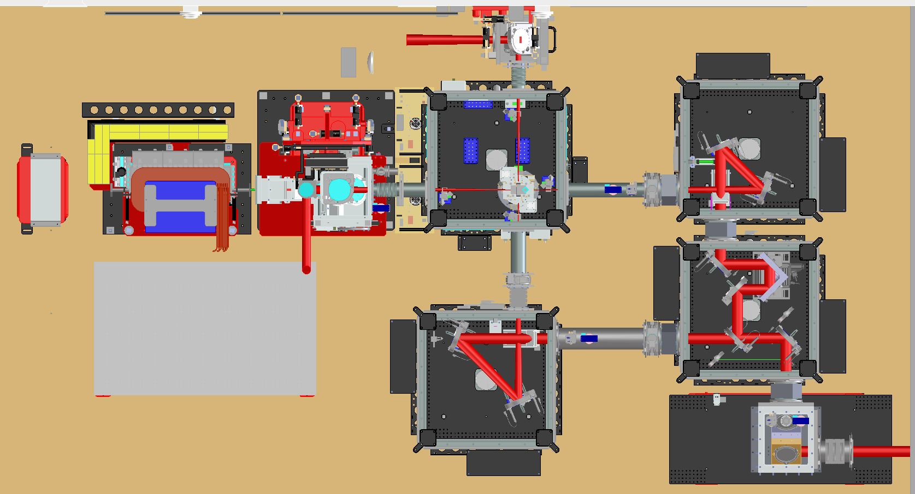
Staging beam line design

Slide 13
Z=43 [mm]
Plasma mirror
Z [mm]
Z=2009 [mm]
Chamber input
I.D. = 15.24 mm
Z=33 [mm]
Nominal cap1 exit
Z=2363 [mm]
Magnet center
Z=0 [mm]
Laser focus
Z=96 [mm]
Nominal cap2 exit

Slide 14
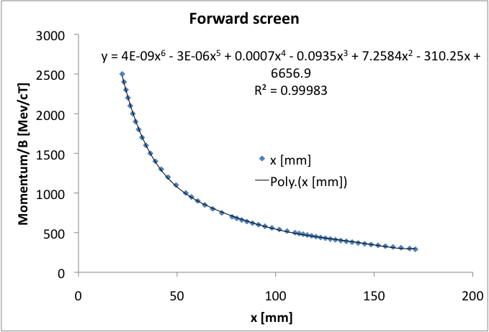
Front screen momentum-position
NOT updated
3.8645e-9*x^6 -2.5268e-6*x^5 +6.7217e-4*x^4 -0.093486*x^3 +7.2584*x^2 -310.253*x +6656.9
Data: server/TREXResources/calibration/DutchMag/frontScreen.xlsx
Program: server/software/matlab/Kei/programs/elcTrajectory/dutch/dutchTrjV02.m

Slide 15
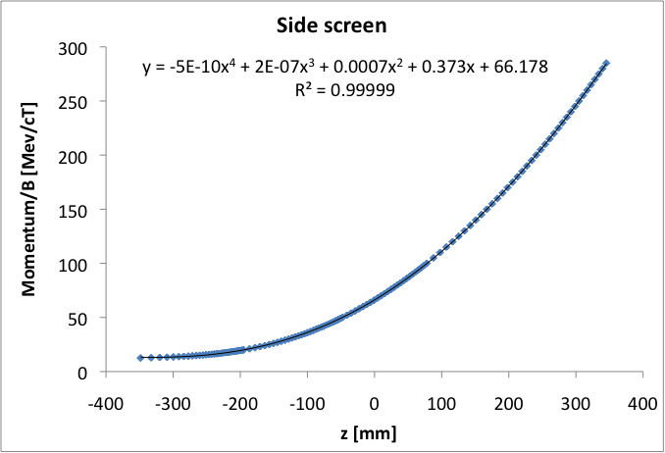
Side screen momentum-position
NOT updated
-4.6091e-10*x^4 +166828e-7*x^3 +7.485e-4*x^2 +0.37296*x +66.178
Data: server/TREXResources/calibration/DutchMag/sideScreen.xlsx

Slide 16
E-beam acceptance
Dutch magnet front
Dutch magnet end
Laser focus
Beam block
0
~1900
~2800
~3100 mm
Aperture @ Dutch magnet exit: I.D. 7/8” = 22.225 mm
Aperture @ beam tube near entrance: I.D. = 15.24 mm
E-beam acceptance: 15.24/2.8 ~ 5.4 mrad (+/- 2.7 mrad)

Slide 17
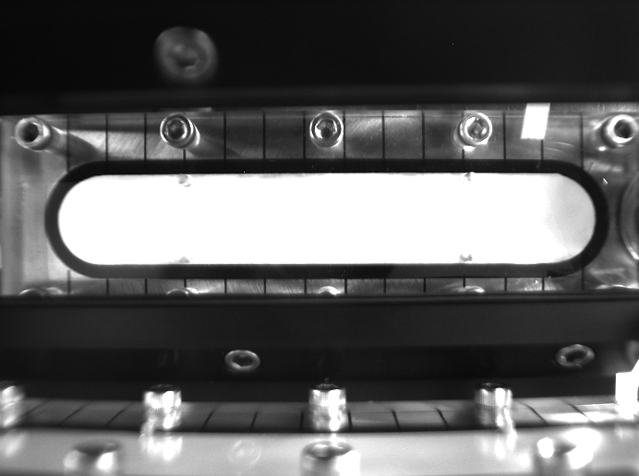
3/21/2014 CCD camera 1 (front), no change was observed.
X=645 pix
21.5 mm
10 mm
Beam tube center
120mm/520pixel, 0.231 mm/pixel
Field of view (692pix) = 159.7 mm
Image right edge = 10.7 mm
Range: 10.7 – 170.4 mm
Notes:
Note: picture is old

Slide 18
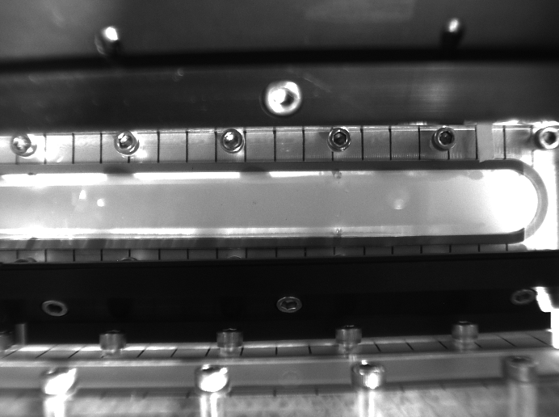
3/21/2014 CCD camera 2 (downstream, side), no change
X=91 pix
170.2 mm from center of magnet
X=666 pix
332.4 mm from center
180mm/638pixel, 0.282 mm/pixel
Field of view = 195.2 mm
Range: 144.5 – 339.7 mm
Save ROI: top 180, height 130
Data: Server/5_resources/StagingResources/Staging van der spec calibration/side cam1

Slide 19
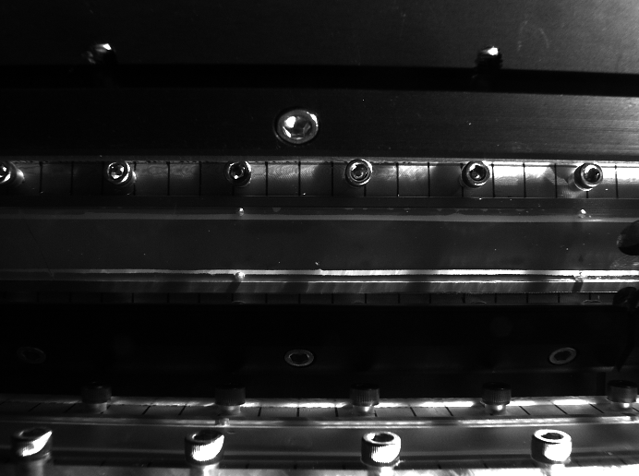
3/21/2014 CCD camera 3 (upstream, side), no change
X=668 pix
170.2 mm from center of magnet
180mm/624pixel, 0.288 mm/pixel
Field of view = 199.6 mm
Range: -22.5 – 177.1 mm
Save ROI: top 184, height 130
Data: Server/5_resources/StagingResources/Staging van der spec calibration/side cam2

Slide 20
3/25/2014 CCD camera 1 (front), changed, calibration is modified.
X=614 pix
21.5 mm
10 mm
Beam tube center
120mm/513pixel, 0.234 mm/pixel
Field of view (692pix) = 161.9 mm
Image right edge = 3.25 mm
Range: 3.25 – 165.2 mm
Note: image is old

Slide 21
3/25/2014 CCD camera 2 (downstream, side), no change
X=91 pix
170.2 mm from center of magnet
X=666 pix
332.4 mm from center
180mm/638pixel, 0.282 mm/pixel
Field of view = 195.2 mm
Range: 144.5 – 339.7 mm
Save ROI: top 180, height 130
Data: Server/5_resources/StagingResources/Staging van der spec calibration/side cam1

Slide 22
3/25/2014 CCD camera 3 (upstream, side), no change
X=668 pix
170.2 mm from center of magnet
180mm/624pixel, 0.288 mm/pixel
Field of view = 199.6 mm
Range: -22.5 – 177.1 mm
Save ROI: top 184, height 130
Data: Server/5_resources/StagingResources/Staging van der spec calibration/side cam2

