Slide 1
Intellectual Property The toolbox
Jonathan Goodacre

Slide 2
What is Intellectual Property?
Dictionary definition:
“Intangible property that is the result of creativity”
I prefer:
“Ideas or concepts that have been brought into being” (somehow!)

Slide 3
Why protect your IP?
Stops others using it without your permission
- control
That control can be valuable to you/your company
- blocks/puts off potential competitors
And to others
- de-risks things for partners/investment
Your business will create IP
Often the most valuable asset start-ups own

Slide 4
…But isn’t IP expensive and complicated?
It can be!
Understand the basics
Understand basic terminology
Understand what IP protection offers
Know what to do and when
Have a general idea of costs and timescales
Know what IP you have/own
Prioritise your IP protection based on need and budget
Know what IP you should protect
Know what IP you don’t need to protect

Slide 5
Quick quiz – answers at the end…
How many forms of IP protection are there?
If you have protection for your IP, does this mean you are free to use it?
Is all IP protection expensive?

Slide 6
What forms of IP are there?
Patents
technical inventions e.g. gadgets, devices, methods of manufacture
Trade marks
branding, other features that are distinctive of origin
Designs
shape/visual appearance of an article
Copyright
artistic creations, literary works (including computer program code) and lots more.

Slide 7



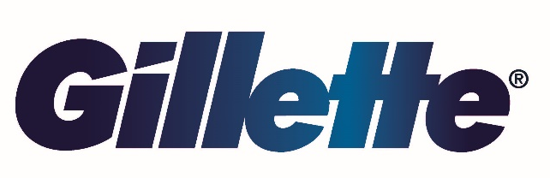
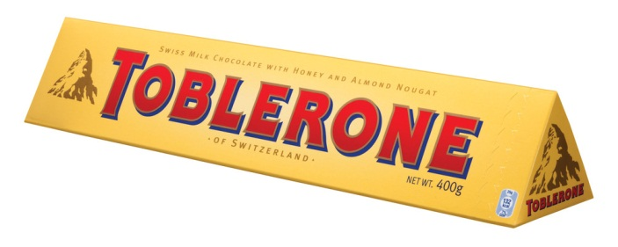
What forms of IP protection are there?
Trade Marks – protecting the “brand”
Words:
McDonalds®
Google ®
Frisbee ®
Jacuzzi ® Plasticine ® Hoover ® Memory Stick ®
Slogans:
BEANZ MEANZ HEINZ ®
JUST DO IT ®
EVERY LITTLE HELPS ®
3-D

Slide 8
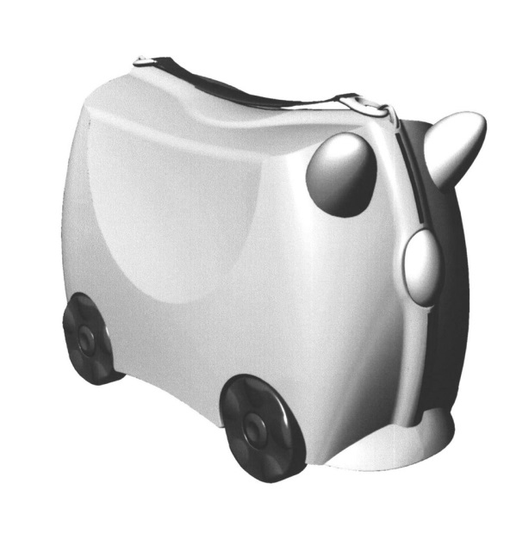
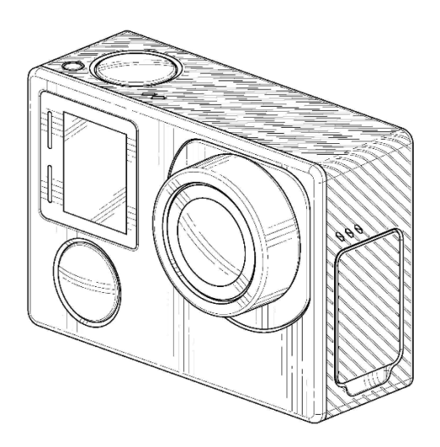
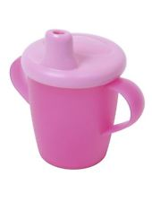
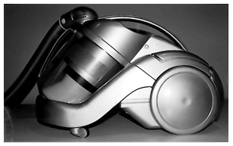
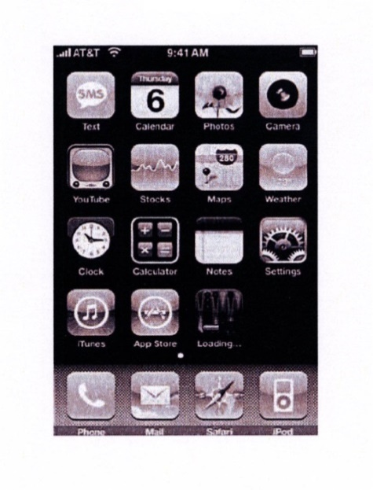
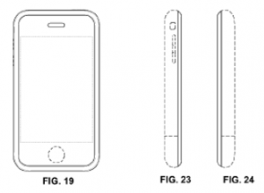

What forms of IP protection are there?
Designs – protecting the “look”

Slide 9
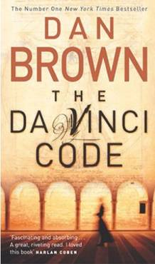
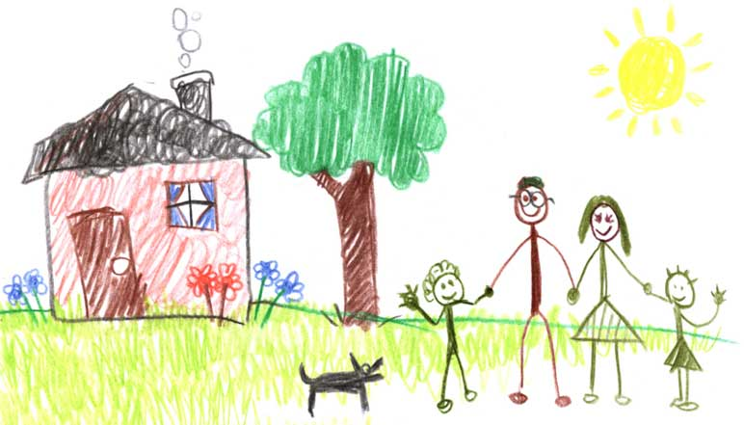
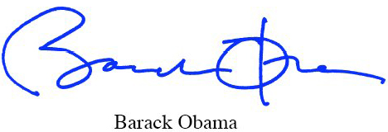
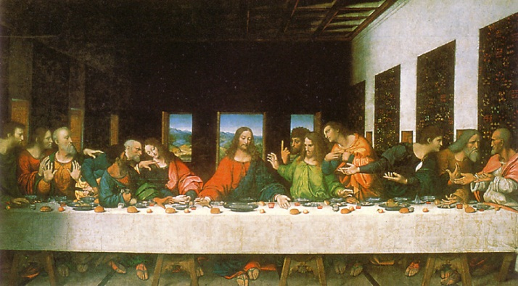
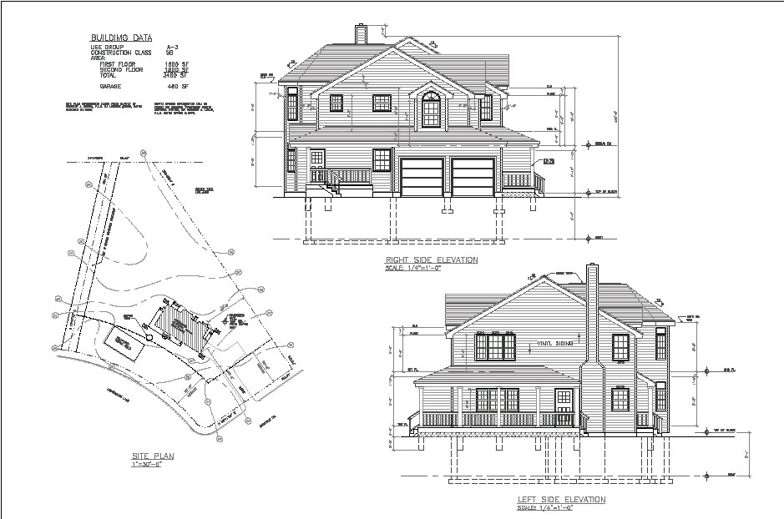
What forms of IP protection are there?
Copyright – protecting the “creation”

Slide 10
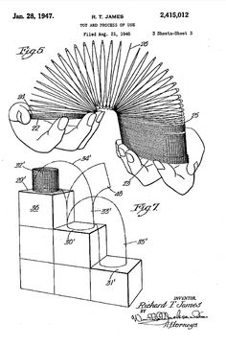
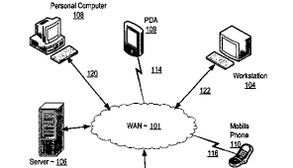
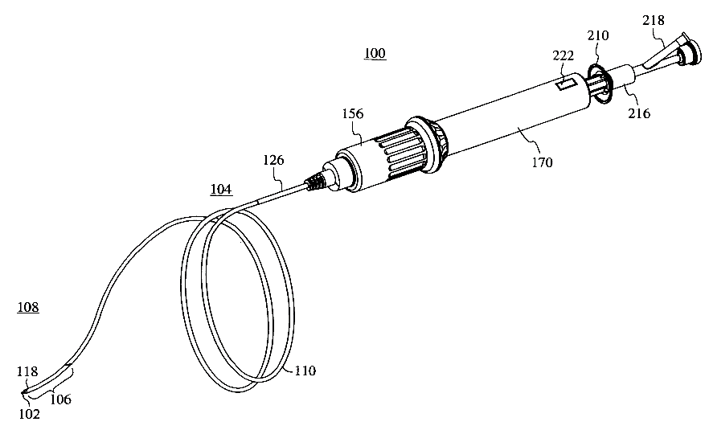
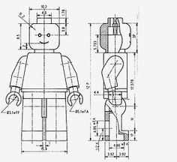
What forms of IP protection are there?
Patents – protecting the “functional/technical”

Slide 11
Trade Marks

Slide 12
Why register a trade mark?
Provides a tool to prevent confusion in the marketplace Registered trade mark symbol ® - deterrent effect Allows you to prevent others from using an identical or similar brand in respect of identical/similar goods or services
Allows you to maintain the integrity of a brand
A registered trade mark lasts forever, providing it is renewed every ten years

Slide 13
Trade marks must not be:
Descriptive Devoid of distinctive character
Examples of trade marks ineligible for registration:
HEALTHY GUMS for toothpaste products
REDSPAM – Registrable in the UK in relation to “network security services”, but not at EU level as “Red” translates to “Network” in Spanish.
Classification system

Slide 14
Registration timescales
Time and costs to registration (assuming no major problems)
* per country
UK | 4 - 6 months | £850 - £2,500
EU | 6 - 10 months | £1,850 - £3,800
Elsewhere* | 6 – 24 months | £500 - £5,000

Slide 15
When should I think about TM protection
Perhaps earlier than you think…
Reputations build early
Is your company name free to use?
(Companies House search is not sufficient – need to search TM databases - difficult for logos etc.)

Slide 16
What makes a good Trade Mark?
No rules – guidelines
Avoid using words that describe what the company does
e.g. “Computer Workshop” for IT repair; or
“Tasty Chocs” for a Confectioner
“Jones Builders” etc.
Abstract words are ideal but can be difficult to find something that resonates with customers
Stylised versions of standard words can work
Can also protect a logo or particular typeface or arrangement of name, but protection more limited

Slide 17
Patents

Slide 18
Why file a patent application?
Can block others from doing what you do
A clear marker of protection
- can appeal to investors and partners
‘Patent pending’ can appeal to customers
Tax benefits for UK companies (Patent Box)
All have a value…

Slide 19
Patents are awarded to inventions that are…
New (novel – not already available to the public)
Inventive (not obvious)
Has been ‘reduced to practice’ (idea brought into being)
Sufficiency of disclosure

Slide 20
What can I protect with a patent?
Products
Components
Whole devices
Assemblies and systems
Processes
Methods of manufacture
Methods of using

Slide 21
What can I not protect? [European law]
Things that are not considered inventions:
Discoveries
Aesthetic creations
Rules/methods of performing mental acts and doing business, playing games, presentation of information, programs for computers……….. “as such”
Things that are contrary to public policy/morality:
Surgical/therapeutic method of treatment; diagnostic methods
Plant/animal varieties
Human beings, uses of embryos for industrial/commercial purposes
Processes for modifying the genetic identity of animals

Slide 22
Basic Patent Facts
Applications and granted rights
A patent starts as an application and has some form of formal examination before it is granted (if at all)
In most countries, you can only enforce your rights once your patent is granted
Duration
Patents can last up to 20 years from the filing date of the application.

Slide 23
Basic Patent Facts
Country based enforcement
Patents are country limited in their effect
e.g. a UK patent can only stop infringers in the UK. Stopping an infringer in the US requires a US patent
Country based cancellation
Patents can be cancelled (revoked) after grant if reasons can be shown that it shouldn’t exist
Cancellation is country based

Slide 24
Basic Patent Facts
What does a patent give you?
Right to prevent others:
Making;
Importing;
Using;
Selling or offering to sell
Stocking products covered by your patent.
Using or offering to use a process covered by your patent
Importing, using, selling, offering to sell products made as a result of a process covered by your patent.
Notice it’s a negative right
The power to stop others making your invention NOT the right to make it yourself

Slide 25
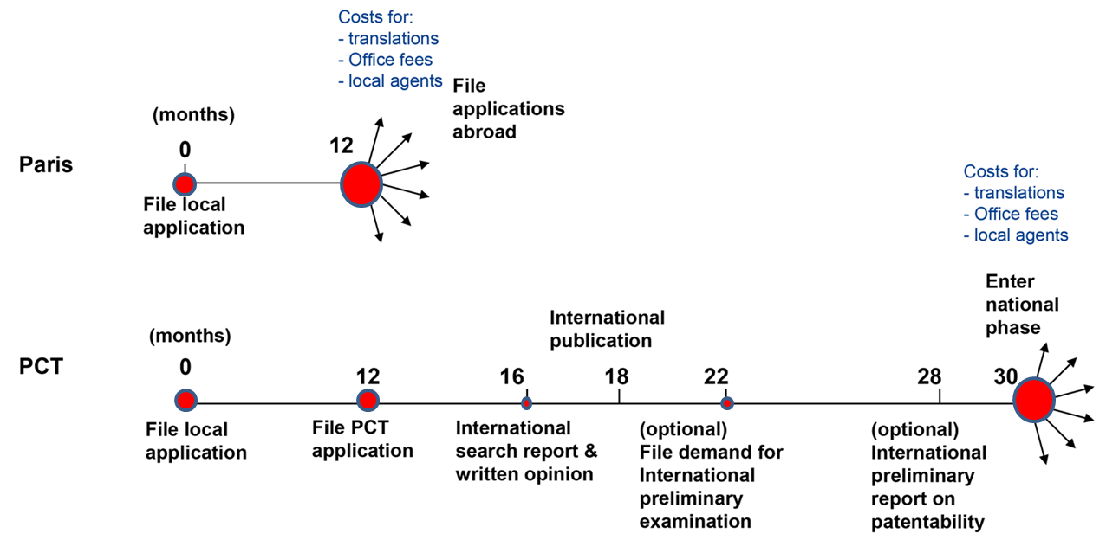
The patenting process
©WIPO (http://www.wipo.int/pct/en/faqs/faqs.html)

Slide 26

Timing and cost
Typical time UK 3 - 4 years, EP 3 - 5 years to grant
Can accelerate to 12 - 18 months to grant but accelerates costs
Costs of drafting £2,500 - £10,000 (one off)
Filing and prosecution to grant (typical)

Slide 27
Registered Designs

Slide 28
Why register a design?
Prevents others copying the design, or making an object having the design
Important for creative products such as pottery, wallpaper, cutlery etc.
Also important for any product that has a distinctive appearance
- Apple® iPad®
- GoPro® cameras
- medical devices
- etc.

Slide 29
Designs – basic facts
No examination in many countries inc. the UK and Europe (but not US)
- Quick and easy (and relatively cheap to get)
Typical costs:
UK (single design): ca. GBP 350
EU (single design): ca. GBP 1,000
Last 25 years (renewed every 5 years) in EU and UK
(14 years in the US)
Can be combined with TM and patents - strategy

Slide 30
Designs – considerations
Scope of protection - relatively narrow
May be filed after your own disclosure in most countries (but not China).
Can defer costs if filing abroad through priority period (6 months)

Slide 31
Copyright

Slide 32
Do I need to register copyright?
Not in the UK or Europe – generates automatically.
US – there is a system for registration (although not essential and rights still generate automatically)
Covers any creation including drawings, written documents, instructions manuals, software code etc.

Slide 33
Advantages/disadvantages
Free!
Long lasting - lasts in the UK and Europe for 70 years from the end of the year of death of the creator.
Only protects against direct copying
Difficult to prove date of creation
Sometimes difficult to prove direct copying

Slide 34
General points

Slide 35
Enforcing your rights
Enforcement should always be a last resort
IP rights have value as a deterrent and in monetisation by attracting investment
Most countries have robust IP protection legal frameworks (including China!)

Slide 36
Quick quiz – poll result
How many forms of IP protection are there?
Many! Certainly more than 10
If you have protection for your IP, does this mean you are free to use it?
Is all IP protection expensive?

Slide 37
Quick quiz – poll result
How many forms of IP protection are there?
Many! Certainly more than 10
If you have protection for your IP, does this mean you are free to use it?
No – IP rights are negative, i.e. they prevent others from doing something
Is all IP protection expensive?

Slide 38
Quick quiz – poll result
How many forms of IP protection are there?
Many! Certainly more than 10
If you have protection for your IP, does this mean you are free to use it?
No – IP rights are negative, i.e. they prevent others from doing something
Is all IP protection expensive?
No – many IP rights are obtained for free

Slide 39
Final words for this part of the talk
IP protection can be expensive
Think about what IP needs to be protected
Think about which form of IP protection works best
Think about what investors will want to see
Think about how you are going to use your IP…

Slide 40
Thank you!
Read our blog ipcopy.co.uk
Follow us on Twitter @KeltieLLP
Keltie LLP
UK | Ireland

