Slide 1


Emotion Detection Analysis
IM1
Suresh Katamsetty 18022208
Sai Lakshmi Surapaneni 17059627
Rashika Jayakumar 17067580
Yamini Myla 18021658

Slide 2
Abstract
The project titled Emotion Detection is Emotion Detection Software to detect the tweet emotion which posted by the user in the twitter. The project “Emotion Detection” is developed in python, which mainly focuses on analysing the tweets and evaluate the tweet emotion based on user inputs.

Slide 3
Project Development Process
GitHub for planning the project
Development - Python 2.7.14 Standard Editor
Unit Test Cases – Shell
Twitter API for collecting tweets
Used graphical images of type GIF format to display the emotion
Spent 80 man hours to complete the project

Slide 4
Project Roles
Suresh Katamsetty – Project Lead
Sai Lakshmi Surapaneni – Developer and Tester
Rashika Jayakumar – Graphical User Interface Designer
Yamini Myla – Developer and Tester

Slide 5
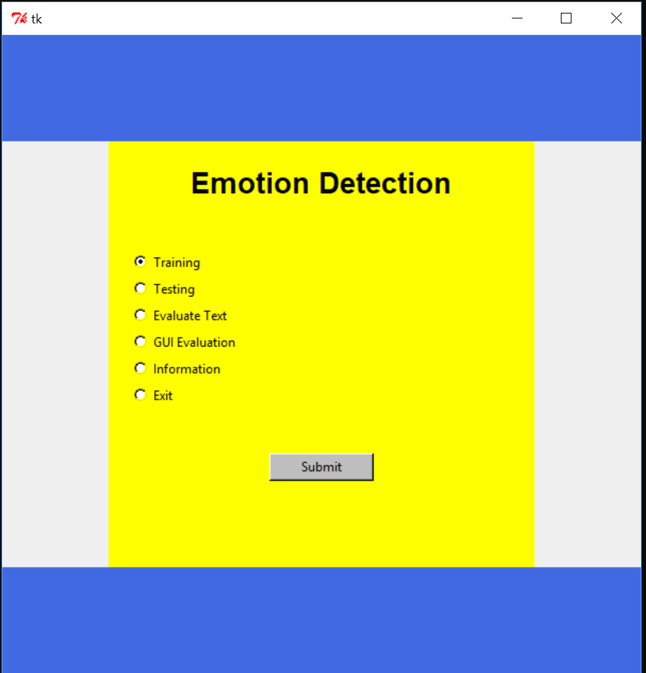
Emotion Detection GUI Window

Slide 6
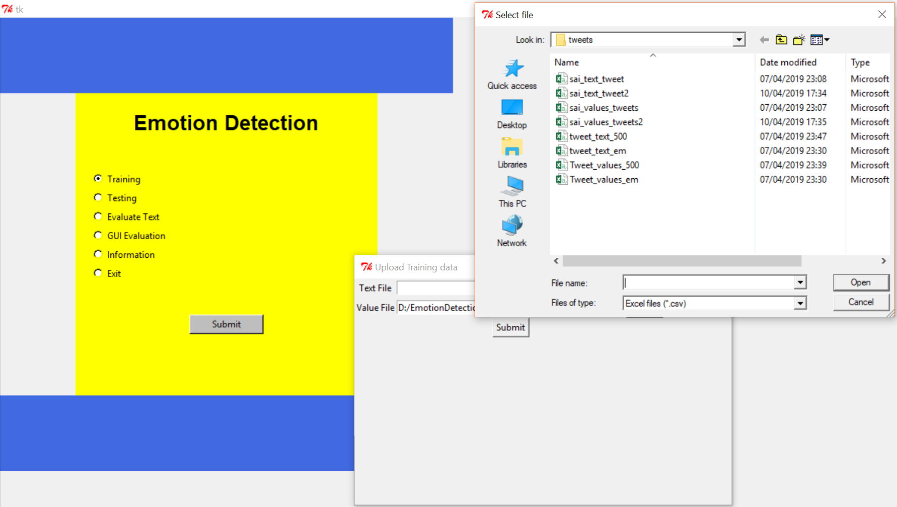
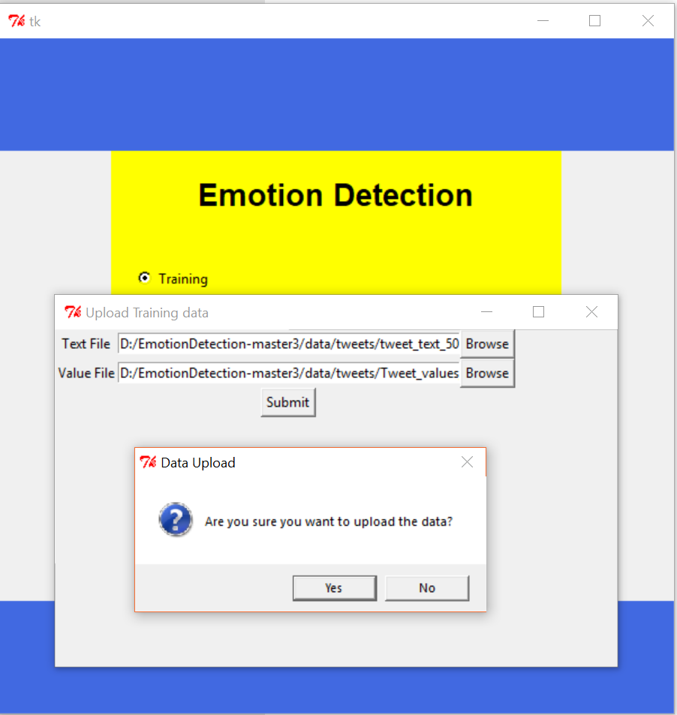
Training Data
Select the radio button of Training
Upload data using the file dialog box to train the data
Prompts message Dialog box to confirm the data upload

Slide 7
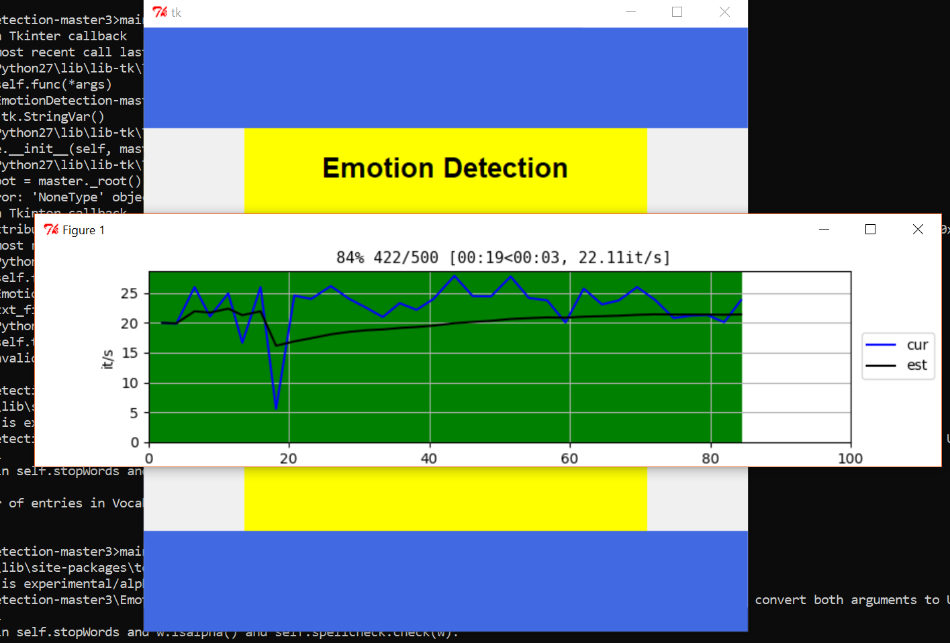
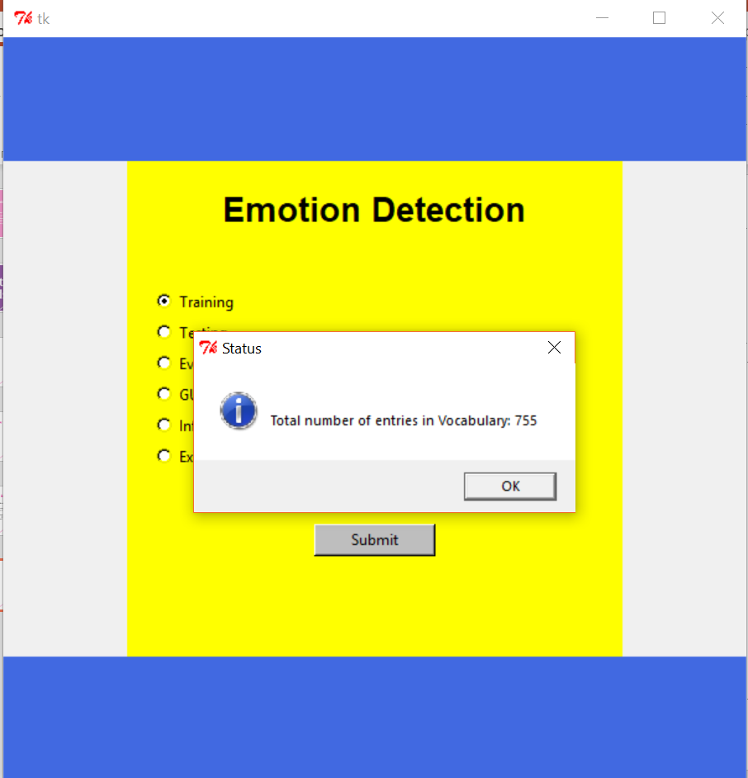
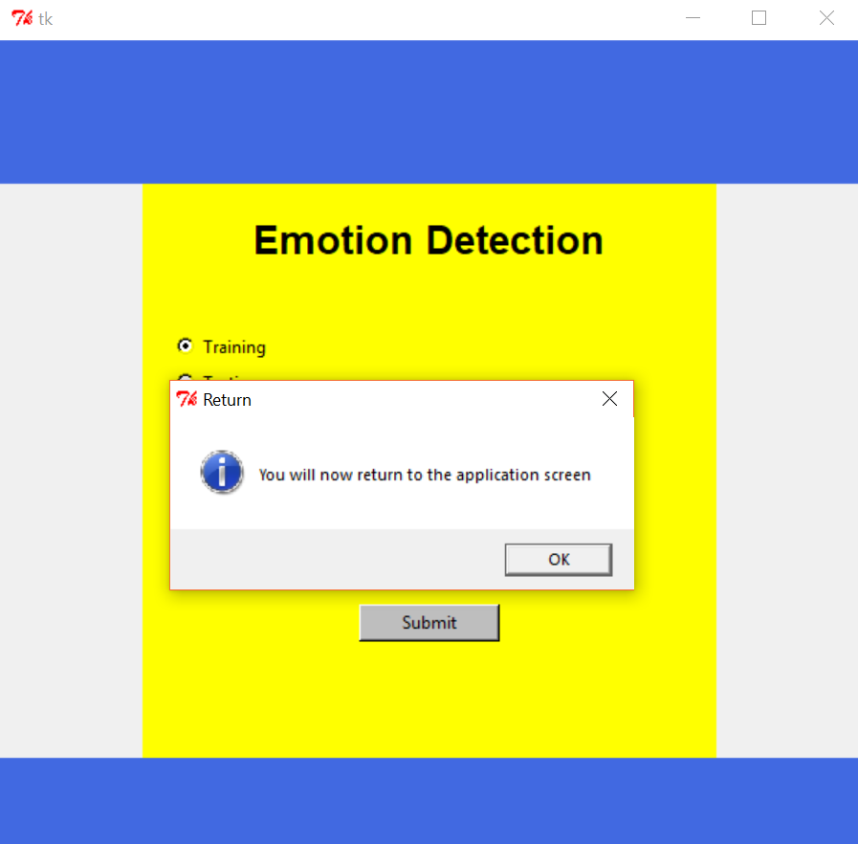
Training
Upload process starts after user confirms the data upload.
Built’s the wordwap based on tweets and displays results “total number of vocabulary <number>”

Slide 8
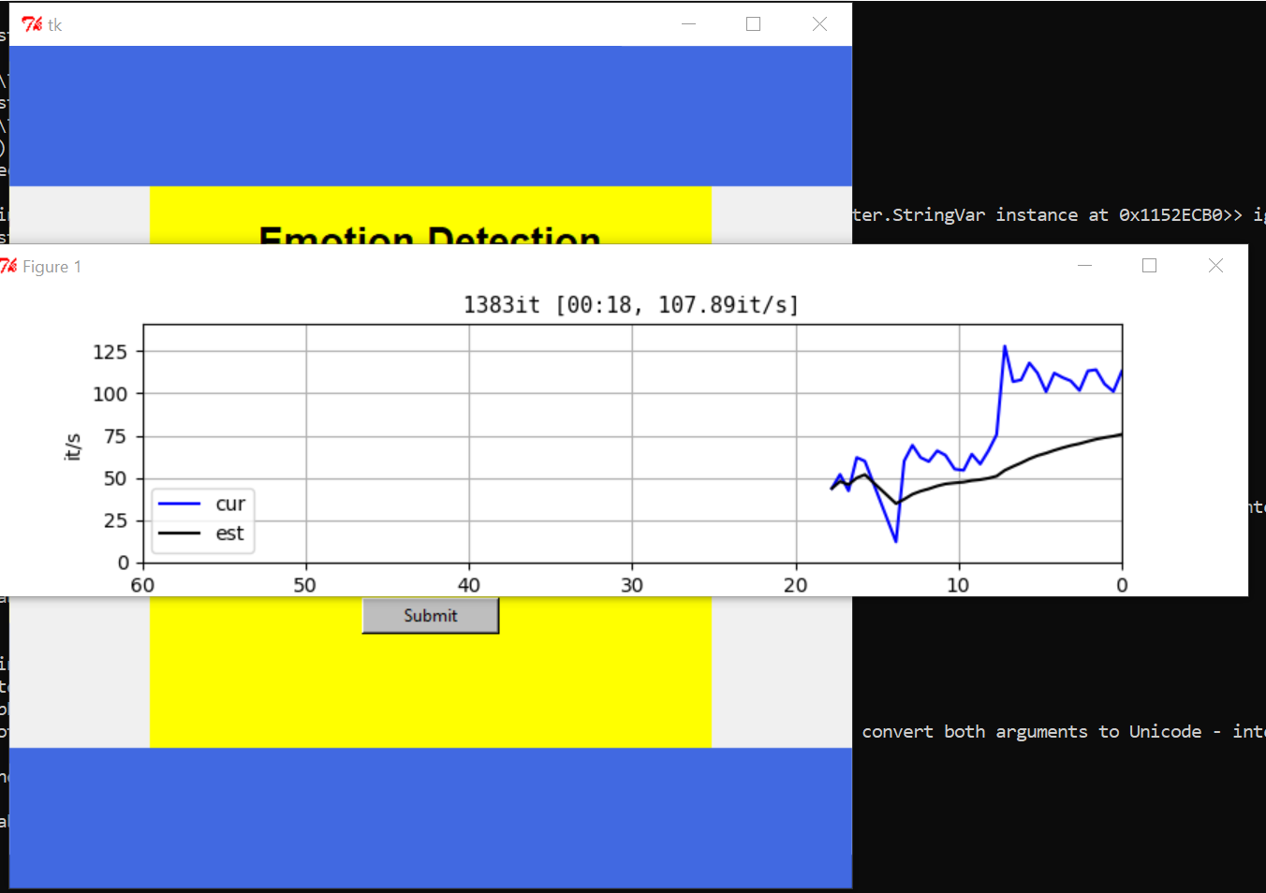
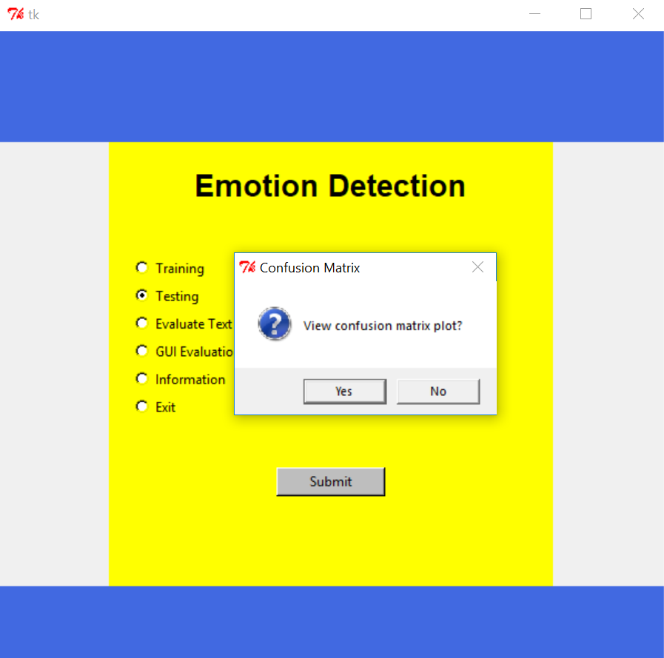
Testing Data Confusion Matrix

Slide 9
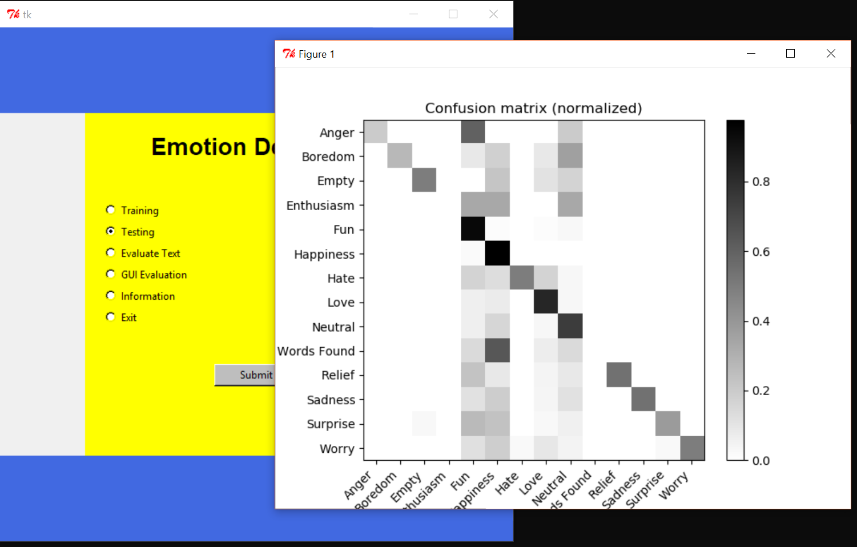
Testing Data Confusion Matrix

Slide 10
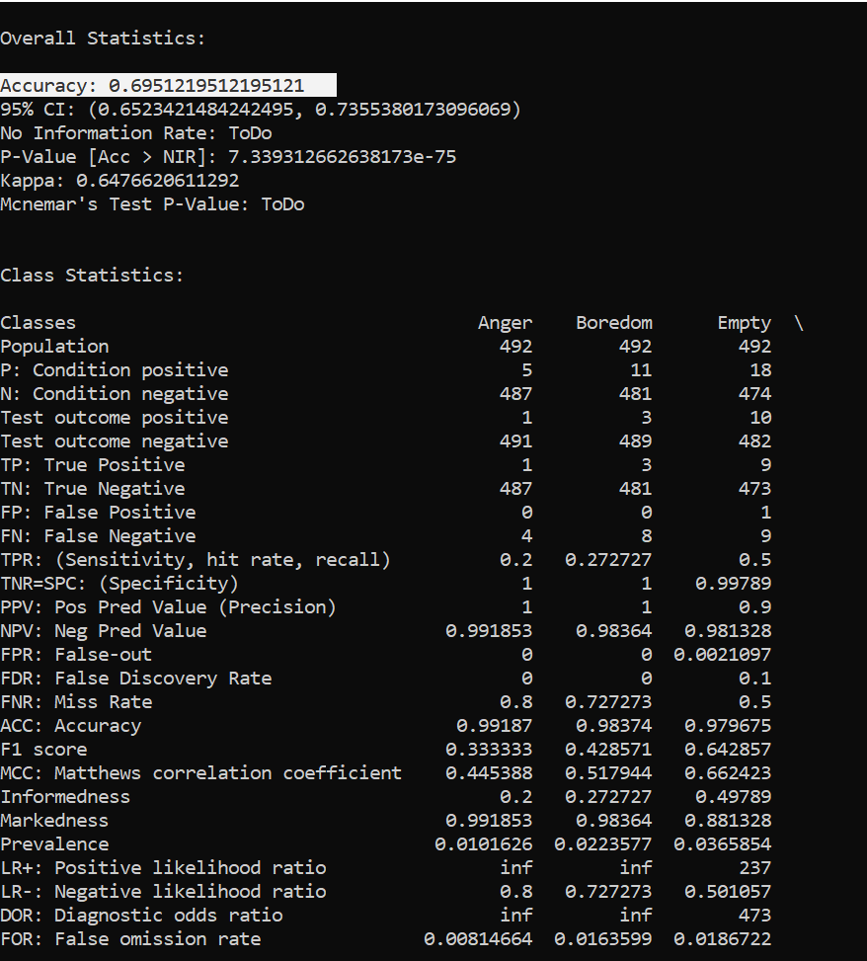
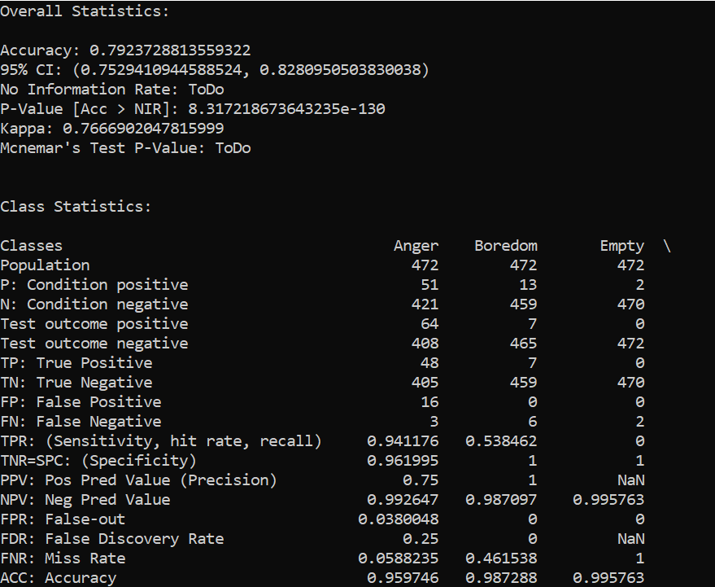
Project Accuracy
1st 500 Fresh Tweet Results
Accuracy = 0.69
Tweets = 500
2nd 500 Tweets Test Results
Accuracy = 0.79
Tweets = 500 F

Slide 11
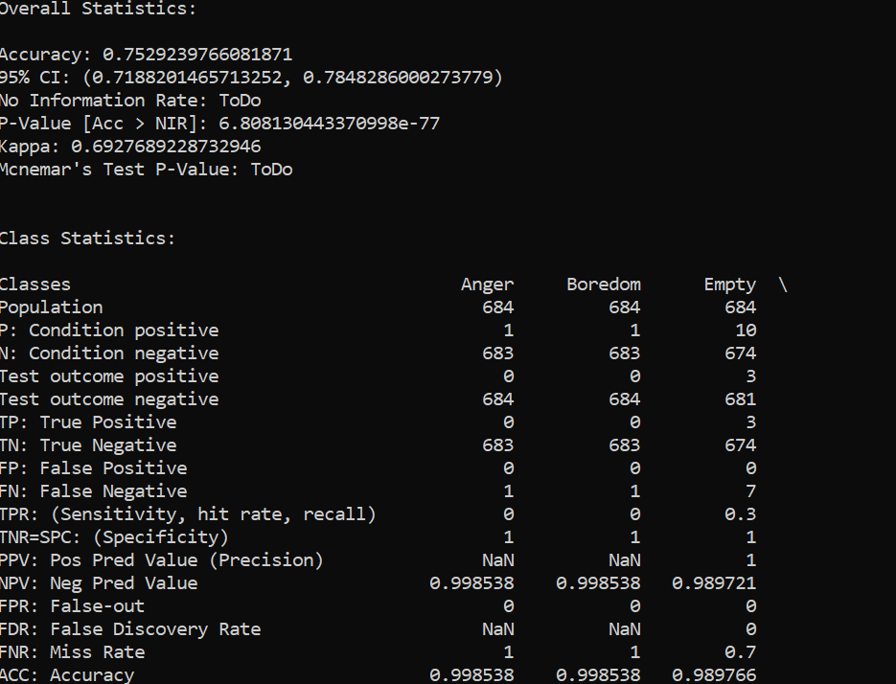
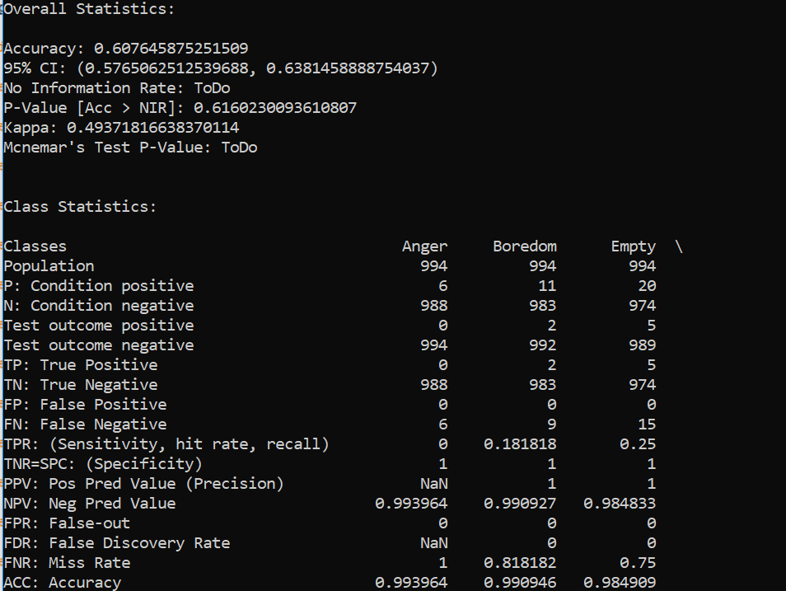
Project Accuracy
700 existing tweets from pool
Accuracy = 0.75
Tweets = 700
Combined 1000 fresh tweets
Accuracy = 0.60
Tweets = 1000
Combined of 1500 fresh tweets and 700 existing tweets
(2200 tweets)
Accuracy = 0.54
Tweets = 2200

Slide 12
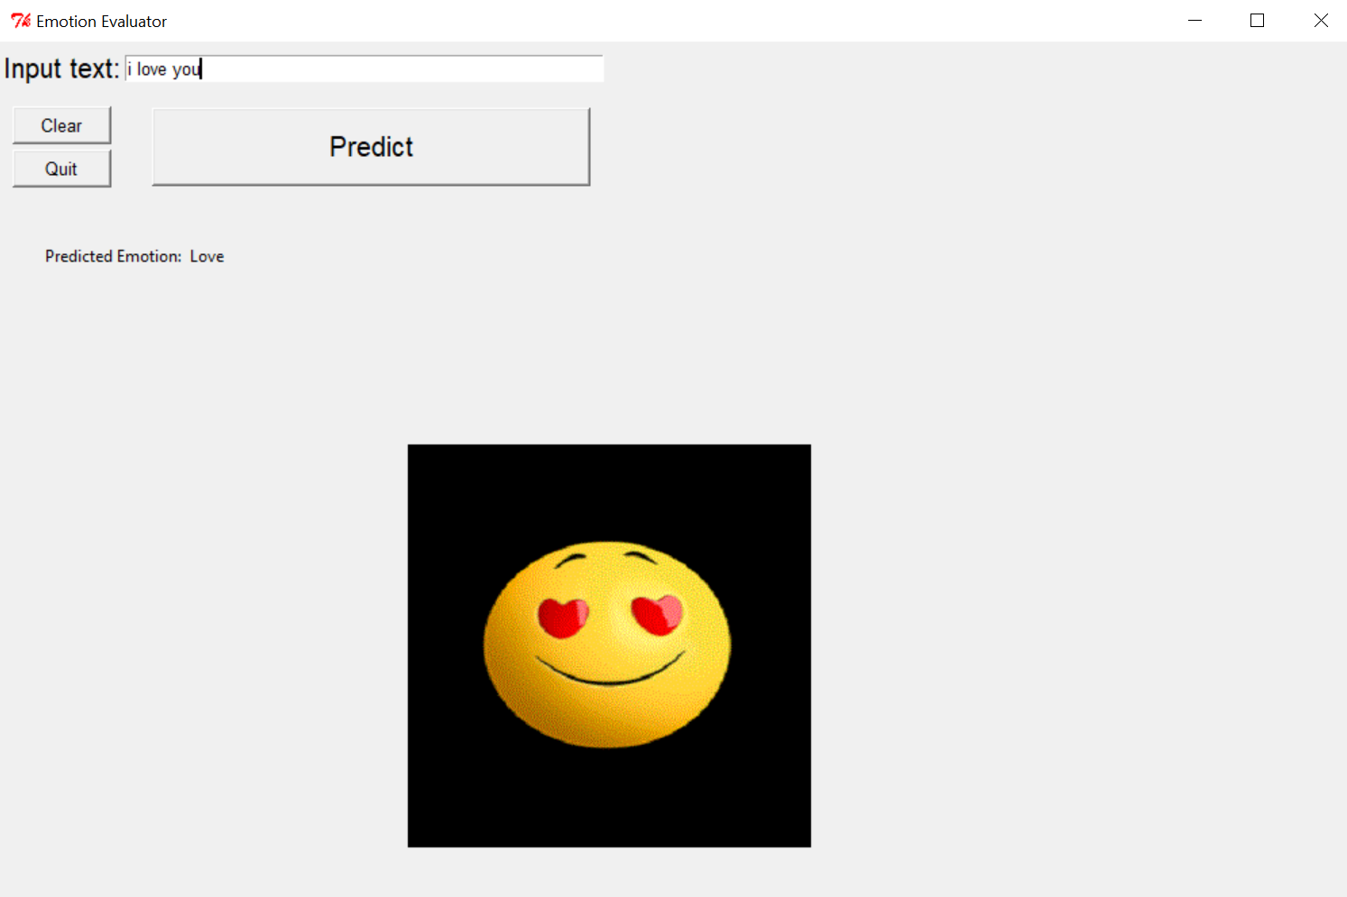
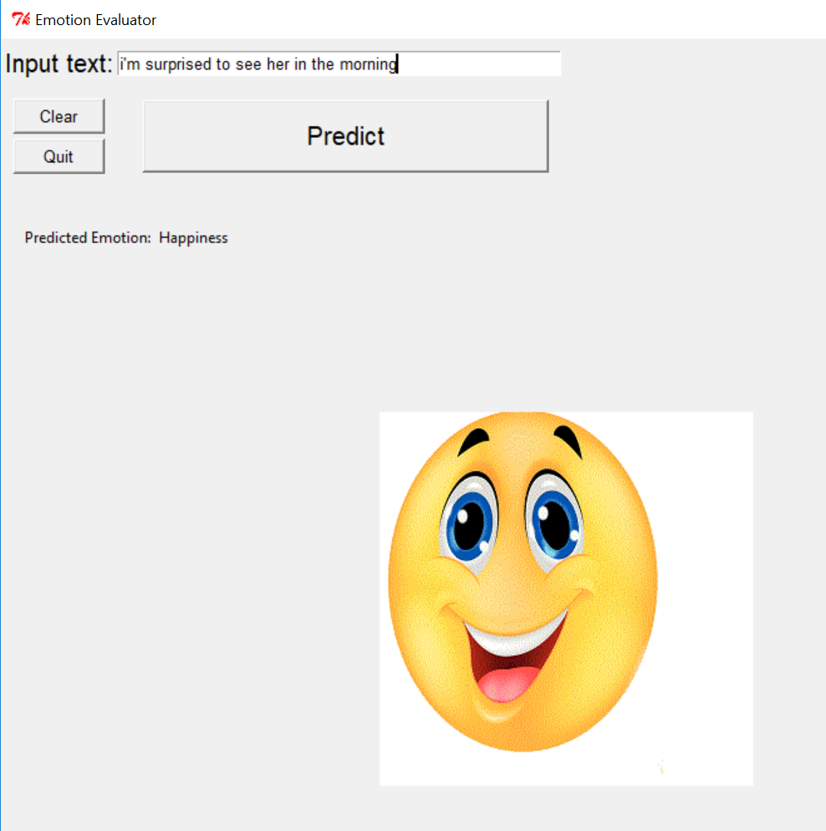
Final GUI Prediction Window

Slide 13
Old vs New tweets result analysis

Slide 14
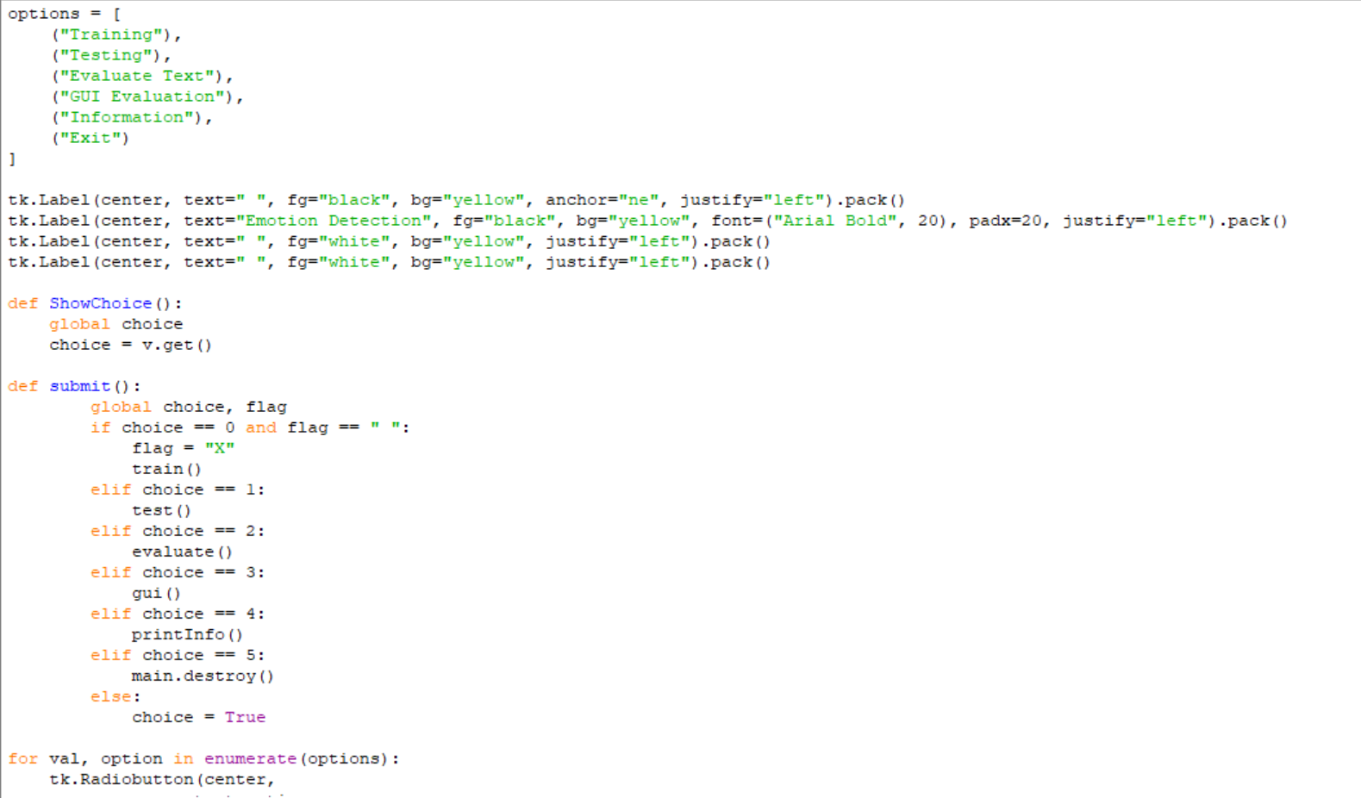
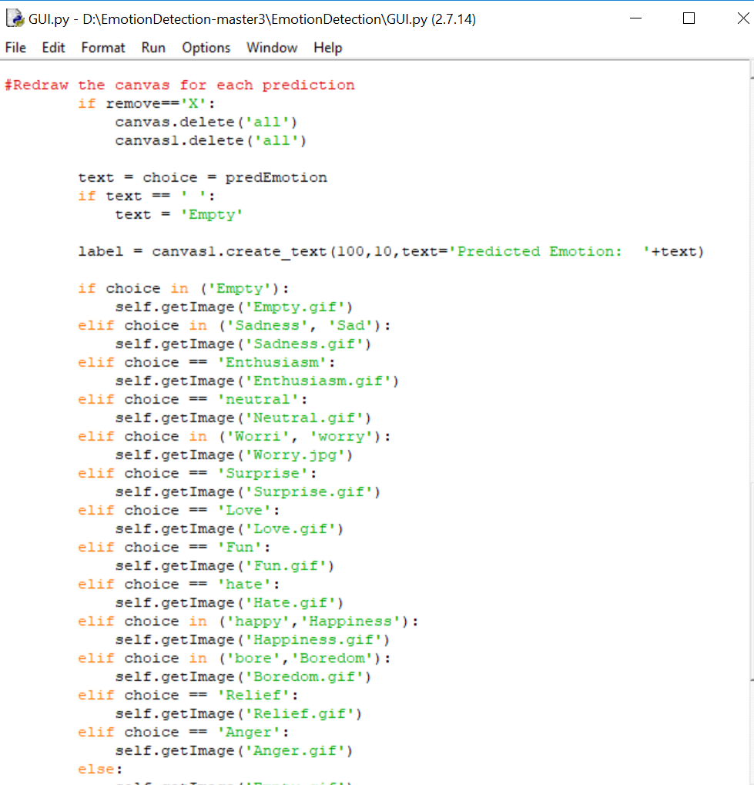
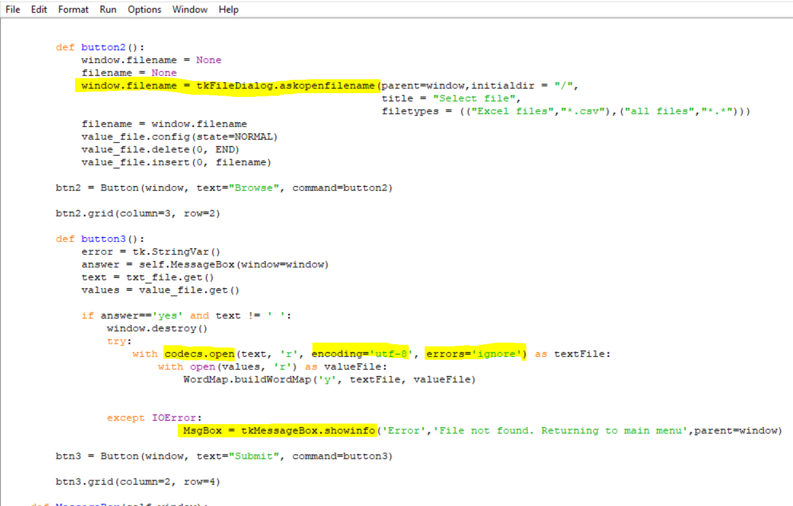
Code

Slide 15
Challenges faced in Development and Testing
More than 3300 tweets cannot be downloaded from twitter for particular username
Removing Junk data from tweets
UTF-8 errors while uploading the data to train the software
Math log error’s due to erroneous data in the value file
Testing results are always dynamic

