Slide 1

Work-let Name: Code-Mixed Language Model and Multi-Intent System
Worklet Details
Worklet ID: VI106RV
College Name: RV College Of Engineering
Understanding REST(Representational State Transfer) and micro service concepts
Understanding the Multi-intent system.
Understanding basic Deep Learning architecture.
Started working on dataset preparation.
Lack of previous work in code mixed Multi intent models
Lack of tools which allow people to make datasets parallely
Automation of dataset creation is infeasible
KPIs achieved till now
Any Challenges/ Issues faced
Next Steps
Creating complete ATIS dataset annotation
Creating Continue exploration of Deep Learning architecture in Multi intent systems.
Literature survey of existing models and datasets
Sampled some code mixed data points.
Started working on a system that allows for working parallely.
Worked on basic Deep Learning architecture
Key Achievements/ Outcome till now
Date: 28-06-21

Slide 2
KPIs achieved till now
Understanding the Multi-intent system
Worked with state of the art models, understanding dataset creations
Attempted working with automated language parsers
Understanding basic Deep Learning Architecture
Started survey of deep learning methodologies.
Worked with basic DL architecture, such as RNNs
Understanding REST (Representational State Transfer) and micro-service concepts
Started working on dataset preparation
Creating a tool to enable creation of dataset remotely

Slide 3
Literature Survey
Sl. No | Title of the paper | Author(s) | Journal/Conference, Year | Key Findings
1 | Unraveling the English-Bengali code-mixing phenomenon | Chanda, A., Das, D., & Mazumdar, C. | Proceedings of the Second Workshop on Computational Approaches to Code Switching, 2016 | FIRE 2013 corpus and Facebook chat corpus for English-Bengali text Also used predictor-corrector method to tag words as English/ Bengali. IBk had 91.65% on FIRE and 90.54% on Facebook chat.
2 | Intent Classification from Code Mixed Input for Virtual Assistants | S. Mukherjee, A. Nediyanchath, A. Singh, V. Prasan, D. V. Gogoi and S. P. S. Parmar | IEEE 15th International Conference on Semantic Computing (ICSC), 2021 | Used Indicative Intent Feature Network (IIFN) Novel approach Domain Specific Feature Network (DSFN), which takes domain information from a sentence to predict intent Accuracy of 96.6% on their dataset Code-Mixed Text for Intent Classification (CoMTIC)
3 | The ATIS spoken language systems pilot corpus | Charles T. Hemphill, John J. Godfrey, George R. Doddington | Proceedings of the workshop on Speech and Natural Language, 1990 | Creation of the ATIS (Air Travel Information System) dataset. It was gathered by using the OAG (Official Airline Guide)

Slide 4
Literature Survey (contd.)
Sl. No | Title of the paper | Author(s) | Journal/Conference, Year | Key Findings
4 | Intent Classification from Code Mixed Input for Virtual Assistants | Siddhartha Mukherjee , Anish Nediyanchath , et al. | IEEE 15th International Conference on Semantic Computing (ICSC), 2021 | Code-Mixed Text for Intent Classification (CoMTIC) with 10 intents Character based network to detect intent from CoM inp Second Part learns domain specific feautures
5 | Language Modeling for Code-Mixing: The Role of Linguistic Theory based Synthetic Data | Adithya Pratapa, Gayatri Bhat, Monojit Choudhury, Sunayana Sitaram, Sandipan Dandapat, Kalika Bali | Proceedings of the 56th Annual Meeting of the Association for Computational Linguistics (Long Papers), p 1543–1553, 2018 | Data is generated based on the Equivalence constraint theory, which helps determine switch points. Randomly generated CoM data, does not help in decreasing the perplexity of the LM
6 | BERT for Joint Intent Classification and Slot Filling | Qian Chen∗ , Zhu Zhuo, Wen Wang | Computing Research Repository (CoRR), 2019 | Multi-layer bidirectional Transformer encoder based on the original Transformer model ATIS dataset used to train it

Slide 5
Any Challenges/ Issues faced
Lack of previous work in Code mixed Multi-intent models
Lack of a tool which allows people to make datasets parallely
Explored various methods for dataset preparation and concluded that the tool would have to be created.
Automation of dataset creation is infeasible
Attempted to replicate a paper’s solution to automate code mixed data preparation which was found to be infeasible due to difficult challenges in slot filling.

Slide 6
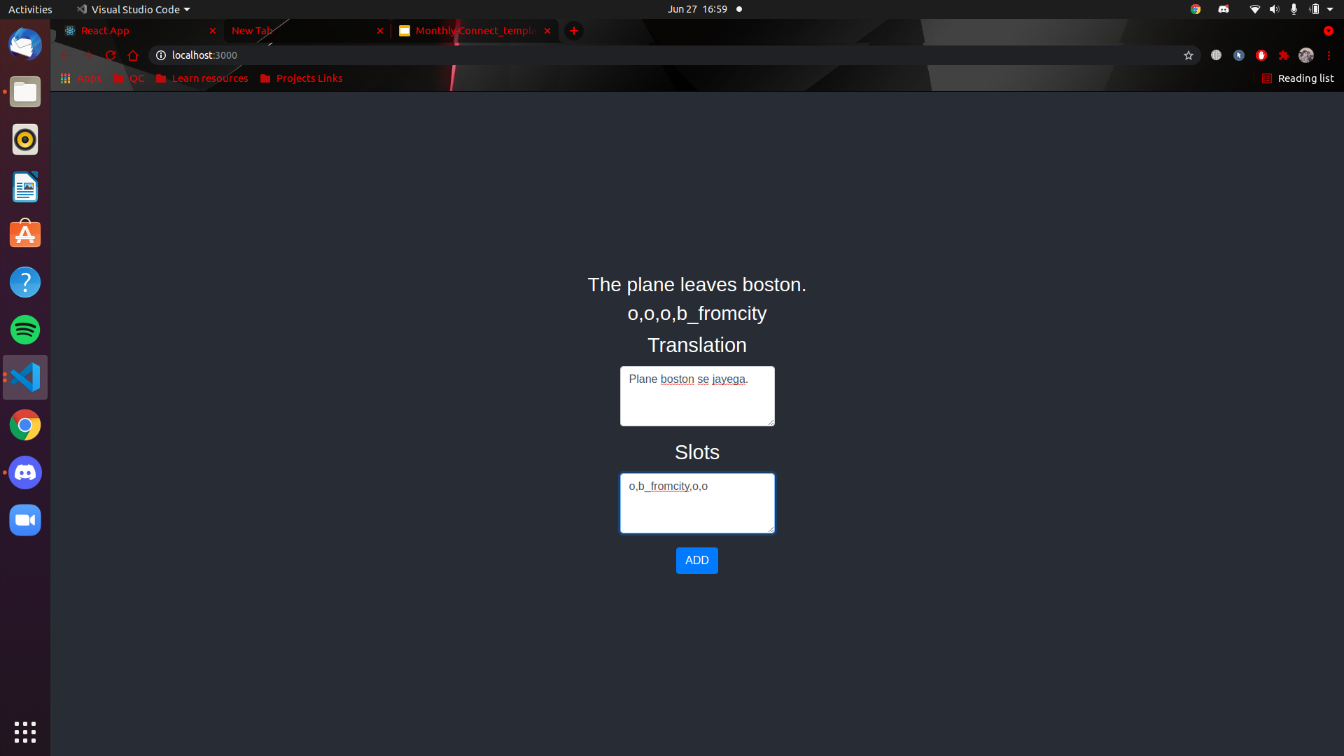
Next Steps
Finish making the tool needed for data annotation.
Start creation of the Hindi-English CodeMixed data corpus based on the ATIS dataset with correct slots and intent annotations, using the tool made.
Continue learning the current deep learning architectures.

Slide 7
Next Steps
The tool that is being made in order to annotate the data remotely and parallely

Slide 8
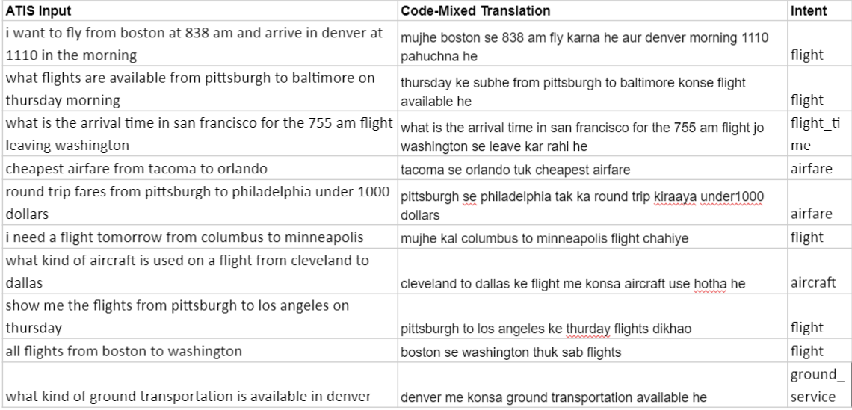
Key Achievements/Outcomes
ATIS code mixed dataset annotation begun.
Initiated tool development for annotation of dataset.
Familiarised with basics of Neural Networks, RNN, Language Processing
Comprehensive Literature Survey on Existing Code Mixed Datasets
Explored the possibility of automated dataset creation
A subset of the annotated dataset.

Slide 9
https://microservices.io/
https://en.wikipedia.org/wiki/Code-mixing
https://paperswithcode.com/paper/joint-multiple-intent-detection-and-slot
English Dataset and basic system: https://github.com/sz128/slot_filling_and_intent_detection_of_SLU
https://www.kdnuggets.com/2020/02/intent-recognition-bert-keras-tensorflow.html
https://arxiv.org/abs/1902.10909
https://paperswithcode.com/paper/bert-for-joint-intent-classification-and-slot
https://github.com/MahmoudWahdan/dialog-nlu
https://chsasank.com/spoken-language-understanding.html
https://www.kaggle.com/siddhadev/ms-cntk-atis
http://nlpprogress.com/english/intent_detection_slot_filling.html
https://github.com/clab/fast_align#input-format
https://www.aclweb.org/anthology/P18-1143.pdf
https://github.com/ai-ml-rnd-experiments/COMTIC/tree/main/CoMTIC
https://machinelearningmastery.com/best-practices-document-classification-deep-learning/
http://www.amitavadas.com/Code-Mixing.html
https://machinelearningmastery.com/tutorial-first-neural-network-python-keras/
https://machinelearningmastery.com/crash-course-recurrent-neural-networks-deep-learning/
References:

