Slide 1
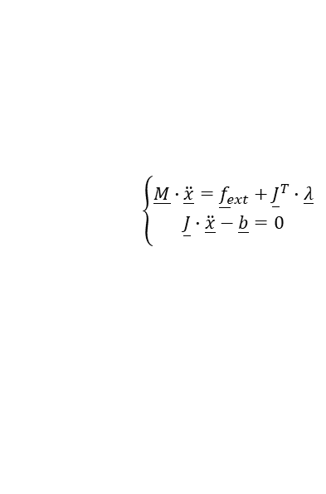
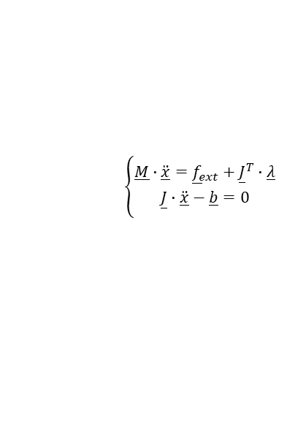
Proposed Flexible Framework
Requirements
Selection
Simulation
Topology Graph
Constraint Model
Modeling
Rigidbody
Joint
Contact
Actuator
Friction
User Interface
Solver
Requirements
System Decomposition
Req. Analysis
Coupling Algor.
Subsystem 1:
Subsystem 2:
$$\left\{\begin{aligned}\underline{M}∙\underline{\ddot{x}}={\underline{f}}_{ext}+{\underline{J}}^{T}∙\underline{λ} \\ \underline{J}∙\underline{\ddot{x}}−\underline{b}=0 \end{aligned}\right.$$
$$\left\{\begin{aligned}\underline{M}∙\underline{\ddot{x}}={\underline{f}}_{ext}+{\underline{J}}^{T}∙\underline{λ} \\ \underline{J}∙\underline{\ddot{x}}−\underline{b}=0 \end{aligned}\right.$$
Validation
Stability
Solving
Solver1
Coupling Algor.
Solver2
Energy
dt1
States
States
dt2
Research Question 1
Generate Graph Structure
Calculating Time
Research Question 2

Slide 2
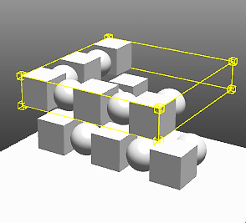
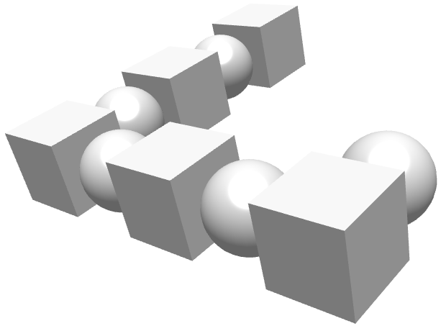
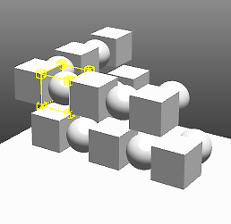
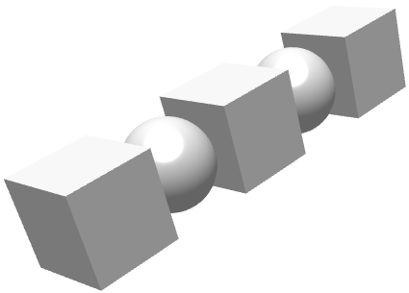
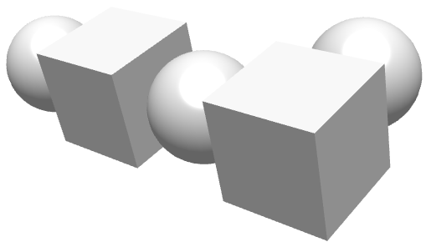
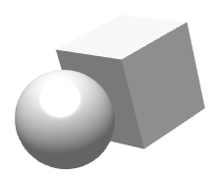
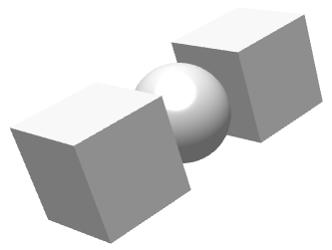
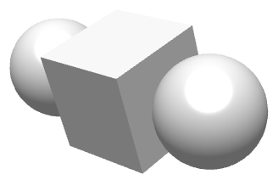
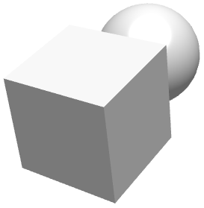
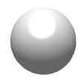
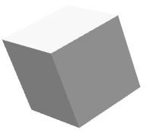
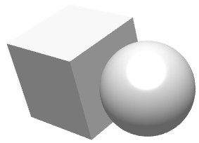
Implementation
New Modular Collision Detection Framework
Broad Phase
Mid Phase
Narrow Phase
Rigid Bodies
Collision Results
Input:
Rigid bodies from the scene
Output:
Potential collision pair of bodies
Algorithms:
AABB, Spatial Hashing, Sweep and Prune
Input:
Potential collision pairs
Output:
Filtered potential shape pairs
Algorithms:
Brute-Force Method, BVH, Flat BVH
Input:
Potential shape pairs
Output:
Detailed Contact Information
Algorithms:
Analytical Method, SAT, GJK

Slide 3
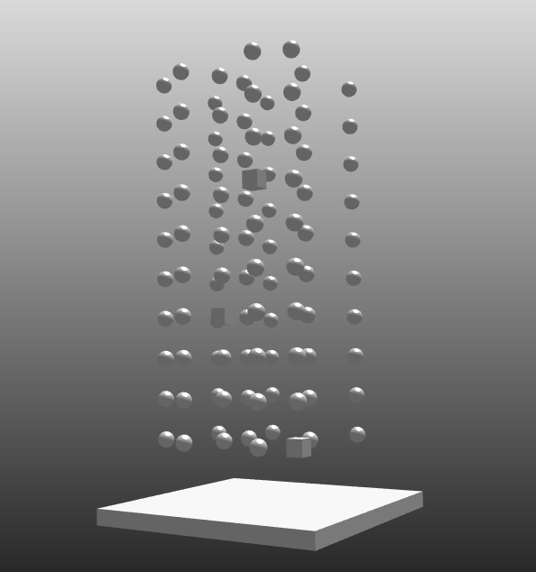
Implementation
Broad Phase Algorithm: Sweep and Prune
Traditional Sweep and Prune:
Sorting: AABBs sorted along X, Y and Z axes
Sweep: Sort geometry min-bounds, test 1D interval overlap and record overlapping pairs for each axis
Optimized Sweep and Prune:
Sorting: Sort AABBs only along X-axis => No repeated sorting on Y or Z axes!
Sweep: Standard sweep on X-axis and refine X-overlaps by checking Y & Z ranges
Testing Scenario: Rigid bodies are dropped under gravity onto a fixed horizontal plane
Method | 3 Balls (1s) | 10 Balls (1s) | 100 Balls (3s) | 100 Bodies (3s)
AABB | 567 µs | 1,297 µs | 139,110 µs | 137,570 µs
Sweep and Prune | 583 µs | 1,014 µs | 40,997 µs | 41,474 µs

Slide 4
Implementation
Mid Phase Algorithms: BVH and Flat BVH
Bounding Volume Hierarchy (BVH)：
Pointer Tree: Organizes geometry into a binary tree of AABBs with recursive build and traversal
Flat BVH:
Linear Array: Flattens the BVH into a contiguous array using indices, constructed via Morton‐code
Enables non‐recursive traversal with an explicit stack, offering better cache locality and GPU‐friendly updates
Testing Scenario:
A complex rigid body which includes many shapes are dropped under gravity onto another fixed complex rigid body.
Shape Pair | Traversal (μs) | Recursive BVH (μs) | Flat BVH (μs)
10 and 10 Shapes | 3,123 | 3,544 | 4,511
20 and 20 Shapes | 4,817 | 4,510 | 6,062
40 and 40 Shapes | 9,742 | 7,423 | 9,405
90 and 90 Shapes | 58,514 | 37,621 | 29,950
100 and 100 Shapes | 59,239 | 40,370 | 26,229

Slide 5
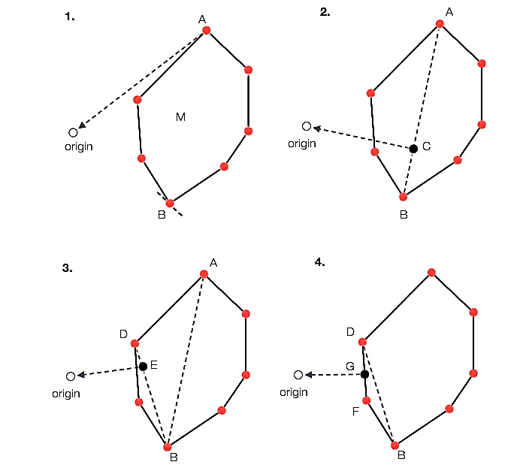
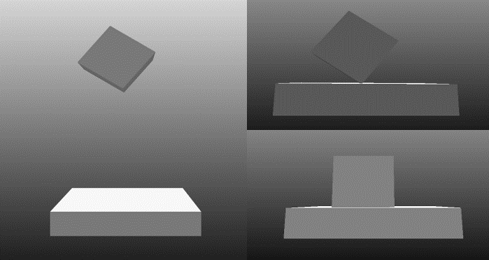
Implementation
Narrow Phase Algorithm: GJK
Gilbert-Johnson-Keerthi (GJK): Computes the minimum distance (or detects intersection) between two convex shapes with Minkowski Difference and Support Function
Algorithm | Pos1 [m] | Pos2 [m] | Pos3 [m] | Pos4 [m] | Penetration Depth [m]
SAT | (0.116412, 0.111038, 2.62890) | (0.316403, 0.111038, 2.62893) | (0.316403, 0.311038, 2.63086) | (0.116412, 0.311038, 2.62893) | 1.24947e–9
GJK | (0.225955, 0.111038, 2.62893) | (0.224988, 0.311038, 2.62893) | (0.115443, 0.111038, 2.62893) | (0.115443, 0.311038, 2.62893) | 2.90601e–9

Slide 6
Implementation
Constraint Modeling and Solving
Non-Smooth DVI
Smooth ODE
Lagrange Multiplier
Penalty Function
LCP / MLCP
CCP / SOCCP
NCP
Pivot
Projection-Relaxation
First-Order Optimization
Second-Order Methods
Time-Stepping Integrator

Slide 7
Implementation
Constraint Modeling and Solving
Existing solvers
Non-Smooth DVI
Smooth ODE
Solvers that are planned or in progress
Lagrange Multiplier
Penalty Function
LCP / MLCP
CCP / SOCCP
NCP
Pivot
Projection-Relaxation
First-Order Optimization
Second-Order Methods
Time-Stepping Integrator
Dantzig
PGS
APGD
IPM
Euler Implicit
Lemke
SI-PGS
Barzilai-Borwein
Newton
HHT
Principal Pivoting
TGS
ADMM
PATH
RK4

Slide 8
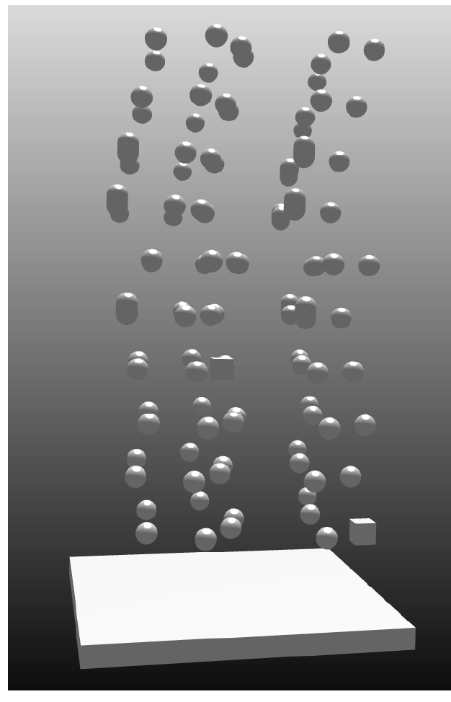
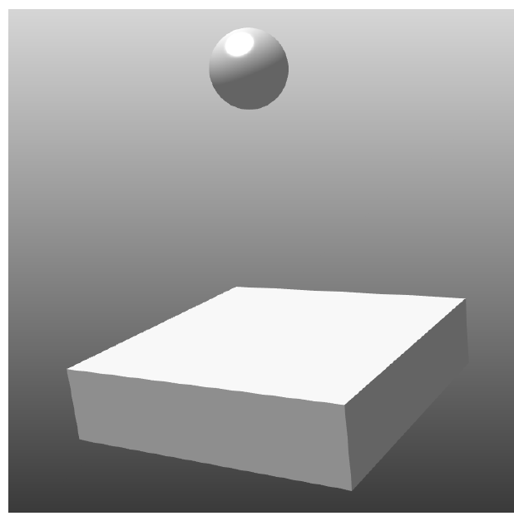
Implementation
Sequential Impulse Projected Gauss-Seidel Solver
Nonholonomic Constraints:
Projected Gauss-Seidel Algorithm (PGS):
One kinematic chain has one Jacobian matrix
Solution is solved based on whole system (global)
Sequential Impulse PGS Algorithm:
Each joint or contact has one Jacobian matrix
Solution is solved based on each constraint (local)
Applied extra “WarmStart” step for faster convergence
Holonomic Constraints:
Model | PGS Time (µs) | SI-PGS Time (µs)
Double Pendulum | 548,444.0 | 504,374.6
Triple Pendulum | 970,391.2 | 801,713.8
Model | PGS Time (µs) | SI-PGS Time (µs)
1 Body | 20,665.4 | 26,401.6
100 Bodies | 2,349,753.4 | 834,965.6

