Slide 1
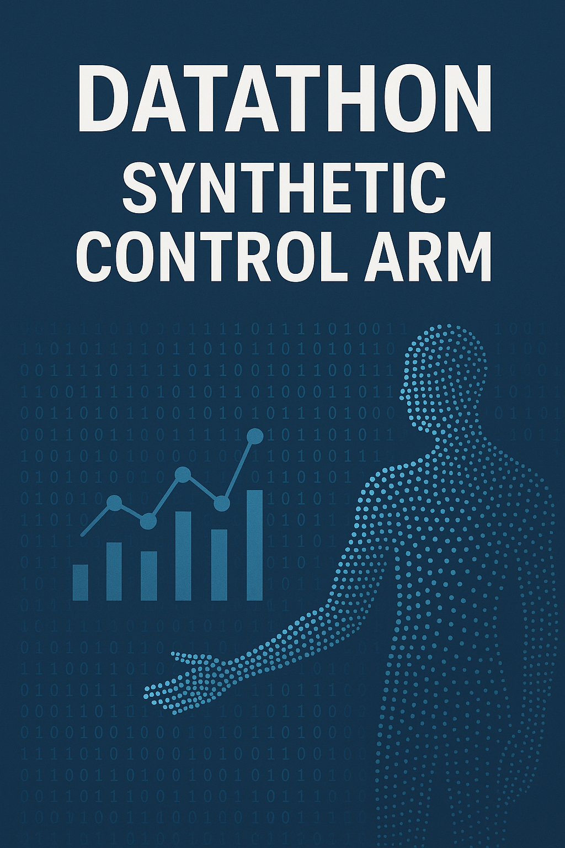
Synthetic Control Arm
DataThon lead: Sadegh Mohammadi
DataThon Co-lead: Davide Cirillo

Slide 2
Goal & Objectives
🎯 Goal of the Datathon
To equip participants with practical skills in data preprocessing, visualization, and representation learning, and to demonstrate how Variational Autoencoders (VAEs) can be used to generate meaningful synthetic data from real datasets.
✅ Objectives
By the end of the datathon, participants will:
1. Understand the basics of data handling:
Learn visualization techniques using the Iris dataset.
Apply dimensionality reduction with PCA to explore latent structures in data.
2. Grasp core concepts of representation learning:
Understand what autoencoders are, their strengths and limitations.
Learn why VAEs are better suited for synthetic data generation.
3. Gain hands-on experience:
Implement autoencoders and VAEs on toy datasets (Iris, MNIST).
Visualize and compare real vs synthetic data distributions.
4. Appreciate real-world applications and limitations:
Explore where synthetic data is used (healthcare, finance, autonomous driving).
Discuss challenges such as quality, bias, and ethics.
5. Collaborate and innovate:
Work in teams to generate and present synthetic datasets.
Share findings, challenges, and creative visualizations.

Slide 3
Agenda
// Setup Environment → Setup coding environment
// Learning by Simple Toy Example (Hands-on)
1. Univariate Analysis
2. Bivariate Analysis
3. Advanced Dimensionality Reduction (PCA/t-SNE)
// Introduction to AutoEncoder and Variational Autoencoder
// Run Variational Autoencoder and Generate Synthetic Data
1. Conduct the statistical analysis and compare Synthetic Data with Real one
2. Generate Embedding from encoder and apply Advanced Dimensionality reduction,
3. Generate Synthetic Data and Compare them with real-one
4. Design a classifier and train two models: i) Train model with real-data ii) Replace real data with Synthetic One

Slide 4
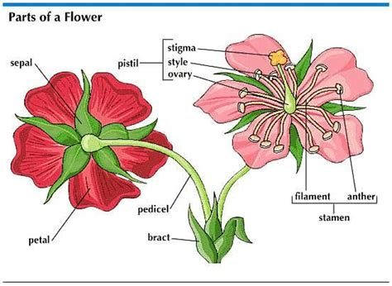
Dataset as a playground
What is the Iris Dataset:
Collected by Edgar Anderson; made famous by Ronald Fisher in 1936.
It contains 150 samples (rows) of iris flowers
There are 3 species of iris in the dataset:
Iris setosa (50 Samples)
Iris versicolor (50 Samples)
Iris virginica (50 Samples)
Each sample has 4 features (numeric measurements):
Sepal length (cm)
Sepal width (cm)
Petal length (cm)
Petal width (cm)
t’s used as a standard benchmark / demonstration dataset in ML. Because it’s small and clean, it’s good to illustrate classification algorithms

Slide 5
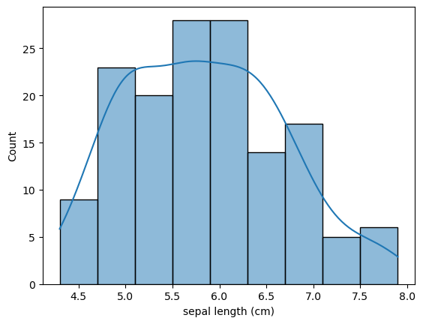
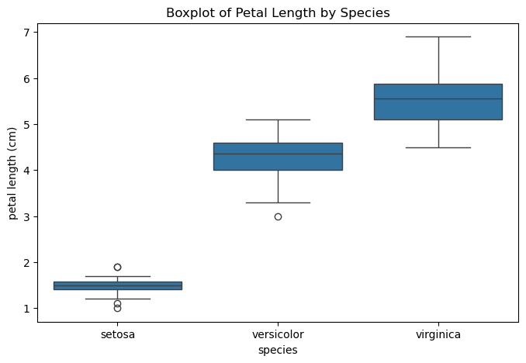
Data Visualization: Univariate Analysis
Univariate: Analyzing one variable (feature) at a time
Goal: Understand the distribution, spread, and patterns of that single feature
Histogram shape of distribution (normal, skewed, bimodal)
Boxplot: median, quartiles, and outliers

Slide 6
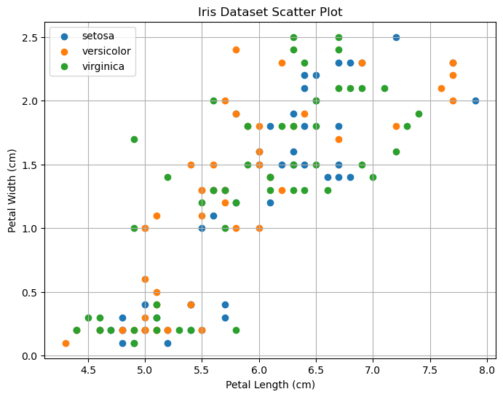
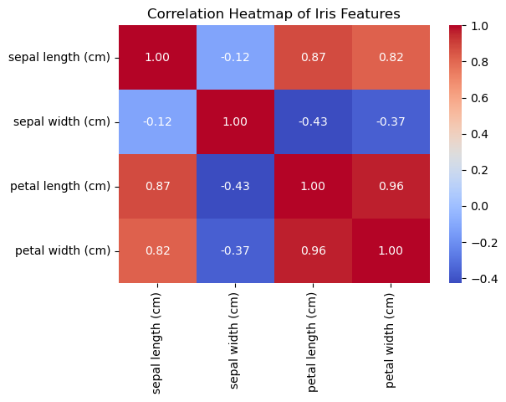
Data Visualization: Bivariate Analysis
Bivariate: Analyzing the relationship between two variables (features) at a time
Goal: Understand how one feature interacts with another (are they correlated? do they separate classes?)
Scatter Plot shape of distribution (normal, skewed, bimodal)
Correlation Heatmap: strength/direction of relationships

Slide 7
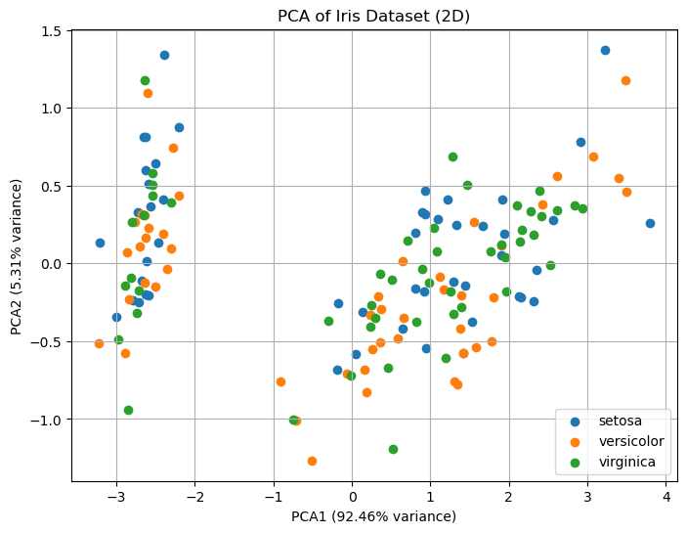
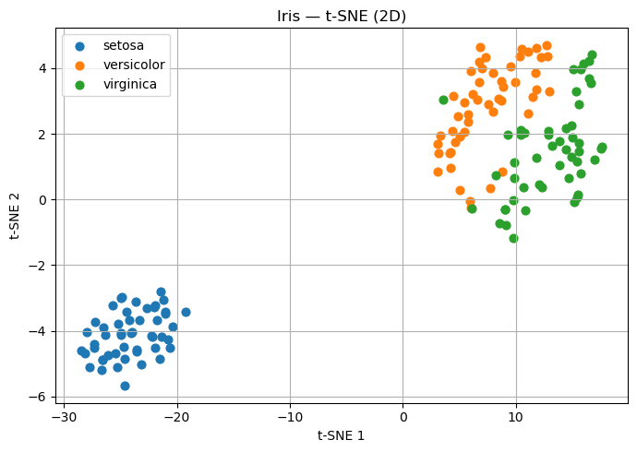
Advanced Visualization: Reducing Dimensions
PCA (Principal Component Analysis):
Projects data into fewer dimensions while preserving variance.
Example: Iris dataset → 4D → 2D plot shows class separation.
t-SNE: Non-linear techniques for high-dimensional visualization

Slide 8
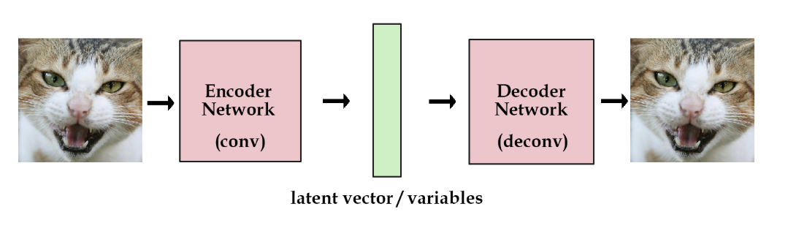
Given this example, start with the real-data
An autoencoder is an AI model that learns how to shrink data into a smaller form and then rebuild it back again.
Example: It’s like teaching a system to make a summary of a cat photo and then recreate the photo from that summary.
Encoder: Compresses data into a smaller form
Decoder: Then rebuilds it back
Compact set of numbers that captures the hidden features of the data. Like a secret recipe describing the essence of an image

Slide 9
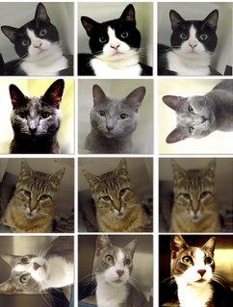

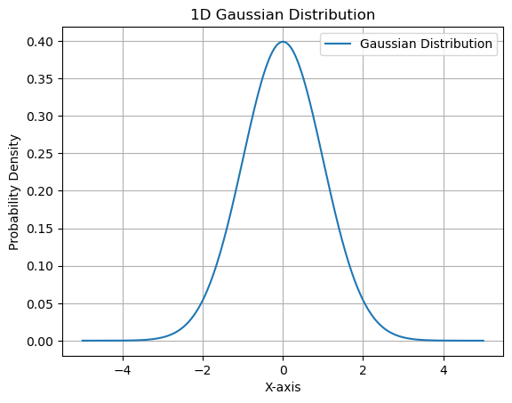
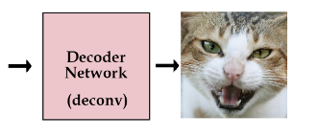


From Latent vector to Images
$$+$$

Slide 10
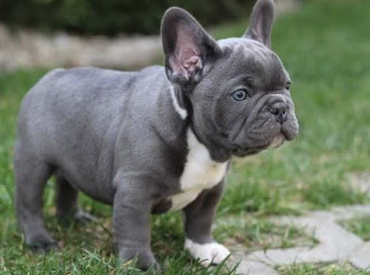

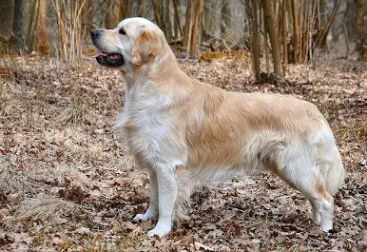

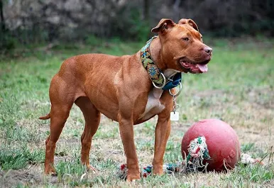
Challenge with AE
AE learns to compress → decompress the data.
It’s very good at reconstructing what it has already seen.
BUT… the latent space (the compressed representation) has no structure:
If you pick a random point in the latent space and try to decode it → you often get garbage.
Why? Because AE never learned how to “fill the space between data points.”
In short: AE = great copier, bad generator.

Slide 11
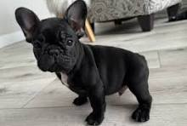
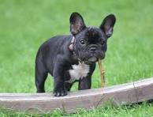
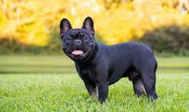
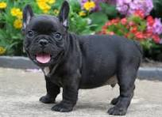




The Architecture that We are going to use
Encoder
Decoder
Mean
Latent Vector
$$μ$$
Real Image
Standard Dev.
Synthetic Image
$$σ$$
$$σ$$
$$μ$$

Slide 12
Dataset preparation
A complete set of Wistar Han and Sprague Dawley rat values
Slide and Data credit to Julia Anna Matyjasiak
Selected continuous values based on highest availability (2362 animals total)
BW
Weight values from time points BWDY -1/1, 7/8, 14/15, 21/22, 28/29
LB
Top 10 occurring laboratory values (filtered by common LBTEST, LBCAT, LBSPEC, LBORRESU_SI)
Eosinophils, Erythrocytes, HCT, Hemoglobin, Lymphocytes, MCHC, MCH, MCV, Monocytes, Platelets
Day 29 values (most common measurement day)
OM
7 most commonly measured organ weights: liver, brain, kidney, heart, spleen, adrenal gland, thymus
SEX | STRAIN | N studies | N animals
F | Wistar Han | 36 | 307
M | Wistar Han | 44 | 412
F | Sprague Dawley | 84 | 769
M | Sprague Dawley | 89 | 874

Slide 13
Dataset preparation
A complete set of Wistar Han and Sprague Dawley rat values
Slide Prepared and Data credit to Julia Anna Matyjasiak
Metadata (can be removed)
ROUTE
UNKNOWN for missing
Unify ROUTE to single type when multiple routes were applied in study
Levels with <0.5% prevalence → OTHER
TRTVCAT
UNKNOWN for missing
Levels with <1% prevalence → OTHER
COMPANY
Levels with <1% prevalence → OTHER

