Slide 1
United states HOSPITALS PATIENT SATISFACTION
Group # 12:
HEMANT CHOWDARY - 0788804
NISHI SHRIVASTAVA - 0770047
PRAYAS BALIYAN - 0790447
Mohammad Mazhar Noor- 0788801
Muhammad Haleem Burney - 0785982

Slide 2
Phase:1 INITIATION
IDENTIFY THE BUSINESS PROBLEM and its root cause

Slide 3
Phase 1 INITIATION:
BUSINESS PROBLEM
Healthcare providers are under more pressure to provide better service quality
Healthcare providers facing issue in building trust and establishing a good reputation.
Challenge in providing the service quality dimensions, trust, and reputation are related to patient satisfaction.
Above factors have a significant impact on the service quality of healthcare organizations, as well as the level of satisfaction.
OBJECTIVE
The analysis will be useful and can help healthcare organizations improve their overall performance and achieve a high level of patient satisfaction.

Slide 4
Data set information: [U.S. Hospital Customer Satisfaction 2016-2020]
The HCAHPS (Hospital Consumer Assessment of Healthcare Providers and Systems) survey is the first national, standardized, publicly reported survey of patients' perspectives of hospital care.
Measuring patients' perceptions of their hospital experience
Three Goals for Survey:
Assess patients' perspectives on care by collecting data
Hospitals to improve quality of care
Enhance accountability in health care by increasing transparency of the quality of hospital care

Slide 5
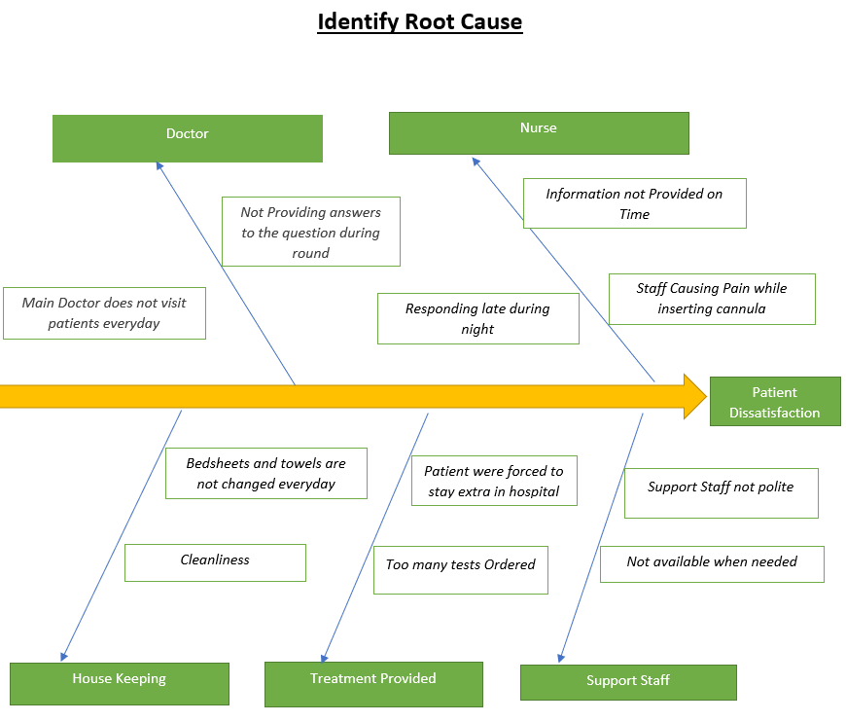
IDENTIFY THE ROOT CAUSE

Slide 6
Phase:2 planning
Exploratory Data Analysis
IDENTIFY the business questions to visualize using Tableau

Slide 7
Exploratory Data Analysis:
Merged the 5 years data using Python
Dropped 21 Columns which were not relevant
Fixed the Structural Errors (Naming Convention, Improper Capitalization, incorrect word use)
87 Survey Questions trimmed down text of long description
Grouped the 87 Survey questions and answers into 12 values using SQL
Removed the “Not Available” and “NA” Data using SQL

Slide 8
IDENTIFY the business questions to visualize using Tableau
Which hospital needs improvement based on the patient feedback? (Based on the rank, city, top 10, or top 5)
What are the parameters that the hospital must consider to improve services
Which Hospital Ownership has the most satisfaction rate
What is the number of critical access hospitals needed in a city based on its mortality rate?
In which hospital did the patients receive the best emergency care?
What has been the overall performance of hospitals between 2016 and 2020? Are certain locations getting better or worse overall?
How has the readmission rate in hospitals changed over time in a particular area?
According to the cities, which hospital type (government, private, defense) is the most famous?

Slide 9
Phase:3 Execution
Data Visualization & Dashboards

Slide 10
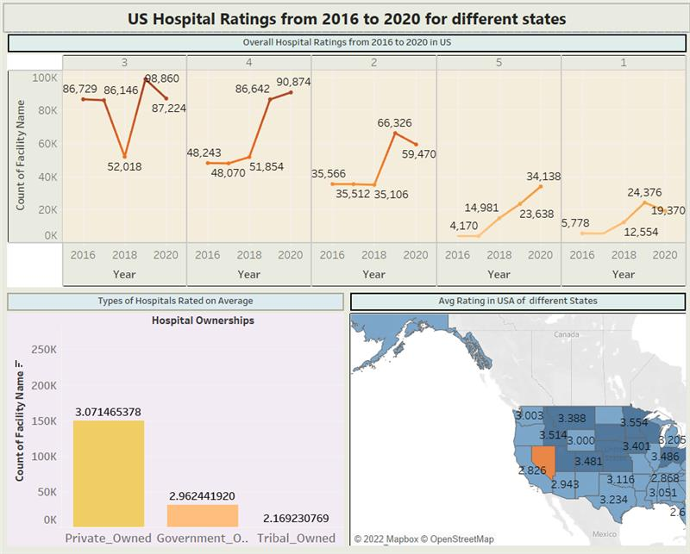
Dashboard1: [US Hospital Ratings from 2016 to 2020 for different states]

Slide 11
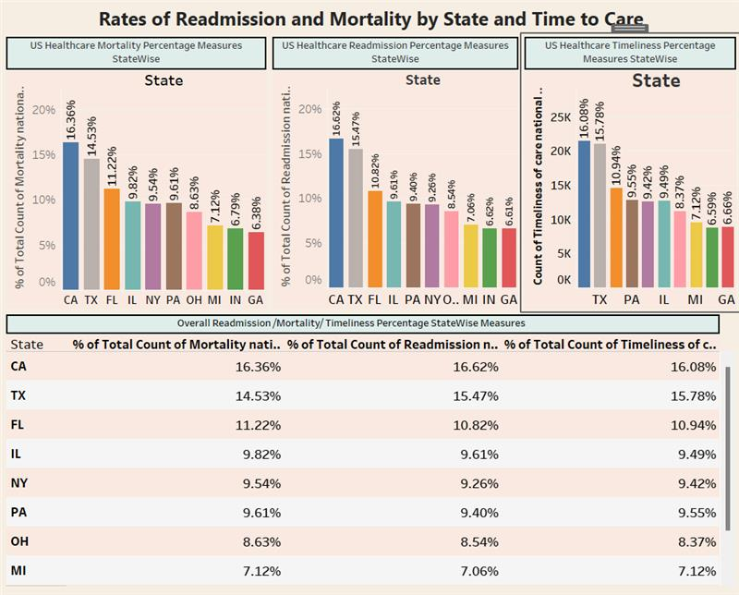
Dashboard2: [Rates of readmission and mortality by state and time to care]

Slide 12
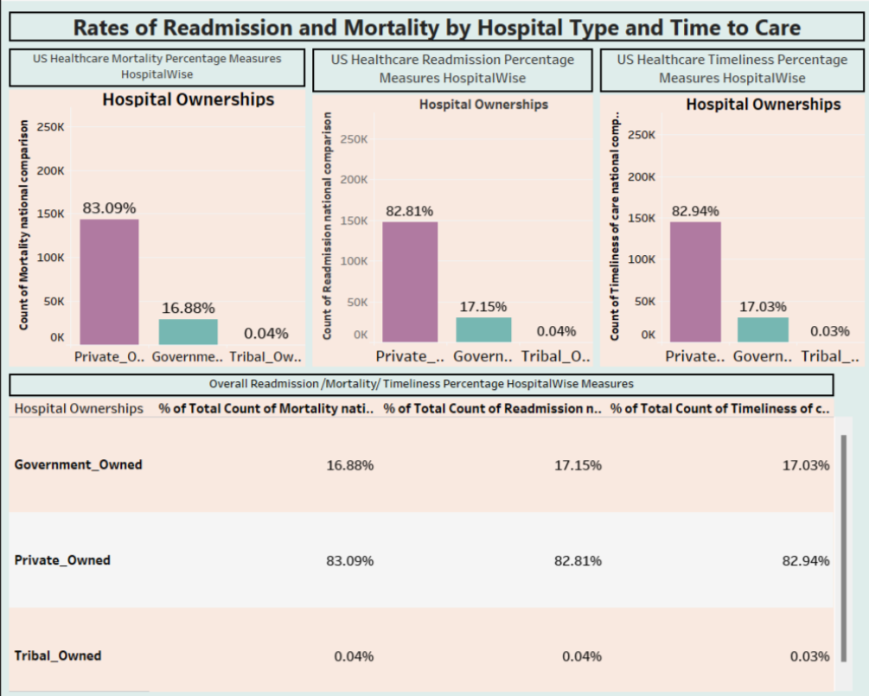
Dashboard3: [Rates of readmission and mortality by hospitals and time to care]

Slide 13
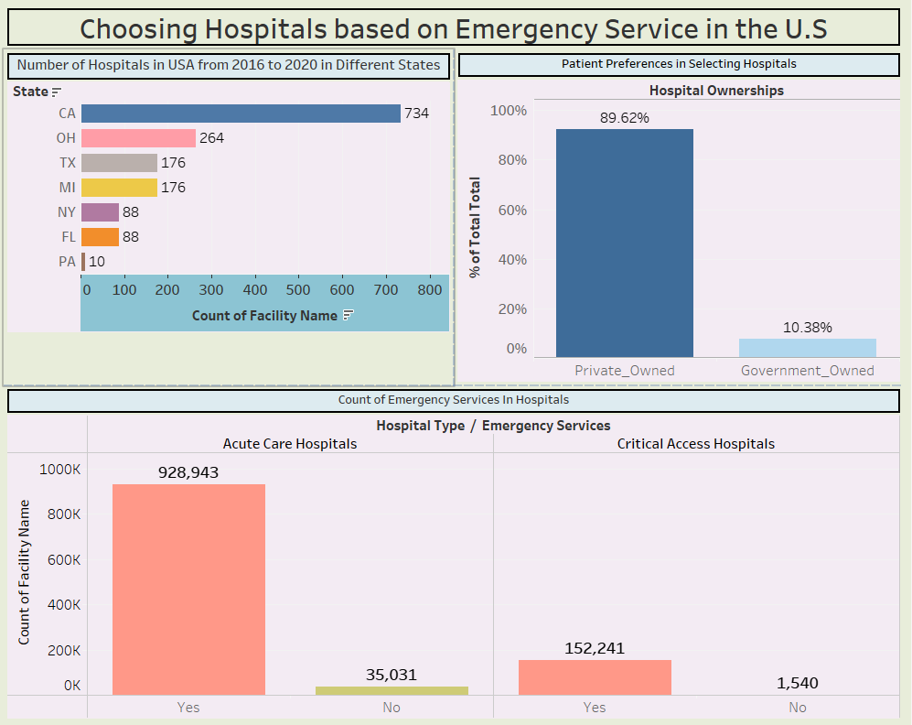
Dashboard4: [Choosing hospitals based on emergency services in the U.S]

Slide 14
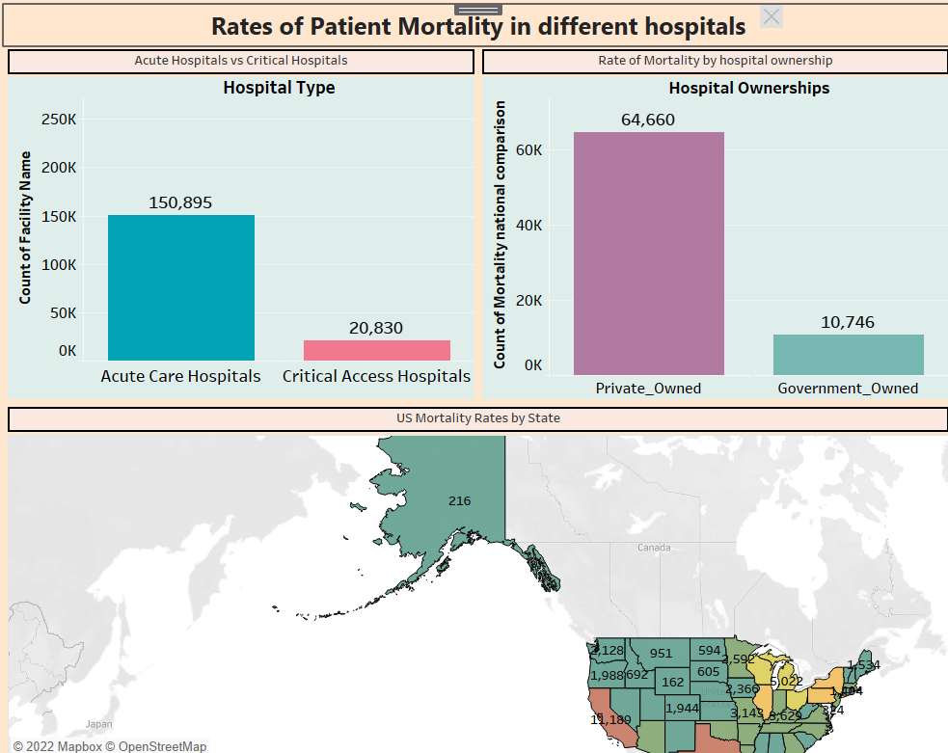
Dashboard5: [Rates of patient mortality in different hospitals]

Slide 15
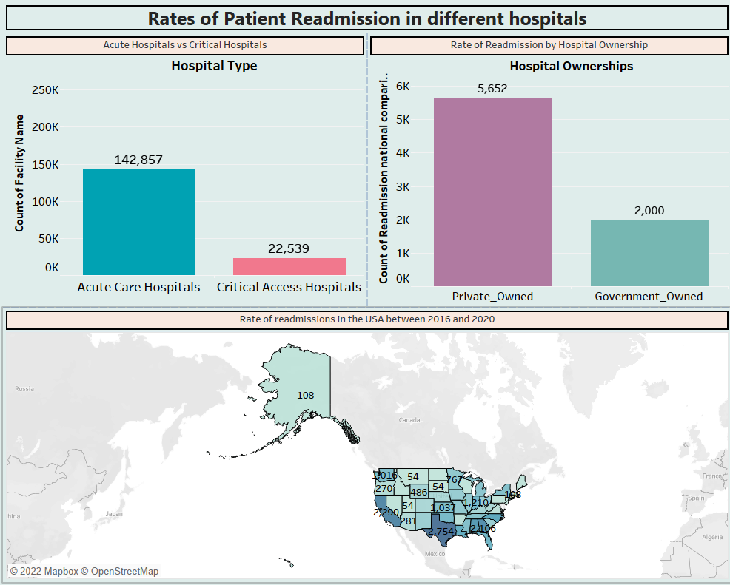
Dashboard6: [Rates of patient Readmission in different hospitals]

Slide 16
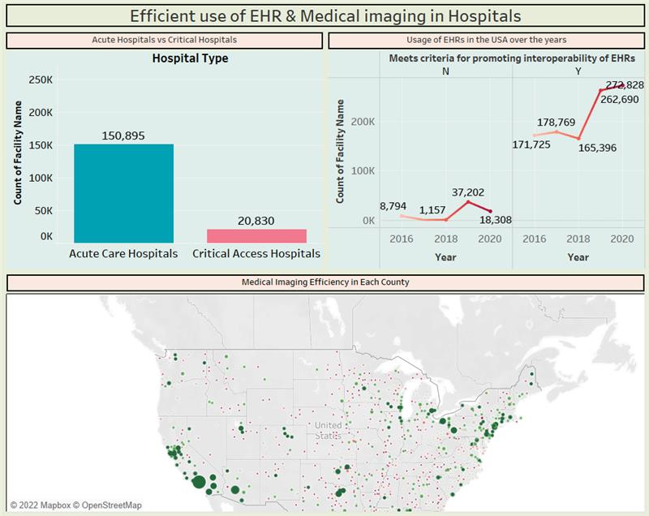
Dashboard7: [Efficient use of EHR & Medical imaging in Hospitals]

Slide 17
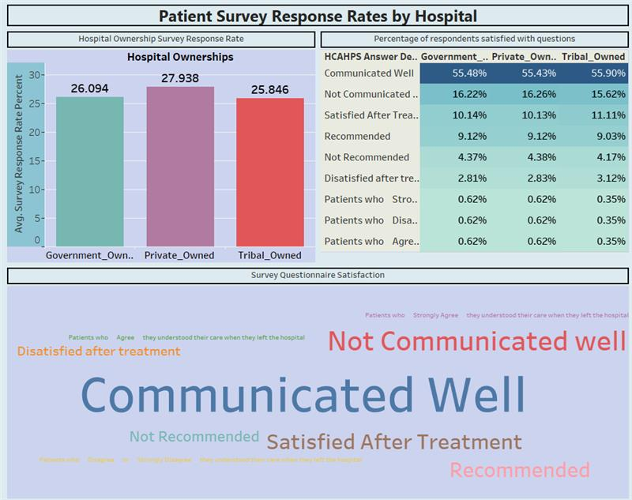
Dashboard8: [Patient Survey Response Rates by Hospital]

Slide 18
Phase:5 Challenges
Understand the survey related terminology, questions, answers, and measure id.
Our challenge was narrowing down lengthy survey questions and answers into small, readable text.
In Tableau, identifying the common values and grouping them.
The biggest challenge we faced was removing the large number of "Not available"s from our dataset.

Slide 19
Conclusion
Most hospitals receive three-star ratings.
In the US, Texas & California had the highest mortality & readmission rates
Hospitals owned by private companies have the highest mortality and readmission rates
Hospitals were found in California to be the most numerous
The majority of patients preferred to be treated in private hospitals
The maximum number of emergency services were available in acute care hospitals.
In the past few years, EHRs and medical interoperability have improved
Doctors and nurses communicated well during their treatment, which resulted in a higher response rate to the survey
In comparison to other hospitals, the private owned hospitals had a higher patient response rate

Slide 20
Thank you
For THE SUPPORT & Guidance by PROF. Mahmoud Artima

