Slide 1



GRAND FINALE · HACK IN HILLS ’26 · TRACK 04
Isolate
rootless sandboxes, no network, one trusted broker, separate user namespaces
AegisLab
Secure infrastructure for adversarial AI safety testing
Measure
every boundary attacked with recorded tests, controls that must leak, and stated sample sizes
The problem. A red team attacks, a blue team defends, and the model under test answers, all on one system. If red can read the defence, if one session can read another's data through the model, or if a result can be edited afterwards, the score measures the leak, not the model.
Why isolation decides validity: a safety finding is only as credible as the boundaries of the test that produced it.
Prove
hash-chained, signed audit log that a reviewer verifies offline; a tampered copy is rejected
Team Tech Mavericks
github.com/Invinciblx777/HIH · read-only demo: aegislab-demo.onrender.com
Labels on every figure: LIVE · RE-MEASURED <date> · RECORDED <date>
Notes:
OPENING, slide 1 (about 30 seconds of the 6-minute talk)
We are Tech Mavericks, and this is AegisLab, for Track 04: securing adversarial AI safety testing infrastructure.
The problem: in an AI safety evaluation a red team attacks, a blue team defends, and the model under test answers, on one system. If red can read the blue team's rules, if one session can read another's data through the model, or if anyone can edit the result afterwards, the score no longer measures the model. It measures the leak. So isolation is not an operations detail: it decides whether the evaluation is valid at all.
AegisLab does three things: it isolates (rootless sandboxes with no network, one trusted broker, separate user namespaces), it measures (each boundary is attacked by recorded tests with controls that must leak), and it proves (a signed, hash-chained audit log that a reviewer verifies offline).
Every figure in this deck carries a label. LIVE means the presented code produces it when it runs; you will see some of those runs today. RE-MEASURED means measured again on the finale code on the date shown. RECORDED means measured earlier and not re-run.
Code shown: main, with finale P1 to P5 merged on 12 Nov 2026. The screenshots and terminal recordings were made on commit 9145592, the finale P4 code. The public read-only demo runs on Render and serves main.

Slide 2
THREAT MODEL
Who must not see what, and where each rule is enforced
UNTRUSTED WORKLOADS
TRUSTED CONTROL PLANE (HOST)
FORBIDDEN FLOWS (each one attacked in a test)
rootless · no network · own user namespace
F1
Red reads the defence rules
config mounted only into the defence runner, read-only, digest attested
Red team
attack payloads, private pack
mailbox
Trusted broker
identity = which mailbox
checks commitments
withholds foreign canaries
F2
Anyone reads results before release
sealed store and role gate: refused until a reviewer releases
F1
F3
One session reads another's data
one stateless message per request, prompt cache off, foreign canaries withheld
Blue defence runner
frozen defence configuration
F4
A tenant reaches the broker's files or key
no-follow mailbox I/O; containers run on their own host UIDs
Audit · sealed store · gate
hash chain · signed checkpoints
F5
A record is changed unnoticed
hash chain, signed terminal checkpoint, reviewer countersignature
F3
Model under test
session state · prompt cache
Red signals blue through monitoring
participants see run-level events only until SEALED
F6
Evidence signing key
host user only, 0600
Tested, not assumed (RE-MEASURED 11 Nov 2026): role × operation × state matrix, 560 attempts, 419/419 denied, 141/141 allowed; none unexpectedly permitted.
F4
Code shown: main (finale P1-P5 merged 12 Nov 2026); media recorded on 9145592 · every figure from finale_package/claims_used_for_finale.json
Notes:
THREAT MODEL, slide 2 (about 30 seconds)
Parties: red holds attack payloads, blue holds a frozen defence configuration, the model holds session state and a prompt cache, a reviewer must trust the result, and observers watch. One trusted broker sits between them.
Six forbidden flows, each attacked in a recorded test:
F1 red reading the defence rules; F2 anyone reading results before a reviewer releases them; F3 one session reading another's data through the model; F4 a tenant reaching the broker's files or the signing key; F5 a record changed unnoticed; F6 red signalling blue through the monitoring stream (closed in the finale work: participants see run-level events only until the run is SEALED, and the stream never carries a red-chosen string).
Tested, not assumed (RE-MEASURED 11 Nov 2026): the role, operation and state matrix made 560 attempts with 419/419 denied and 141/141 allowed; none unexpectedly permitted. Evidence: aegislab/evidence/finale_p4_2026-11-11/role_matrix_extended.json.
Trusted and not defended: the broker and its signing key, and the shared host kernel and container runtime. That is our residual-risk slide later.

Slide 3
ARCHITECTURE
Five layers, a sandboxed model server, a user-namespace split
1
Red sandbox
private attack pack
mailbox / socket
TRUSTED CONTROL PLANE · host user
Reviewer
countersigns the
terminal checkpoint
WHAT EACH LAYER ENFORCES
2
1
Container limits
rootless Podman, --network none, read-only root, no capabilities, no-new-privileges, pids/memory/CPU caps, --userns auto, non-root user
Trusted broker
identity bound to mailbox
routes · checks · withholds · quotas
Blue defence runner
frozen config, read-only
5
One controlled path
file mailbox with no-follow I/O, size and type checks, per-tenant quotas; the model only via a 0700 UNIX socket
Strict verifier
separate program
pinned key + hash
2
Audit chain
signed checkpoints
anomaly alerts
3
Result gate
SEALED, verified,
reviewer releases
Model worker (stub)
fresh container per run
3
Role and run identity
identity from the mailbox; server-side role gate; run-scoped capability tokens; reviewer-only release
Observers
run-level events
until SEALED
Evidence signing key
0600, host user only
4
Model and session isolation
one stateless message per request, prompt cache off and guarded, foreign canaries withheld in plain and re-encoded form
4
Sandboxed model server
llama.cpp CPU, Qwen2.5-0.5B
--network none, UNIX socket
F4 split, RE-MEASURED 11 Nov 2026
4 containers, container UID 900; broker UID 1000; key unreadable: errno 13
Capability tokens
run-scoped, separate key
5
Audit and verification
hash chain, signed terminal checkpoint, reviewer countersignature, independent strict verifier
each container on its own subordinate host UID (F4)
Code shown: main (finale P1-P5 merged 12 Nov 2026); media recorded on 9145592 · every figure from finale_package/claims_used_for_finale.json
Notes:
ARCHITECTURE, slide 3 (about 40 seconds). Walk left to right.
Left: the workloads. Red, blue and the stub model worker are separate rootless Podman containers: no network, read-only root, all capabilities dropped, no-new-privileges, pids, memory and CPU limits. The real model, llama.cpp on CPU with Qwen2.5-0.5B, runs in its own rootless container with no network at all: the broker reaches it only through a UNIX socket in a 0700 directory.
The finale change on this slide is the user-namespace split (F4). Every container runs as a non-root user inside and on its own subordinate host UID outside; the broker, which owns the evidence signing key, is a different host user. RE-MEASURED 11 Nov 2026: 4 containers, container UID 900, distinct host UIDs 525188/526212/527236/528260, none the broker's UID 1000, and the key bind-mounted into a container is unreadable (errno 13). Evidence: aegislab/evidence/finale_p4_2026-11-11/userns_proof_final/.
Centre: the trusted broker. Identity comes from which mailbox a message is in, never from the message. It routes, checks commitments, withholds foreign canaries, and enforces per-tenant quotas. Every decision goes into the hash-chained audit log.
Right: the reviewer releases and countersigns, the strict verifier is a separate program with a pinned key and terminal hash, and observers see only run-level events until the run is sealed.
What is still trusted: the broker and its key, and the shared host kernel. A host-user compromise still reaches the key; see the residual-risk slide.

Slide 4
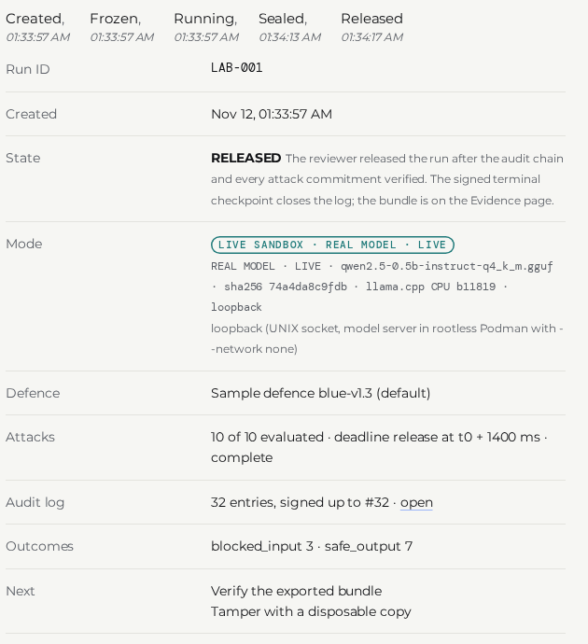
LIVE DEMO PLAN
What you will see run, and what is recorded
Real model, live scripts/real_model_demo.sh
13/13 checks in about 28 s: stateless sessions, a leak the model makes is withheld (also in base64), strict verify
1
LIVE
Console run card start_real_model_console.sh
REAL MODEL · LIVE, deadline release at t0 + 1400 ms, run sealed
2
LIVE
Evidence Evidence page / verify_cli
strict verify: exit code 0; tampered copy: exit code 1
3
LIVE
F4 proof table evaluation/p4_userns_proof.py
13/13 F4 checks: every container on its own host UID, none the broker's
4
LIVE
Fallback if the venue fails walkthrough video (offline)
the same steps recorded on the presented code; labelled RECORDED on screen
5
RECORDED 12 NOV 2026
SCREENSHOT of the real console, 12 Nov 2026: the run card of a real-model run
Expected counts are from the rehearsal on the presented code; a LIVE run on stage must reproduce them. The launch link is never shown.
Code shown: main (finale P1-P5 merged 12 Nov 2026); media recorded on 9145592 · every figure from finale_package/claims_used_for_finale.json
Notes:
LIVE DEMO PLAN, slide 4 (spoken in 15 seconds; the demo itself takes about 2 minutes of the 6-minute talk)
What you will see, in this order:
1. LIVE: scripts/real_model_demo.sh with the real model. It shows that sessions are stateless, that a leak the model makes is withheld by the broker (including a base64-encoded canary), and that the exported bundle verifies strictly. Expected: 13/13 checks in about 28 s (the rehearsal on the presented code; the stage run must reproduce it).
2. LIVE: the console started with scripts/start_real_model_console.sh. The run card says REAL MODEL · LIVE and "deadline release at t0 + 1400 ms"; the launch link is opened off-screen and never shown.
3. LIVE: the Evidence page or verify_cli: strict verification gives exit code 0, a tampered copy gives exit code 1.
4. LIVE if time allows: the F4 proof table, 13/13 F4 checks.
5. If anything fails at the venue: the offline walkthrough video, recorded on the presented code and labelled RECORDED on screen.
Fallback line if a live step fails: "The venue run failed; here is the same step recorded on the same code on 12 November, and the transcript is in the repository."

Slide 5
LEAKAGE RESULTS WITH A REAL MODEL
No leak detected, and the controls show the probes see one
RE-MEASURED 11 NOV 2026
Qwen2.5-0.5B Q4_K_M · llama.cpp CPU, sandboxed model server · finale P4 code
E3 prompt cache · RE-MEASURED 11 Nov 2026
cache off: 0 of 120 trials with cached tokens
cache on (control): cached-token AUC 1.00/1.00
E1 isolation: another session's canary recovered
0 of 104 sessions
0 of 1040 isolation trials
E4 injection · RE-MEASURED 11 Nov 2026
72 injection attacks, 69 reached the model
0 protected values to red; 282 of 282 replayed denied
E1 negative control (nothing planted)
0 of 320 negative-control trials
E1 positive control: history shared on purpose (must leak)
16 of 16 sessions
E5 failure handling · RE-MEASURED 11 Nov 2026
9 of 9 checks hold
backend down: fail closed, uniform refusal
E1 positive control: context-sharing gateway (must leak)
13 of 16 sessions
Second model · RECORDED 10 Nov 2026
Qwen2.5-1.5B, reduced run (E1 + E3):
0 of 280 isolation trials (0 of 28 sessions); controls 4 of 4 and 3 of 4
E2 full pipeline: broker + sandboxes + real model
0 of 26 isolation runs
312 attacks, 0 reached red
E2 context-sharing control: leaks withheld by the broker
2 of 4 runs
17 attacks withheld, 0 reached red
No leak detected is not no leak: one-sided 95% upper bound 0.29% of trials, 2.84% of sessions (RE-MEASURED 11 Nov 2026). One model at full scale, CPU only, one host.
Code shown: main (finale P1-P5 merged 12 Nov 2026); media recorded on 9145592 · every figure from finale_package/claims_used_for_finale.json
Notes:
LEAKAGE RESULTS, slide 5 (about 40 seconds)
Real model: Qwen2.5-0.5B on llama.cpp, CPU, in the sandboxed server. All of this was RE-MEASURED 11 Nov 2026 on the finale P4 code; evidence aegislab/evidence/finale_p4_2026-11-11/llm_final/INDEX.json.
E1, direct adapter: 0 of 104 sessions and 0 of 1040 isolation trials recovered another session's canary. The probes can see a leak: with history shared on purpose 16 of 16 sessions leaked, through a context-sharing gateway 13 of 16 sessions; with nothing planted, 0 of 320 negative-control trials. [RE-MEASURED 11 Nov 2026]
E2, the full pipeline (broker, sandboxes, real model): 0 of 26 isolation runs had a foreign canary, 0 reached red. In the context-sharing control the model did leak in 2 of 4 runs; the broker withheld 17 attacks withheld and 0 reached red. [RE-MEASURED 11 Nov 2026]
E3: with the prompt cache off, 0 of 120 trials showed cached tokens; with it on (the control) the cached-token AUC 1.00/1.00. [RE-MEASURED 11 Nov 2026]
E4: 72 injection attacks, 69 reached the model, 0 protected values to red, 282 of 282 replayed denied. E5: 9 of 9 checks hold. [RE-MEASURED 11 Nov 2026]
Second model (RECORDED 10 Nov 2026): Qwen2.5-1.5B, reduced run: 0 of 280 isolation trials, 0 of 28 sessions, controls 4 of 4 and 3 of 4.
Say it plainly: no leak detected is not the same as no leak. The one-sided 95% upper bound is 0.29% of trials and 2.84% of sessions. One model at full scale, one reduced, CPU only, one host; GPU untested. [RE-MEASURED 11 Nov 2026]

Slide 6
THE TIMING STORY
Our own test found a 250 ms leak; deadline release fixed it
1 · Stub model: 250 ms buckets work
held-out accuracy 0.435–0.540 at 250 ms
chance level; +197 ms per answer
RE-MEASURED 11 Nov 2026
THREE EXECUTIONS, REAL MODEL, BALANCED CLASSES RE-MEASURED 11 Nov 2026
1.0
2 · Real model: the same padding leaks
one execution: 1.000 at 250 ms
the refusal decision stays readable from latency
RECORDED 10 Nov 2026
0.7
0.5
3 · Fix: deadline release
every reply leaves at t0 + D, answered or refused; a slow model is cut off and refused
default now: t0 + 1400 ms (LIVE)
stub keeps 250 ms buckets
250 ms buckets
deadline release
250 ms buckets: accuracy 0.945/0.960/0.950, p = 0.001 in every execution: leak detected.
Deadline release: accuracy 0.495/0.545/0.575 against baselines 0.515/0.540/0.515 (black ticks); p = 0.560/0.197/0.044.
Third execution p = 0.044: below 0.05 but above the pre-declared 0.05/9 = 0.0056, so no leak detected (inconclusive as to absence). Reported as measured.
Cost (RE-MEASURED 11 Nov 2026): +519 to +621 ms per answered request; 3–8 % of model calls cut off (D per execution 1300/1400/1300 ms). D is host- and model-specific and must be re-calibrated elsewhere.
Code shown: main (finale P1-P5 merged 12 Nov 2026); media recorded on 9145592 · every figure from finale_package/claims_used_for_finale.json
Notes:
THE TIMING STORY, slide 6 (about 45 seconds). This is the slide where we show a result that changed.
1. With the stub model, 250 ms response buckets bring a latency classifier to chance: 0.435–0.540 at 250 ms (RE-MEASURED 11 Nov 2026), at +197 ms per answer.
2. When we ran the same timing test against the real model, it broke: one execution gave 1.000 at 250 ms (RECORDED 10 Nov 2026). Real-model latency spans many 250 ms buckets, and refusals never reach the model, so the decision stays readable. Our own harness found this; nobody reported it to us.
3. The fix is deadline release: every reply, answered or refused, leaves at t0 plus D; a model that has not answered in time is cut off and red gets the uniform refusal. We ran it three times with balanced classes (RE-MEASURED 11 Nov 2026):
250 ms buckets: accuracy 0.945/0.960/0.950, p = 0.001 each time: leak detected. [RE-MEASURED 11 Nov 2026]
Deadline release: accuracy 0.495/0.545/0.575, against majority baselines baselines 0.515/0.540/0.515, p = 0.560/0.197/0.044. [RE-MEASURED 11 Nov 2026]
The third execution's p = 0.044 is below 0.05 but above the threshold we declared before measuring, 0.05/9 = 0.0056 (Bonferroni over nine tests). So the verdict is "no leak detected", which is inconclusive as to absence, and we show the number instead of hiding it. [RE-MEASURED 11 Nov 2026]
Cost (RE-MEASURED 11 Nov 2026): +519 to +621 ms per answered request, 3–8 % of model calls cut off, D per execution 1300/1400/1300 ms. The default for a real-model backend is now D = 1400 ms (LIVE); the stub keeps 250 ms.
Limits: one host, one model, one classifier, n per execution as in the evidence; D must be re-calibrated on other hardware. Evidence: aegislab/evidence/finale_p4_2026-11-11/timing_deadline/aggregate.json.

Slide 7
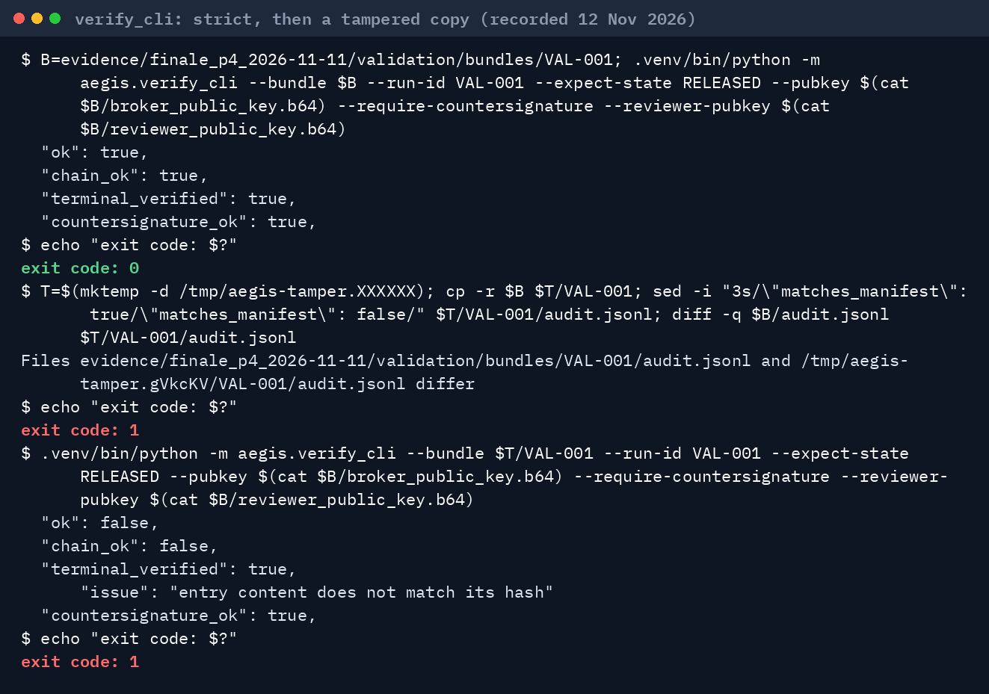
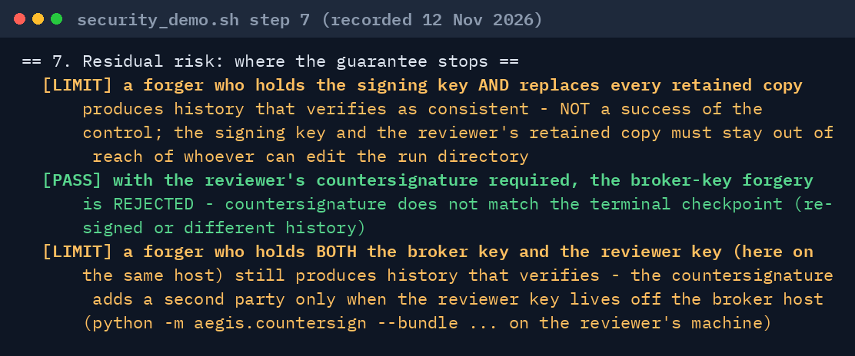
AUDIT INTEGRITY
Chained, signed, countersigned, independently verified
Hash chain
each entry carries the previous entry's hash
Signed checkpoints
Ed25519 over the chain, kept in a reviewer vault
Terminal checkpoint
binds the final entry: truncation is detectable
Countersignature
reviewer signs the terminal checkpoint (Partial)
Strict verifier
separate program; pinned key and terminal hash
LIVE security_demo.sh step 7: a broker-key forgery and the stated limit
LIVE recorded transcript, 12 Nov 2026: strict verify, then a one-field edit of a copy
Tamper suite (RE-MEASURED 11 Nov 2026): 19/19 tamper categories, each detected in 30/30 trials; CLI 10/10 genuine bundles accepted, 40/40 tampered copies rejected. Countersignature is Partial: it stops a broker-key forgery only while the reviewer key is off the broker host.
Code shown: main (finale P1-P5 merged 12 Nov 2026); media recorded on 9145592 · every figure from finale_package/claims_used_for_finale.json
Notes:
AUDIT INTEGRITY, slide 7 (about 30 seconds)
The broker appends a digest of every decision to a hash chain, signs checkpoints with Ed25519 and copies them to a reviewer vault. At release it signs a terminal checkpoint that binds the last entry, so deleting entries from the end is detectable. New for the finale: the reviewer countersigns that terminal checkpoint with a separate key, and verify_cli can require both signatures.
Left terminal (LIVE, recorded on the presented code): strict verification of the P4 bundle with the key pinned and the countersignature required gives exit code 0. Changing one field in a copy of the audit log gives exit code 1.
Right terminal (LIVE, security_demo.sh step 7): a forger who holds the broker key and replaces every retained copy produces history that verifies on its own; with the reviewer countersignature required it is refused. The stated limit: a forger who holds both keys still succeeds, so the countersignature is Partial: it helps only when the reviewer key is on a different machine.
Tamper suite (RE-MEASURED 11 Nov 2026): 19/19 tamper categories, each detected in 30/30 trials; the CLI accepted 10/10 genuine bundles accepted and rejected 40/40 tampered copies rejected. Evidence: aegislab/evidence/finale_p4_2026-11-11/validation/audit_tamper.json.

Slide 8
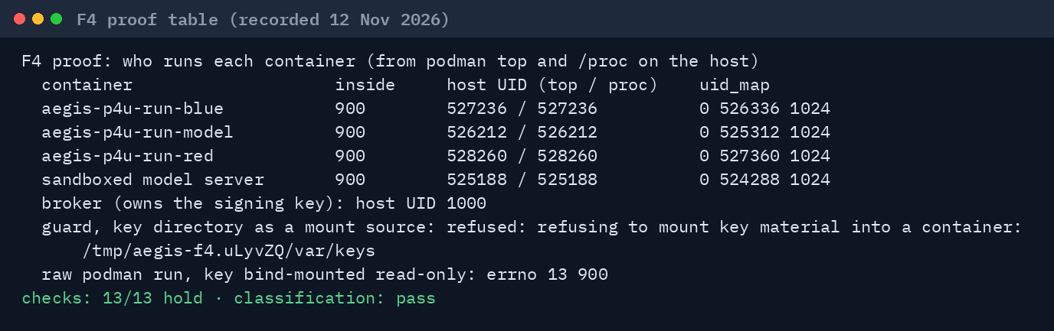
HARDENING ADDED FOR THE FINALE
We closed the gaps a judge would press on, and measured each fix
F4 · user namespaces
containers never run as the key owner
container UID 900, host UIDs 525188/526212/527236/528260, errno 13 (RE-MEASURED 11 Nov 2026)
Re-encoded canaries
base64, hex, rot13, reversed, split and spelled-out forms of a foreign canary are withheld
still missed: double encoding, ciphers, paraphrase
Anomaly detectors
6 detectors in the signed log (LIVE): denial bursts, forbidden sweeps, mailbox violations, canary near-misses, cut-offs, latency drift
thresholds fixed, not tuned on adversarial traffic
Capability tokens
run-scoped, operation-scoped, at most one hour; only the reviewer mints release rights
no revocation list yet
Mailbox quotas
2,100 messages per run, 400 per 10 s, 32 MiB, 512 outbox entries (LIVE); over a limit the tenant is cut off and the run seals incomplete
Monitor side channel closed
participants see run-level events only until SEALED; no red-chosen string in the stream
cache guard: cache_prompt=true refused unless an explicit unsafe opt-in
Also pinned: the sandbox base image by digest; pyproject and uv.lock corrected.
Not done: gVisor or Kata (runsc not installed on the test host); key in a KMS or HSM.
Anomaly panel: the Audit page of a real-model lab run shows each detector, its threshold and its rationale (walkthrough video).
LIVE recorded transcript, 12 Nov 2026: the F4 proof table (evaluation/p4_userns_proof.py)
Code shown: main (finale P1-P5 merged 12 Nov 2026); media recorded on 9145592 · every figure from finale_package/claims_used_for_finale.json
Notes:
FINALE HARDENING, slide 8 (about 30 seconds; in the 3-minute version skip to the residual-risk slide)
Six changes since Round 2, each with tests and, where it matters, a live measurement:
F4: containers never run as the key owner. container UID 900, host UIDs 525188/526212/527236/528260, the key bind-mounted into a container gives errno 13 (RE-MEASURED 11 Nov 2026). Before, a container escape was key theft; now a host-user compromise still is.
Re-encoded canaries: the broker now withholds base64, hex, rot13, reversed, split and spelled-out forms of another run's canary. It still misses double encoding, other ciphers, homoglyphs and paraphrase. The detector is the second line; server-side isolation is the first.
Anomaly detectors: 6 detectors write alerts into the signed log (LIVE). Thresholds are fixed and were not tuned on adversarial traffic, so an attacker below every threshold is not flagged.
Capability tokens: run-scoped and operation-scoped, at most one hour, the operator cannot mint the right to release. No revocation list yet.
Mailbox quotas: 2,100 messages per run, 400 per 10 s, 32 MiB, 512 outbox entries (LIVE).
Monitor side channel (F3 in our analysis): participants see run-level events only until the run is SEALED.
Not done: gVisor or Kata (not installed on the test host), and a KMS or HSM for the key.

Slide 9
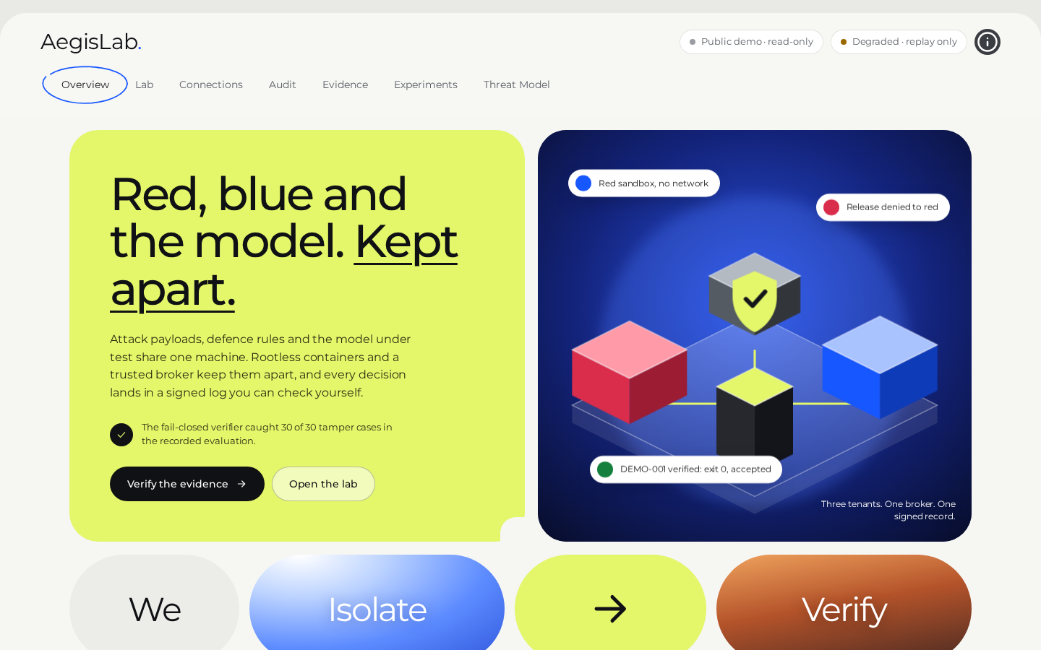
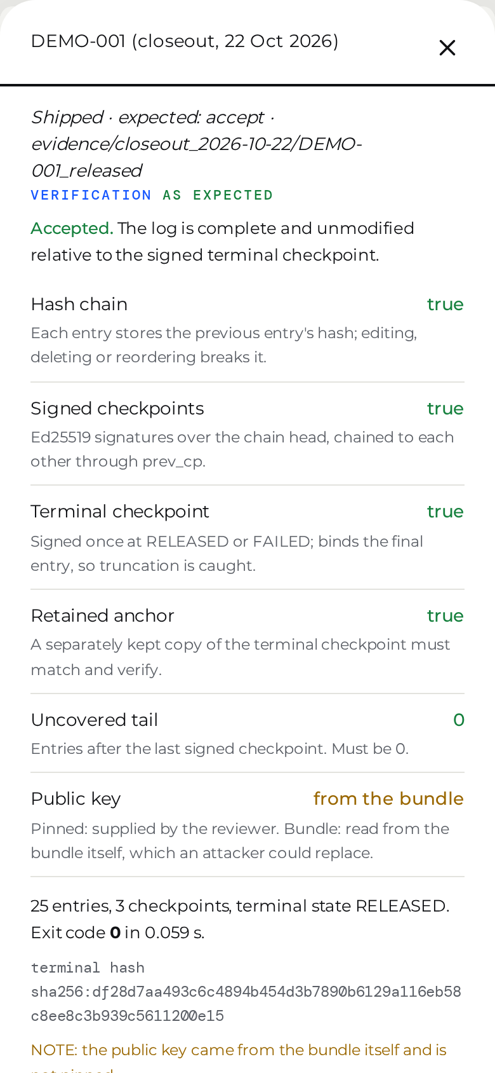
DEPLOYABILITY
Rootless, CPU only, offline, checked in CI, and a read-only public demo
Rootless Podman
no root, no daemon; one Fedora laptop; the sandbox image pinned by digest
CPU only, offline
llama.cpp on CPU; the model and server binary checked by sha256; nothing downloaded at the venue
Checked, not trusted
release gates in CI on every push
702 tests passed (RECORDED 12 Nov 2026); check_claims 357/357 checks (LIVE)
Public read-only demo
aegislab-demo.onrender.com: browse evidence, verify a bundle, tamper with a disposable copy
no operator session, no runs, no containers; rate-limited
SCREENSHOTS 12 Nov 2026, the presented code run locally with AEGIS_PUBLIC_DEMO=1: degraded mode, header 'Public demo'; phone: bundle verify accepted.
The hosted site serves origin/main until P1–P4 are merged; the verify fix is in P1.
Why read-only: a live operator console on a public URL would expose run control; it stays loopback-only.
Code shown: main (finale P1-P5 merged 12 Nov 2026); media recorded on 9145592 · every figure from finale_package/claims_used_for_finale.json
Notes:
DEPLOYABILITY, slide 9 (about 25 seconds)
Everything runs on one ordinary laptop: rootless Podman (no root, no daemon), a sandbox image pinned by digest, llama.cpp on CPU, and model files checked by sha256, so nothing has to be downloaded at the venue.
Checked, not trusted: the release gates run in CI on every push. On this branch: 702 tests passed (RECORDED 12 Nov 2026); check_claims.py recomputes every quoted figure from the raw files, 357/357 checks (LIVE).
The public demo at aegislab-demo.onrender.com is read-only by design: anyone can browse the evidence, verify a bundle with the independent verifier, and tamper with a disposable copy to see it rejected. It has no operator session, cannot create runs, has no containers, and is rate-limited. A live operator console on a public URL would expose run control, so the live console stays on loopback.
The public demo runs on Render from main, so the verify fix from P1 is live there. The older copy on Vercel is secondary and is redeployed by hand. The screenshots are of the presented code run locally in the same public mode.

Slide 10
RESIDUAL RISKS
What would still fail, stated before you ask
Host compromise
the signing key is a 0600 file of the host user: a kernel exploit that gains that user can forge evidence. Countersignature: Partial (reviewer key off-host only).
Anomaly thresholds not tuned
fixed, never trained on adversarial traffic: an attacker below every threshold is not flagged.
Deadline D is host- and model-specific
calibrated on one laptop for Qwen2.5-0.5B; elsewhere re-calibrate. Too short: more cut-offs. Too long: only latency.
Capability tokens
no revocation list; the API has no TLS (loopback only).
No leak detected is not absence
one classifier, one host; cache, memory-bandwidth and CPU-contention channels not measured; post-cut-off generation not measured as a channel.
Shared kernel
containers share the host kernel; gVisor and Kata not tried.
Canary detector gaps
double encoding, other bases, ciphers, homoglyphs, translation, paraphrase, a token split across replies.
Coverage
one host; one model at full scale (0.5B) plus a reduced 1.5B run; CPU only; GPU and accelerator KV-cache isolation untested.
Source: docs/finale/P4_REPORT.md section 5 and aegislab/THREAT_MODEL.md section 10.
Code shown: main (finale P1-P5 merged 12 Nov 2026); media recorded on 9145592 · every figure from finale_package/claims_used_for_finale.json
Notes:
RESIDUAL RISKS, slide 10 (about 30 seconds; never skip this slide, in any version of the talk)
Read the two highlighted ones aloud. First: host compromise. The evidence signing key is still a 0600 file of the host user. A kernel exploit that becomes that user can forge evidence. The reviewer countersignature only helps if the reviewer key lives on another machine, so we call it Partial. Second: "no leak detected" is not "no leak". It is one classifier on one host, and we did not measure cache, memory-bandwidth or CPU-contention channels.
The others: the deadline is calibrated for one host and one model; the canary detector misses double encodings and paraphrase; the anomaly thresholds were never tuned on adversarial traffic; capability tokens have no revocation list and the API has no TLS; containers share the kernel and we did not try gVisor; and our figures cover one host, one model at full scale plus a reduced 1.5B run, CPU only. GPU isolation is untested.

Slide 11
FUTURE SCOPE
What we would build next, in the order the residual risks ask for it
Key custody
signing key in a KMS or HSM, rotation, a transparency log for terminal checkpoints
closes: host compromise
Semantic leak detection
paraphrase- and translation-aware detectors next to the canary scan
closes: detector gaps
Stronger sandbox
gVisor or Kata containers, one VM per tenant for high-assurance runs
closes: shared kernel
Adversarially tuned detectors
thresholds fitted on red-team traffic, with false-positive budgets
closes: untuned thresholds
GPU and accelerator isolation
KV-cache and CUDA-context tests on a GPU server, multi-slot inference servers
closes: coverage
Multi-party operation
token revocation, TLS and SSO, reviewer on a separate machine by default
closes: tokens, Partial countersignature
Not claimed: production readiness, a third-party audit, invulnerability, model robustness to prompt injection, any customer or certification.
Code shown: main (finale P1-P5 merged 12 Nov 2026); media recorded on 9145592 · every figure from finale_package/claims_used_for_finale.json
Notes:
FUTURE SCOPE, slide 11 (about 15 seconds; skip in the 3-minute version)
Each item answers one residual risk: key custody in a KMS or HSM with rotation and a transparency log; gVisor or Kata, or a VM per tenant; GPU and accelerator KV-cache isolation tests; paraphrase-aware leak detection; detector thresholds fitted on red-team traffic; and multi-party operation with token revocation, TLS, SSO and the reviewer on a separate machine.
We do not claim production readiness, a third-party audit, invulnerability, robustness of the model itself, or any customer or certification.

Slide 12
AEGISLAB · TECH MAVERICKS
Isolate, measure, prove
Thank
you!
AM
Abdul Munaf Z
Solution architect & integration engineer
LS
Likhith Sai N
Sandbox security & infrastructure engineer
SR
Sreeram Rajesh
Product interface & evaluation engineer
Code and evidence: github.com/Invinciblx777/HIH
Read-only demo: https://aegislab-demo.onrender.com
Notes:
CLOSE, slide 12 (about 15 seconds)
AegisLab isolates the parties of an AI safety test, measures every boundary with controls that must leak, and proves the result with evidence a reviewer verifies offline. We showed what holds, what changed when we tested against a real model, and what would still fail.
Abdul Munaf Z, solution architect and integration engineer; Likhith Sai N, sandbox security and infrastructure engineer; Sreeram Rajesh, product interface and evaluation engineer.
Code and evidence: github.com/Invinciblx777/HIH. Read-only demo: aegislab-demo.onrender.com. Thank you; we are happy to take questions.

