Slide 1
MiniProject
● ● ● ● ● ●
● ● ● ● ● ●
● ● ● ● ● ●
● ● ● ● ● ●
● ● ● ● ● ●
● ● ● ● ● ●
● ● ● ● ● ●
● ● ● ● ● ●
● ● ● ● ● ●
● ● ● ● ● ●
● ● ● ● ● ●
● ● ● ● ● ●
● ● ● ● ● ●
● ● ● ● ● ●
● ● ● ● ● ●
● ● ● ● ● ●
● ● ● ● ● ●
● ● ● ● ● ●
● ● ● ● ● ●
● ● ● ● ● ●
● ● ● ● ● ●
● ● ● ● ● ●
● ● ● ● ● ●
● ● ● ● ● ●
● ● ● ● ● ●
● ● ● ● ● ●
● ● ● ● ● ●
● ● ● ● ● ●
● ● ● ● ● ●
LoL Data
시각화
박민규 김명재 이태현 이다은

Slide 2
● ● ● ●
● ● ● ●
● ● ● ●
● ● ● ●
● ● ● ●
● ● ● ●
● ● ● ●
● ● ● ●
● ● ● ●
● ● ● ●
● ● ● ●
● ● ● ●
Table of contents
01. FLOW CHART
02. EPIC MONSTER STEALS
03. GOLD
04. ENEMY MISSING PINGS

Slide 3
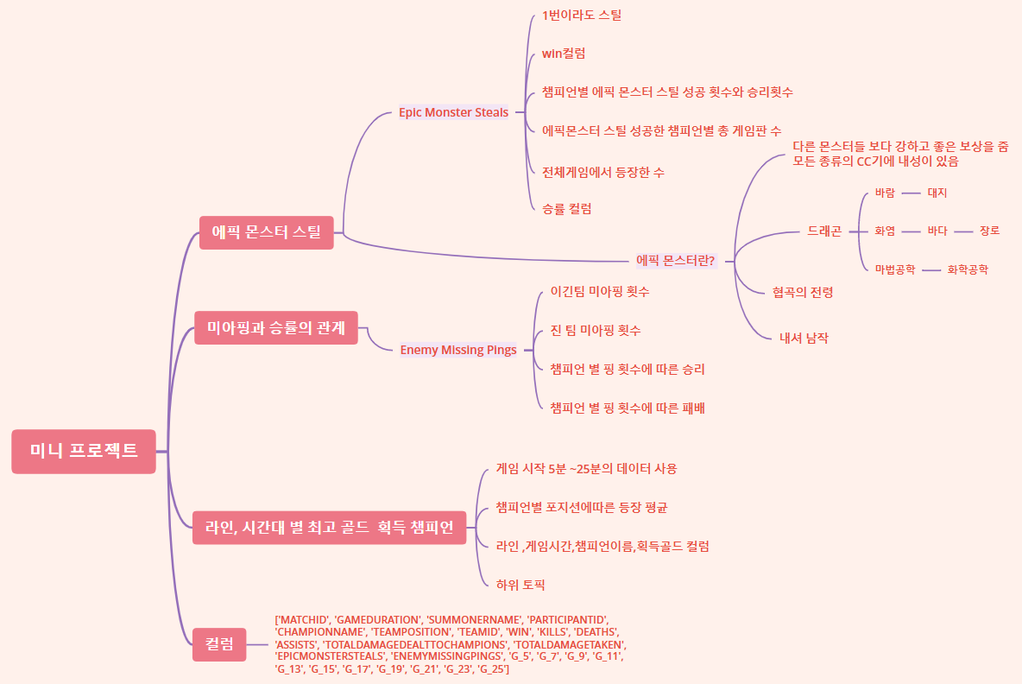
● ● ● ●
● ● ● ●
● ● ● ●
● ● ● ●
● ● ● ●
● ● ● ●
● ● ● ●
● ● ● ●
● ● ● ●
● ● ● ●
● ● ● ●
● ● ● ●
FLOW CHART
기본 데이터 목록
match_id
matches['info']['gameDuration']
matches['info']['participants'][0]['summonerName']
matches['info']['participants'][0]['participantId']
matches['info']['participants'][0]['championName']
matches['info']['participants'][0]['teamPosition']
matches['info']['participants'][0]['teamId']
matches['info']['participants'][0]['win']
matches['info']['participants'][0]['kills']
matches['info']['participants'][0]['deaths']
matches['info']['participants'][0]['assists']
matches['info']['participants'][0]['totalDamageDealtToChampions']
matches['info']['participants'][0]['totalDamageTaken']

Slide 4
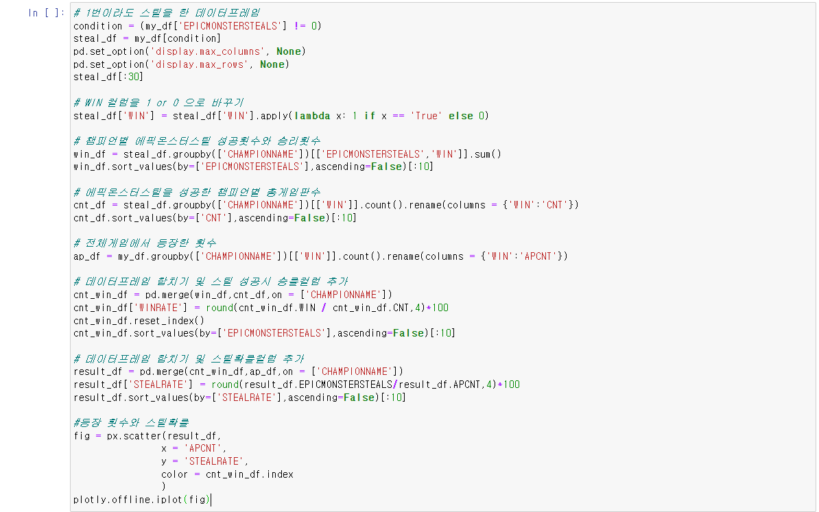
● ● ● ●
● ● ● ●
● ● ● ●
● ● ● ●
● ● ● ●
● ● ● ●
EPIC MONSTER STEALS
● ● ● ●
● ● ● ●
● ● ● ●
● ● ● ●
● ● ● ●
● ● ● ●
CODE
&
GRAPH

Slide 5
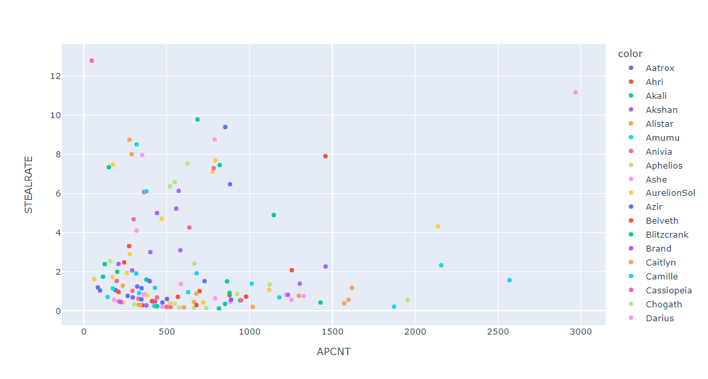
● ● ● ●
● ● ● ●
● ● ● ●
● ● ● ●
● ● ● ●
● ● ● ●
EPIC MONSTER STEALS
● ● ● ●
● ● ● ●
● ● ● ●
● ● ● ●
● ● ● ●
● ● ● ●

Slide 6
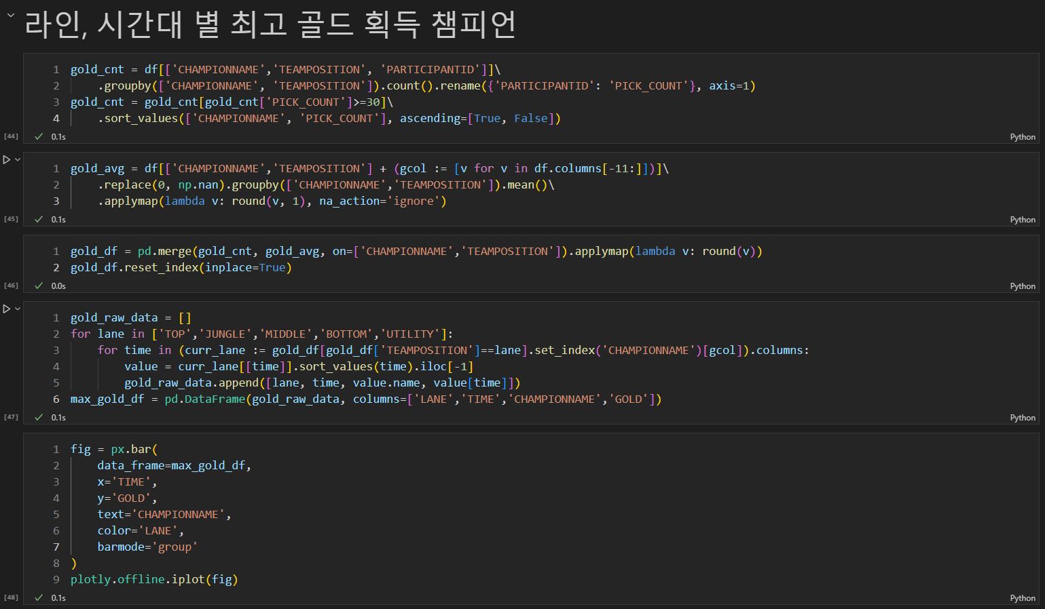
● ● ● ●
● ● ● ●
● ● ● ●
● ● ● ●
● ● ● ●
● ● ● ●
● ● ● ●
● ● ● ●
● ● ● ●
● ● ● ●
● ● ● ●
● ● ● ●
LANE, SUGAR POWDER GOLD RATE
CODE
&
GRAPH

Slide 7
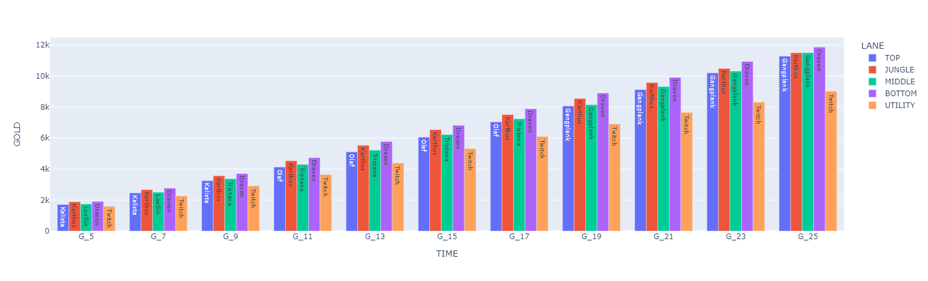
● ● ● ●
● ● ● ●
● ● ● ●
● ● ● ●
● ● ● ●
● ● ● ●
● ● ● ●
● ● ● ●
● ● ● ●
● ● ● ●
● ● ● ●
● ● ● ●
LANE, SUGAR POWDER GOLD RATE

Slide 8
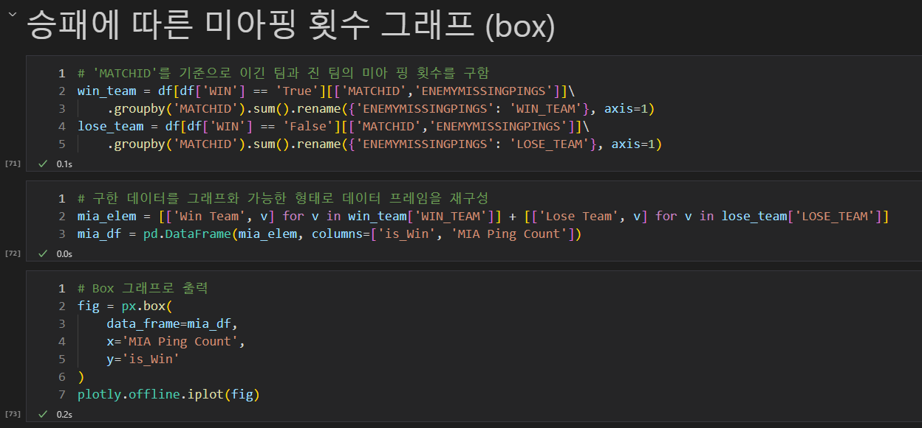
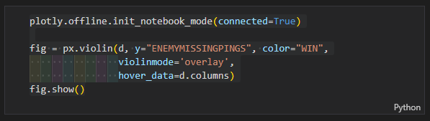
● ● ● ●
● ● ● ●
● ● ● ●
● ● ● ●
● ● ● ●
● ● ● ●
ENEMY MISSING PINGS
● ● ● ●
● ● ● ●
● ● ● ●
● ● ● ●
● ● ● ●
● ● ● ●
CODE
&
GRAPH

Slide 9
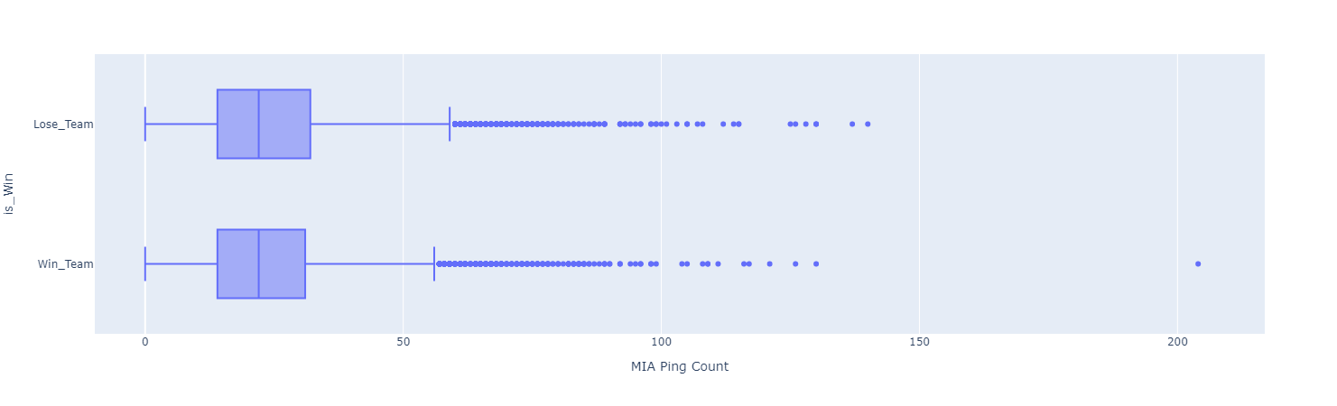
● ● ● ●
● ● ● ●
● ● ● ●
● ● ● ●
● ● ● ●
● ● ● ●
ENEMY MISSING PINGS
● ● ● ●
● ● ● ●
● ● ● ●
● ● ● ●
● ● ● ●
● ● ● ●

Slide 10
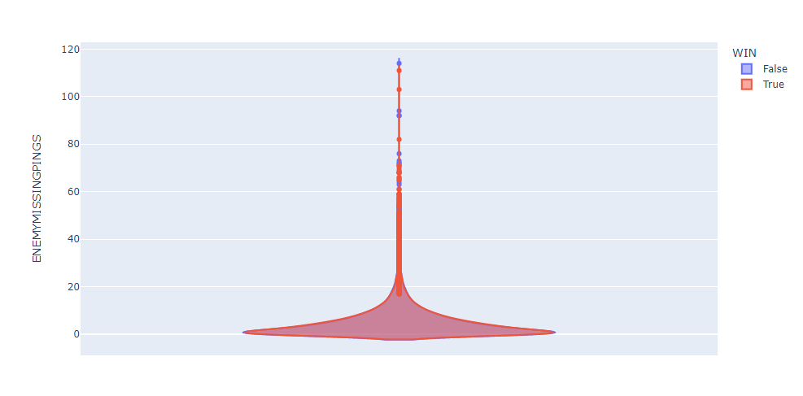
● ● ● ●
● ● ● ●
● ● ● ●
● ● ● ●
● ● ● ●
● ● ● ●
ENEMY MISSING PINGS
● ● ● ●
● ● ● ●
● ● ● ●
● ● ● ●
● ● ● ●
● ● ● ●

Slide 11
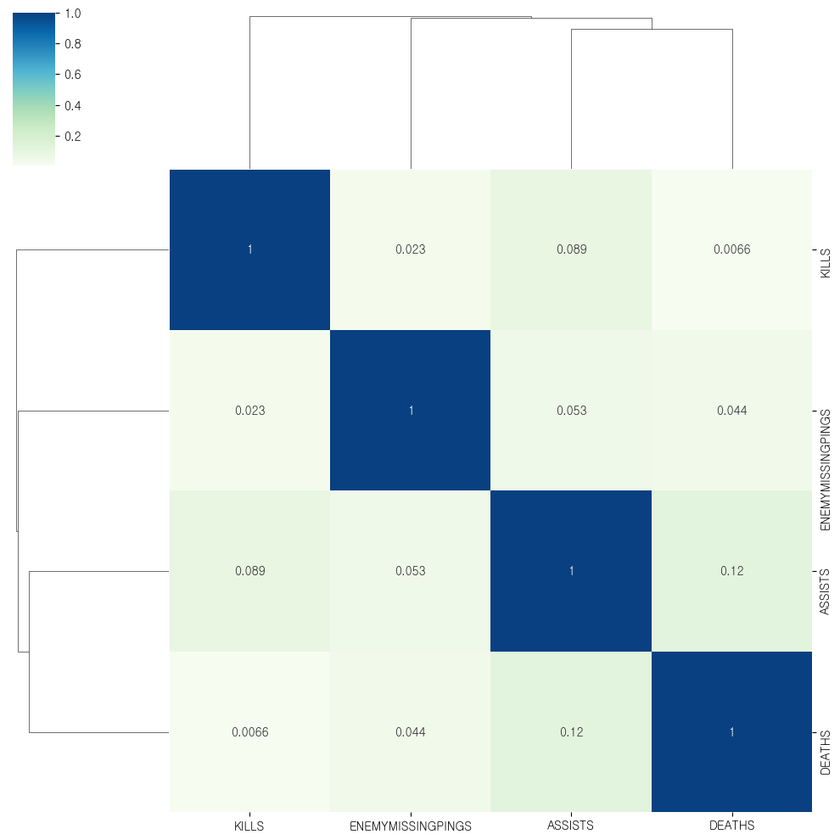

● ● ● ●
● ● ● ●
● ● ● ●
● ● ● ●
● ● ● ●
● ● ● ●
ENEMY MISSING PINGS
● ● ● ●
● ● ● ●
● ● ● ●
● ● ● ●
● ● ● ●
● ● ● ●
CLUSTER
MAP

