Slide 1
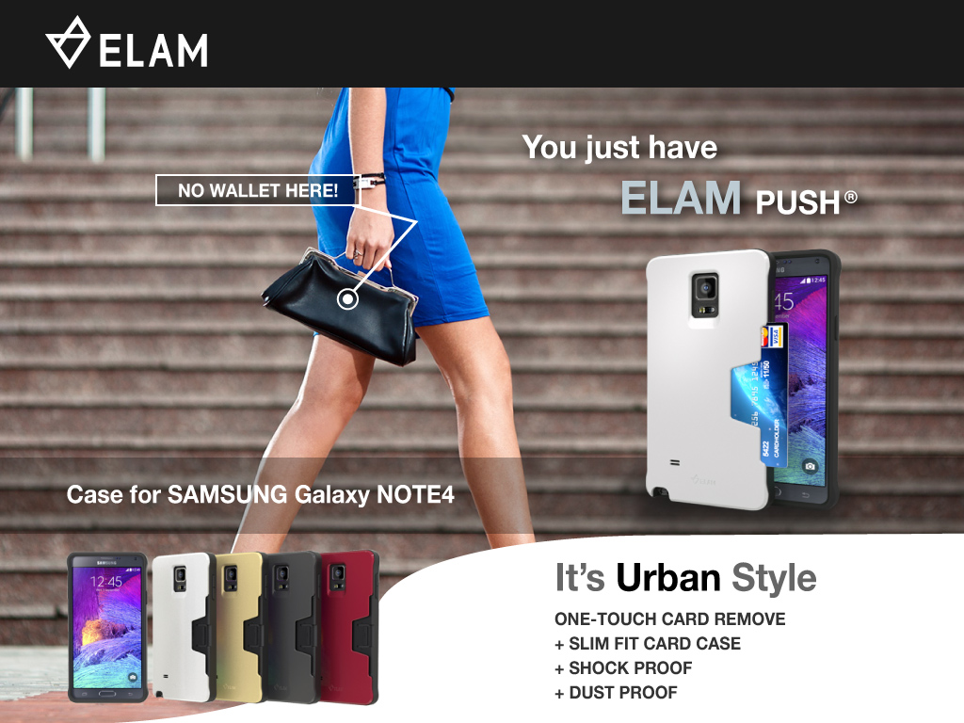

Slide 2

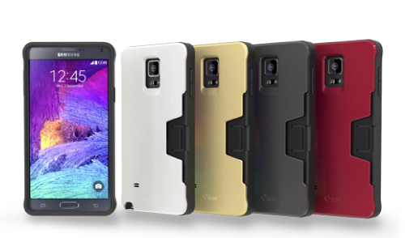
《 Product’s Advantage 》
No. | Functionality | Design & Color | Materials
1 | Easy remove (card) | Fancy & Urban style | Flexible & Strong
2 | Card magnetic protection by 2 slim buttress which are placed in between 2 PC plates | Ergonomic ♦ Easy Holding ♦ Thumb Fit Cut ♦ Wide S-pen hole | High quality’s PC + TPU
3 | Shockproof | Wide S-pen hole | Dirty- less Plate
4 | Dustproof | Slim fit body
5 | Transportation Card Recharging | No joint-line on TPU
6 | Screen protection by prominent TPU | Gorgeous pearl on classy 4 different colors
7 | Trouble –free springs( Patent ) for smooth card in & out
8 | Push button to hold card tight

Slide 3
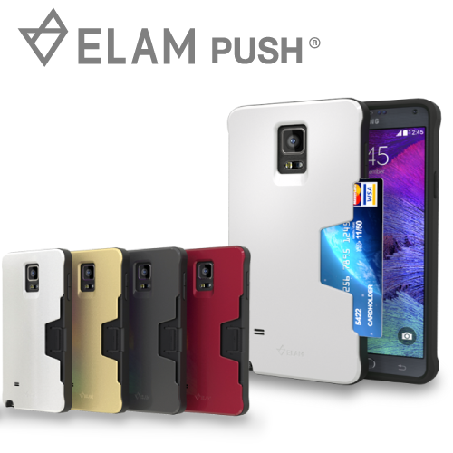
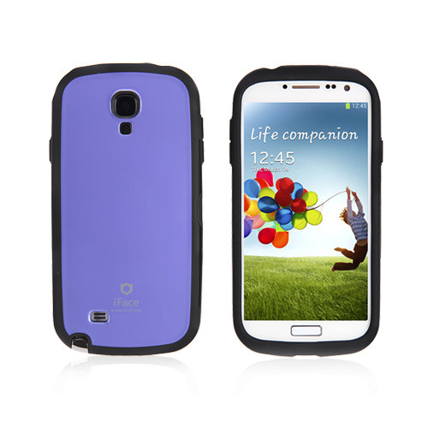
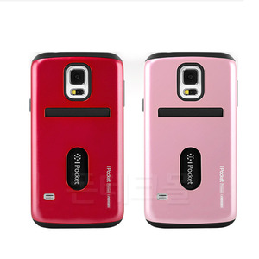
《 Products Comparison in Size(mm) & Color 》
iface innovation
ELAM-push
Goospery ipocket premium
Thickness | Thick | Slim | Thick
Size | 86 x 163 x 18 | 83 x 158 x 15 | 84 x 159 x 18
Color | Solid color | Pearl color | Solid color

Slide 4
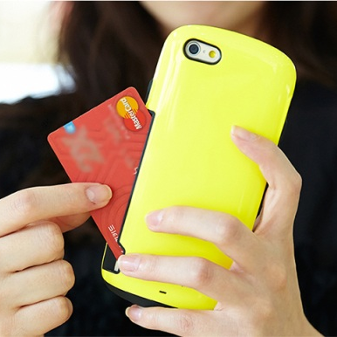
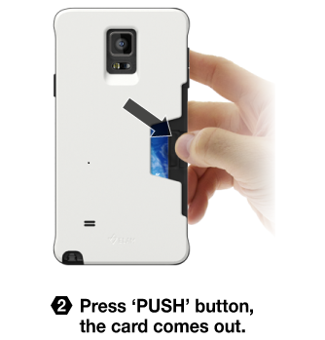
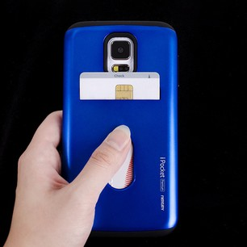
《 Card Holding system 》
iface innovation
ELAM-push
Goospery ipocket premium
Comparison | iface innovation | ELAM-push | Goospery ipocket premium
Card Holding system | Manually (Putting card in to & out is difficult) | Semi-auto (easy in & out –press PUSH button) | Manually (Putting in to & out is difficult)
Transportation card recharging | Unavailable | Available | Available
Card dropping safety | Card may falling out of the case. | Card never falling out of the case (push-button holds the card) | Card may falling out of the case
Card damage | Magnetic can be scratched. | Magnetic is protected. -Card buttress lines are placed in between 2 PC plates (card is in the air between two plates) | • Magnetic can be scratched. • Card may be bended

Slide 5

http://www.youtube.com/watch?v=GxqRIZA38Cw
http://www.youtube.com/watch?v=GxqRIZA38Cw
http://www.youtube.com/watch?v=GxqRIZA38Cw
http://www.youtube.com/watch?v=GxqRIZA38Cw
《 Easy remove (card)》
http://www.youtube.com/watch?v=GxqRIZA38Cw

Slide 6
《 Springs》
Trouble –free springs( Patent )
for smooth card in & out
http://youtu.be/59pmB5gYTOI

Slide 7
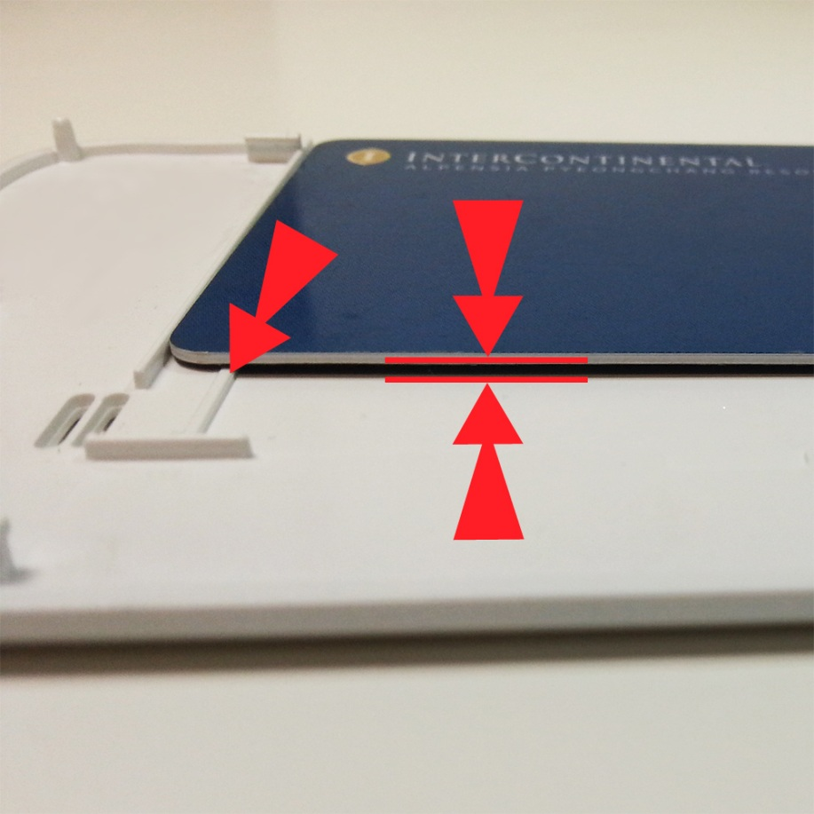
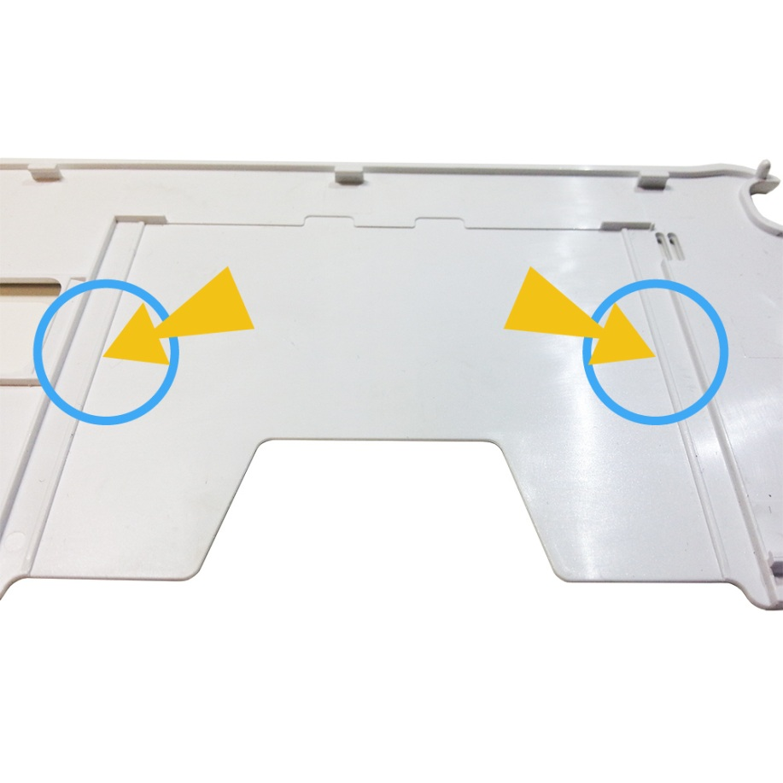
《 magnetic Protection》
Card magnetic protection by 2 slim buttress which are placed in between 2 PC plates

Slide 8
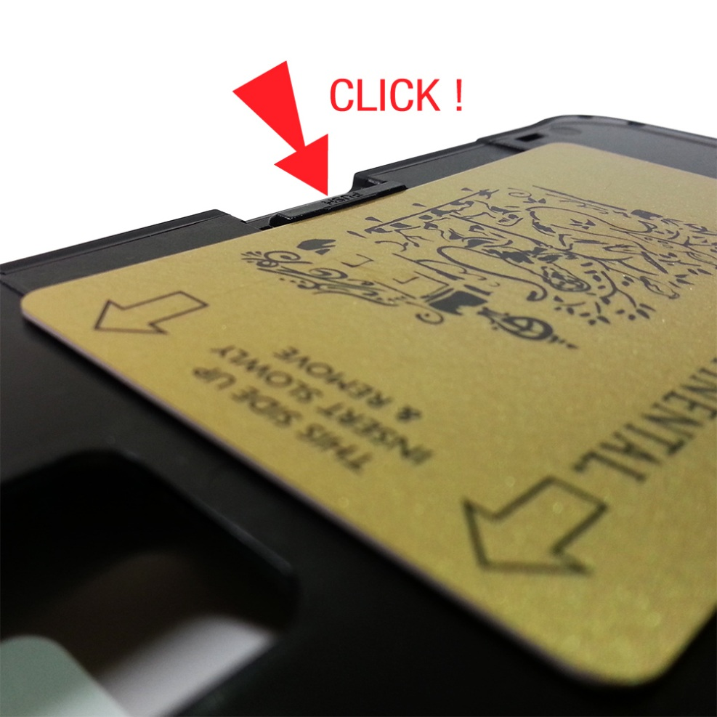
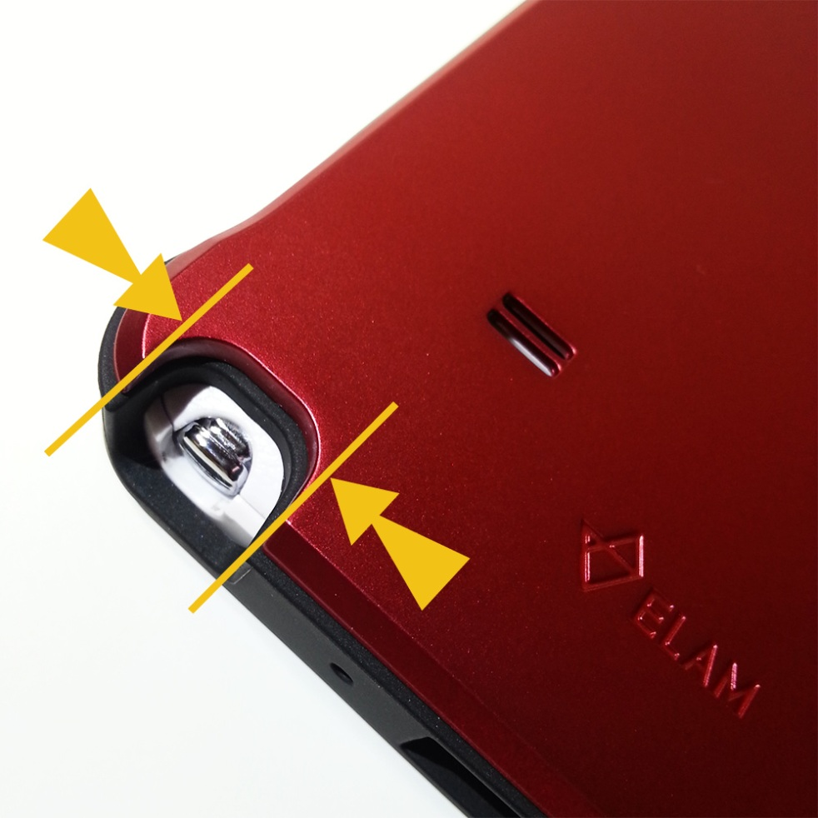
《 Push button& Wide S-pen hole 》
Push button to hold card tight
S-pen hole & Gorgeous pearl color

Slide 9
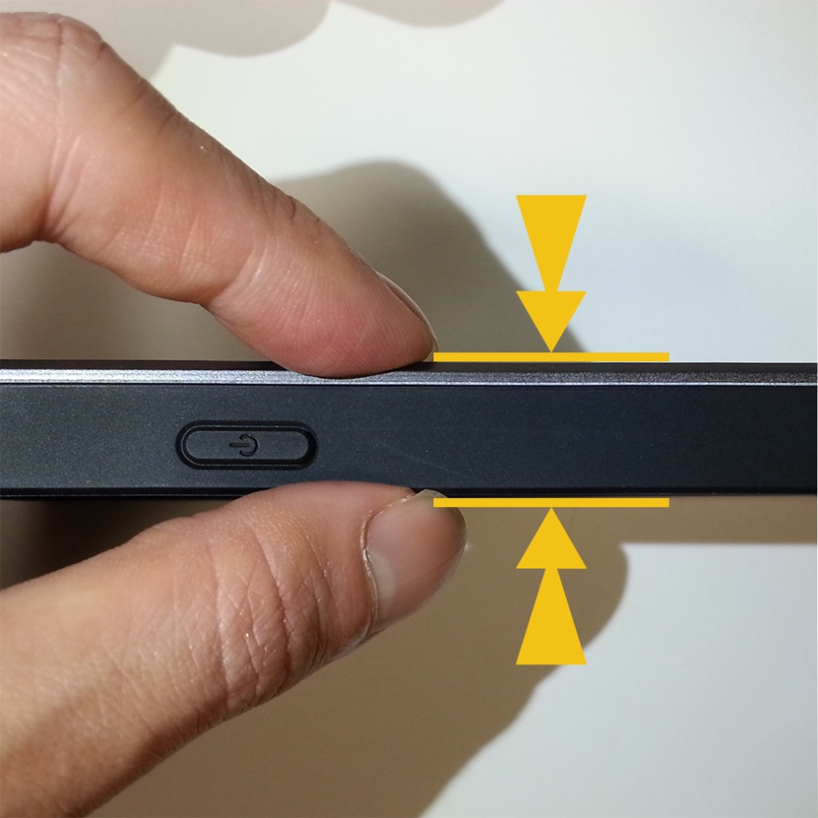
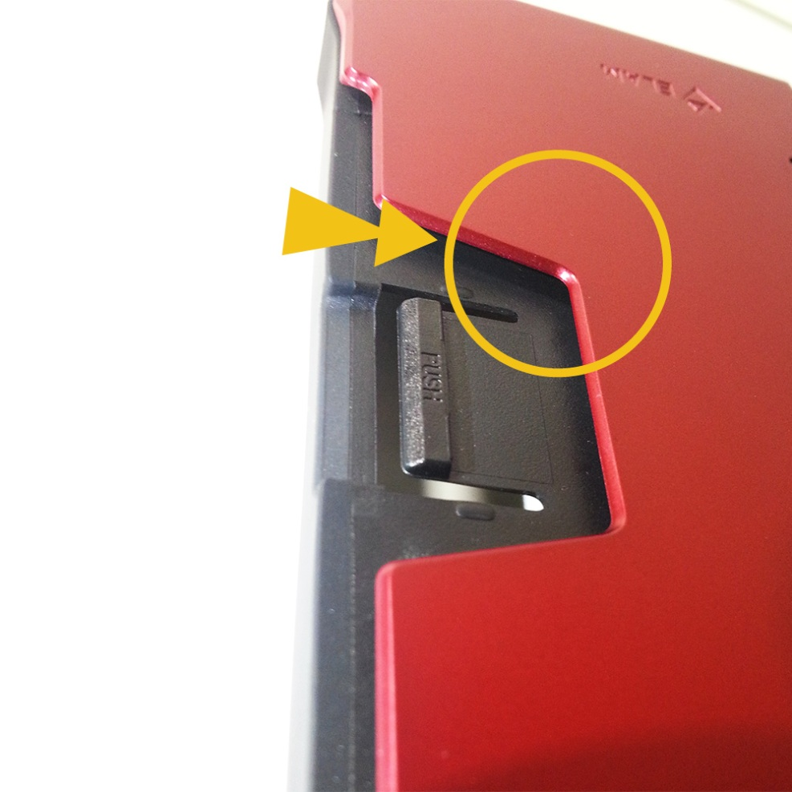
《 exterior》
Slim fit body
Thumb Fit Cut

Slide 10
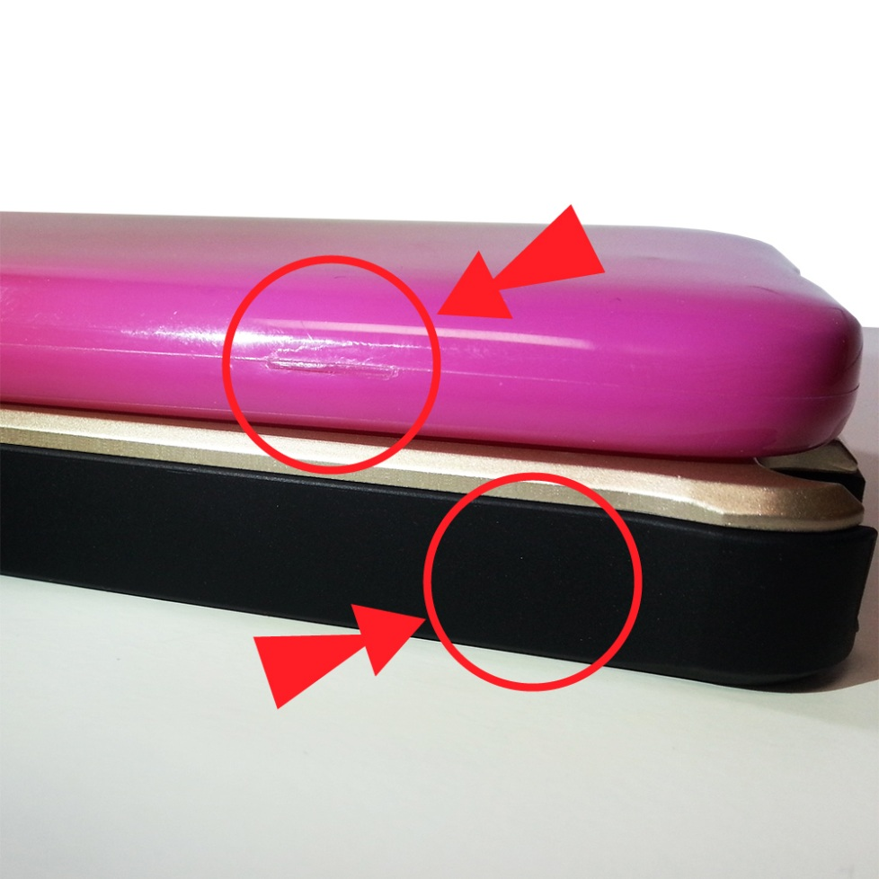
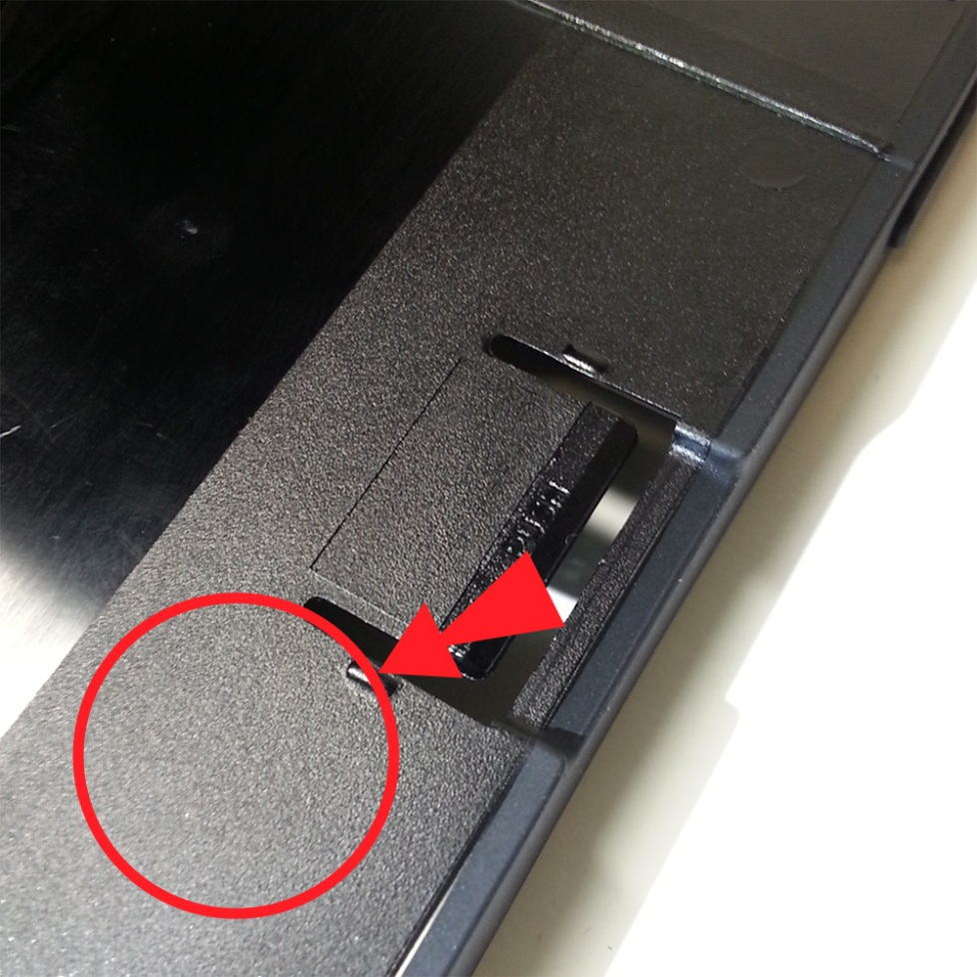
《 exterior》
No joint-line on TPU
Dirty- less Plate

Slide 11
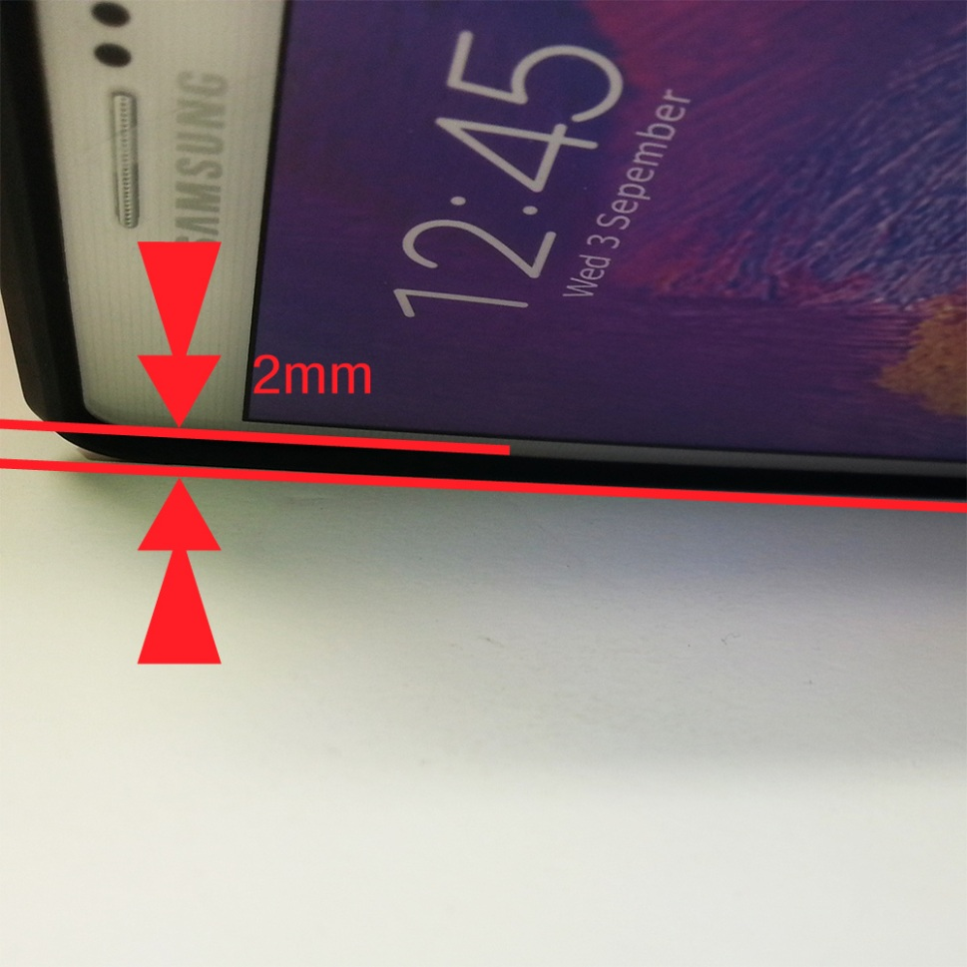
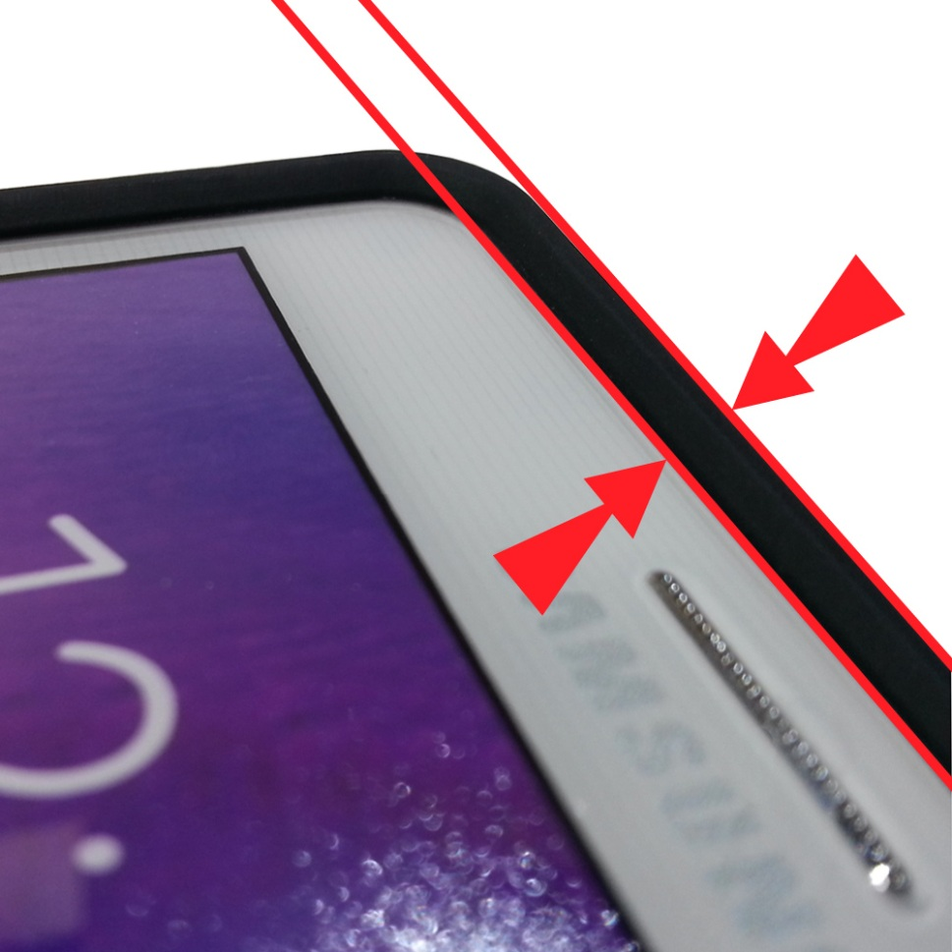
《 Screen protection》
Screen protection by prominent TPU

Slide 12
《 Price》
* Price is negotiable depends on your order quantity.

