Slide 1


SMART INDIA HACKATHON 2025
TITLE PAGE
Problem Statement ID – 25130
Problem Statement Title- Student Innovation
Theme- Heritage & Culture
PS Category- Software
Team ID-
Team Name (Registered on portal)

Slide 2
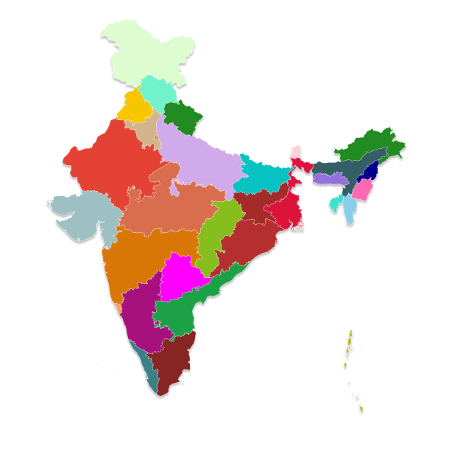
Cultural & Heritage of India
Your Team Name
An interactive website showcasing India’s rich culture and heritage.
AI Chatbot guide to answer user queries in a cultural way.
AR/VR integration for scanning monuments and exploring history.
Currency converter & language translation for global accessibility.
Interactive Indian map with state-wise info (food,monuments, festivals,etc.).
Recommendation & prediction system suggesting best times to visit.
Covers History, Arts, Crafts, Music, Food, Clothing, Festivals & more in one platform.

Slide 3







TECHNICAL APPROACH
Your Team Name
Technical Approach
Frontend: HTML , React , CSS , Javascript
Backend: Express JS, Node JS , MongoDB.
AI: Fast API , LLM Grok
AR: Framework(AR.js or MindAR.js) , Backend(Node.js + MongoDB)
APIs: Currency converter and language translation integration.
Visualization: Interactive map with state-wise details
Methodology and process for implementation (Flow Charts/Images/ working prototype)

Slide 4
FEASIBILITY AND VIABILITY
Your Team Name
Analysis of Feasibility
Uses proven technologies (Web development, AI, AR, APIs).
Scalable nationwide with modular updates for each state and cultural dataset.
Accessible via web browsers, ensuring availability for both domestic & international users.
Potential Challenges and Risk
Collecting & validating authentic cultural and historical data.
Handling multilingual translation accuracy.
AR performance may vary on low-end devices.
Strategies to Overcome Challenges
Use AI translation APIs (Google Translate, Azure Translator) with manual corrections for accuracy.
Optimize AR for progressive loading to support low-end devices.
Provide offline caching and lightweight versions of the website for areas with poor connectivity.
Partner with government tourism boards and cultural organizations for verified data.

Slide 5
IMPACT AND BENEFITS
Your Team Name
Preserves and promotes Indian culture & heritage digitally.
Enhances tourism experience with AI guides & AR history exploration.
Breaks language barriers through translations.
Facilitates global users with currency conversion & cultural insights.
Encourages inclusive learning for students, researchers, and travelers.
A one-stop cultural platform unmatched in detail and interactivity.

Slide 6
RESEARCH AND REFERENCES
Your Team Name
Ministry of Culture, Government of India – https://indiaculture.nic.in
Incredible India Tourism Portal – https://www.incredibleindia.org
UNESCO World Heritage Sites in India – https://whc.unesco.org
Research papers on AR/VR in heritage preservation & AI in tourism.
State tourism websites for authentic cultural and historical data.

Slide 7
IMPORTANT INSTRUCTIONS
Please ensure below pointers are met while submitting the Idea PPT:
Kindly keep the maximum slides limit up to six (6). ( Including the title slide)
Try to avoid paragraphs and post your idea in points /diagrams / Infographics /pictures
Keep your explanation precise and easy to understand
Idea should be unique and novel.
You can only use provided template for making the PPT without changing the idea details pointers (mentioned in previous slides).
You need to save the file in PDF and upload the same on portal. No PPT, Word Doc or any other format will be supported.
Note - You can delete this slide (Important Pointers) when you upload the details of your idea on SIH portal.

