Slide 1
CS240: Final project
By:
Abhilasha 23B1011
Arya 23B0902

Slide 2
Problem Statement
Input: Network graphs
Output: Performing classification tasks based on features of the graphs' nodes
Example:
Input: Cora Dataset on a set of papers and citations between them
Output: Classification tasks (which field does the paper belong to)

Slide 3
Motivation
Why is this an interesting problem?
Many real world datasets (social, citation, etc.) are best represented as graphs
Classifying nodes using both features and connections gives deeper insights
It’s a practical and relevant problem with broad usage

Slide 4
Motivation
What makes it interesting, impactful, or challenging?
Graphs are irregular structures, making them harder for standard models to handle
Requires models to learn from both node features and network structure
Very versatile, can be used for both supervised and unsupervised tasks; example: Useful in fraud detection, recommendations, and social analysis

Slide 5
Motivation
Is there a real-world application or gap this project addresses?
Fills a gap where traditional ML fails to use relational data
Helps in tasks like:
Detecting fake or inactive accounts
Recommending content
Analyzing user or document networks

Slide 6
Literature Review
Graph-based data is common in fields like social networks, biology and recommendation systems
Traditional machine learning models struggle with relational and irregular data structures
GNNs were developed to combine node features with structural information for tasks like node classification, link prediction, and clustering
Early models like GCN (2016) and GAT (2017) showed how deep learning can effectively process node features and relationships.

Slide 7
Literature Review
"Semi-Supervised Classification with Graph Convolutional Networks" (2016)
Available at: https://arxiv.org/abs/1609.02907
"Understanding Graph Attention Networks: A Practical Exploration" (2020)
Available at: https://medium.com/@farzad.karami/understanding-graph-attention-networks-a-practical-exploration-cf033a8f3d9d
"Graph Attention Networks" (2017)
Available at: https://arxiv.org/abs/1710.10903

Slide 8
Dataset
Each node in the graph represents a scientific publication, and edges represent citation links between them.
Sample Node Features (vector): [0,1,0,…,0,1]
(1433-dimensional one-hot/TF-IDF-like vector of word presence in the paper)
Corresponding Label (class): Neural_Networks
(the field which the paper was published in)

Slide 9
Dataset
Number of Nodes (Samples) : 2,708 papers
Number of Edges : 5,429 citation links
Number of Classes : 7 (paper topics like Neural_Networks, Rule_Learning, etc.)
Number of Features per Node : 1,433
Task Type : Node classification
Graph Type : Undirected citation graph
Class | Count
Neural_Networks | 818
Rule_Learning | 237
Reinforcement_Learning | 208
Probabilistic_Methods | 426
Theory | 351
Genetic_Algorithms | 418
Case_Based | 250

Slide 10
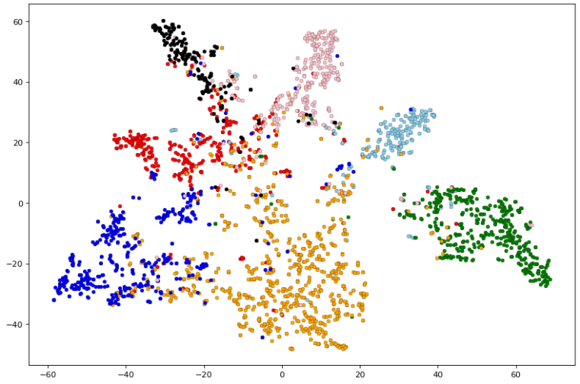
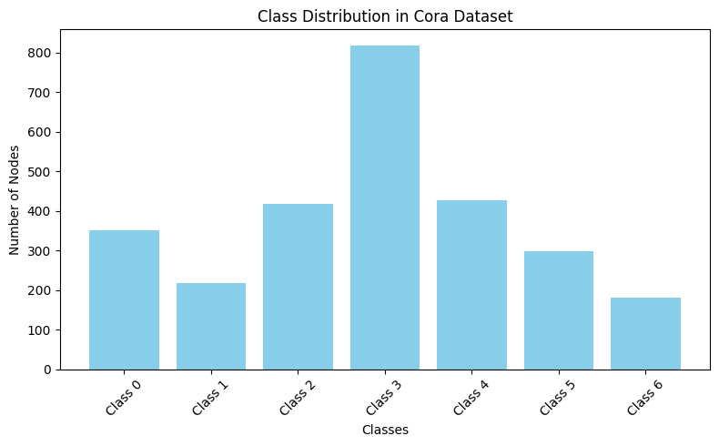
Dataset
Dataset Name : Cora Citation Network
Title of Paper : “Collective Classification in Network Data”
Link to Dataset : https://linqs.soe.ucsc.edu/data

Slide 11
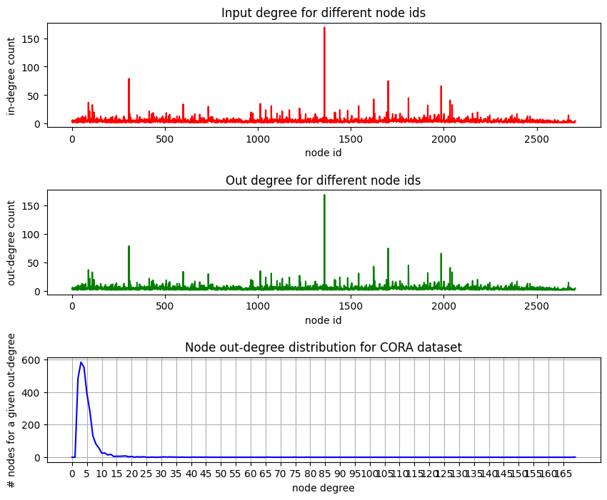
About the Dataset

Slide 12
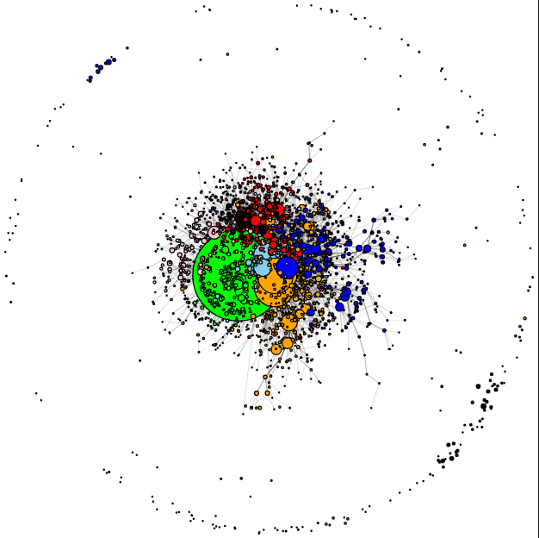
Visualizing the Graph

Slide 13
Method/Technique
We experimented with two popular graph neural network architectures:
Graph Convolutional Network (GCN)
Layers : GCNConv → ReLU → GCNConv
Function: Aggregates features from neighboring nodes using a fixed (averaged) weighting scheme
Graph Attention Network (GAT)
GATConv (multi-head attention) → Leaky RELU → GATConv
Function: Learns dynamic weights for neighbors using self-attention — giving more importance to relevant neighbors

Slide 14
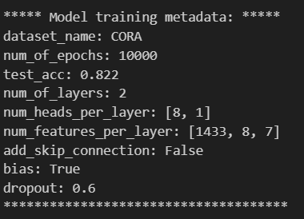
GAT Architecture
Cross Entropy Loss
2 Layers (GNNs are typically much shallower than CNNs)
Attention Heads: Subgraphs which the layer is concentrating on
num_of_epochs here is a bound; actual training done in around 2000 loops

Slide 15
GCN Architecture
Feature | GCN
Layers | 2
Hidden units | 64
Activation | ReLU
Optimizer | Adam (lr = 0.003)
Weight decay | 5e-4
Loss function | Cross Entropy Loss
Dataset | Cora (with NormalizeFeatures)
Epochs | 200

Slide 16
Method/Technique
GCN captures local structure efficiently and is computationally simple
GAT improves flexibility by learning which neighbors (edges) are most relevant via attention scores
Comparing both lets us explore the trade-off between simplicity (GCN) and expressiveness (GAT)
Libraries used : pyTorch, matplotlib, plotly, networkX, sklearn, scipy, numpy

Slide 17
Results
Accuracy in GCN: 82.20% (70.3% in paper)
Accuracy using GAT: 85.3% (83% in paper)
The given dataset is homophilic (evident from the very low difference between maximum and minimum edge weight)

Slide 18
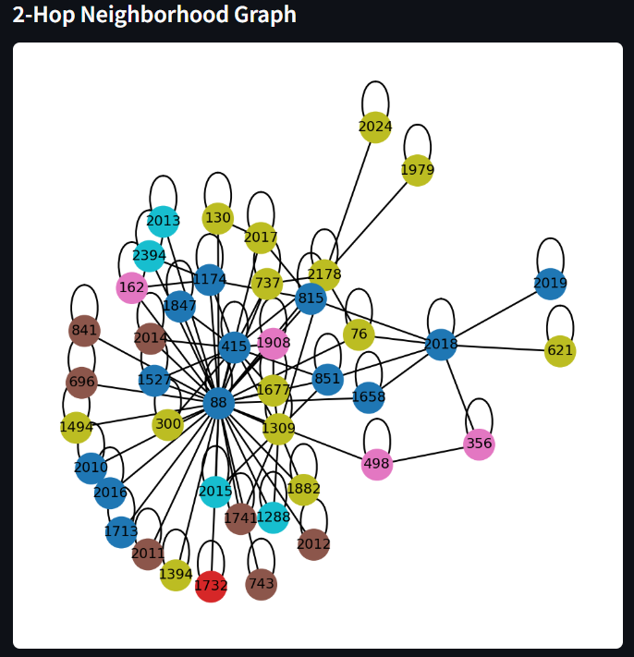
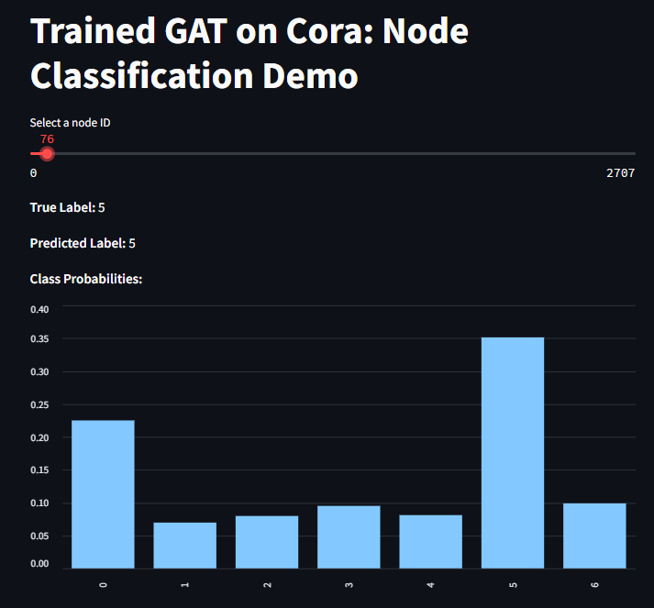
Analysis
Seeing that the minimum and maximum weights for edges are nearly the same, the dataset is homophilic
The errors usually stemmed from mis-labelling when a particular neighbor with higher weight had high variance in their neighbors but the node itself had low variance

Slide 19
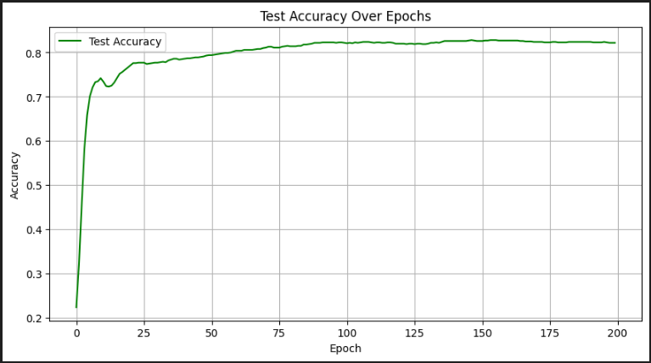
Error analysis - GCN
Assumes uniformly weighted edges, might miss out on some very crucial information about relation between edges and features of the endpoints

Slide 20
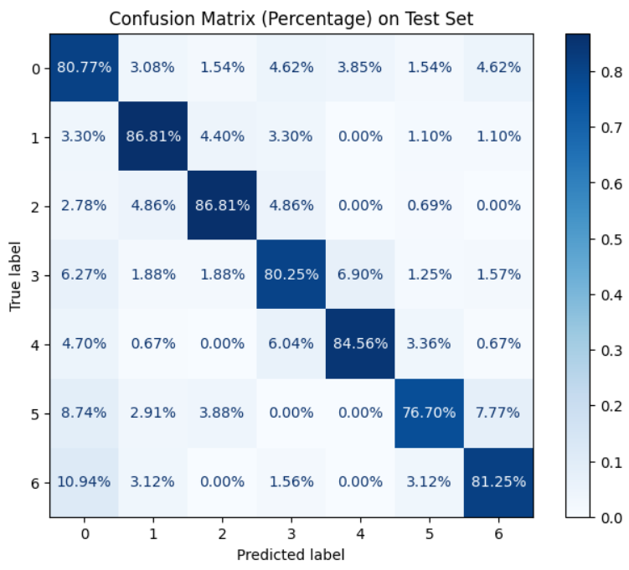
Error analysis

Slide 21
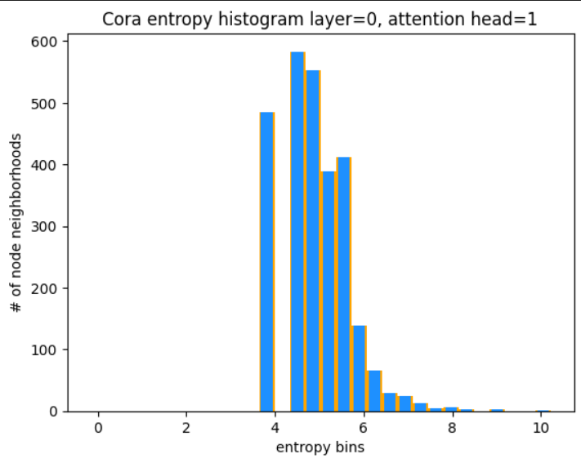
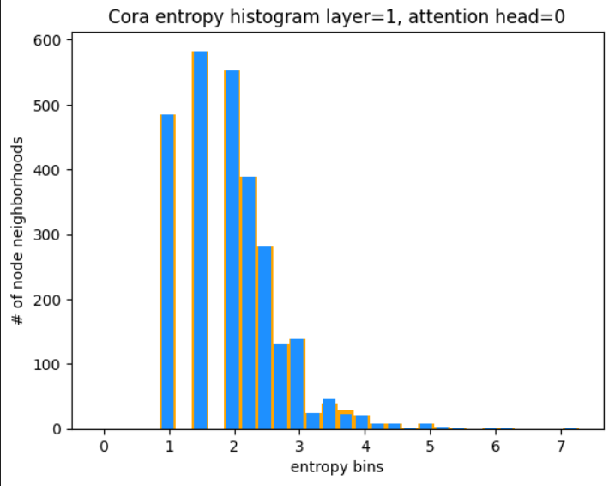
Improvements over the paper
Improved Accuracy from both papers (GCN and GAT)
Performed entropy analysis with different attention heads for different layers in GAT

Slide 22
Learnings
Performing classification tasks on unstructured data like graphs cannot be performed by structured algorithms
Key Takeaways
Graph Neural Networks are a powerful model to do both transductive and inductive tasks
Some graphs which represent heterophilic data needs to be dealt with using different weights for different edges (GATs)
Technical Learnings
GATs outperform GCNs due to their ability to handle more general graph-based data
GNNs are much shallower than CNNs due to the more irregular and non hierarchial nature of the underlying data they need to work on

Slide 23
Summary and Conclusion
Performing classification tasks on unstructured data like graphs cannot be performed by structured algorithms
Graph neural networks become useful in such cases to spot patterns and derive information about graph embeddings
Potential future work could include efficient online addition of nodes and edges

Slide 24
Thank YOU

