Slide 1
Lab 4

Slide 2
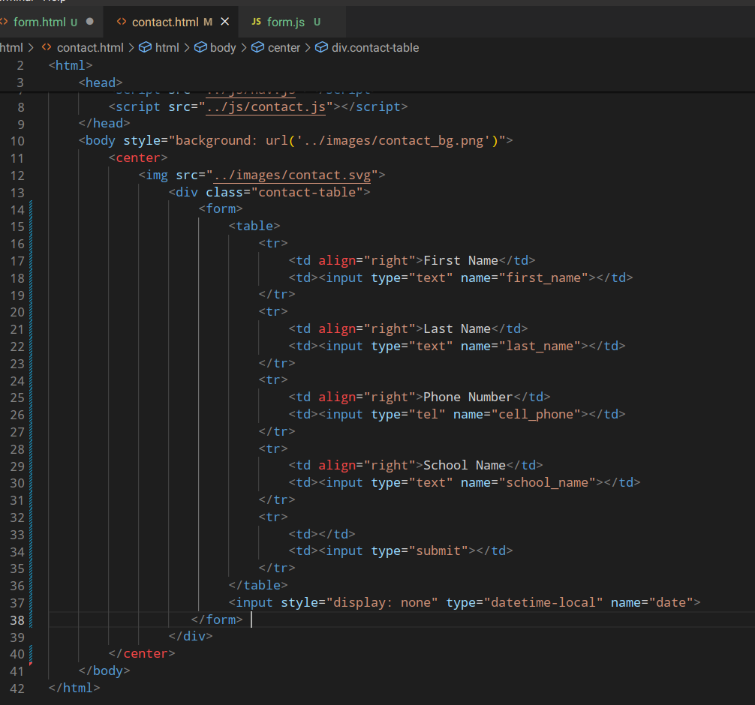
Step 1: Create an HTML form

Slide 3
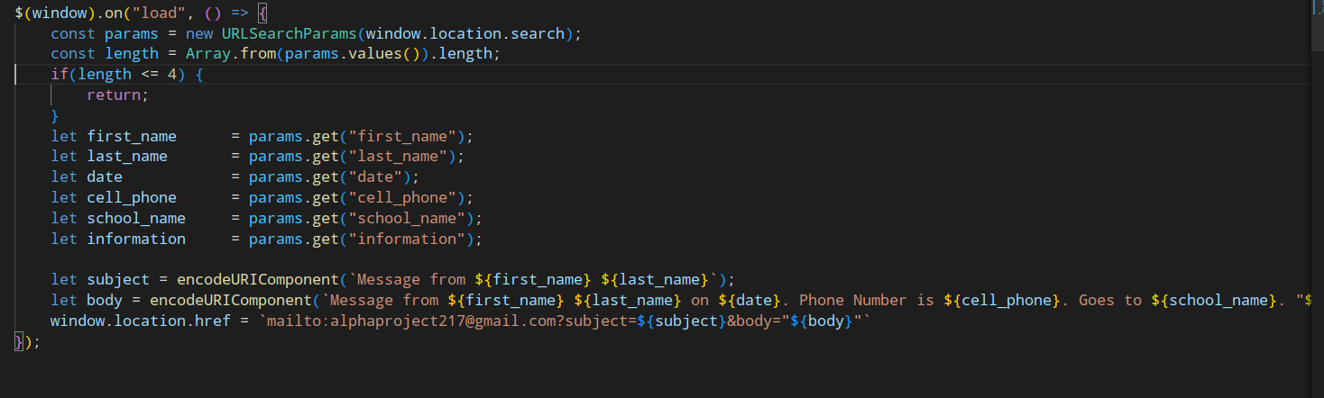
Step 2: Make it send an email

Slide 4
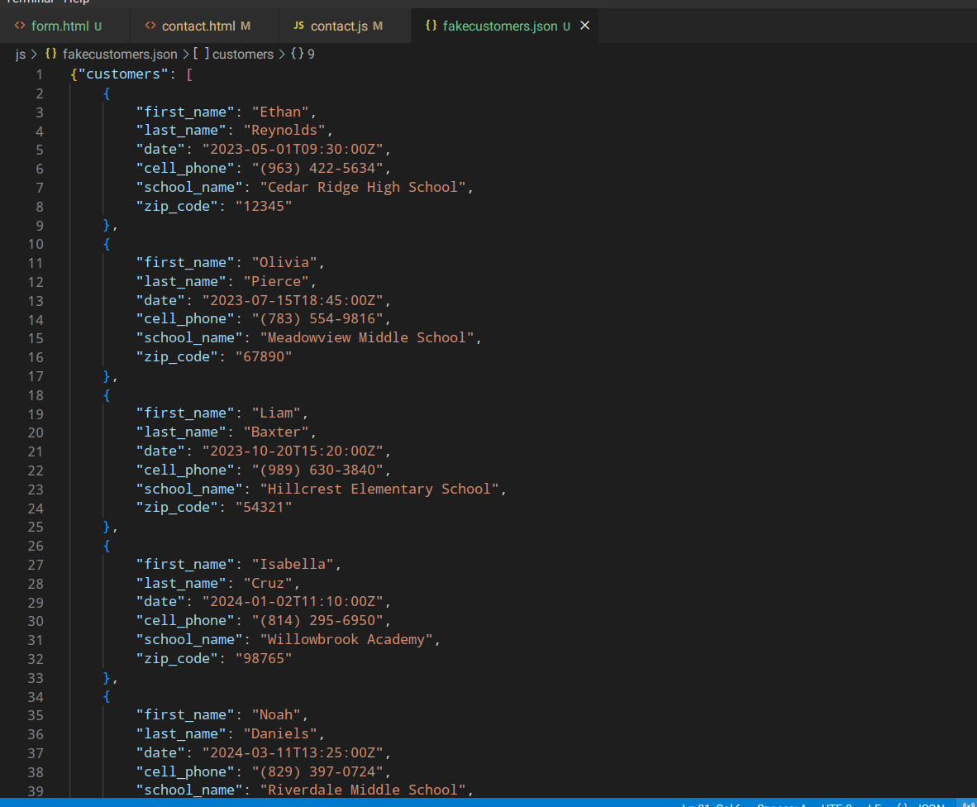
Step 3: Create a JSON file with fake people who entered the form

