Slide 1
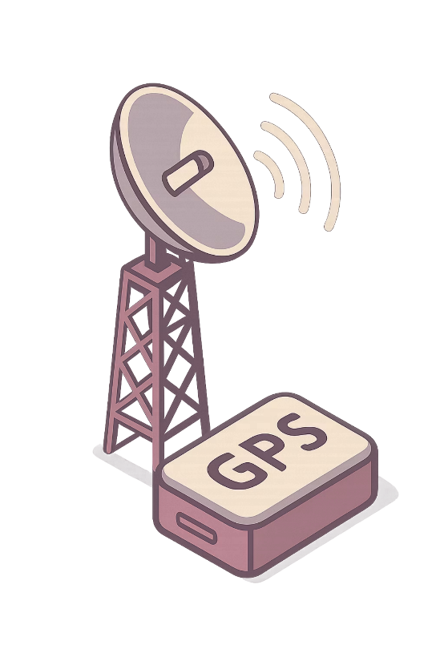
IoT-Based Asset Tracking System Using LoRa and GPS
Team & Course
Team Members
Team: IoT Innovators
Adam Amr — 55-4111
Kareem Emad — 55-4357
George Ehab — 55-25881
Farah Khaled — 55-5083
Rahma Mohamed — 55-23548
Course: Internet of Things
Instructor: Dr. Tallal El Shabrawy

Slide 2
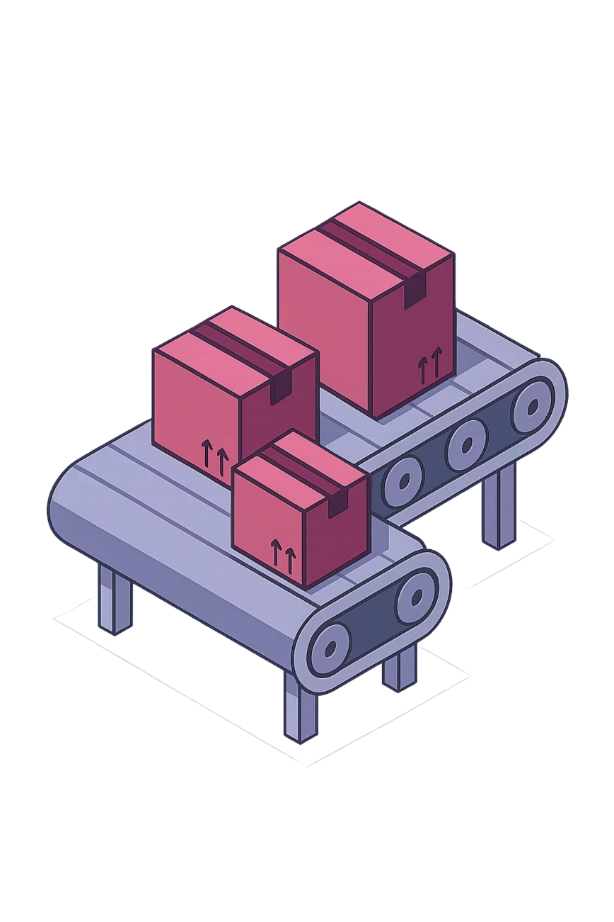

Introduction & Problem Statement
Asset tracking is critical for logistics, equipment monitoring, and location-aware IoT applications. Many traditional systems rely on GSM, Wi-Fi, or Bluetooth — each carrying trade-offs in power consumption, communication range, or cost.
The Problem
Why It Matters
Tracking assets efficiently and reliably across varying environments without excessive cost or power draw.
Smart logistics, equipment tracking, and field monitoring all demand dependable, scalable location solutions.
Our Goal
Build a low-cost, low-power, long-range prototype that transmits asset location wirelessly and displays it clearly.
Our solution combines GPS for location acquisition and LoRa for long-range wireless transmission — addressing the core limitations of existing approaches.

Slide 3

Related Work
Existing tracking technologies each solve part of the problem, but none offer a complete balance of range, power efficiency, cost, and ease of monitoring.
GPS + GSM Trackers
Bluetooth / Wi-Fi Trackers
LoRa-Based Tracking Systems
Strengths: Real-time tracking with broad cellular coverage.
Strengths: Well-suited for short-range or indoor environments.
Strengths: Long-range, low-power communication ideal for IoT deployments.
Limitations: Higher power consumption, SIM/data costs, and dependence on cellular infrastructure.
Limitations: Limited range and dependence on nearby infrastructure access points.
Limitations: Some systems lack visualization features, historical monitoring, or have infrastructure dependencies.
Our project targets a practical balance using GPS + LoRa + dashboard visualization — combining the best of each approach while minimizing their individual drawbacks.

Slide 4
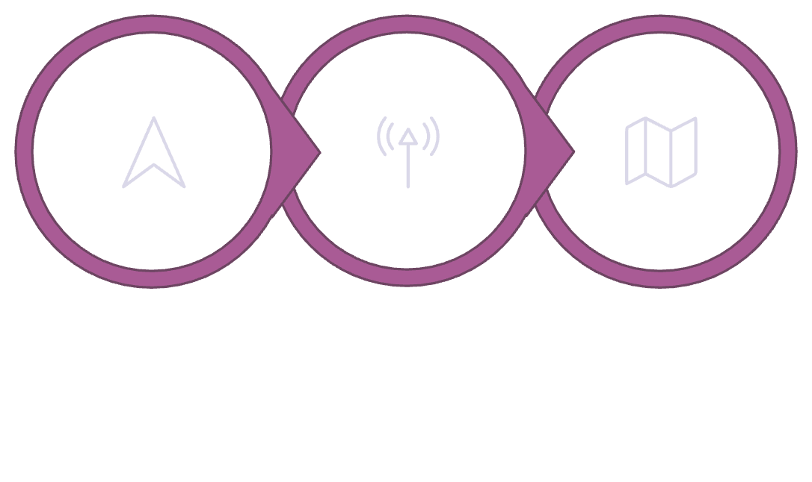
Proposed Solution
Our proposed system is an IoT asset tracking solution built around three core components working in concert to deliver real-time, long-range location monitoring.
System Components
How It Works
Sender node attached to the asset
Receiver node at the monitoring station
Dashboard interface for visualization
Sender reads real-time coordinates from a NEO-6M GPS module
Coordinates are transmitted via the LILYGO LoRa32 board
Receiver LoRa board captures the transmitted data
Location is forwarded to the dashboard for visualization
Dashboard displays live position and stores history
Sender Node
LoRa Link
Receiver & Dashboard
The architecture enables long-range data transmission, live location visualization, and a historical movement trail as the mandatory additional feature.

Slide 5

Key Features of the System
Real-Time Asset Tracking
GPS Coordinate Acquisition
Continuously acquires and transmits the live location of the tracked asset.
Uses the NEO-6M GPS module to read latitude, longitude, and satellite count.
Long-Range LoRa Communication
Historical Movement Trail
Transmits data over long distances with minimal power consumption using LoRa protocol.
Records and displays the recent path of movement — the mandatory additional feature of this project.
Dashboard Visualization
Power Usage Observation
Integrates Google Maps API for live map markers and stored coordinate records.
Measures and monitors power consumption to evaluate system efficiency.
The historical movement trail allows users to see not only the current location, but also the recent path of movement — enabling richer analysis and monitoring.

Slide 6
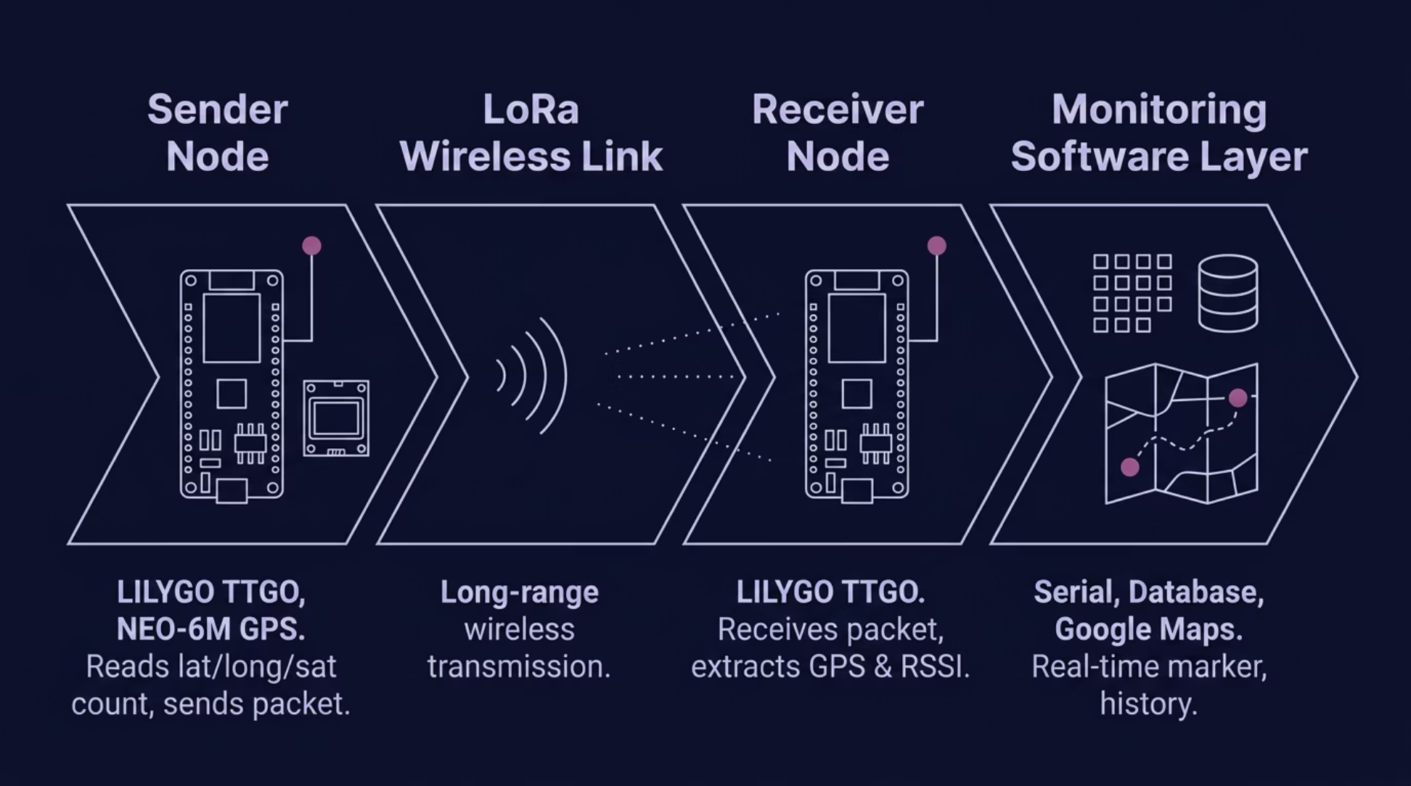

System Architecture
The system is organized into four functional layers, each responsible for a distinct part of the tracking pipeline.
GPS Sensor
Sender Node
Receiver Node
Software & Dashboard
NEO-6M GPS module
Reads latitude, longitude, satellite count
LILYGO TTGO LoRa32-OLED board
Parses GPS data
Packages and sends data via LoRa
LILYGO TTGO LoRa32-OLED board
Receives LoRa packet
Extracts GPS coordinates and RSSI
Displays and prepares data for backend/software layer
Serial or backend interface
Database storage for coordinates
Google Maps API integration
Real-time marker + movement trail

Slide 7
Implementation Plan
The project is structured as a focused 4-week development timeline, with clear deliverables at each milestone.
Week 1 ✓
Week 3
Stabilize hardware, firmware, and payload format. — Completed
Add historical trail, geofence, and documentation.
1
2
3
4
Week 2
Week 4
Connect receiver/backend path and build dashboard v1.
Final integration, testing, power measurement, and demo prep.
Task Distribution
Firmware / Hardware
Backend / Integration
GPS integration, LoRa transmission, testing.
Data ingestion, database, API/backend logic.
Frontend
QA / Documentation
Dashboard, map, history trail, geofence display.
Logs, screenshots, report, slides, demo prep.

Slide 8

Progress So Far
Significant progress has already been achieved, validating the core communication chain of the system ahead of schedule.
1
Correct TTGO LoRa32 Board Configuration Confirmed
2
NEO-6M GPS Successfully Connected and Tested Outdoors
The correct TTGO LoRa32 boards were identified and configured with the proper port settings and firmware.
The NEO-6M GPS module was connected and validated outdoors, with valid coordinates acquired along with satellite count and HDOP.
3
Structured LoRa Payload Implemented
4
Sender Successfully Transmits Live GPS Payloads Over LoRa
A structured payload format was defined and implemented for device ID, fix, latitude, longitude, UTC timestamp, satellites, HDOP, and uptime.
The sender node is now transmitting live GPS payloads over LoRa reliably.
5
Receiver Successfully Receives and Parses the Full Payload with RSSI
6
Receiver OLED Issue Identified and Bypassed
The OLED output issue on the receiver was identified and bypassed; all data was verified through the Serial Monitor.
The receiver node successfully receives, parses, and displays the full payload, including RSSI signal strength.
7
Firebase Realtime Database Selected and Initialized
8
Week 1 Deliverables Completed
Firebase Realtime Database was chosen as the backend. Initial schema created for latest and history location records.
Firmware stabilization, wiring documentation, payload definition, backend choice, and initial schema setup have all been completed.
Milestone Status: The core communication chain — GPS acquisition → LoRa transmission → receiver display — is fully operational and validated.

Slide 9
Challenges & Next Steps
Challenges Faced So Far
Next Steps
Difficulty identifying correct board settings and COM ports during initial setup
USB cable and hardware interfacing issues requiring troubleshooting
01
02
Build the dashboard interface and backend
Integrate Google Maps API for live visualization
03
04
GPS fix acquisition required time and outdoor testing conditions
Pin mapping and wiring between GPS module and LoRa board needed careful verification
Implement real-time location updates on the dashboard
Store coordinates with timestamps in a database
05
06
Receiver OLED initialization caused watchdog resets — receiver validation completed through Serial Monitor output instead
Implement the historical movement trail feature
Measure system power behavior and consumption
07
Final integration, testing, and project demo preparation

Slide 10
Conclusion
Our project proposes a practical, well-validated IoT solution for asset tracking that balances performance, cost, and usability.
Validated Core System
Low-Cost & Long-Range
Live GPS acquisition, structured LoRa transmission, and receiver-side packet parsing have all been validated successfully.
The system is designed to be affordable and energy-efficient, suitable for real-world deployment and academic demonstration.
Next Milestone
Final System Vision
Dashboard integration and the historical movement trail are the immediate focus, bringing the system to full functionality.
The completed prototype will provide both live tracking and movement history visualization through an intuitive web dashboard.

Slide 11

Thank You
Questions?
Team — IoT Innovators
Project
Adam Amr — 55-4111
Kareem Emad — 55-4357
George Ehab — 55-25881
Farah Khaled — 55-5083
Rahma Mohamed — 55-23548
IoT-Based Asset Tracking System Using LoRa and GPS
Course: Internet of Things
Instructor: Dr. Tallal El Shabrawy

