Slide 1
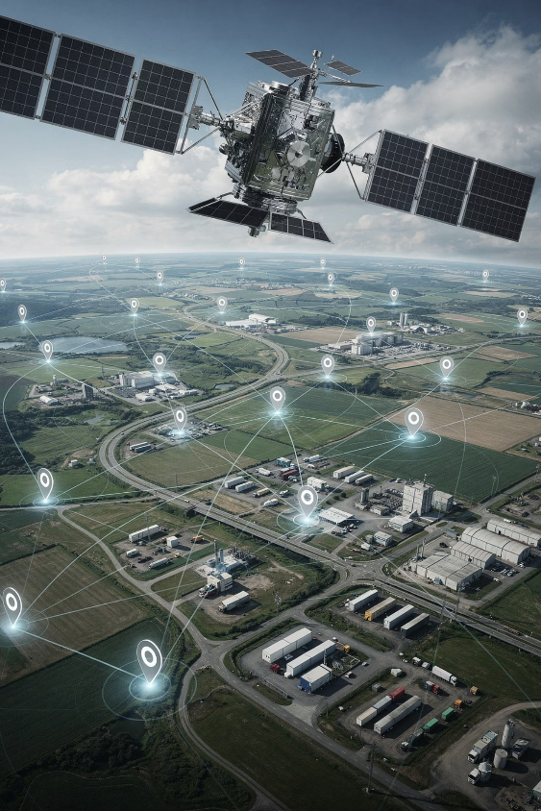
Outdoor Asset Localization
IoT-Based GPS + LoRa Tracking System
Team: IoT Innovators
Adam Amr 55-4111 | Kareem Emad 55-4357 | George Ehab 55-25881
Farah Khaled 55-5083 | Rahma Mohamed 55-23548
Course: NETW1010 — Internet of Things | Dr. Tallal El Shabrawy
1

Slide 2
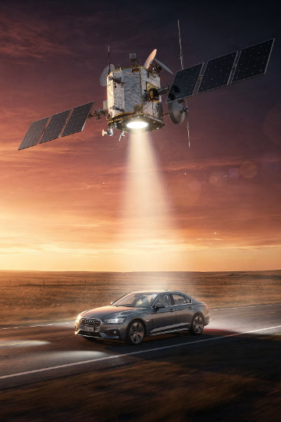

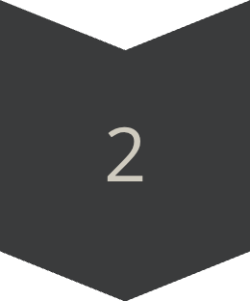
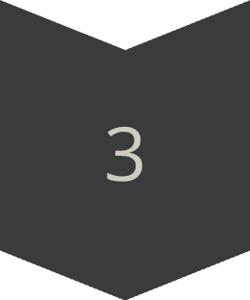
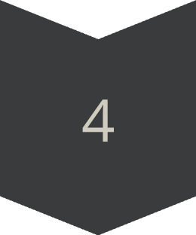
Project Idea
We built an IoT system that tracks outdoor assets in real time. End-to-end flow:
GPS Sender
Collects asset coordinates
LoRa Transmission
Sends coordinates long range
Receiver Gateway
Forwards data to Firebase via MQTT
Live Dashboard
Shows location, history, geofence, battery, and health
2

Slide 3
Problem & Motivation
The Challenge
Why LoRa?
Outdoor assets travel across large areas where WiFi is often unavailable. Traditional tracking depends on connectivity that may not exist in the field.
LoRa is ideal here because it is built for low-power, long-range communication.
No WiFi in open terrain
High cellular power use
Limited Bluetooth and Zigbee range
Long Range
Kilometers of coverage
Low Power
Battery life for extended use
No WiFi Needed
Works without internet infrastructure
3

Slide 4
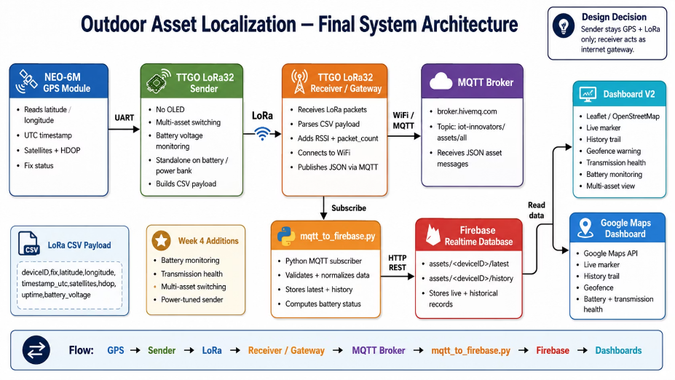
Final System Architecture
The Sender stays GPS + LoRa only for low power use. The Receiver handles WiFi, MQTT, and internet connectivity.
4

Slide 5
Hardware Components
NEO-6M GPS Module
1
Collects location, time, satellites, and HDOP.
TTGO LoRa32 Sender
2
Reads GPS data and sends LoRa packets from the asset.
TTGO LoRa32 Receiver
3
Receives LoRa packets and publishes them to MQTT via WiFi.
Battery
4
Powers the sender node in the field.
Laptop
5
Runs the Python backend and live tracking dashboard.
5

Slide 6
Sender Node
Role: Field Device on the Moving Asset
The sender is mounted on the moving asset. It reads GPS data via UART, builds a CSV payload, and transmits it over LoRa.
FINAL SENDER FEATURES
No OLED display to save power
Multi-asset ID switching for simulation
Battery voltage included in payload
Power-tuned transmit intervals
6

Slide 7
Receiver / Gateway
The receiver bridges the field and the cloud, removing the need for a COM-port serial bridge in the final architecture.
Listen for LoRa Packets
Parse CSV Payload
Add RSSI & Packet Count
Convert to JSON
Monitors the LoRa channel for incoming sender transmissions.
Splits the CSV string and extracts the GPS fields.
Appends signal strength and packet counter metadata.
Formats the data as JSON for MQTT publishing.
Connect WiFi & Publish MQTT
Joins WiFi and publishes to the MQTT broker.
7

Slide 8

Payload Format
Original Payload (Early Version)
Final Week 4 Payload
deviceID,fix,latitude,longitude,
timestamp_utc,satellites,
hdop,uptime
deviceID,fix,latitude,longitude,
timestamp_utc,satellites,
hdop,uptime,battery_voltage
Basic GPS fix and position fields.
Added battery_voltage to monitor power behavior.
Live example:
ASSET-03,1,29.992250,31.555190,2026-05-24T19:53:12Z,5,2.4,807,3.84
8

Slide 9


MQTT + Firebase Backend
MQTT Topic
Firebase Data Paths
iot-innovators/assets/all
Latest position:
assets/<deviceID>/latest
The Python backend subscribes to this topic and validates each incoming message.
Subscribe to MQTT
History trail:
assets/<deviceID>/history
Listens for JSON messages
This structure supports live updates and historical tracking at the same time.
Validate & Normalize
Standardizes fields and formats
Compute Battery Status
Derives NORMAL, LOW, or CRITICAL
Upload to Firebase
Writes latest and history paths
9

Slide 10
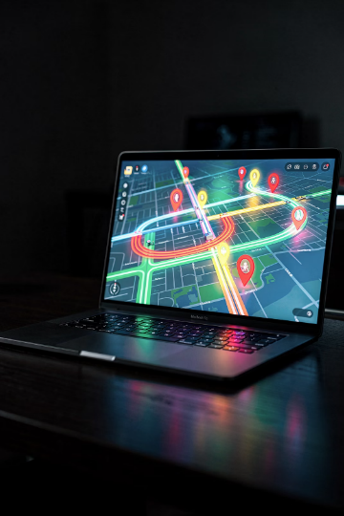
Dashboard V2
Dashboard V2 uses Leaflet and OpenStreetMap for an open-source, reliable, billing-free interface. It is the primary stable view for the system.
Live Tracking
Signal & Power
Live map marker
GPS status
Coordinates
UTC time
RSSI strength
Battery voltage
Battery label
Asset status
Advanced Features
Geofence zone
History trail
Transmission health
Asset dropdown
10

Slide 11
Google Maps Dashboard
Google Maps API Implementation
A Google Maps API version was also implemented to meet the requirement. It mirrors Dashboard V2 with the familiar Google Maps interface.
Live Marker
History Trail
Geofence
Battery & Health
Real-time position
Movement path
Circular zone
Power and status
11

Slide 12
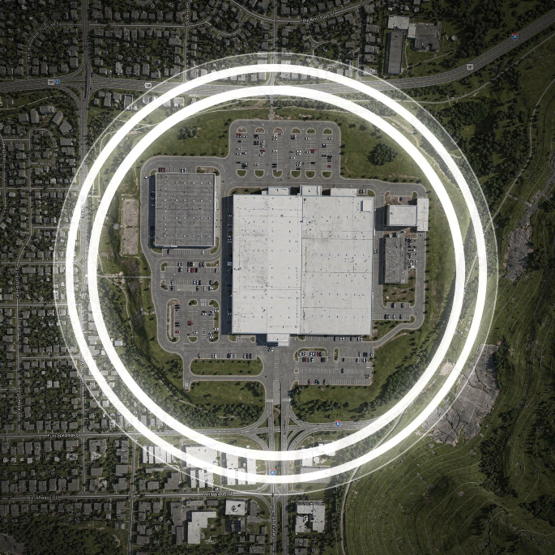
Geofence Feature
Circular Geofence Implementation
We implemented a circular geofence directly in the dashboard. The system continuously checks the asset’s GPS position against the zone center.
✅ Inside Zone
Asset is within the radius — green status shown
⚠️ Outside Zone
Asset crosses the boundary — warning alert triggers
The geofence radius and center are configurable for any site perimeter.
12

Slide 13

History Trail
Firebase Storage Path
What the Trail Shows
The history trail helps operators understand asset behavior over time.
assets/<deviceID>/history
Each GPS record is appended to Firebase, creating a time-ordered history of positions.
Movement Path
Time Context
Connected line of recorded positions
Each point includes a UTC timestamp
The dashboard uses the latest records to draw a connected polyline on the map.
Route Replay
Review where the asset traveled
13

Slide 14

Week 4 Additional Feature: Transmission Health
The dashboard analyzes packet_count values from Firebase history to detect data gaps in the LoRa/MQTT pipeline.
Latest
N
Δ
Packet Number
Records Checked
Missing Packets
Most recent packet count from Firebase
History entries analyzed for gaps
Detected sequence gaps in the stream
OK
Health Status
Overall status: GOOD, DEGRADED, or POOR
Transmission Health helps detect LoRa/MQTT data gaps during testing and deployment, enabling faster troubleshooting.
14

Slide 15
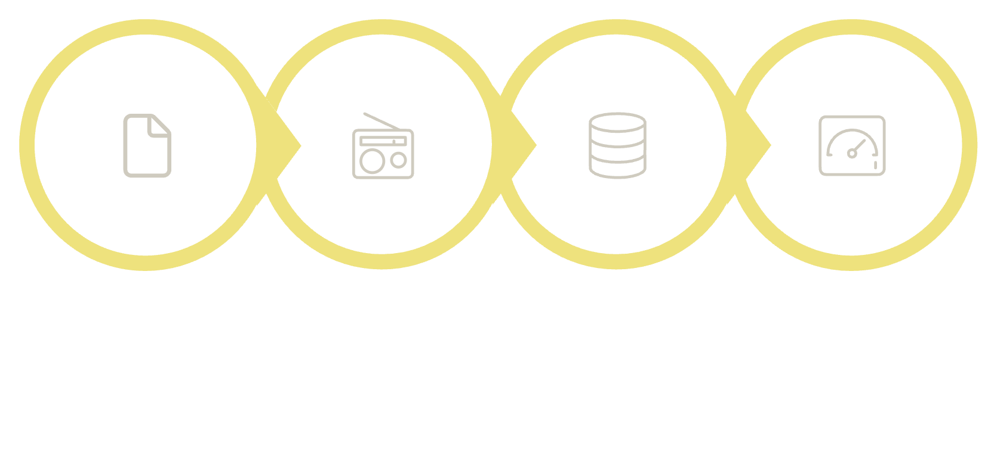

Battery Monitoring & Power Behavior
End-to-End Battery Pipeline
Live Example Result
Battery Voltage: 3.84 V
Battery Status: NORMAL
The sender reads battery voltage and includes it in each LoRa transmission. The Python backend converts voltage into a human-readable status.
Read Voltage
Send Payload
Store & Compute
Display Status
🟢 NORMAL
🟡 LOW
Above safe threshold
Near depletion
🔴 CRITICAL
Needs immediate attention
This supports the Week 4 power behavior observation requirement.
15

Slide 16
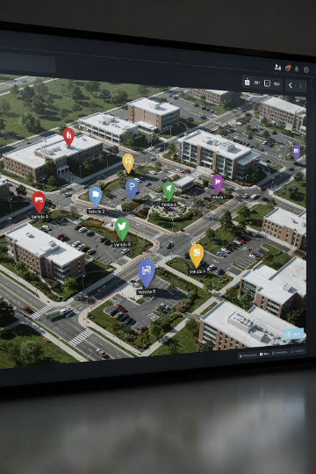



Multi-Asset Support
The sender cycles through multiple asset IDs over time, simulating a realistic multi-asset deployment from a single device.
ASSET-01
ASSET-02
ASSET-03
First tracked asset in the rotation cycle
Second tracked asset in the rotation cycle
Third tracked asset in the rotation cycle
This is more realistic than static simulation — one sender behaves like multiple assets over time. The dashboard dropdown lets operators select and monitor each asset independently.
16

Slide 17
Final Demo Scenario
The live demo shows the full end-to-end system in real-world conditions.
Sender on Golf Car
1
Device rides on a moving golf car, powered by battery or power bank
2
LoRa Transmission
Sender broadcasts GPS payload wirelessly across the outdoor area
Receiver in Hall
3
Receiver stays in the presentation hall, connected to laptop and WiFi
4
MQTT → Firebase
Backend uploads parsed data to Firebase in real time
Live Dashboard
5
Dashboard shows movement, trail, battery, and health status
17

Slide 18
Testing Results
Screenshots and outputs confirm successful end-to-end testing with ASSET-03.
Live Dashboard — ASSET-03
Firebase — Latest & History Updated
Dashboard showed live marker, 3.84 V, NORMAL, history trail, and active transmission health.
Realtime Database updated both latest and history on every packet.
Receiver Serial Monitor
Backend Upload Confirmed
Serial output confirmed LoRa reception, parsing, and MQTT publishing with correct RSSI and packet count.
Python logs confirmed MQTT subscription, validation, and Firebase upload for each packet.
18

Slide 19
Limitations
Known Constraints
Technical Limitations
GPS Indoor Fix
Public MQTT Broker
Battery Voltage Accuracy
Multi-Asset Switching Gaps
GPS may be weak or unavailable indoors due to signal obstruction.
Testing uses a public broker, which is not suitable for secure production.
Voltage is an ADC approximation, not a direct current measurement.
Brief transmission gaps may appear during asset ID switching.
LoRa Range Variables
Range depends on antenna quality, distance, and obstacles.
19

Slide 20

References
These peer-reviewed papers informed the design and implementation of this IoT asset tracking system:
1
2
3
Johnsen et al.
Wijayapraja et al.
Muladi et al.
MQTT over LoRa for Tracking
Explored MQTT over LoRa for asset tracking and established the communication pattern used here.
IoT-LoRaWAN Ambulance Tracking with Firebase/MQTT
Showed a LoRaWAN tracking system with Firebase and MQTT, closely matching this architecture.
LoRa Mesh GPS Tracking for Outdoor Safety
Examined LoRa mesh GPS tracking and offered insights on range, reliability, and multi-node deployment.
20

Slide 21

Conclusion
We built a complete IoT asset tracking system, from hardware to dashboard.
GPS + LoRa
MQTT + Firebase
Live Location
Long-range, low-power field communication
Reliable cloud backend with real-time sync
Real-time marker on map
History Trail
Geofence
Multi-Asset
Movement path visualization
Inside/outside alerts
Switchable asset IDs
Battery Monitor
TX Health
Voltage status classification
Packet gap detection
We demonstrated the system live with a GPS sender on a moving golf car, proving the full IoT pipeline works in the real world.
21

Slide 22
Thank You!
IoT Innovators
Thank you for your time. We’re happy to answer questions about our design, implementation, or results.
Adam Amr
Kareem Emad
George Ehab
55-4111
55-4357
55-25881
Farah Khaled
Rahma Mohamed
55-5083
55-23548
NETW1010 — Internet of Things | Dr. Tallal El Shabrawy
22

