Slide 1

Swami Keshvanand Institute Of Technology,
Management and Gramothan
Jaipur
Department Of Computer Science & Engineering
Summer Training/Internship
Front-end
WEB DEVELOPMENT
Coordinator:
Nidhi Srivastav
ASSISTANT PROFESSOR
Presented By:
Krishna Swami
22ESKCY029
CSE(IoT) 5th sem

Slide 2
INTRODUCTION
This training is organized by Front-End web development
Here we learnt about various languages used for web development like HTML,CSS,JAVA Script.
Responsive Web Design is used in all types of modern web development
Web development refers to the building, creating, and maintaining of websites.
Frontend Development: The part of a website that the user interacts directly is termed as front end.

Slide 3

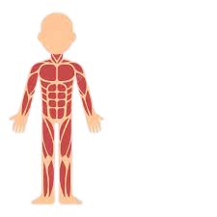
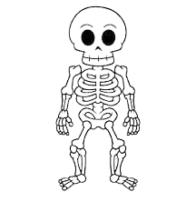
Web Page
HTML
CSS
JS
skeleton
style
functionality

Slide 4
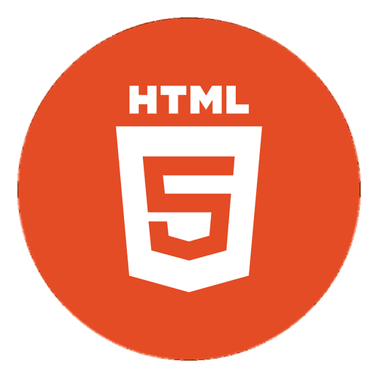
HTML
What is HTML?
HTML (HyperText Markup Language) is the code that is used to structure a web page and its content.
HTML is the standard markup language for Web pages.
HTML—“HyperText Markup Language”—is the language used to tell your web browser what each part of a website is.
By using HTML, you can define headers, paragraphs, links, images, and more, so your browser knows how to structure the web page you're looking at.
HTML is easy to learn.

Slide 5
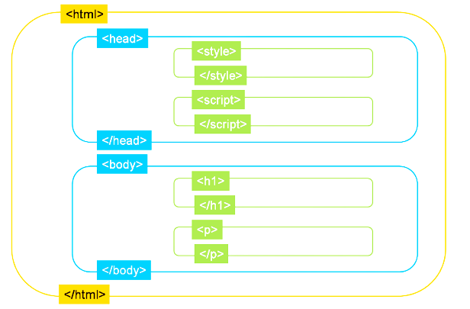
Basic HTML Page Structure

Slide 6
Various Tags Used In HTML
Unclosed HTML Tags
Some HTML tags are not closed, for example br and hr.
<br> Tag: br stands for break line, it breaks the line of the code.
<hr> Tag: hr stands for Horizontal Rule. This tag is used to put a line across the webpage.
<p> Tag: p stands for paragraph. This tag is used to change the paragraph.
HTML Text Tags
Heading Tag: <h1>, <h2>, <h3>, <h4>, <h5>, <h6>.
<strong> Tag:This tag is used to define text with strong importance.
HTML Link Tags
<a> : The anchor tag defines a hyperlink that links one page to another page.
<base>: The <base> tag specifies the base URL and/or target for all relative URLs in a document.

Slide 7
HTML List Tags
<ul>Tag: unordered list
<ol>Tag: ordered list
<li>Tag: list item
<dl>Tag: the description list.
<dt>Tag: data term.
<dd>Tag: data definition (description).
HTML Meta Tags
<!DOCTYPE >Tag: used to inform the browser about the version of HTML used in the document
<Title>Tag: used to provide a title name for your webpage. It is necessary for Search Engine Optimization (SEO).
<Link>Tag: used to specify the relationship between the current document and external source.

Slide 8
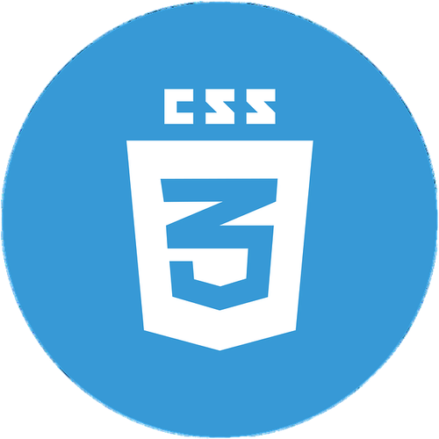
CSS
What is CSS ?
Cascading Style Sheets (CSS) is a simple mechanism for adding style.
e.g., fonts, colors, spacing) to a Web documents.
Another defination can be CSS is used to define styles for our web pages, including the design, layout and variations in display for different devices and screen sizes.
CSS is the language we use to style an HTML document.
CSS describes how HTML elements should be displayed.

Slide 9
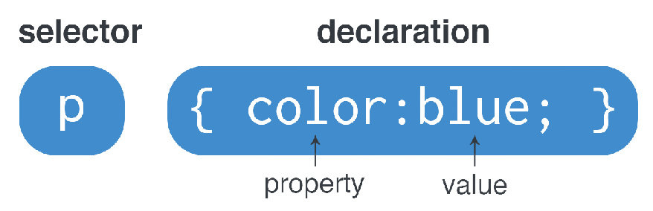
CSS Syntax :

Slide 10
Different Ways To Add Style HTML Page Using CSS
Inline CSS:
Inline CSS is used to apply CSS on a single line or element.
<p style="color:blue">Hello CSS</p>
2.Internal CSS:
Internal CSS is used to apply CSS on a single document or page. It can affect all the elements of the page. It is written inside the style tag within head section of html.
<style>
p{color:blue}
</style>
3.External CSS:
External CSS is used to apply CSS on multiple pages or all pages. Here, we write all the CSS code in a css file. Its extension must be .css for example style.css.
p{color:blue}
You need to link this style.css file to your html pages like this:
<link rel="stylesheet" type="text/css" href="style.css">
The link tag must be used inside head section of html.

Slide 11
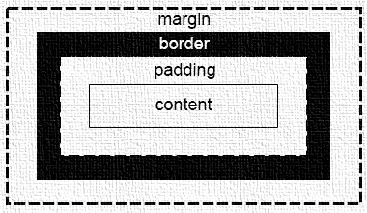
CSS BOX MODEL:
All html elements can be considered as boxes.
The term Box Model is used when talking about design and layout.
The image below illustrates the box model :
Content - The content of the box, where text and images appear .
Padding - Clears an area around the content. The padding is transparent.
Border - A border that goes around the padding and content.
Margin - Clears an area outside the border. The margin is transparent.

Slide 12

Bootstrap
What is bootstrap?
Bootstrap is the popular HTML, CSS and JavaScript framework for developing a responsive and mobile friendly website.
Bootstrap is a free, open source front-end development framework for the creation of websites and web apps.
Designed to enable responsive development of mobile-first websites, Bootstrap provides a collection of syntax for template designs.
Bootstrap

Slide 13

JAVA SCRIPT
What Is Java Script?
JavaScript is a light-weight object-oriented programming language which is used by several websites for scripting the webpages.
JavaScript follows the syntax and structure of the C programming language. Thus, it is a structured programming language.
It is an interpreted, full-fledged programming language that enables dynamic interactivity on websites when applied to an HTML document.

Slide 14
Syntax:
JavaScript Values:
The JavaScript syntax defines two types of values:
Fixed values
Variable values
Fixed values are called Literals.
Variable values are called Variables.
JavaScript Variables:
In a programming language, variables are used to store data values.
JavaScript uses the keywords var, let and const to declare variables.
An equal sign is used to assign values to variables.
Display Output:
To access HTML element JavaScript can use the document.getElementById(id)
method.

Slide 15
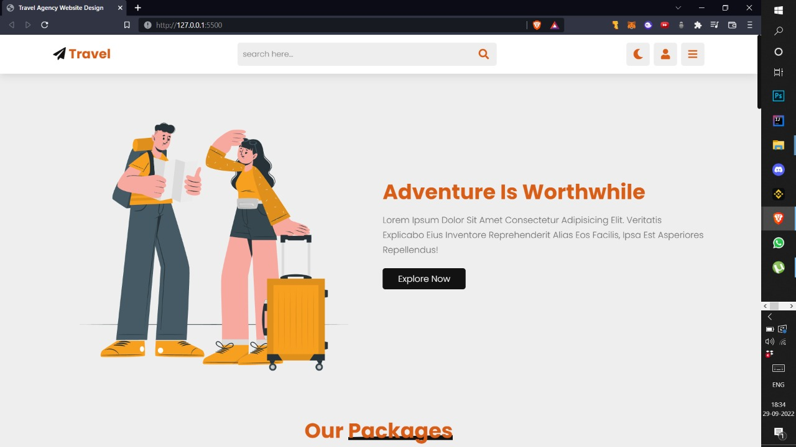
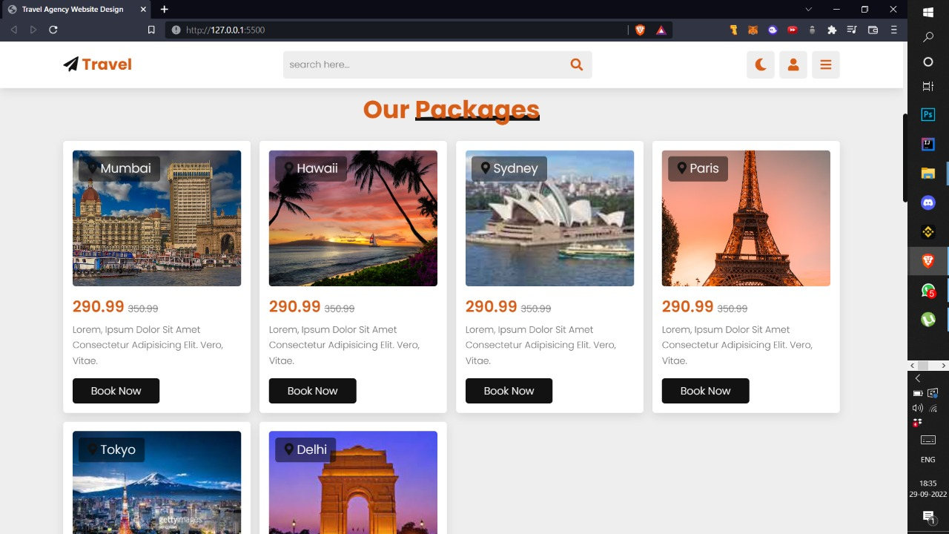
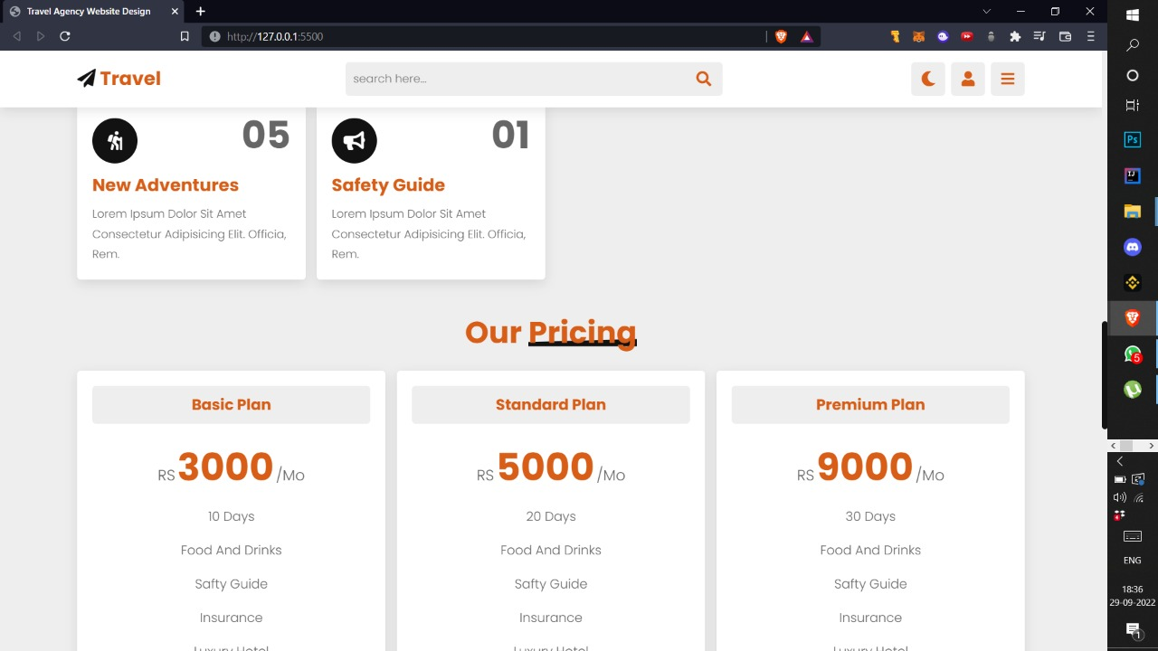
My project:

Slide 16





CERTIFICATE
KRISHNA SWAMI

Slide 17
Thank You

