Slide 1

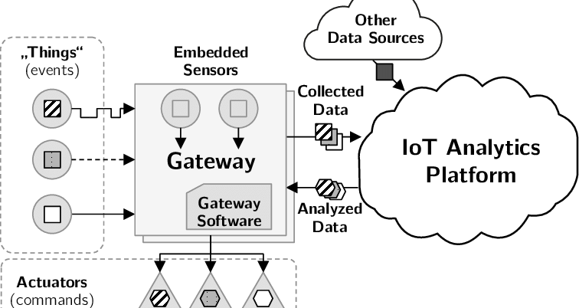
IOT-BASED GREENHOUSE AUTOMATION
| WATKIDOG JOACHIM | MUGISHA RONALD | LOCHA DERRICK | ACAA GLADYS OBOL
Problem
Project Design
Results
Insufficient food production for the population due to the changing climatic conditions, rapid population growth and urbanization.
Project Objectives
Main Objective
To increase food production with minimal labor through automation.
Specific Objectives
To study and analyze the current greenhouse systems.
To design a miniature greenhouse, which is equipped with an automatic monitoring and controlling system.
To implement and test the system.
To constantly monitor and control the environmental conditions in the greenhouse to ensure it remains at preset parameters (temperature, light, soil moisture, and humidity).
Results
Include key screenshots of your system and visualisations
Result 2
Result 3
Step 1
Microcontroller
Step 2
Read and act on the greenhouse environmental variables (temperature, humidity, light and moisture)
Step 3
Store and analyze the data.
Step 4
Display results to the user though a web interface.
Sensors
Database
Web platform
Project Requirements
R1. Functional
The system must detect temperature, light, moisture, humidity levels within the greenhouse.
The system must analyze the sensor readings recorded over a specified period of time.
The system must display the sensor readings and the analyzed data on the web interface.
The system must turn on the irrigation system when the soil moisture level is below the threshold value.
The system must turn on the U.V lights when the light intensity is below the threshold.
The system must turn on the funs when the temperature or humidity levels are above the threshold .
R2. Non-Functional
0
Conclusion
Brief summary of what you discovered based on results
Indicate and explain whether or not the data supports your hypothesis
Future Work
Target Users
Create a mobile application for the system.
Install cameras to observe the greenhouse activities at real time remotely.
The system to be able to determine the soil fertility.
Greenhouse farmers
State what they will use the system for
Agricultural Researchers
State what they will use the system for
User category xx
State what they will use the system for
References
Include print and electronic sources in alphabetical order
Notes:
To change this poster, replace our sample content with your own. Or, if you'd rather start from a clean slate, press the New Slide button on the Home tab to insert a new page. Now enter your text and pictures in the empty placeholders. If you need more placeholders for titles, subtitles or body text, copy any of the existing placeholders, then drag the new one into place.

