Slide 1

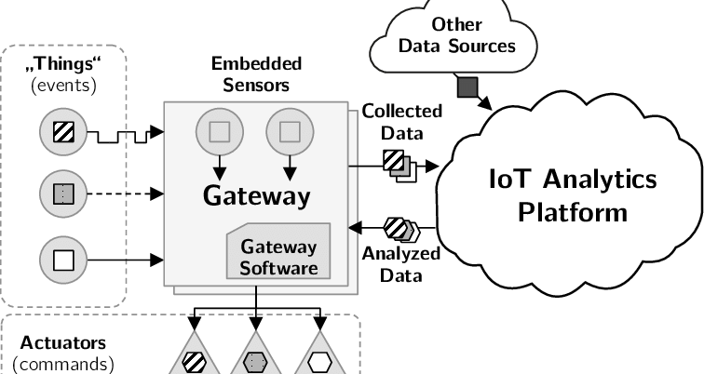
IOT-BASED GREENHOUSE AUTOMATION
| WATKIDOG JOACHIM | MUGISHA RONALD | LOCHA DERRICK | ACAA GLADYS OBOL
Problem
Project Design
Results
Insufficient food production due to increasing population and urbanization.
Project Objectives
Main Objective
To increase food production with minimal labor through automation
Specific Objectives
To study and analyze the current greenhouse systems.
To design a miniature greenhouse, which is equipped with an automatic monitoring and controlling system.
To implement and test the system.
To constantly monitor and control the environmental conditions in the greenhouse to ensure it remains at preset temperature, light, moisture and humidity levels.
Project Requirements
Results
Include key screenshots of your system and visualisations
Result 2
Result 3
Step 1
Show key components of your system
Step 2
Describe this step in your experiment
Step 3
Describe this step in your experiment
Step 4
Describe this step in your experiment
R1.The system must be able to detect temperature, light, moisture level, humidity within a greenhouse.
R2. The system must store the data collected in a database.
R3. The system must use the data collected in the database to automatically control the conditions within a greenhouse.
R4. The system must be able to analyze the data collected.
Conclusion
Brief summary of what you discovered based on results
Indicate and explain whether or not the data supports your hypothesis
Target Users
Future Work
User category xx
State what they will use the system for
User category xx
State what they will use the system for
User category xx
State what they will use the system for
Observation 1
Observation 2
Observation 3
References
Include print and electronic sources in alphabetical order
Notes:
To change this poster, replace our sample content with your own. Or, if you'd rather start from a clean slate, press the New Slide button on the Home tab to insert a new page. Now enter your text and pictures in the empty placeholders. If you need more placeholders for titles, subtitles or body text, copy any of the existing placeholders, then drag the new one into place.

