Slide 1

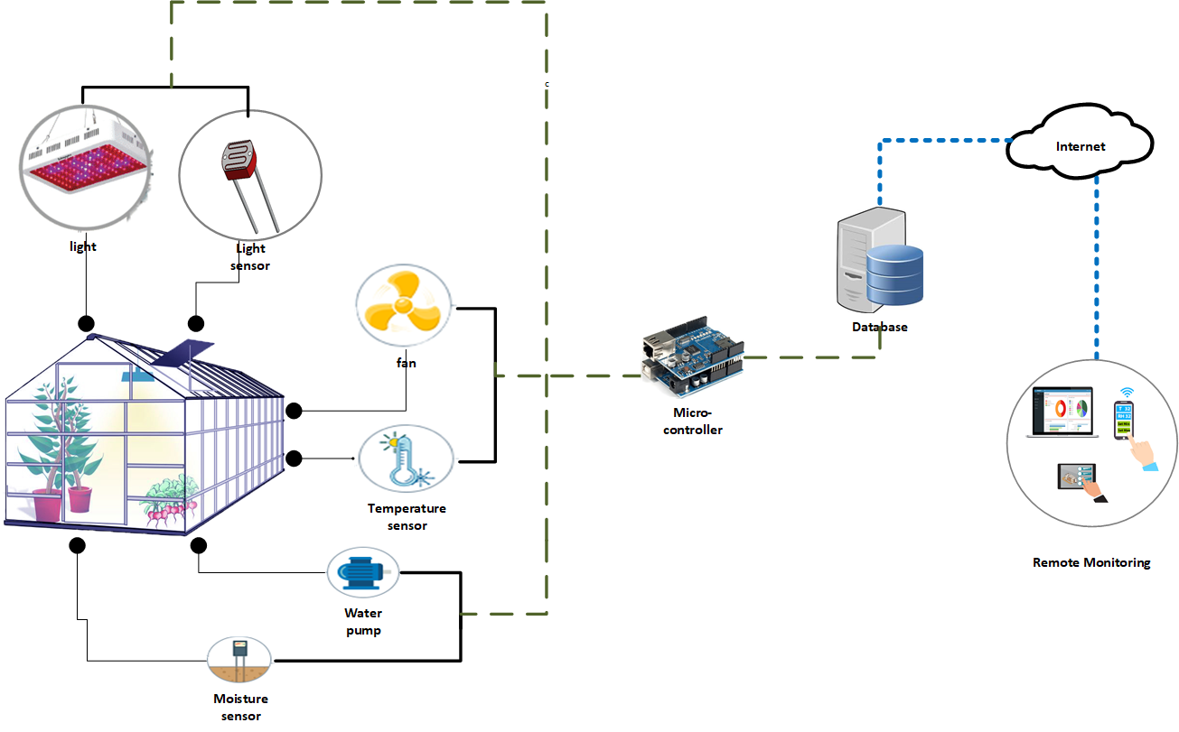
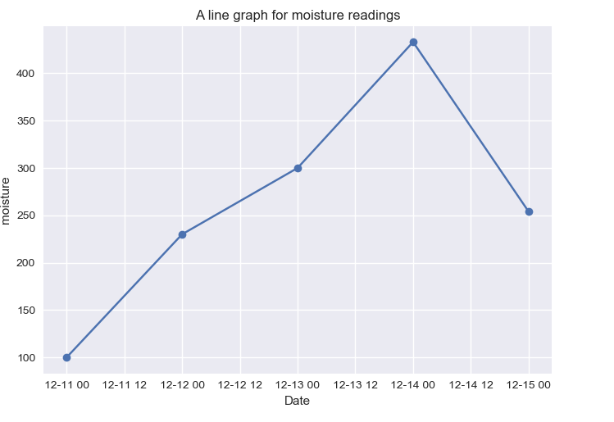
IOT-BASED GREENHOUSE AUTOMATION
| WATKIDOG JOACHIM | MUGISHA RONALD | LOCHA DERRICK | ACAA GLADYS OBOL
Problem
Project Design
Results
Insufficient food production for the population due to the changing climatic conditions, rapid population growth and urbanization.
Project Objectives
Main Objective
To increase food production with minimal labor through automation.
Specific Objectives
To study and analyze the current greenhouse systems.
To design a miniature greenhouse, which is equipped with an automatic monitoring and controlling system.
To implement and test the system.
To constantly monitor and control the environmental conditions in the greenhouse to ensure it remains at preset parameters (temperature, light, soil moisture, and humidity).
Results
Step 1
Microcontroller
Step 2
Read and act on the greenhouse environmental variables (temperature, humidity, light and moisture)
Step 3
Store and analyze the data.
Step 4
Display results to the user though a web interface.
Sensors
Database
Web platform
Project Requirements
R1. Functional
The system must detect temperature, light, moisture, humidity levels within the greenhouse.
The system must analyze the sensor readings recorded over a specified period of time.
The system must display the sensor readings and the analyzed data on the web interface.
The system must turn on the irrigation system when the soil moisture level is below the threshold value.
The system must turn on the U.V lights when the light intensity is below the threshold.
The system must turn on the fans when the temperature or humidity levels are above the threshold .
R2. Non-Functional
It must be scalable
It must be safe
It must be maintainable
It must be testable and debuggable
Conclusion
Temperature, moisture, light, and humidity sensors will be used in the project to give the exact values of the parameters.
The moisture sensor gave the correct result according to the soil condition and the results can be seen on the web page.
Future Work
Target Users
Create a mobile application for the system.
Install cameras to observe the greenhouse activities at real time remotely.
The system to be able to determine the soil fertility.
Greenhouse farmers
Farmers will be able to carry out crop production throughout the year without the worry of weather and climatic changes.
Agricultural Researchers
Plant researchers will use the data stored in the database to know which kind of plants grow better under what kind of conditions and make insightful predictions.
References
[1] W. P. Review, Uganda population 2019,http://worldpopulationreview.com/countries/
Uganda-population/
, Nov. 2019.
[2] A. Deliamiezade, “Https://www. tandfonline. com/doi/abs/10.1080/15332640.2018.
1556764”, 2019.
[3] E. R. Morgan and R. Wall, “Climate change and parasitic disease: Farmer
mitigation?”,
Trends in parasitology
, vol. 25, no. 7, pp. 308–313, 2009.
[4] S. Lavender, P. Healy, I. Robinson, R. Lally, S. Ties, D. Lumbroso, E.
Valone, G. Gibson, L. Tincani, C. Chambers,et al., “Application of earth
observation to a ugandan drought and flood mitigation service”,
[5] P. L. Yates, “Food and agriculture organization of the united nations”,
Journal of Farm Economics
, vol. 28, no. 1, pp. 54–70, 1946
Notes:
To change this poster, replace our sample content with your own. Or, if you'd rather start from a clean slate, press the New Slide button on the Home tab to insert a new page. Now enter your text and pictures in the empty placeholders. If you need more placeholders for titles, subtitles or body text, copy any of the existing placeholders, then drag the new one into place.

