Slide 1

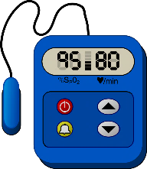














IoT-ASAP

Slide 2
IoT-ASAP
2018

Slide 3
IoT-ASAP
2019

Slide 4
IoT-ASAP
2020

Slide 5
IoT-ASAP
2017

Slide 6
IoT-ASAP
2018

Slide 7
IoT-ASAP

