Slide 1
MakeCode web app
Blockly
Final
Executable
JavaScript
User
Machine Code
link
Runtime
Machine Code
a priori
compile
C++ runtime

Slide 2
web app
Blockly
Final
Executable
User
Program text
compile
service
User
Program text
User
Machine Code
link
Runtime
Machine Code
a priori
compile
C++ runtime

Slide 3
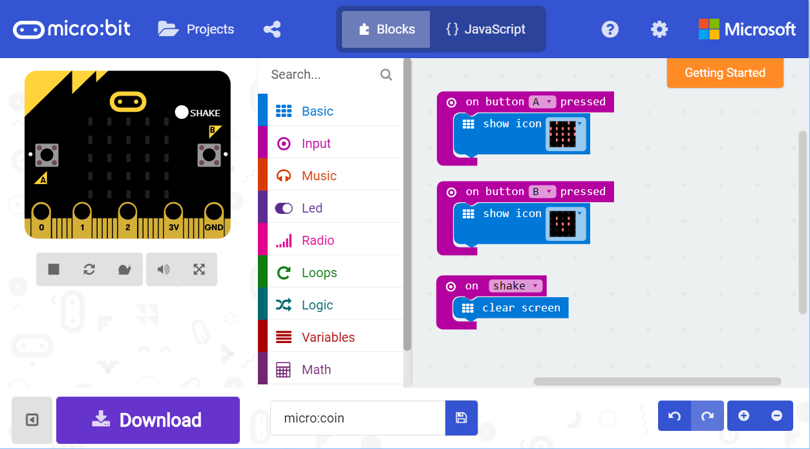
A
D
C
B
E

