Slide 1






Prototyping a Small-Scaled Resilient Software-Defined Wireless Mesh Network with Dual-band Data and Out-of-band Control Planes
APAN50 6th August 2020
Phoo Phoo Thet Lyar Tun¹, Chaodit Aswakul¹ , JongWon Kim²
¹Wireless Network and Future Internet Research Unit, Department of Electrical Engineering, Faculty of Engineering, Chulalongkorn University, Bangkok, Thailand,
²Networked Computing Systems (NetCS) Laboratory, School of Electrical Engineering and Computer Science, Gwangju Institute of Science and Technology, Gwangju, South Korea.
Paper Session III: Software Defined Infrastructure and Network Updates
Place – Zoom Video Conference
Date and time – 6th Aug, 2020 (13:30– 15:00, Hong Kong Time)

Slide 2
Contents
Objective
To design and implement the small-scaled resilient SDWMN
To test the routing scenarios
Motivation
Problem facing in Big city
Ways to solve this problem
Background
What is SDWMN?
Implementation preliminary laboratory-based testbed setting
Testbed design
Preliminary laboratory-based testbed design and setting
Result of preliminary laboratory-based testbed
Conclusion
Future work
Acknowledgement

Slide 3
Objective
To design and implement a small-scaled resilient Software-Defined Wireless Mesh Network (SDWMN), by separating control and data planes.
The network design criteria includes the consideration to achieve the resiliency for both the control plane and data plane of the network.
Therefore, dual-band (2.4GHz and 5GHz) wireless interfaces are adopted for the data plane while the out-of-band wired network is used for the control plane.

Slide 4

Road Traffic Congestion
Bangkok, the capital city of Thailand, is ranked as the most congested city in Asia and the second most congested city globally [*].
How to solve this
Problem???
(monitor road traffic
Congestion/
Monitoring applications)
[*] TomTom NV Dutch Company, Amsterdam, The Netherlands. Tomtom traffic index. Available from : https://www.tomtom.com/en gb/trafficindex/city/bangkok/, March 2016. [2020, May].
Image source : https://thethaiger.com/news/bangkok/more-underpasses-overpasses-built-to-solve-bangkok-traffic-congestion-pm [22 May,2020]

Slide 5


Communication Medium
wired connection?
wireless connection?
Wi-Fi ?
WiMAX ?
LoRaWAN ?
3G or 4G ?
+
wired connection
Infrastructure mode or ad-hoc mode?
Ad-hoc mode?
Ad-hoc mode !

Slide 6
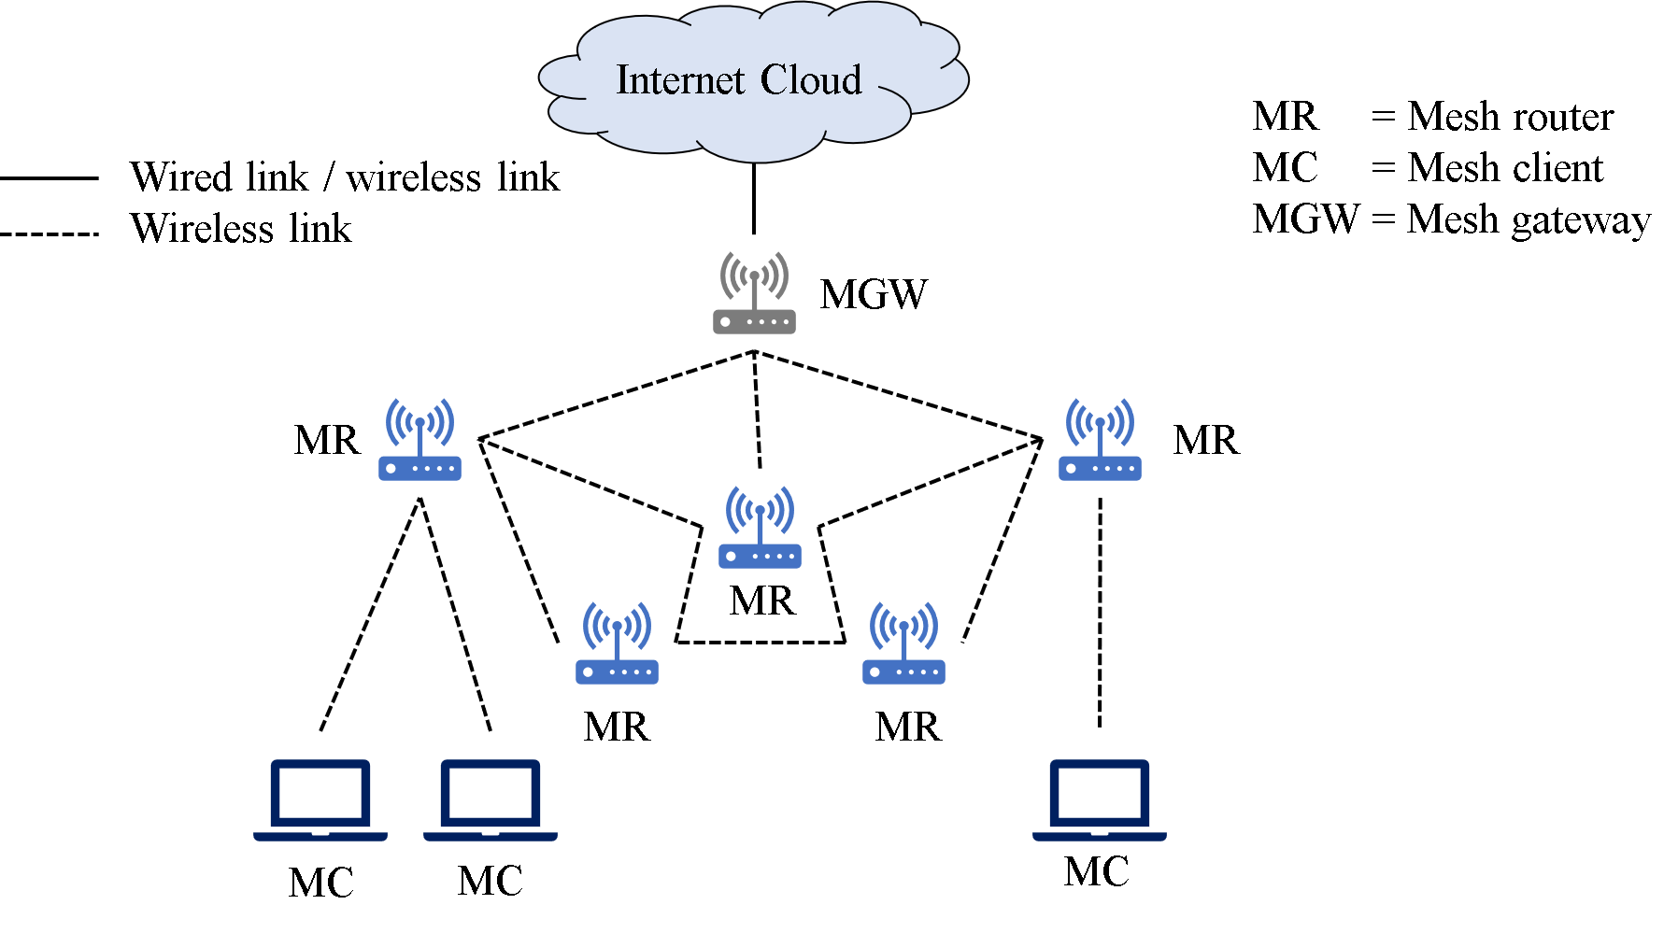
Wireless Mesh Network (WMN)
Figure : Typical architecture of WMN [1]
[1] M. Seyedzadegan, M. Othman and B. M. Aliand S. Subramaniam, “Wireless mesh networks: WMN overview, WMN architecture”, International Conference on Communication Engineering and Networks IPCSIT, Vol.19, pp.12-18, 2011.

Slide 7
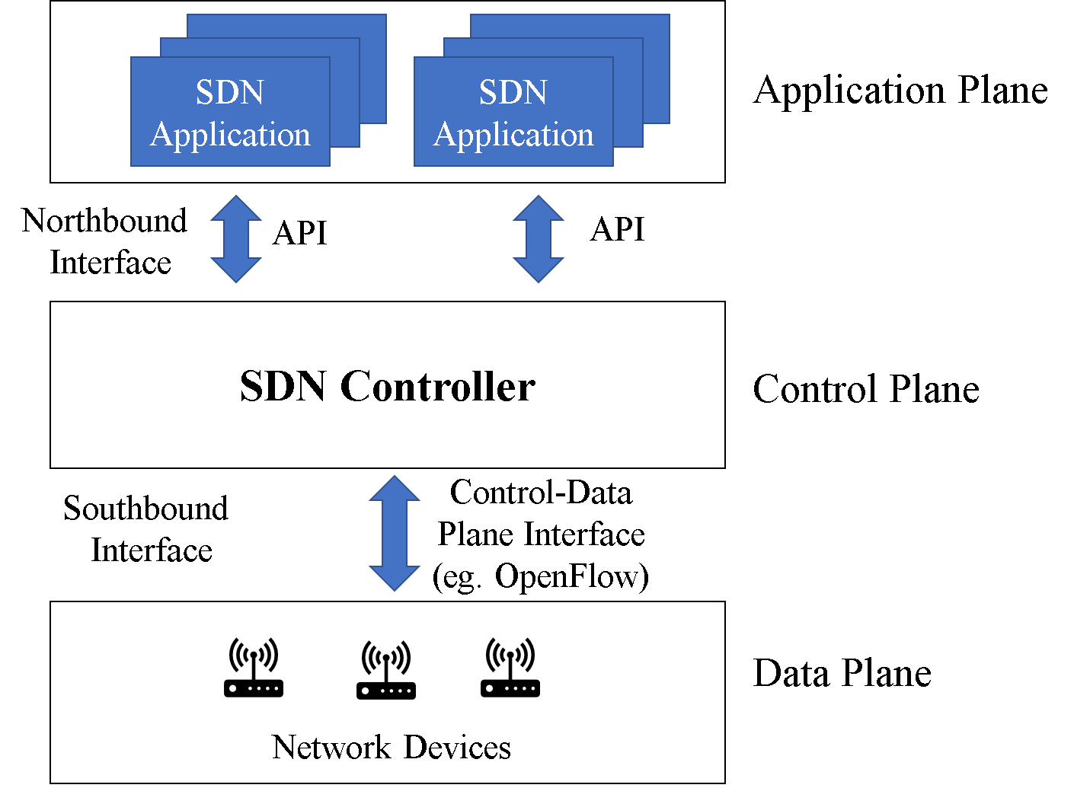
Software Defined Networking (SDN)
Figure : Typical architecture of SDN [2]
[2] Open Network Foundation, “Software Defined Networking: The new norm for networks”, ONF White Paper, 2012.

Slide 8
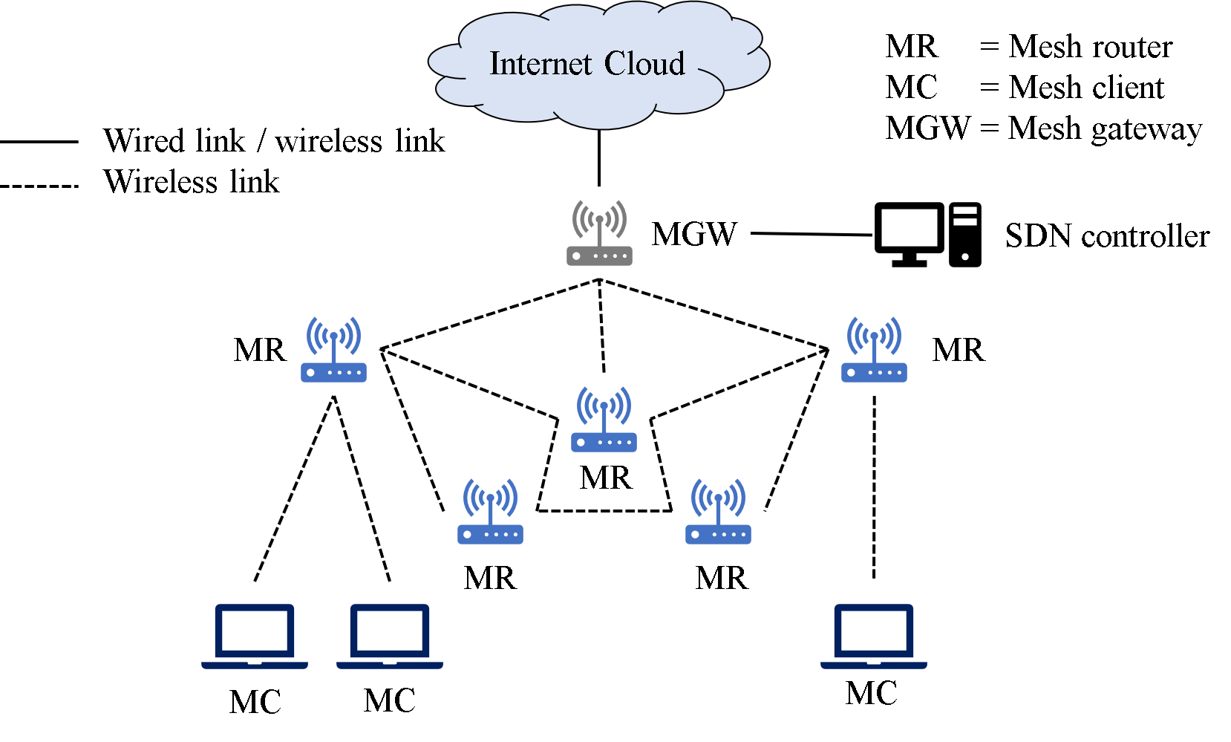
Software Defined Wireless Mesh Network (SDWMN)
There are two ways to set up the control plane for the SDN, out-of-band architecture uses the dedicated control plane, and the in-band architecture uses the shared control plane [5].
Figure : Typical architecture of SDWMN [8]
[8] S. Y. Htet, “Design and implementation of medium-range outdoor wireless mesh network with Openflow in Raspberry Pi”, Master of Engineering Thesis, Chulalongkorn University, Bangkok, Thailand, 2018.
[5] A. Jalili, H. Nazari, S. Namvarasl and M. Keshtgari, “A comprehensive analysis on control plane deployment in SDN: In-band versus out-of-band solutions”, Proc. 4th IEEE International Conference Knowledge-Based Engineering Innovation (KBEI), pp. 1025-1031, Dec.2017.

Slide 9
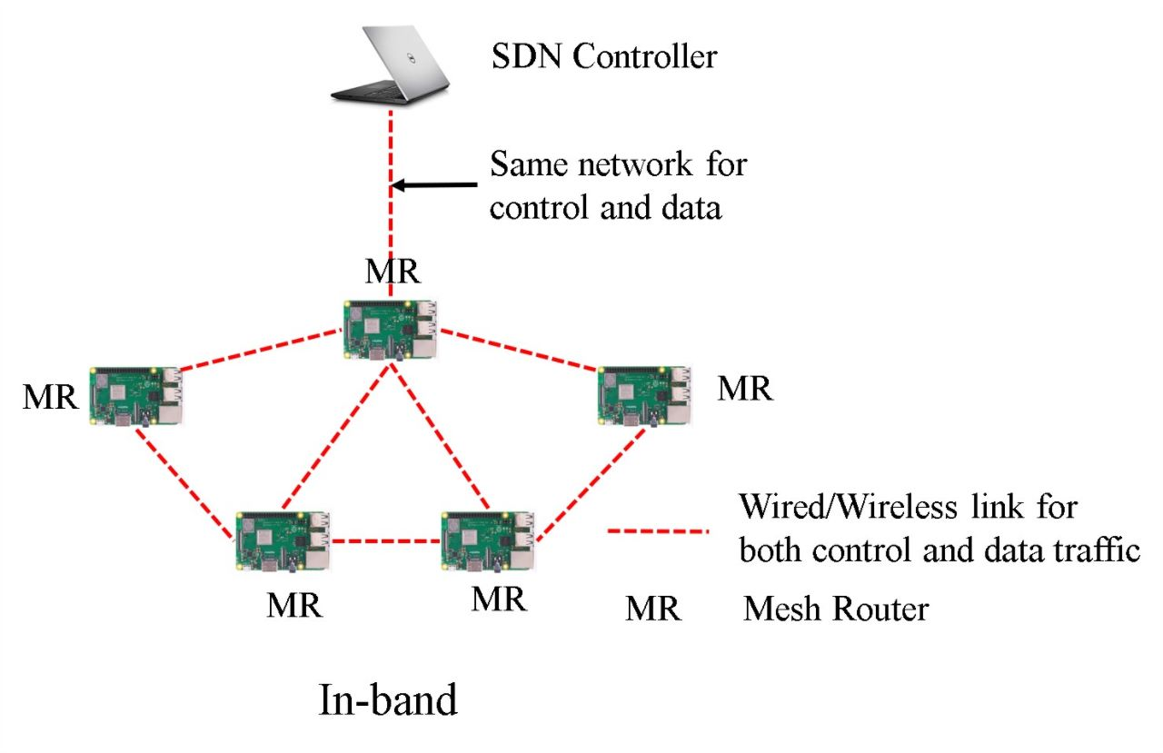
Software Defined Wireless Mesh Network (SDWMN) (Cont.)
Figure : In-band [5]
[5] A. Jalili, H. Nazari, S. Namvarasl and M. Keshtgari, “A comprehensive analysis on control plane deployment in SDN: In-band versus out-of-band solutions”, Proc. 4th IEEE International Conference Knowledge-Based Engineering Innovation (KBEI), pp. 1025-1031, Dec.2017.

Slide 10
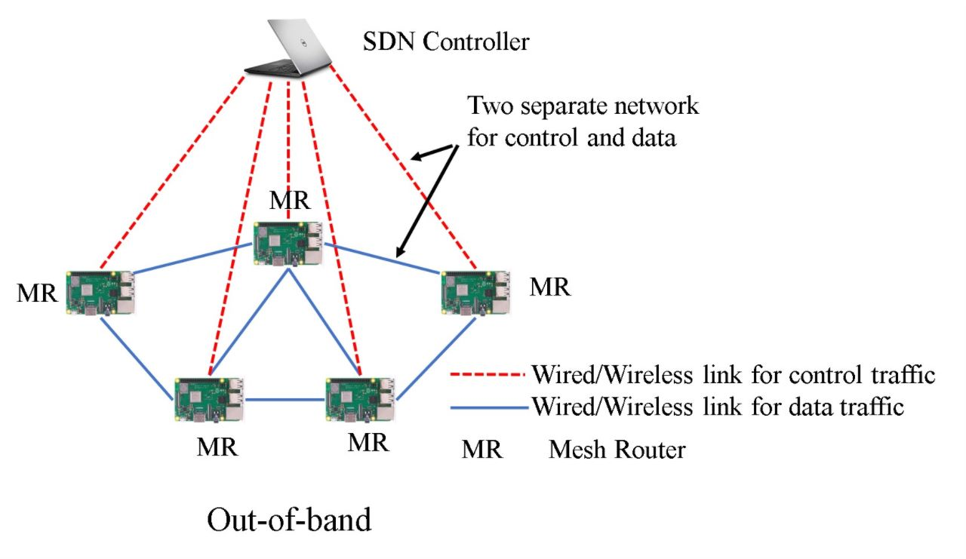
Software Defined Wireless Mesh Network (SDWMN) (Cont.)
Figure : Out-of-band [5]
[5] A. Jalili, H. Nazari, S. Namvarasl and M. Keshtgari, “A comprehensive analysis on control plane deployment in SDN: In-band versus out-of-band solutions”, Proc. 4th IEEE International Conference Knowledge-Based Engineering Innovation (KBEI), pp. 1025-1031, Dec.2017.

Slide 11
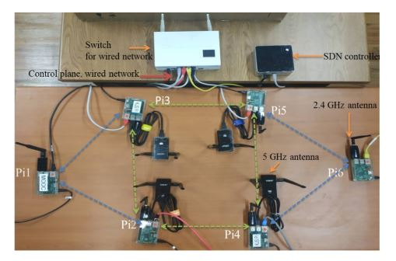
Figure.1: Proposed SDWMN Network.

Slide 12
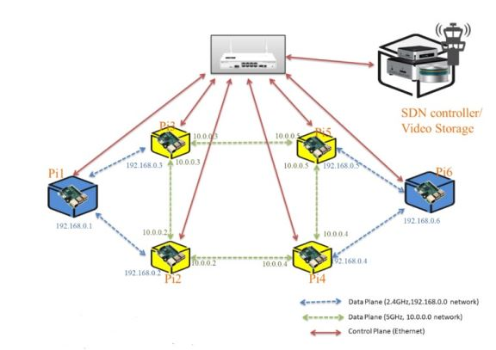
Figure. 2: Proposed SDWMN network with IP configuration.

Slide 13
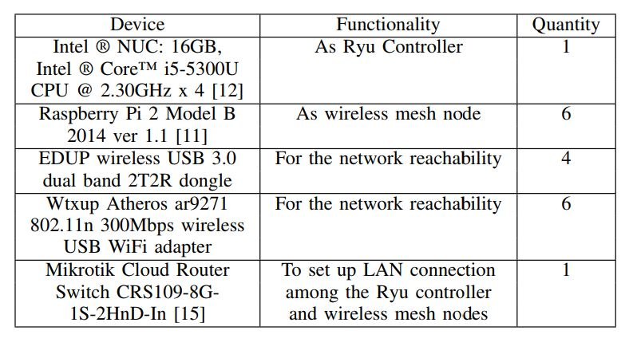
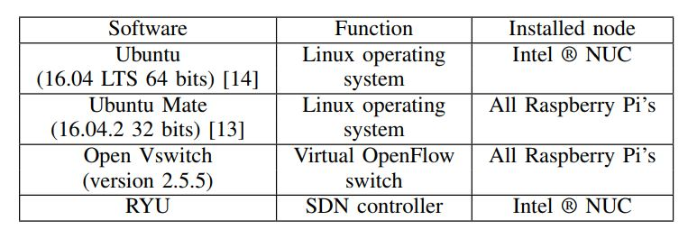
TABLE I: Hardware list of indoor SDWMN in-band testbed.
TABLE II: Software list of
SDWMN in-band testbed.
[11] Raspberry Pi 2. https://www.raspberrypi.org/. Accessed:2020, June. [12] Intel®NUC . https://ark.intel.com/content/www/us/en/ark/products/85213/intel-core-i5-5300u-processor-3mcache-up-to-2-90-ghz.html. Accessed: 2020, June. [13] Ubuntu-Mate. https://ubuntu-mate.org/. Accessed: 2020,June. [14] Ubuntu. https://www.ubuntu.com/. Accessed: 2020, June. [15] Mikrotik cloud router. https://mikrotik.com/product/CRS109-8G-1S-2HnD-IN/. Accessed: 2020, June.

Slide 14
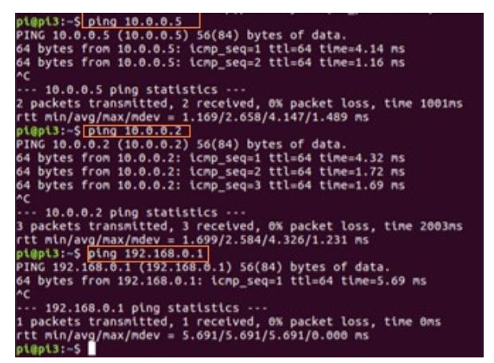
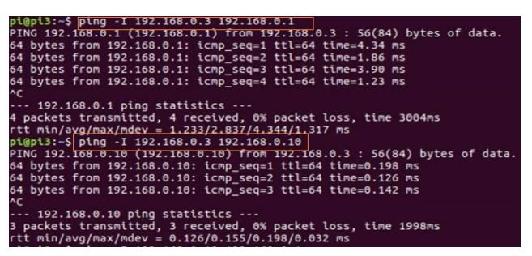
Figure.3: Ping results from Pi3 to its neighboring nodes.
Figure.4: Ping Results from Pi3 to Pi6.

Slide 15
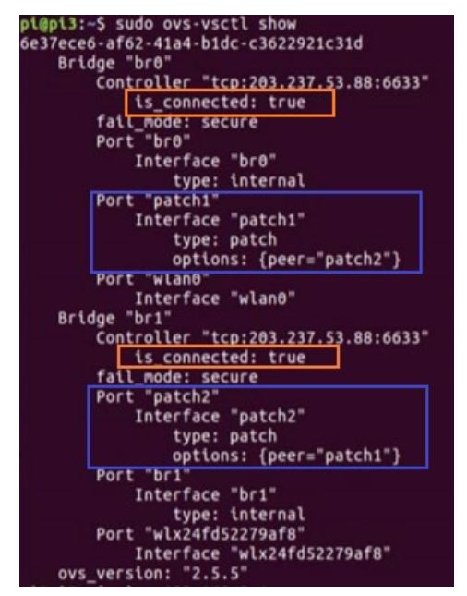
Patch ports are used to communicate between two OVS bridges.
Figure.5: Controller connection status and patch port configuration at Pi3.

Slide 16
Discussions
According to the ping results of Figure 3 and Figure 4, the primary routes and the alternative routes of SDWMN work properly.
According to Figure 5, the connections between Ryu controller and Pi nodes are established correctly.
The proposed SDWMN design with out-of-band control plane and dual-band data plane was tested for the resiliency of the proposed SDWMN.

Slide 17
Conclusion
The prototype small-scaled resilient dual-band based SDWMN testbed is implemented.
The failure scenario of the wireless mesh node’s single wireless interface and interface switching mechanisms are tested in the developed real testbed.
With Ryu application implemented to install the necessary preplanned forwarding rules for the primary route and the data plane, our test has confirmed the functionality of proposed SDWMN.

Slide 18
Future work
To apply out-of-band control plane and dual-band data plane strategy in the future larger SDWMN network design for the reliability improvement of data plane and control plane.
To apply the interface switching mechanism for the testing of reliable data and control planes.
To build the reliable SDWMN network for the road traffic monitoring application to solve the road traffic congestion problem.

Slide 19
Acknowledgement
This work is supported by Asi@Connect's Data-Centric IoT Cloud Service Platform for Smart Communities (IoTcloudServe@TEIN) Project.
1st author is supported by Chulalongkorn University's Scholarship Program for ASEAN Countries.

Slide 20

Visit us !

