Slide 1
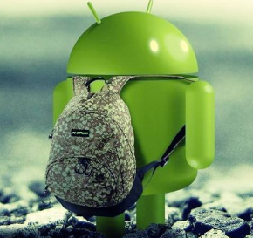
Group 1 Anyone There
Rahul Bobhate, Hiranava Das, Sharique Hussain, Hamza Karachiwala, Suryansh Singh
This Project is Sponsored by Google's 2016 Internet of Things (IoT) Technology Research Award Pilot

Slide 2
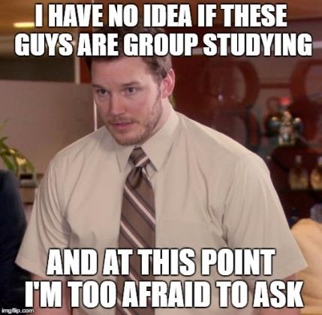
Why have this system
Confused at library entrance
Looking for friends
Looking for place
Need help with a course
Hate relying on WhatsApp replies (only getting blue ticks)

Slide 3
The Library should help us
It should tell us who is here
It should tell us where there is place
It should know about the study activities
It should facilitate managing study groups

Slide 4
Ingredients
Beacons for location and context
Tell us which room we are in - Proximity and Nearby API
Associate users with a beacon and effectively a room
Brillo-Weave duo for tracking footfall
Keep a count of users in every section
Identify a good are to scout a place
Cloud service to manage our data
Java Spring based API driven architecture
Ensures client flexibility
Mobile app as a user interface
Interaction medium for our users
Visual cues using maps
Voice command enabled

Slide 5
Architecture
Weave API
Weave Cloud
Service
SQL DB
Brillo
Proximity
API Tool
Beacon Cloud
Web Service
Nearby
Beacon
Mobile device

Slide 6
Status
COMPONENT | COMPLETED | PENDING
BEACONS | Room data associated with attachments successfully | Common space beacons – would need more
BRILLO-WEAVE | Integration of our cloud service with Weave | Hardware sensors instead of mocked data
CLOUD SERVICE | Providing all the APIs currently required | Performance tuning for cost efficiency
MOBILE APP | Providing the visualized functionalities as expected | Social network integration

Slide 7
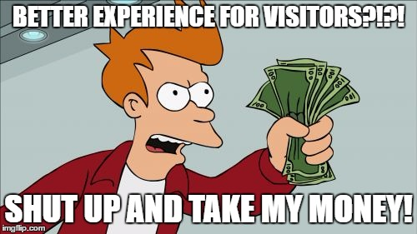
Can we make money
Not straightforward, but YES!
Enhances user experience
Not limited to a library
Parks
Conferences
Wedding halls
Public spaces need it

Slide 8
Click for video demo!
https://www.youtube.com/watch?v=5EL35dluXF8&feature=youtu.be

Slide 9
THANK YOU!

Slide 10
Content
Project idea: 1-2 slides
What problem are you trying to address
What is the idea of your solution
Used Technology: 1 slide
Architecture of the solution: 1 slide (pictorial)
Any assets to showcase your project (photos, etc.): 1 slide
What works? And What does not? 1 slide
What business model may be utilized in connection with your project? (how can money be made from your idea?) 1 slide
Finally, 2 min high quality video

