Slide 1
Survey of IoT Ecosystem
Group 1 –
Hamza Karachiwala
Hiranava Das
Rahul Bobhate
Sharique Hussain
Suryansh Singh

Slide 2
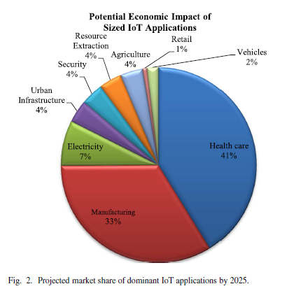
Why have this survey?
Scope of IoT
Horizontal and vertical markets
Vast field
Devices, applications and communication
Architectures, protocols and standards
Challenges and research
Security, trust, management
Market Value
Massive growth projection
$3 trillion - $6trillion value by 2025

Slide 3
We will cover
Architecture - Hamza
Elements - Hiranava
Protocols –
Application-Sharique
Service Discovery-Suryansh
Infrastructure-Hiranava
Others-Hiranava
Research Challenges - Suryansh
Big data - Rahul
Horizontal integration- Sharique

Slide 4
IoT : Survey of Enabling Tech, Protocols, Applications
Al-Fuqaha, Guizani, Mohammedi, Aledhari, Ayyash
IEEE COMMUNICATION SURVEYS & TUTORIALS
2015

Slide 5
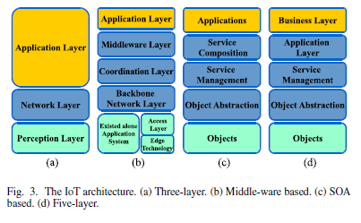
Architecture

Slide 6
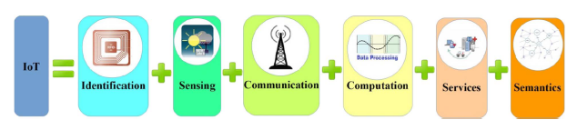
IoT Elements

Slide 7
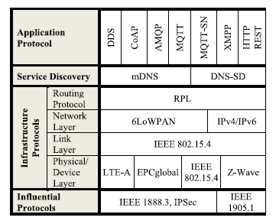
Protocols

Slide 8
Challenges
Availability
Access to hardware and software
Reliability
Dependability of hardware and software
Mobility
Delivery and management
Performance
Components and protocols
Management
Light weight FCAPS of billions of devices
Interoperability
Applications and devices
Security and Privacy
CIA among smaller devices

Slide 9
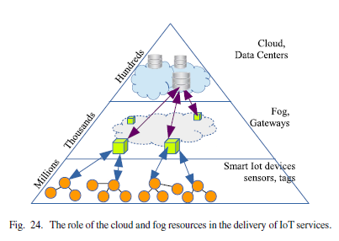
Big Data, Cloud and Fog
Analytics in real time on big data
Time Series Database (Modified Hadoop at FB)
Cloud Computing
Challenges and Platforms (Xively Nimbits)
Fog Computing
Cloudlet or edge computing improving interaction with cloud

Slide 10
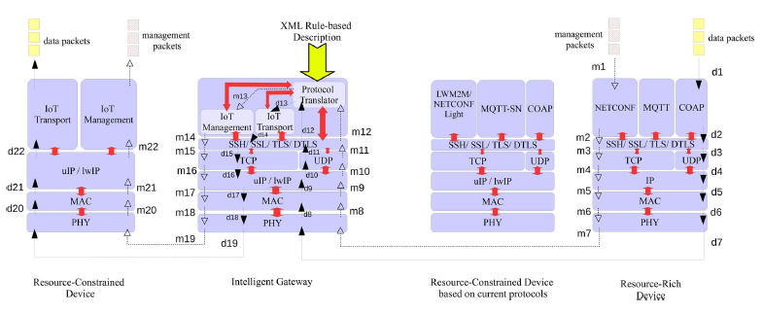
Horizontal Integration between Application Protocols

Slide 11
Thank You!

