Slide 1
Survey of IoT Ecosystem
Group 1 –
Hamza Karachiwala
Hiranava Das
Rahul Bobhate
Sharique Hussain
Suryansh Singh

Slide 2
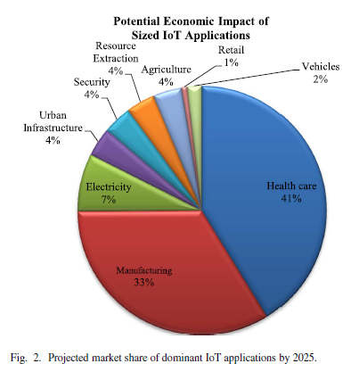
Why have this survey?
Scope of IoT
Horizontal and vertical markets
Vast field
Devices, applications and communication
Architectures, protocols and standards
Challenges and research
Security, trust, management
Market Value
Massive growth projection
$3 trillion - $6trillion value by 2025

Slide 3
We will cover
Architecture
A
Protocols
Security QoS
Big data
Horizontal integration

Slide 4
IoT : Survey of Enabling Tech, Protocols, Applications
Al-Fuqaha, Guizani, Mohammedi, Aledhari, Ayyash
IEEE COMMUNICATION SURVEYS & TUTORIALS
2015

Slide 5
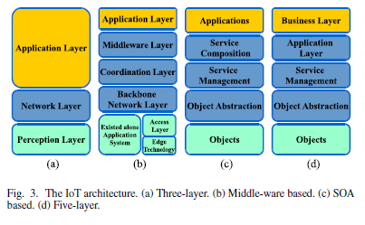
Architecture

Slide 6
IoT Elements

