Slide 1
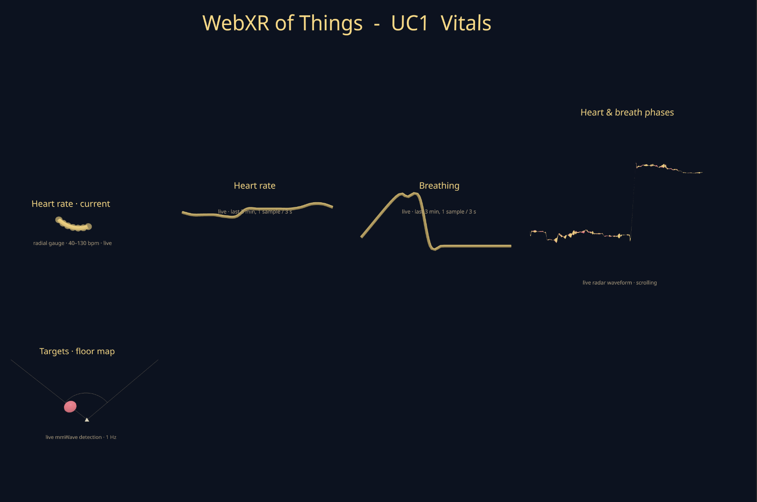
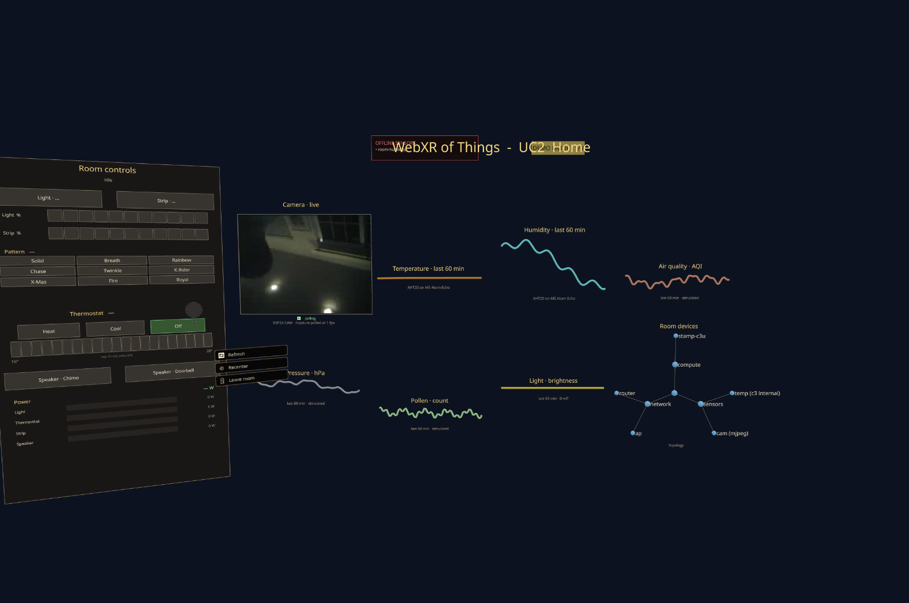
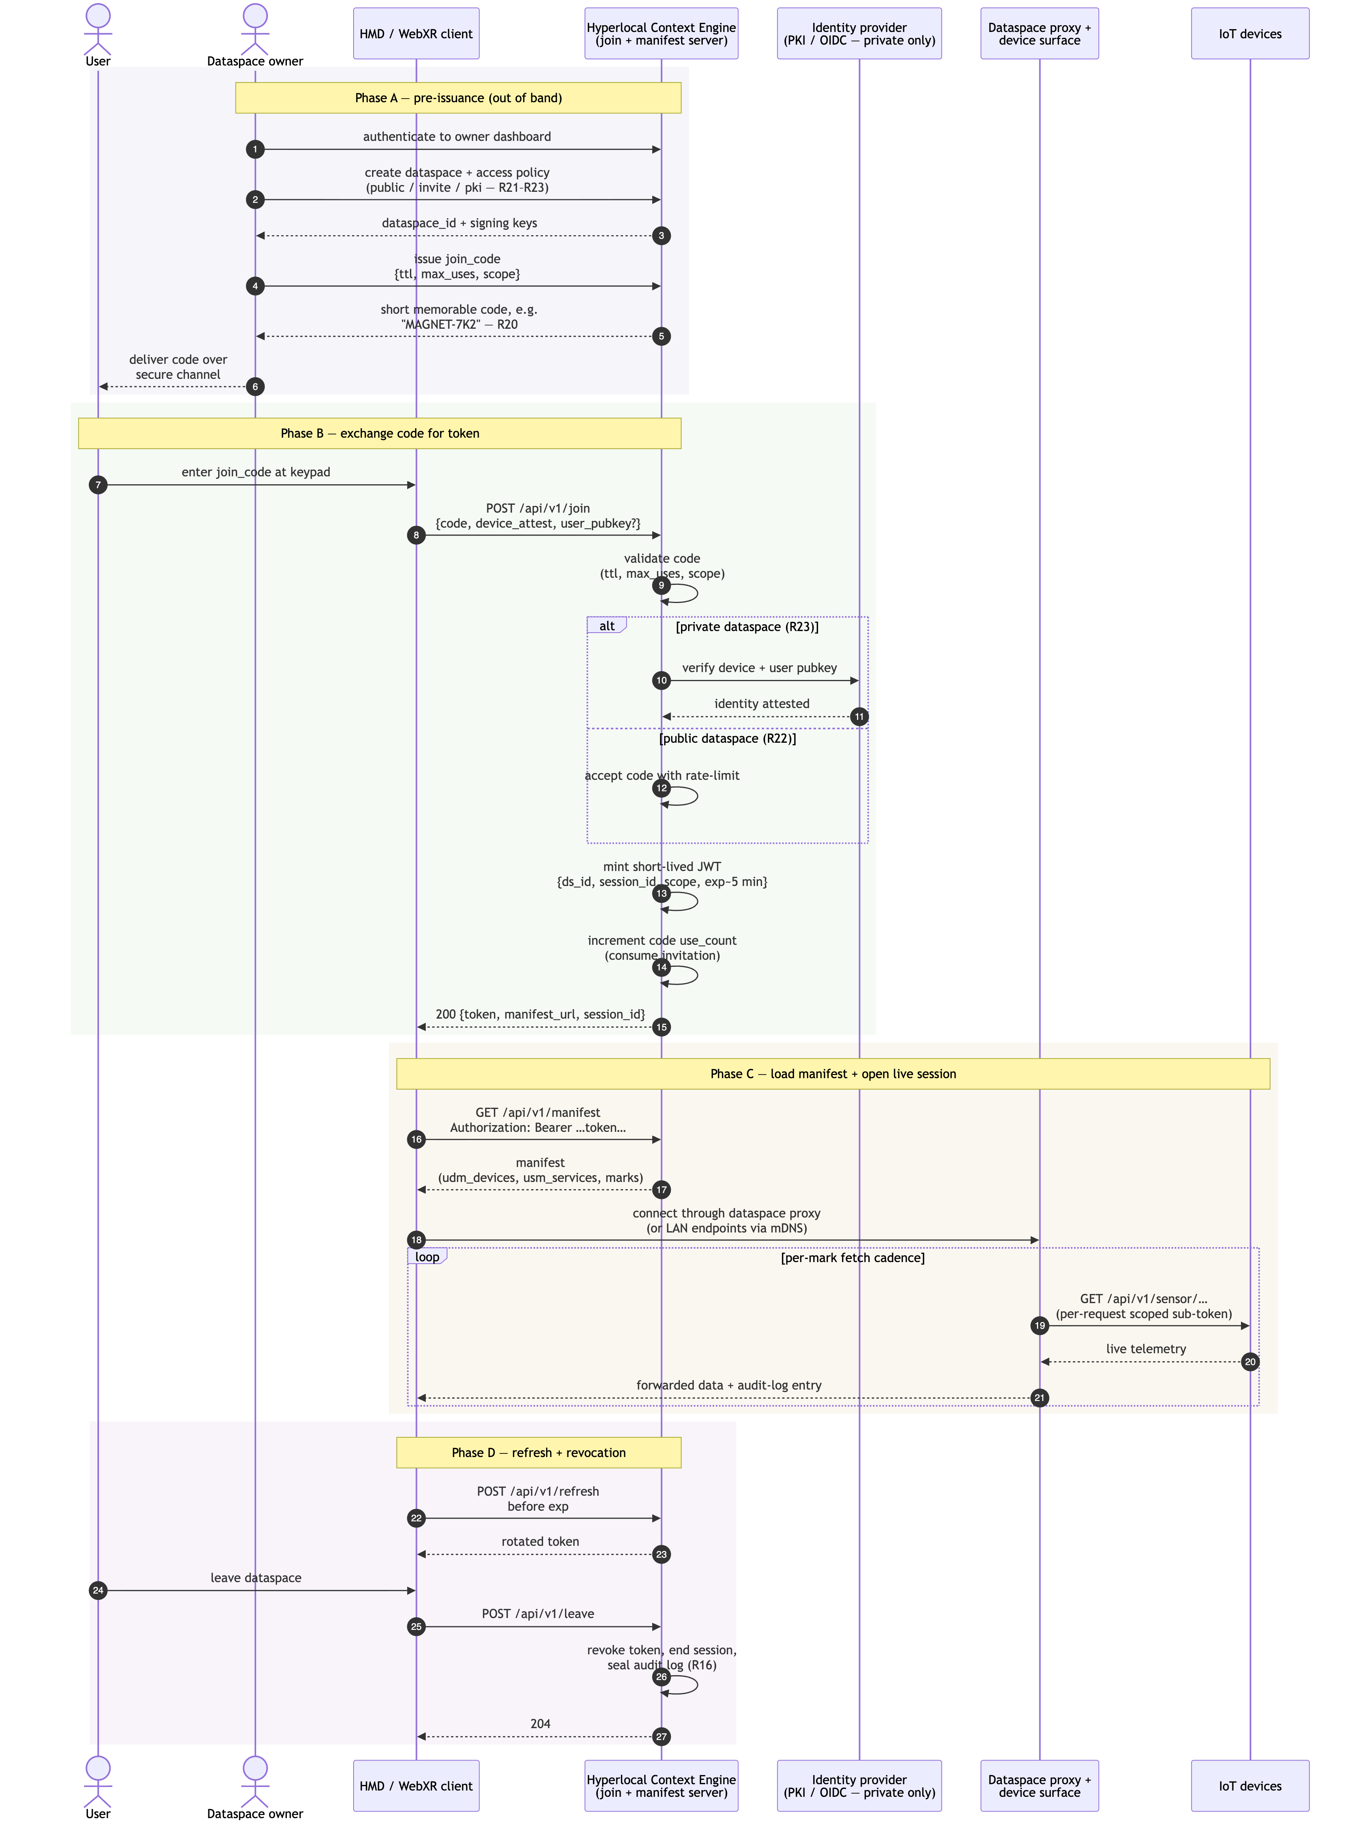
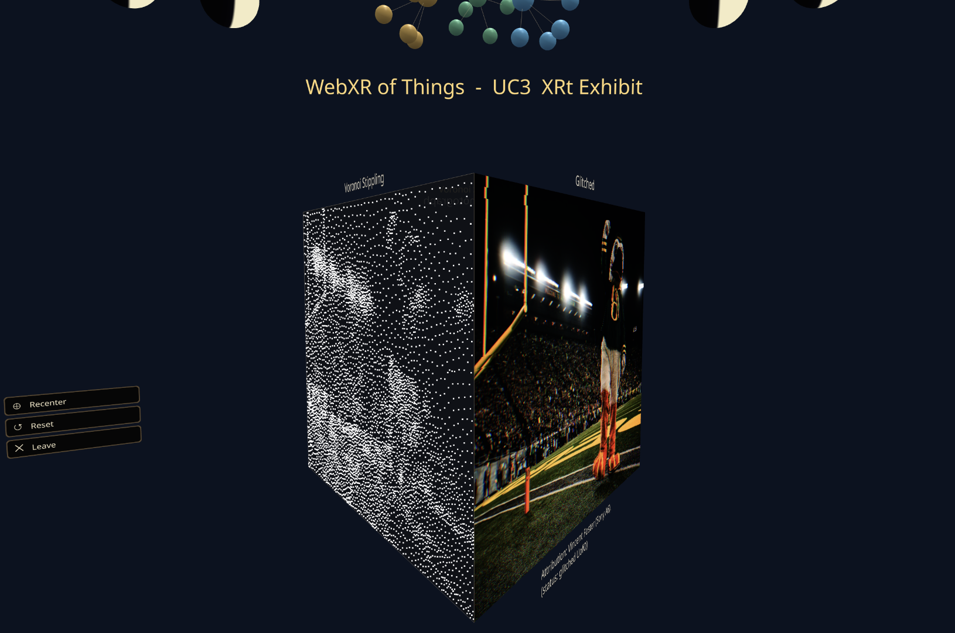
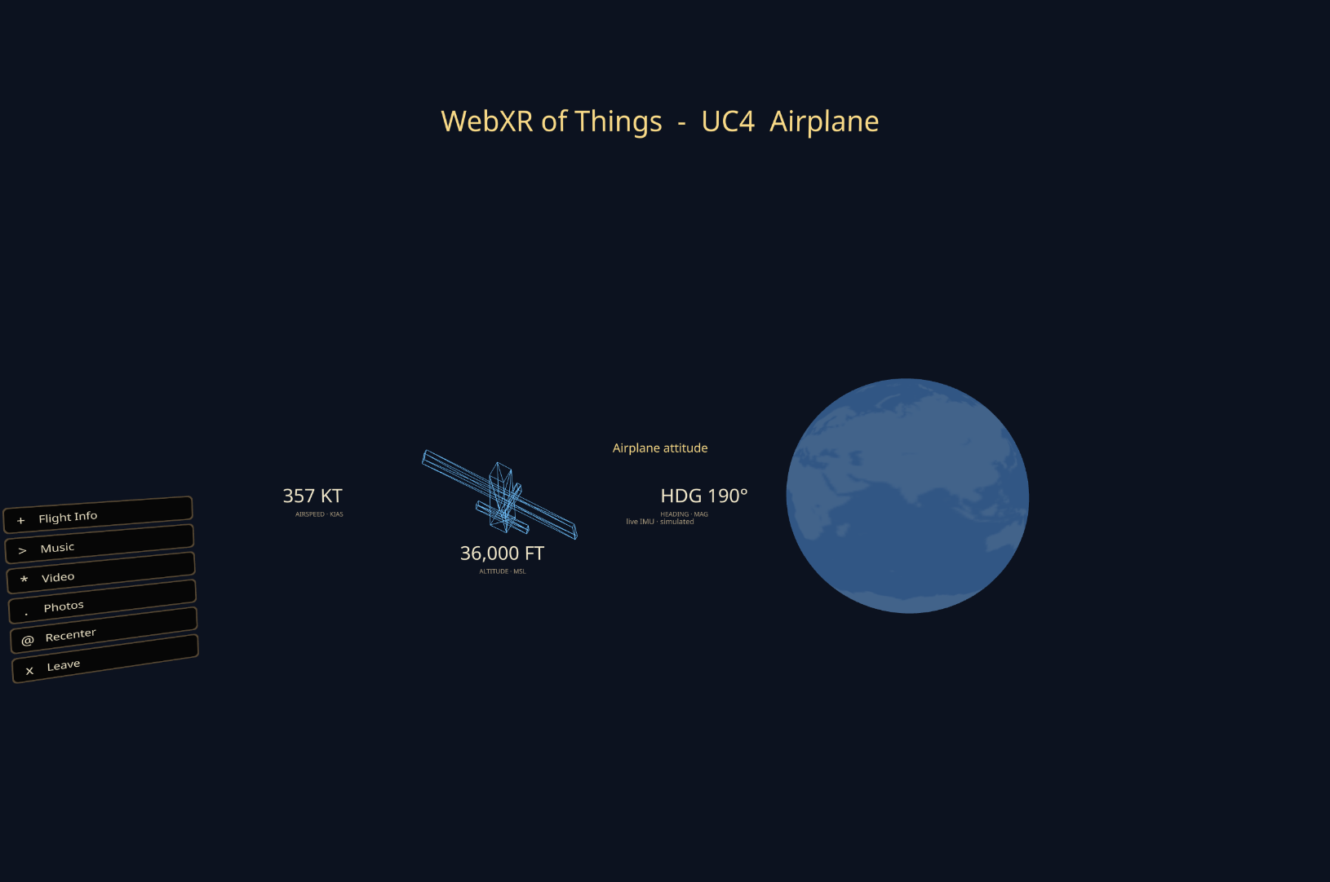

The WebXR Of Things
David J. Kordsmeier¹
¹株式会社IoTone Japan 〒810-0001 福岡市中央区天神一丁目11番1号 ONE FUKUOKA BLDG. 7F · djk@iotone.co.jp
Introduction
Methods
Results
The WebXR Of Things introduces the idea that WebXR can be the default interface to data, people, places, or services
We explore a hyperlocal approach to looking at the world in our immediate vicinity through a generated XR experience
Like ”The Internet of Things” before it, data and services are locked up in silos.
URLs are too long to remember, too complicated to type in XR, AR tags don’t work in XR, and so begins the woeful journey of the XR user
The user journey to get into a WebXR experience is a challenge of its own, and we explore an open source approach, privacy friendly and distributed, to easing the entry and exit of XR experience
PoC as a tool to explore the “dataspace”+”joincode” concept
Devices: Meta Quest 3s, Snaap Spectacles ‘24 + a collection of IoT gadgets (various ESP32s) found in each Use Case
A joincode server manages access to dataspaces
A JSON schema defines the UX, not an app, and every device and service is represented by a metadata specification
It is possible to simplify the user journey of figuring out how to get into an XR experience by using a joincode
Dataspaces offer a unique environment outside of a silo ecosystem, and let you explore people (my data, my health, who is here), places (a museum, this room, outside my house), and things (airplane entertainment system, a movie, the status of the hvac), including services in each
The WebXR UX can be generated from schemas written in JSON or YAML instead of requiring a native app
WebXR has a degraded browser experience, this must be addressed by the community, not by FANG companies
Core Software OSS contributions: dataspace PoC, joincode server, Universal Device Metadata, Universal Service Metadata, Spatial D3.js (for ThreeJS)
ESP32 gadgets using ESPIDFORTH (a FORTH port to ESP-IDF)
A PoC is available on Github: https://github.com/IoTone/ProjectMagNET/tree/dev/reference-designs/webxrofthings/prototype/d3-spatial/demo
This poster, and original proposal: https://github.com/IoTone/ProjectMagNET/blob/dev/reference-designs/webxrofthings
Figure 1-UC1: Human Vitals
Figure 1
Conclusions
Figure 1. HR, Breathing, and “human radar”
The WebXR of Things can be a reality if we design it into our products
It is possible to build in an open way on top of W3C standards to explore IoT devices, and the data around us
Dataspaces can exist anywhere: in a home, a car, an airplane seat, at a hospital, in a museum, at this conference.
The owner of the data should own the stack and decide their own privacy and copyright to data, not the device manufacturer or HMD maker. To force the user into adversarial outcomes of data collected by the HMD is a risk to the future of XR devices becoming mainstream
Open Questions: how can the XR community unite to solve serious challenges with substandard WebXR browser experience? Who among us will build the first Open Hardware spatial XR glasses?
Figure 2-UC2: Connected Home
Objectives
Figure 2
WebXR should be the default experience to devices, places, things
Establish the concept of a dataspace, a hyperlocal location encapsulated in a known ”joincode” to enter a particular XR experience
Design a mechanism to generate a UX from a schema, based on device and service definitions
Provide a reference implementation for the design, prototyped on two existing XR capable platforms
Call out the need for more unification to solve WebXR browser issues to get feature parity with native XR experiences
Future Work
We plan to port the demo running on a laptop to a MediaTek Genio MTK720 from GTI to act as a gateway that can be deployed into any location, including a cyberdeck
We want to finish Spatial D3.js to get the various design primitives ported spatially
We would like to find collaborators to build a true Open Hardware XR Glasses design
Figure 2. IoT Home, spatial lighting controls, door chimes, security cam, hvac
Figure 3-UC3: XRt Gallery
Figure 3
Acknowledgements
Figure 3. A UofO Duck Tribute in XR
Special thanks to IoTone, Inc (USA) for supporting the OSS work. Claude code for PoC.
Work like this cannot happen without projects like ThreeJS, W3C standards, Chromium
Hackathons like VisionDevCamp and MIT Reality Hack which inspire us to think spatially
Tron (1982), the one that taught us about the data worlds locked away inside of computers
Projects like Mozilla Hubs[1], HomeAssistant[2] for some solid ideas
Figure 4-UC4: Airplane Entertainment System
References
Contact
[1] Mozilla Hubs link codes (2020) example: https://blog.mozilla.org/wp-content/blogs.dir/278/files/2020/10/hubs-share.png
[2] HomeAssistant (2013-Present): https://www.home-assistant.io/
QR
Code
Here
David J. Kordsmeier
IoTone Japan
djk@iotone.co.jp
www.iotoneai.site
Figure 4. In-Seat Entertainment Experience: aircraft telemetry, video, audio, spatial photos

