Slide 1
Meet doctor iot based
By :
NIYITEGEKA Janvier 219013744
UWUMUREMYI Gaspard Nelly 219013749
KAMUHANDA Deny-Beny 217292887

Slide 2
Components
NodeMCU esp8266
Pulse sensor
DHT22 sensor (Thermistor)
Breadboard

Slide 3
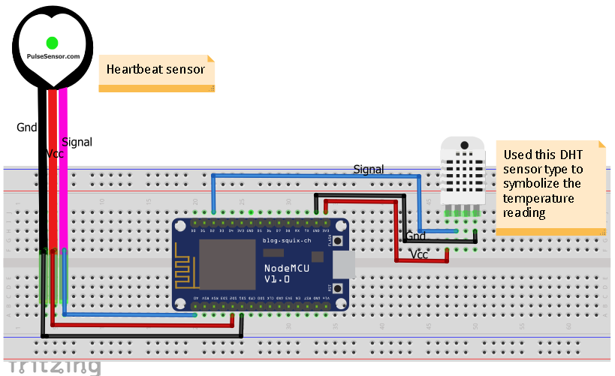
Block diagram

Slide 4
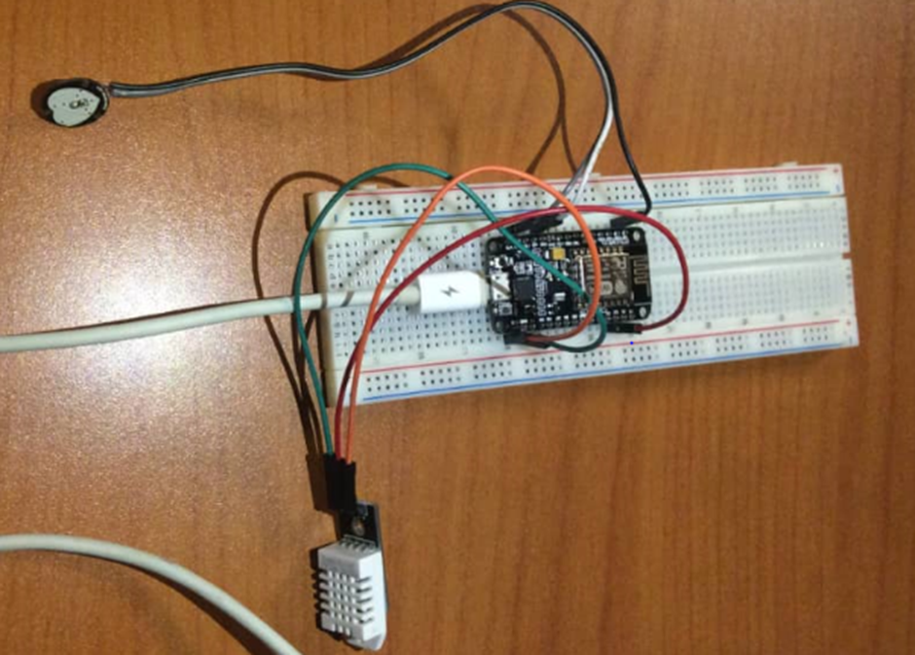
Implementation photo

Slide 5
Pseudo code
Include ESP8266, DHT and PubSubClient libraries.
Declare Sensors pin connection on the board
Define pule_sensor() function for reading pulse Sensor data
Set up WiFi connection for the board
Connecting to Ubidots
Set up initial configuration using setup() function
Using loop() function to read data from sensors and also call then excute other functions

Slide 6
Demo video

