Slide 1
Metaverse optimized
distributed systems architectures.
Standards for representing
the avatars in Metaverse
Diana-Isabela Crainic
Ioan Sava

Slide 2
The Metaverse
Combination of the prefix "meta" (implying transcending) with the word "universe", describes a hypothetical synthetic environment linked to the physical world;
An online virtual world which incorporates augmented reality, virtual reality, 3D holographic avatars, video and other means of communication;
Countless benefits: immersive virtual experience world travel, high quality interaction with family members, improved learning experience;
Hurdle to overcome: interoperability.

Slide 3
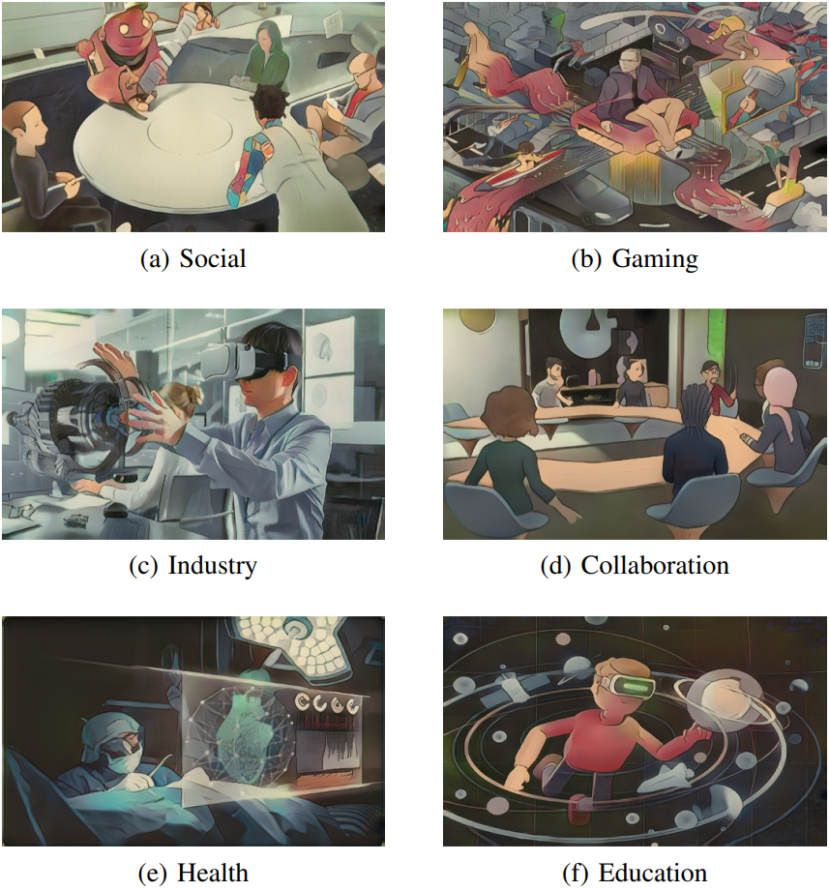
The Metaverse
Applications
Images: https://arxiv.org/pdf/2204.02001.pdf

Slide 4
The Metaverse optimized distributed systems architectures
Need for high-bandwidth and low-latency that will require compute to be closer to the end user, in order to have an immersive experience;
Compute and data will be highly distributed, which will drive the need for a lot of processing capacity in datacenters and at the edge and more powerful PCs;
MTP latency needs to be below the human perceptible limit to allow users to interact with holographic augmentations seamlessly and directly;
Edge computing can reduce the user-experienced latency compared with cloud offloading;
Edge computing is a solution for both security and privacy by allowing data processing and storage at the edge;
Edge Computing vs Cloud Computing;

Slide 5
The Metaverse Avatar
An avatar emerges as a digital identity, an extension of ourselves in the virtual space;
Types of avatars:
VR Avatar
Full Body Avatar
A flexible online representation of an user - it will be able to cross through different virtual worlds and are designed to be extremely realistic;
One of the most logical interoperable element of this digital realm because it represents the identity of the person.

Slide 6
Q & A

