Slide 1
Apache Spark - Fast unified analytics engine
Authors
Ioana – Laura Popescu

Slide 2
Cuprins
Introducere si Motivare
Abordare Teoretică
Implementare
Simulare
Concluzii

Slide 3
Motivation App
Web Search
    12 PB Web data
    Must search quickly
    How?
Web Search Primer
    Users supply words in query --> find all documents with a specified word
    Read 12PB of web pages, find keywords in a single machine:
      100MB/s = 1GB/10s → 12PB in 120000000s -> ~ 4 years!

Slide 4
Motivation App (2)
We need parallelism!
    Run previous task in one day?
    Need a cluster (at least 1400 machines)
Functionality of the computation system?
    Move data around
    Check liveness
    Deal with failures
    Process stuff

Slide 6
MapReduce
Automatic parallelization & distribution
  map() and reduce() functions run on parallel
Fault-tolerant
  Master detects worker failures and re-executes in-progess reduce tasks
Clean abstraction for programmers

Slide 7
Hadoop
Uses MapReduce
Integrates with HDFS
Commonly used
Writes all intermediary results to disk!
  It slows down significantly even the smallest of jobs

Slide 8
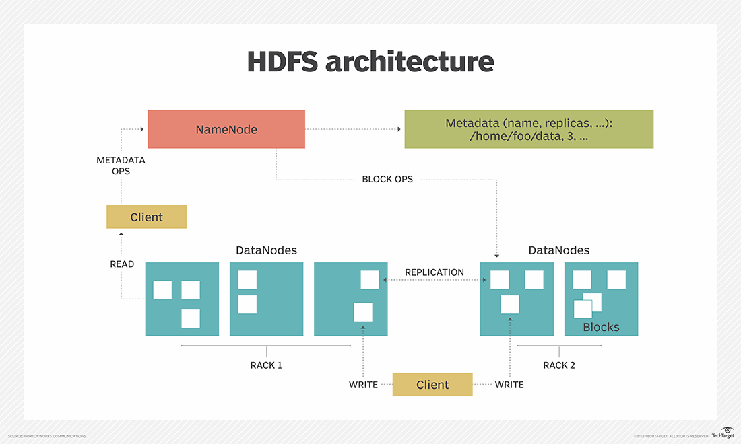
HDFS

Slide 9
Apache Spark
Tries to use RAM whenever available
Uses RDD’s
  Collections of objects spread over the datanodes
  Built with parallel transformations
  Rebuilt on failure detection

Slide 10
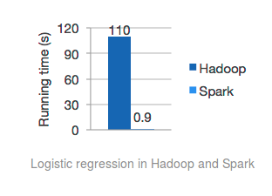

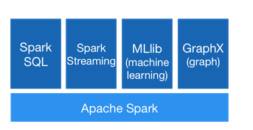

Slide 11
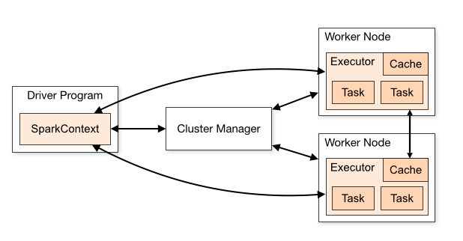
Spark Architecture

