Slide 1
Utilizarea masinilor virtuale pentru executia sistemelor de operare pe microprocesoare scalabile
Autori
Ioana – Laura Popescu

Slide 2
Cuprins
Introducere
Abordare Teoretică
Analiza tendintelor actuale in domeniu
Concluzii

Slide 3
Introducere
Motivatia principala este, de obicei, data de posibilitatea time-sharing-ului intre multiple sisteme de operare “single task”
Avantaje
Reducerea costului
Companiile ruleaza 1 aplicatie/server pentru toleranta la defect
Virtualizare -> 1 single-purpose server = mai multe servere pe acelasi system fizic
Reducerea energiei folosite
mai putine servere fizice → mai putine de alimentat
Optimizarea timpului
Mai putine servere fizice → deployment mult mai flexibil si se reduce timpul de mentenanta

Slide 4
Abordare teoretica
Emularea unuia sau mai multor sisteme de calcul pe acelasi system fizic.
Full Virtualization
Implementeaza functionalitatea necesara pentru a rula unul sau mai multe sisteme de operare intregi separate.
Process virtualization
sunt facute in asa fel incat sa execute programe in medii independente de platforma. Aceste masini virtuale pornesc in momentul rularii unui proces, iar cand procesul isi incheie executia, de asemenea face si masina virtuala aferenta. (ex JVM)

Slide 5
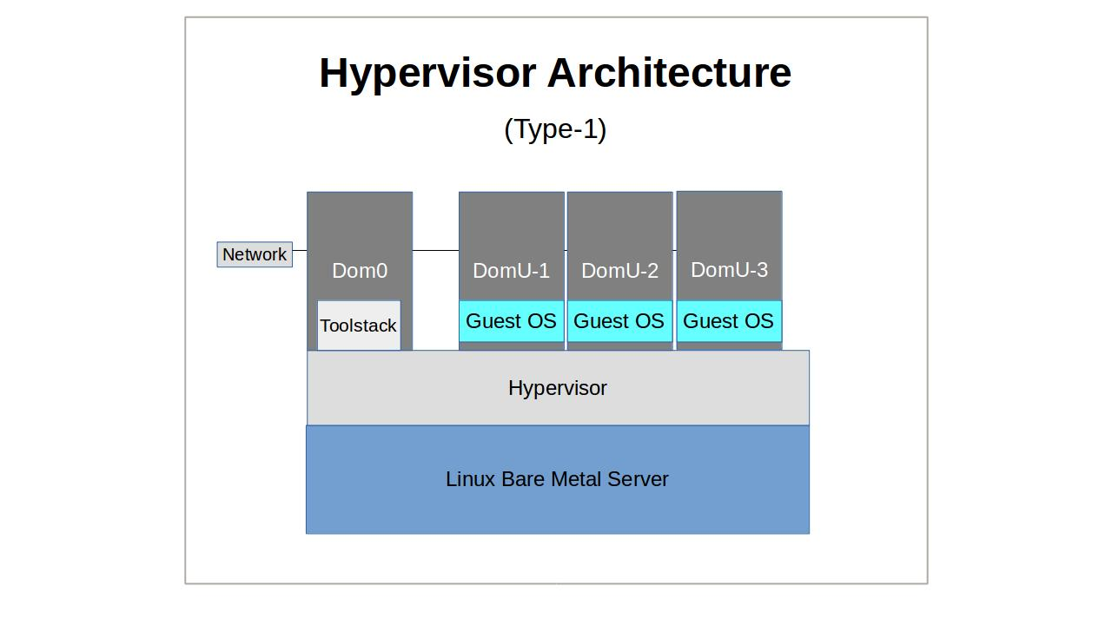
Abordare teoretică
Hipervizorul “traieste” intre hardware si sistemul de operare, si “decupleaza” sistemul de operare de hardware. Acesta se ocupa de managementul de resurse (ca memoria si disk I/O) si administreaza accesul la acestea.

Slide 6
Analiza tendintelor actuale in domeiu
KVM (Kernel Virtual Machine)
OpenSource
Kernel module -> Kernel acts as hypervisor
Needs virtualiation aware CPU: Intel-VYT Amd-V
Loadable .ko
kvm-intel.ko, kvm-amd.ko
Support for: Linux, BSD, Solaris, Windows, Haiku, ReactOS, Plan 9, AROS Research Operating System si macOS
Has a VMM to map VCPU, Networking etc to VM

Slide 7
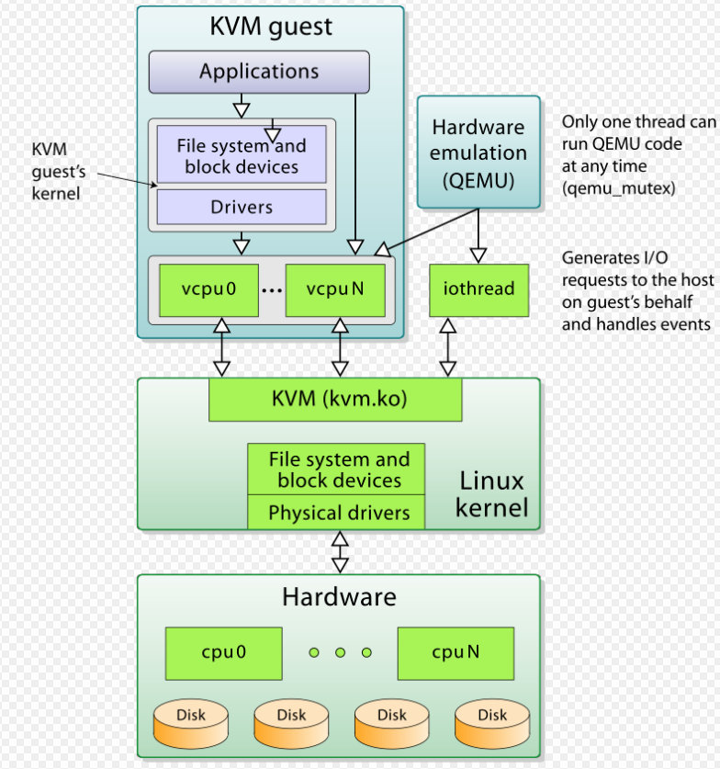
KVM

Slide 8
Xen
Hypervisor type 1 → bare-metal
Ruleaza privilegiat
Foloseste paaravirtualizare
SysCall-uri -> HyperCalluri
Hipervizorul se ocupa de
sincronizarea resurselor de CPU, management de memorie, acces la retea etc
Pornirea domeniului mai privilegiat (dom0)
Doar dom0 are access pe HW si se ocupa de domU

Slide 9
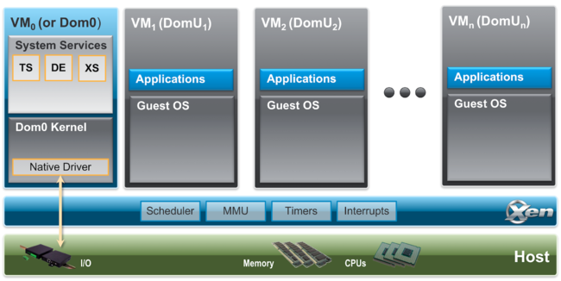
Xen

Slide 10
VMWare
VMWare Workstation
Highly used for driver testing to avoid SO destruction
Uses physical machine’s devices
Microsoft Windows, Linux și Mac OS X
For Servers: VMWare ESXi/ESX
Type 1 Hypervisor
Rewrite machine code to trap when VMM intervention may be required -> SLOW
Binary Translation is portable

Slide 11
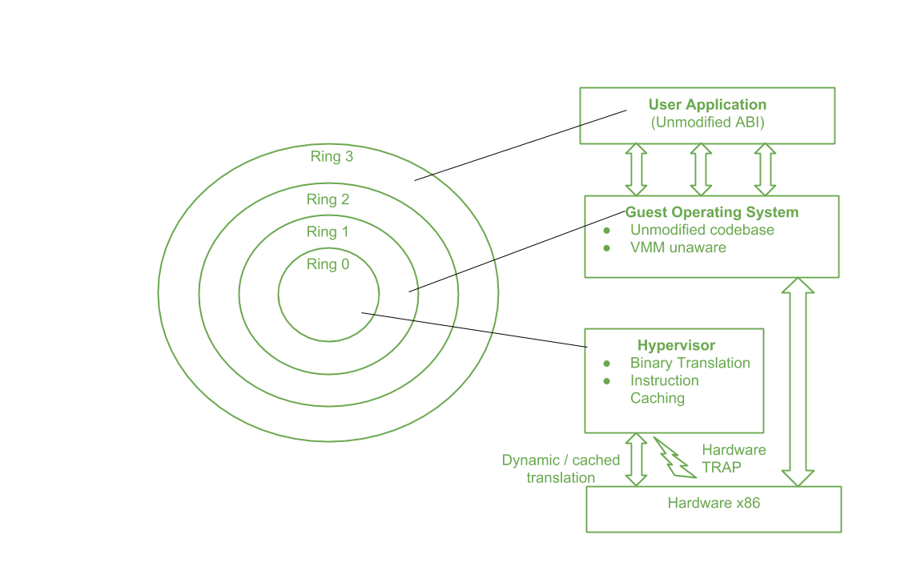
VmWare ESXi

Slide 12
Tehnologii avansate utilizate în arhitecturi bazate pe rețele de “cluster”-e
Autori
Ioana – Laura Popescu

Slide 13
Cuprins
Introducere si Motivare
Abordare Teoretică
Implementare
Simulare
Concluzii

Slide 14
Introducere
Web Search
12 PB Web data
Must search quickly
How?
Web Search Primer
Users supply words, find all documents with a specified word
Read 12PB of web pages, find keywords, 100MB/s -> years!

Slide 15
Abordare Teoretica
Clustering
Interconection of server in a way that they act as one server
Shared resources: TCP/IP addresses, network cards, databases
Hadoop
Distributed computation system to run jobs on clusters
Map-Reduce
Apply map on each input -> (key, value) pairs
All values with a common key -> get to one reducer
Spark
Another computation system
Difference against Hadoop: uses RAM whenever it can
Faster!
Uses RDD’s
Collection of elements partitioned across the cluster
Can be operated on in parallel

Slide 16
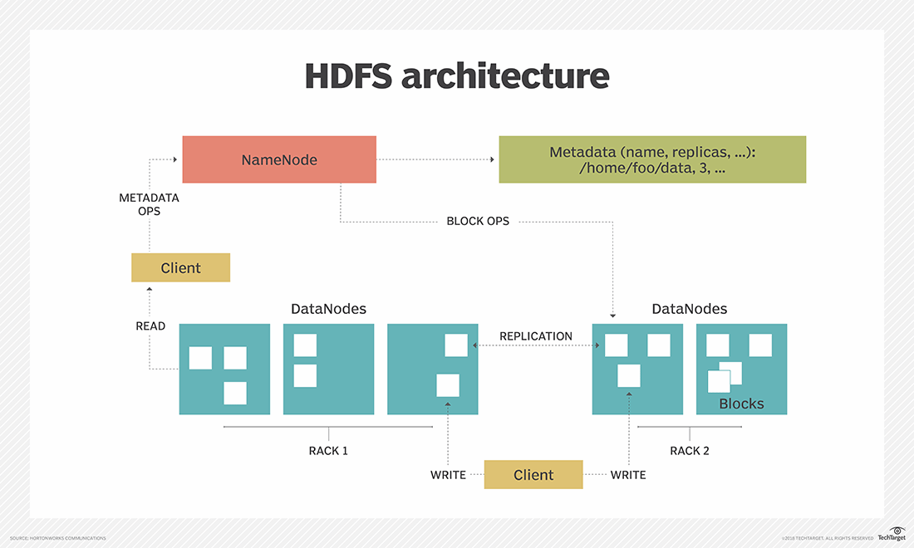
HDFS

Slide 17
Application
Milion Song DataSet
Expose Loudness War by computing a file with metadata 10.000 songs
API to access it
MetaData: Author, year, Loudness and others
Map-Reduce:
From the file, compute with mapToPair function (Loudness, Year)
Use mapValues to obtain: (Year, (Loudness, 1))
On Reduce: Sum up Loudnesses and 1’s (to get the counts)
Final mapValues(Year, SumOfLoudness/SomOfOnes)
Code in the document od Lab 5!

Slide 18
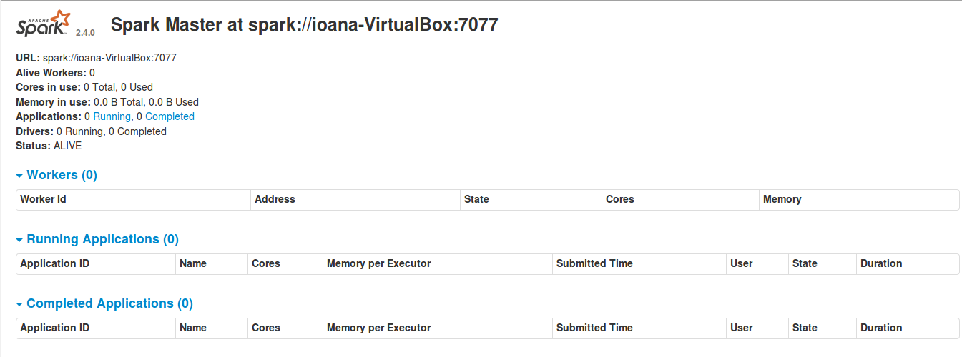
Simulare
MasterNode at Localhost:8080 (The only dataNode as well)

Slide 19
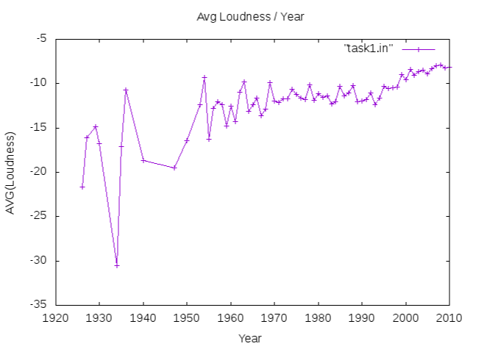
Plot data from output file

