Slide 1
Implementarea si verificarea functionalitatii de interceptare a pachetelor Modbus TCP
Autori
Conducători științifici
Ioana – Laura Popescu
As. Drd. Ing. Dumitru Cristian Trancă

Slide 2
Cuprins
Security Challenges
Modbus over TCP
Existing solutions
Implementation

Slide 3
CyberSecurity Challenges in IIoT
ICS had been operating in isolation outside the industrial plant up until now
Increasing use of TCP/IP and Ethernet
Security provided by isolation withdrawn
  Why though?

Slide 4
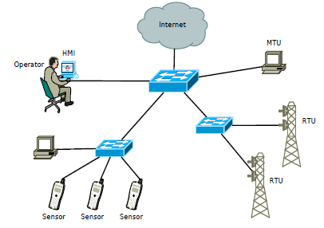
SCADA System Components
*Typical SCADA System components

Slide 5
Many ICS’s include web-enabled HMI’s
Huge cost savings
Also huge security challenges
ICS’s stand as vulnerable as enterprise IT
  Not as prepared
    Weak encryption or not at all (man in the middle)
  Consequences much more worst
    i.e possible loss of human lives

Slide 6
Modbus over TCP
TCP/IP provides all necessary packages sent between two participants over LAN
  It has nothing to do with the content of the messages
Motbus/TCP is an application level protocol
  Follows client/server paradigm
Available requests:
  Read/write operations on registers
  Control and monitor device I/O

Slide 7
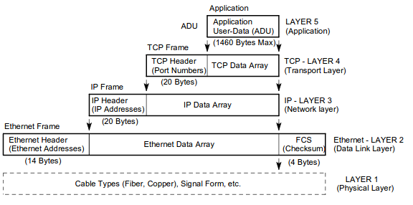
Modbus over TCP

Slide 8
Existing solutions

Slide 9
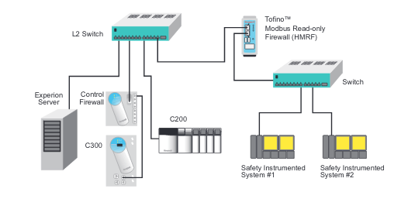
  Tofino 9211-ET-HN3

Slide 10
Tofino 9211 ETHN3
Read only firewall
It has predefined filtering of allowing only certain read operations
Statefull firewall
Upgradable via USB
  Encrypted update files
  Diagnosis report
Throughput of 1000 Modbus frames/second

Slide 11
  Open-source firewalls in SCADA
Uses advanced iptables features without change in framework
Done multiple experiments to get the best candidate
Statefull firewall
Closely analysed features of iptables as compared to IPFW, PF, IP filter
  Statefull, port/host/protocol, NAT, String match
  Iptables is the only one that provides byte filter and string filter

Slide 12
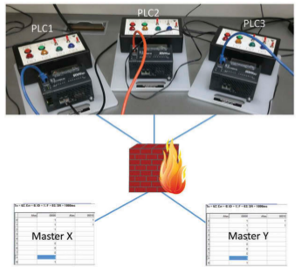

Slide 13
Opensource IEC 61131-3
Added extensions to iptables via kernel module
Has not been updated ever since 2004
Has several patches, but does not comiple with kernel > 2.6

Slide 14
Experimental Setup
Raspberry Pi 3 Model B v1.2 with Raspbian
ModbusDriver application for modbus master and slave simulation
2 ubuntu 16.04 laptops communicating with each other via wifi

Slide 15
Implementation of sniffer
Raspberry opens a raw socket intercepting all traffic
Parses the packets such that it analyses only TCP and Modbus default port (502)
Analyses Data payload, and extracts the function code, and applies a simple match so that “Passed” packets will only be of Read operations
Statefull analyzer

Slide 16
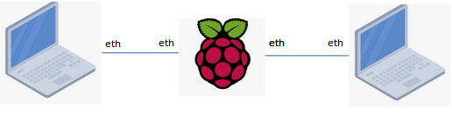
Future work to be achieved
Add Ethernet connections so all traffic between the 2 peers will pass through raspberry
Further send only packets that are marked as “passed”
  Via opening an additional socket and bind it to the appropiate interface
Generate a benchmark on RT vs NonRT kernel

