Slide 1
Regeneration Vehicle Insurance Project
Team Leader
Team Members
Αναστασάκη Ιωάννα
Βασιλάκη Ελένη
Κωνσταντινίδης Νικόλαος

Slide 2
Project Description
A console application.
Read from File/Database.
Print to screen / Write to file.

Slide 3
App Features
Check vehicle Insurance status by plate number.
Show list of vehicles about to expire till given date.
Retrieve database sorted by plate number.
Calculate total cost of expired vehicle(s) for given owner.

Slide 4
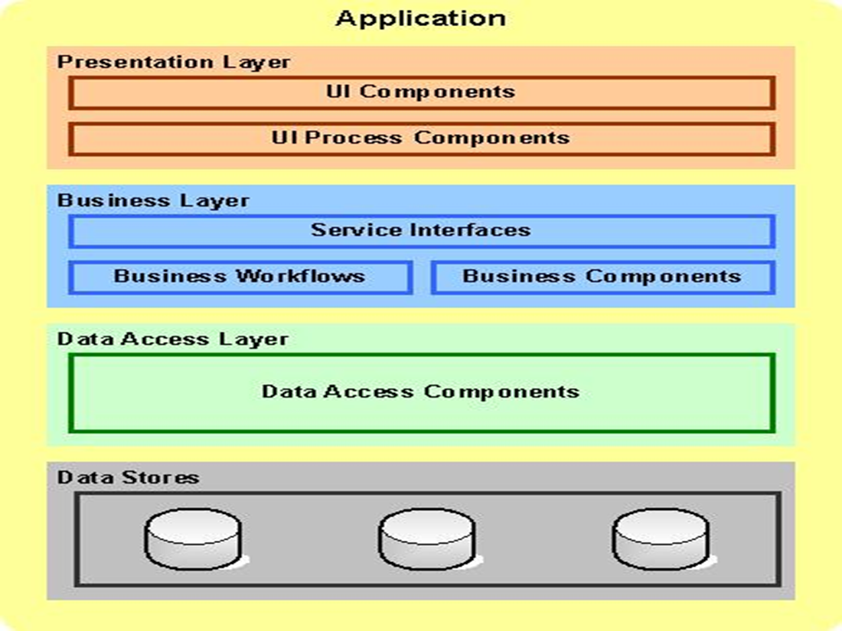
Typical Web App Structure

Slide 5
Our Project Structure
Presentation Layer
ConsoleMenu
Business Layer
BusinessLogic
FileUtilities
Data Access Layer
ExpireList
Sorting
TotalDept
VehicleStatus
ExportData
ImportData
Model
Connection
Connection
DBRequests
Owner
Vehicle

Slide 6
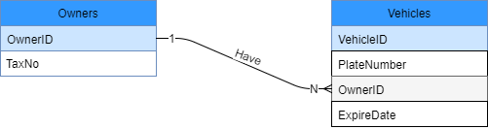
Database Structure

Slide 7
Workload Distribution

Slide 8
Tasks in common
Design Database
Discuss App overall Functionality
Finalize App Structure
Test each others code

Slide 9
Individual Tasks
Vehicle Insurance
Total Debt
Connection
DBRequests
Ιωάννα
User Validation
File Utilities
Data Output
Expire List
Models
Ελένη
Νίκος
Sorting Functionality
Console Menu
Menu input option validation

Slide 10
Points worth your attention
Strong Validation checks, ensuring proper user input/file and valid attribute values .
Use of prepare statements in Database to prevent sql injections and enhance overall app performance.
Minimal (according to current requirements) yet expandable DB Schema.

Slide 11
Points worth your attention
Export in UTF8 Format
Use of Regular Expressions for validation.
Additional validation of the plate numbers of the vechile with regular expressions
Models Composition – Override - Overload
Teamwork collaboration.

Slide 12
Live Demo

Slide 13
Thank You

