Slide 1


Ioannis Bouzas
Student
Token and Resource Aware
Long Term Memory for On Device Agents
Department of Computer Science & Engineering
University of Ioannina
Konstantinos Skianis
Supervisor

Slide 2
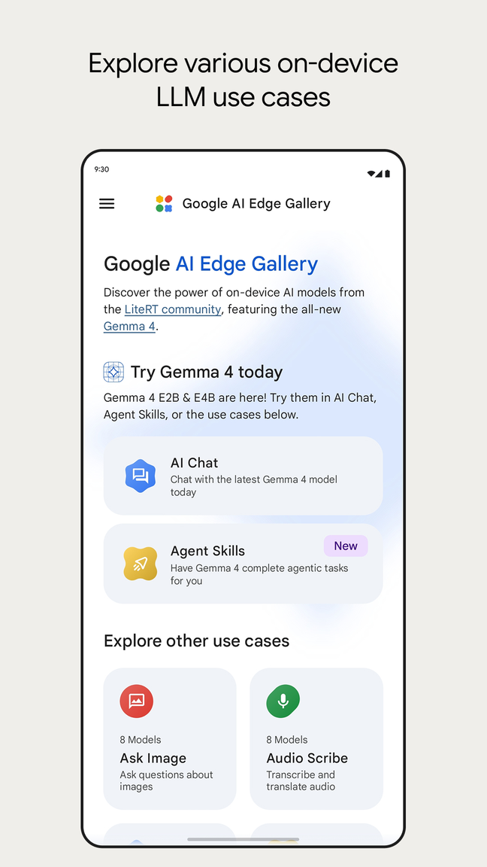
Local Inference
Google AI Edge Gallery lets you run the world's most powerful open-source Large Language Models (LLMs) on your mobile device. Fully offline, private, and lightning-fast.
Agentic Skills, Chat and Mobile Actions, everything locally
Source: https://github.com/google-ai-edge/gallery

Slide 3




SLM releases over time
2024
Phi 3 mini
Llama 3
Gemma 2
OpenELM
(Apple Products)
2025
Gemma 3
Phi 4
Qwen 3
Ministral 3
2026
Gemma 4
Qwen 3.5
Every family has models of about 4B parameters or fewer.
LFM 2.5
Sources: https://ollama.com/search

Slide 4
Fundamental Problem

Slide 5
Fundamental Problem
Context Window

Slide 6
Fundamental Problem
Context Window
The context window is the model’s working memory — and working memory is expensive.
COMPUTE TIME
HEAT & RAM
BATTERY DRAIN

Slide 7
One conversation, 419 turns
Turn 20 · 25 May
“…raising awareness for mental health…”
Last 79 turns: kept by the history budget
May 2023
19 sessions · two friends · five months
Oct 2023
“What did the charity race raise awareness for?”
Recent turns only
Retrieval
“The conversation does not mention a charity race.”
“mental health”
✗ Wrong
✓ Correct
LoCoMo conv-26 · Gemma 4 E2B · Galaxy S23 Ultra

Slide 8
“One of the most critical steps towards useful personal and professional agents is reliable memory. Models need to remember what matters and recognize when earlier information becomes relevant.”
Meta AI, Muse Wonder (October 2026)
Memory systems are usually evaluated on servers, in accuracy and tokens
What they cost on the phone itself is rarely measured
How can a small model on a phone remember a long history, within the phone's resources, and still answer correctly?
Source: Meta AI, “Muse Wonder: A Frontier Model For Personal & Professional AI Agents”, research.meta.ai/blog/muse-wonder, 12 Oct 2026

Slide 9
Research questions
RQ1
How do different long-term memory strategies affect the question-answering performance of small language models?
What trade-offs between answer quality and resource consumption arise when deploying long-term memory strategies on smartphones?
RQ2
What are the capabilities and limitations of knowledge-graph-based memory for small language models under constrained context and resource budgets?
RQ3

Slide 10

How should an on-device agent remember?
Recent turns
Vector Retrieval
Knowledge Graph
Retrieve relevant memories
Structured facts, extracted locally by the SLM
full context, truncated
Evaluate them based on
Answer Quality
On Device Cost

Slide 11
Models Stack
Qwen3.5 0.8B
Qwen3.5 2B
Qwen3.5 4B
Gemma 4 E2B Gemma 4 E4B
Embeddings Model → Nomic Embed Text v1.5
Judging Model → Llama 3.1 70B Instruct
All readers and the judge are 4-bit (Q4_K_M)
Phone readers: GGUF from huggingface.co/unsloth · phone embedder: huggingface.co/nomic-ai
Server-side models: ollama.com

Slide 12
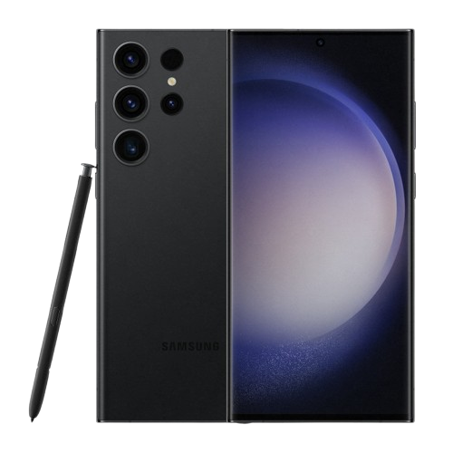
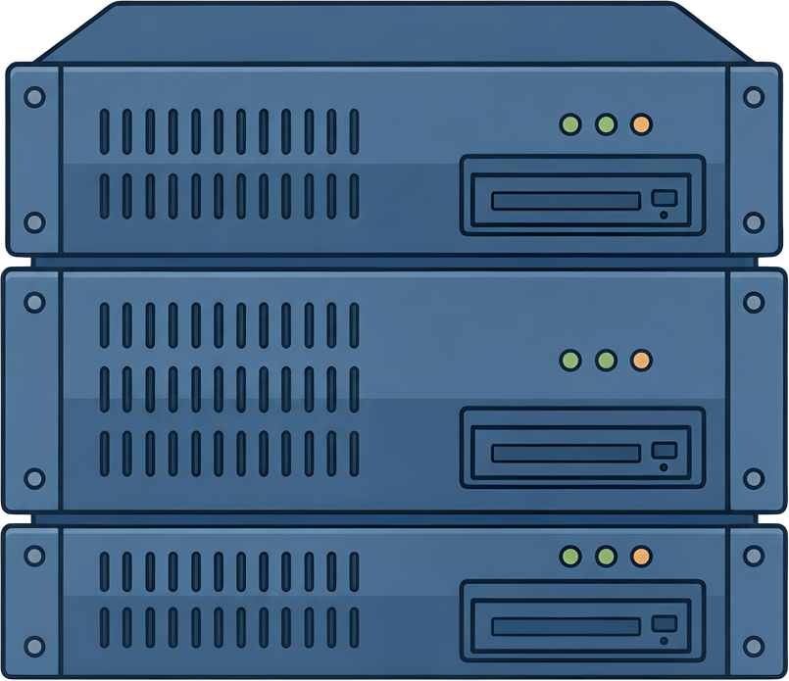
Setup: one phone, one workstation
Samsung Galaxy S23 Ultra
Workstation
12 GB RAM
Snapdragon 8 Gen 2
3.36 GHz Cortex-X3
5,000 mAh
  llama.cpp in Termux
Same Memory Code
More Questions
Second Benchmark
Judging Model

Slide 13
Benchmarks
Two established benchmarks for long-term conversational memory
Scored by a 70B judge + human audit
LoCoMo
LongMemEval-S
10 long conversations
369–689 turns per history
~16K-17K tokens
4 question types
Both on phone/workstation
60 questions
~491 turns per history
~115K tokens
6 question types
Workstation only
Phone accuracy is measured on the phone and not from the workstation.

Slide 14
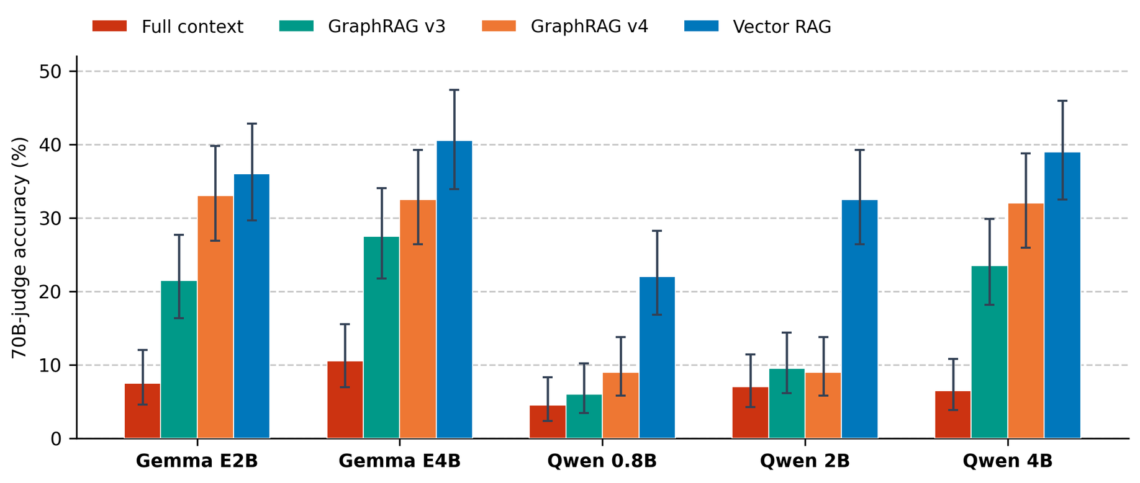
RQ1 · Which memory answers correctly?
Vector retrieval: highest accuracy estimate for all 5 models
Gemma 4 E2B: full context (4,096-token window) 7.5% · graph facts 21.5% · graph + sources 33.0% · vector 36.0%
LoCoMo · 200 questions per cell · workstation · 70B judge · GraphRAG v3 = graph facts, v4 = graph + source text
Similar findings with larger readers: Han et al. (2026, KDD) · Qian et al. (2025, MemoRAG, WWW) · Jia et al. (2025, TMLR)

Slide 15
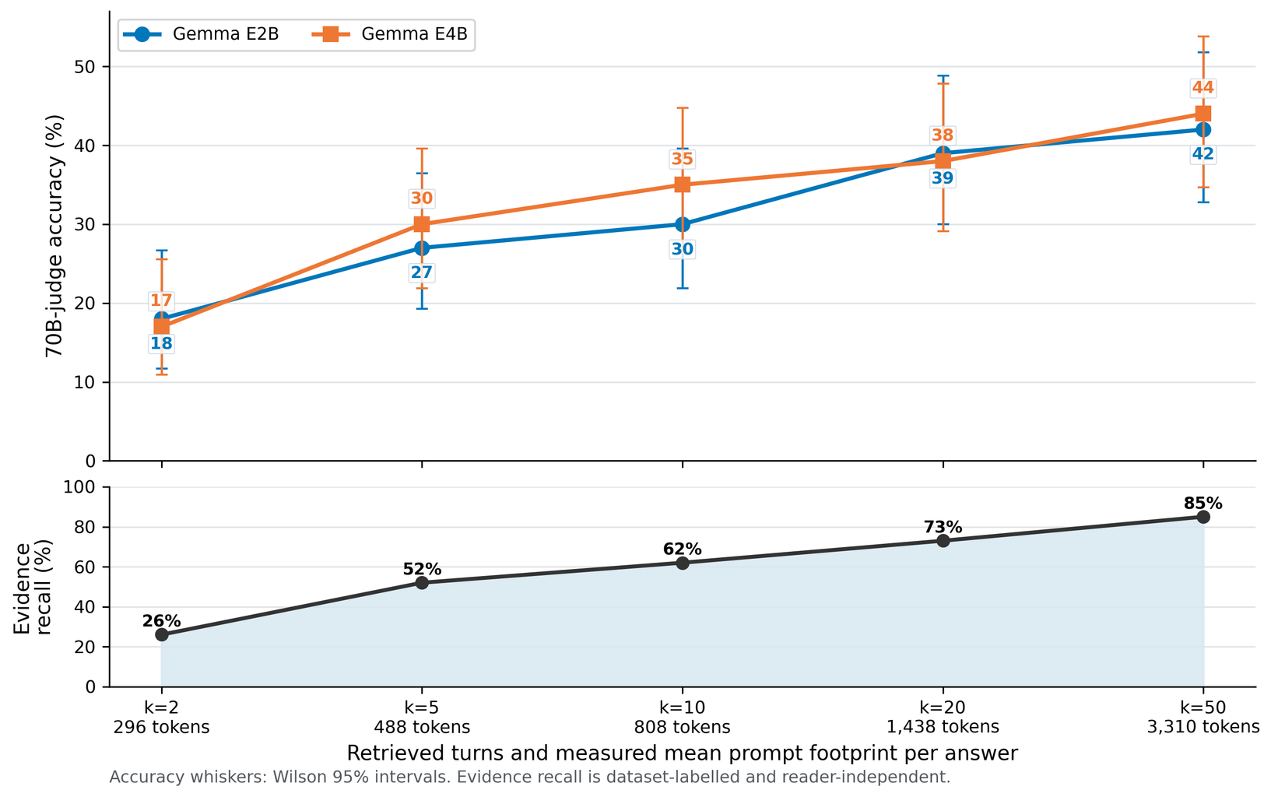
RQ1 · Over the tested ranges, depth moved accuracy more than model size
+15 to +27
points from retrieving more turns (k = 2 → 50), across all 5 models
+4.5 / +6.5
points from doubling the parameters (Gemma / Qwen)
More evidence helps, but the prompt grows: 296 → 3,310 tokens
LoCoMo · depth sweep on a 100-question subset · workstation · size gains from the 200-question grid

Slide 16
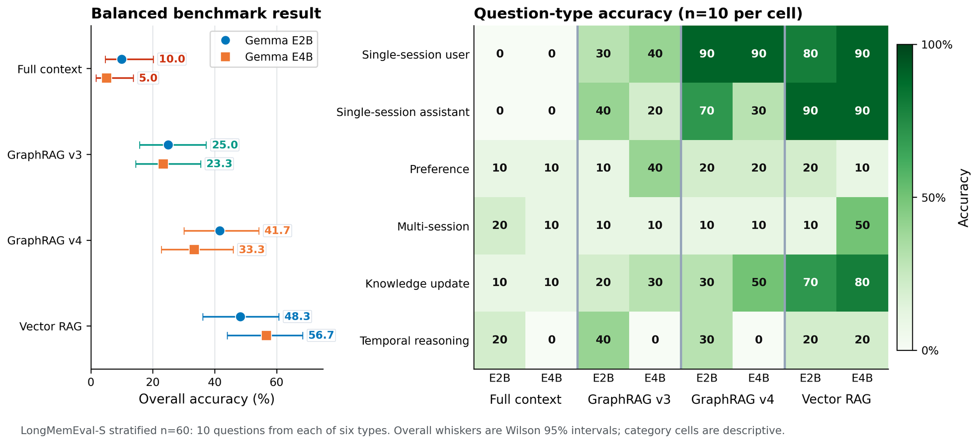
RQ1 · What about LongMemEval-S?
LongMemEval-S: vector highest, full context lowest
Gemma E2B / E4B: vector 48.3 / 56.7% · graph + sources 41.7 / 33.3% · full context 10.0 / 5.0%
LongMemEval-S · 60 questions (10 per type) · workstation · 70B judge
Consistent with the LongMemEval-S comparison in Jia et al. (2025, TMLR)

Slide 17
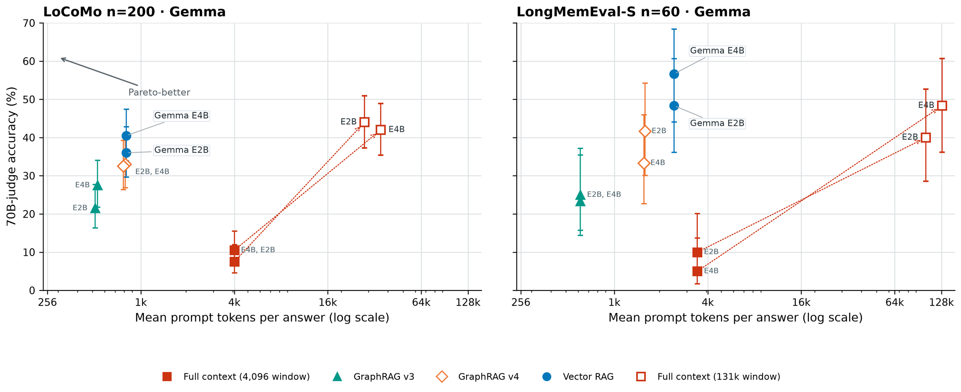
Whole history: full context catches up, at many times the tokens
LoCoMo: long window 44.0% vs vector 36.0% (E2B) · LongMemEval-S: vector ≈8 pts ahead
The whole history costs about 39–48× the prompt tokens of vector retrieval
Workstation · 70B judge · Gemma 4 shown (Qwen 4B: 41.5 vs 39.0, 45.0 vs 50.0)

Slide 18
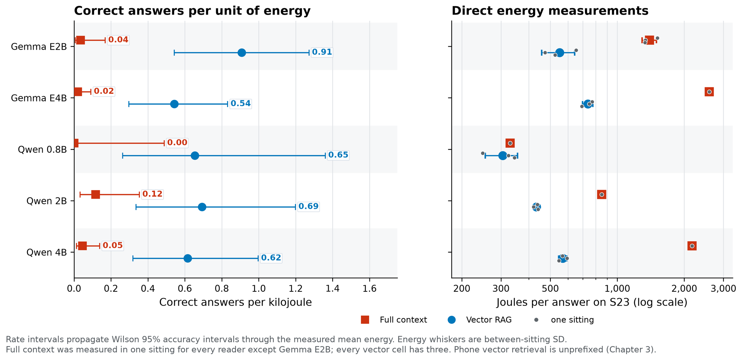
RQ2 · On the phone, the better answer was also the cheaper one
5.8–26.9× more correct answers per kJ with vector retrieval
4 of 5 readers (Qwen 0.8B: ratio undefined) · vector 20–50% correct vs full context 0–10% · 6.8–8.2× faster query service
Galaxy S23 Ultra · 20 LoCoMo questions per cell · accuracy measured on the phone · energy from the hardware Coulomb counter
Similar phone studies (document RAG, preprints): Park et al., 2025 (MobileRAG, J per query) · Jiang et al., 2026 (SmartRAG, prefill-bound latency)

Slide 19
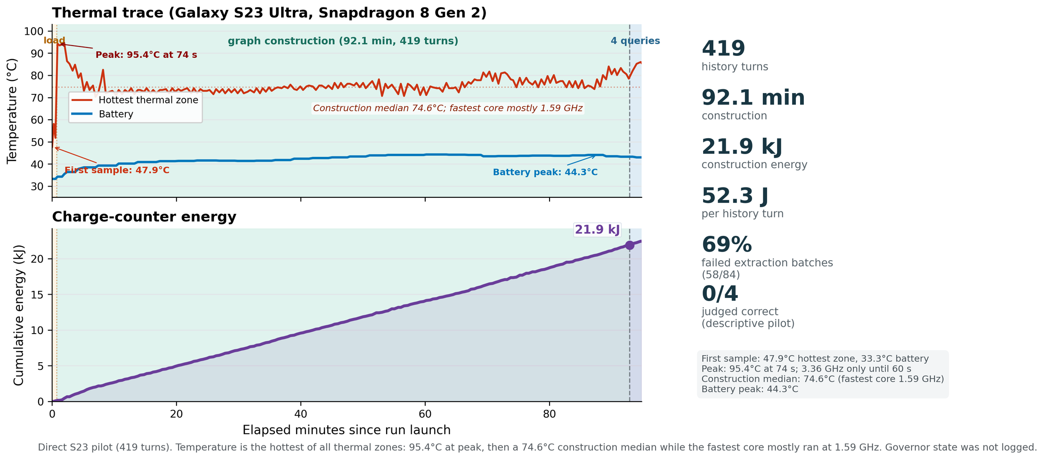
RQ2 · The bill a prompt doesn't show
Building the memory: a graph cost about 26× the energy of embeddings
52.3 J vs 2.04 J per history turn · before even the first question
Graph pilot: 419 turns · 92 min · 21.9 kJ · 58 of 84 extraction batches failed
Similar finding on servers: ingestion and retrieval dominate processing time in memory frameworks (Jia et al., 2025, TMLR)

Slide 20
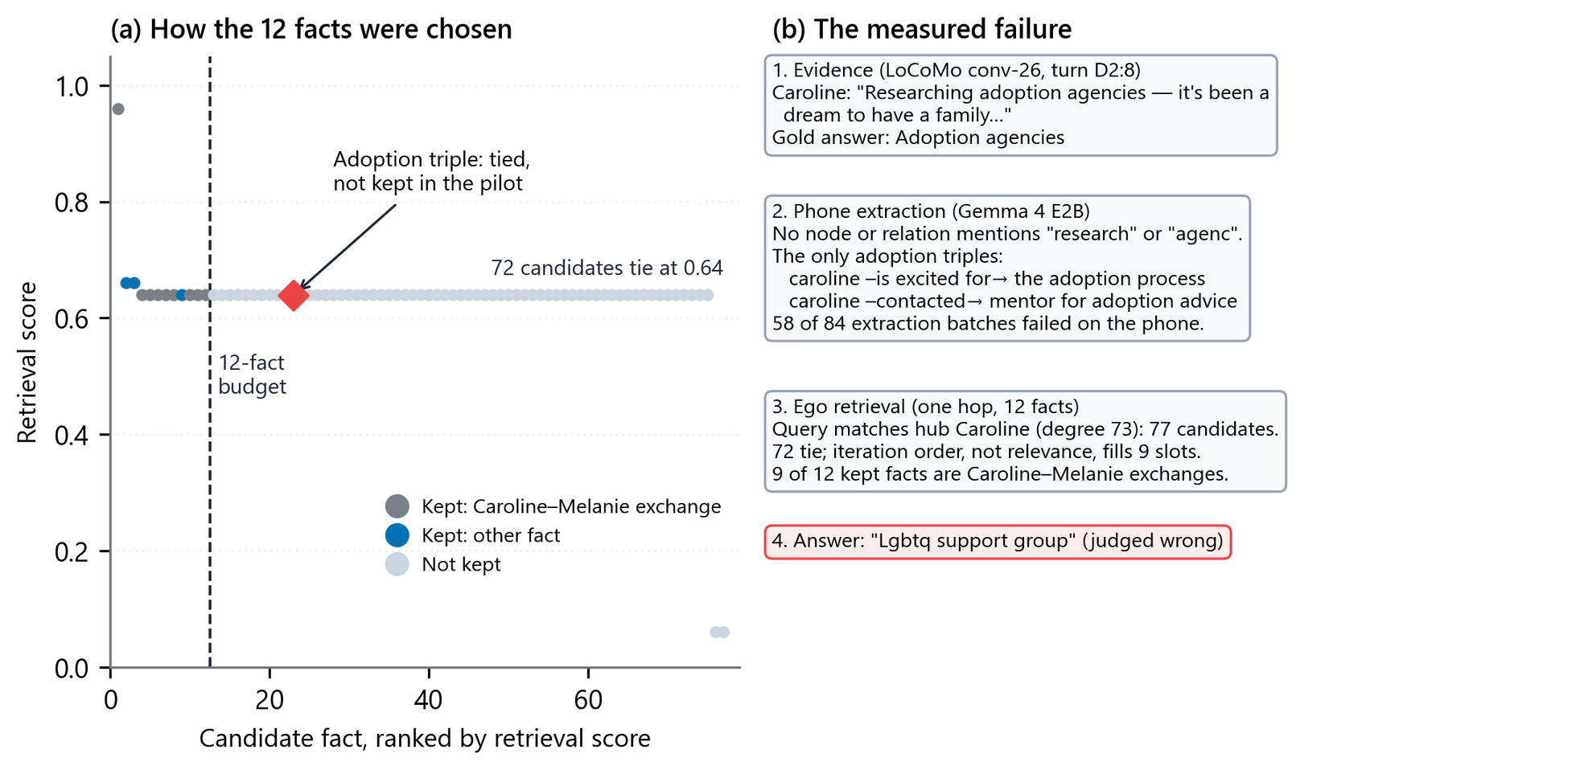
RQ3 · One failure, traced end to end
The fact was weakened in extraction, then crowded out by a tie
72 candidate facts tie at the same score · 9 of 12 kept slots filled by iteration order, not relevance
Galaxy S23 Ultra graph pilot · LoCoMo conv-26 · Gemma 4 E2B extractor · one-hop ego retrieval (GraphRAG v1)
Similar finding: an RGCN reasoner drops from 60.69% on ground-truth facts to 24.88% on facts extracted by a 4B Gemma model (Kelesis et al., 2026)

Slide 21
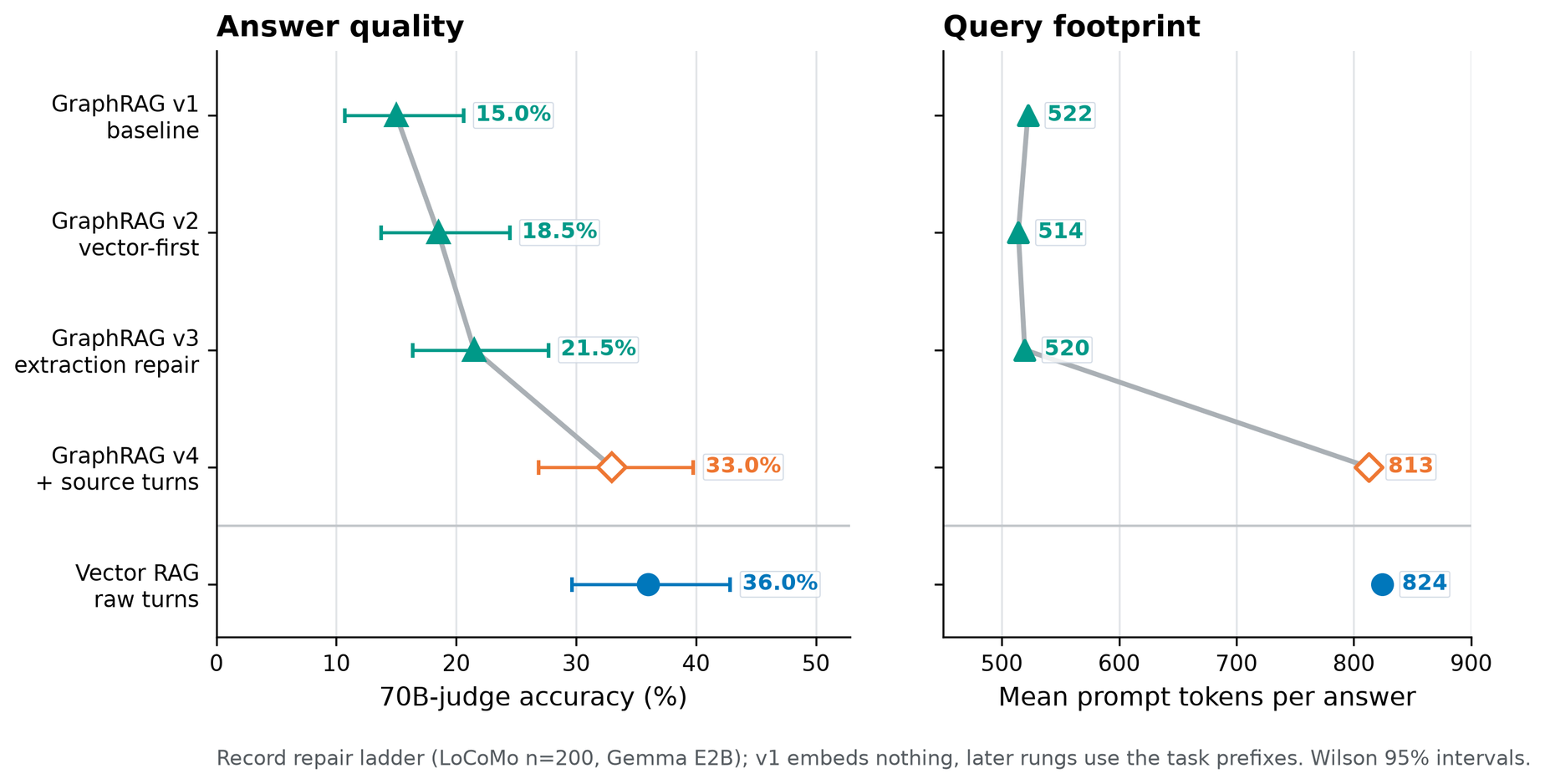
RQ3 · Putting the source text back
21.5% → 33.0% by restoring the source turns
Same retrieved turns, same model: adding the source text recovered most of the gap · still below vector 36.0%
LoCoMo · 200 questions · Gemma 4 E2B · workstation · E4B: 27.5% → 32.5% · restored text also lengthens the prompt (520 → 813 tokens)
Similar finding with larger models: graph results depend on the evidence supplied, triples alone or with source text (Han et al., 2026, KDD)

Slide 22
RQ3 · SPE: keep the triple, or pay for its source?
Under a token budget, expand only the facts that need their original text
Triple
+ its source turn
(John, went to, martial arts gym)
“I went to that martial arts gym on 5th street to do kickboxing and taekwondo!”
mean ≈ 17.5 tokens
mean + ≈ 75 tokens
The rule: most similarity per token, until the budget is full
Budgets: 240 or 370 tokens · a new triple competes with its full similarity;
an upgrade only with the similarity it adds
Measured means: 17.5 tokens per selected triple, 75.4 tokens per upgrade (Gemma 4 E2B, budget 370)
Related designs: SEEM adds source text for every retrieved event frame (Lu et al., 2026, ACL); LeanMem when an LLM planner asks (Liao et al., 2026)

Slide 23
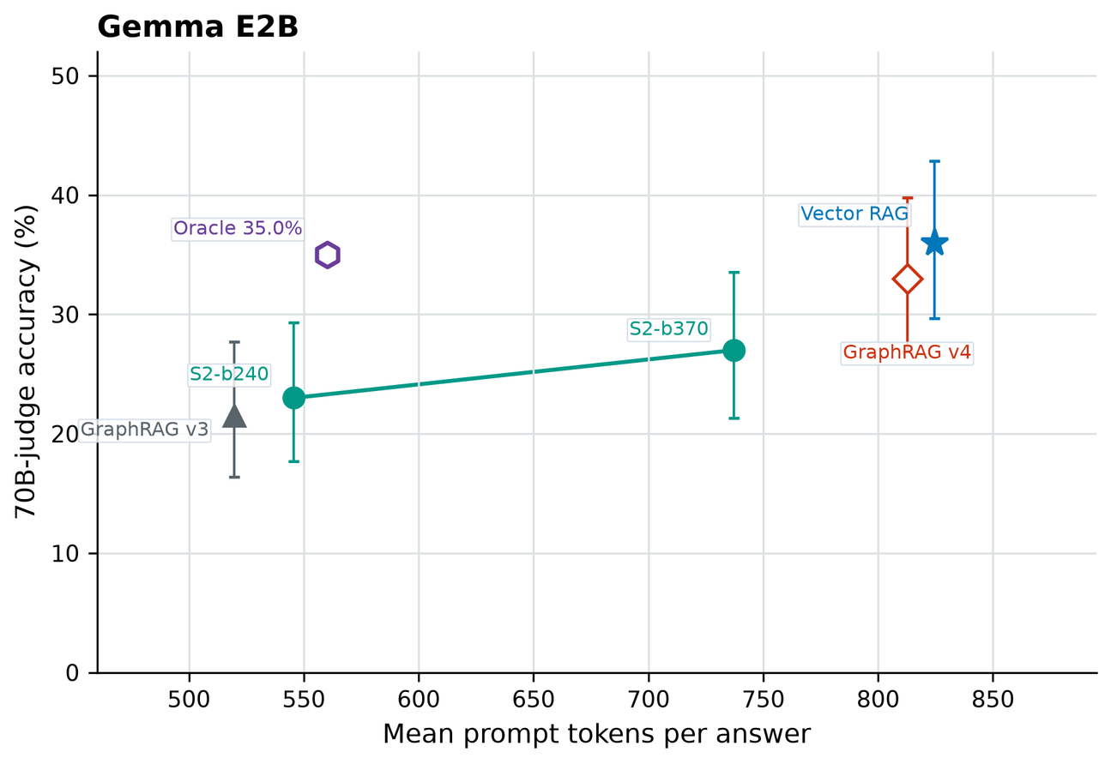
RQ3 · SPE result: the selector never chose a source
0 of 800
prompts chose a source turn
27.0% vs 33.0%
SPE-2 (budget 370) vs graph + source text
Oracle: 35.0%
with 31% fewer tokens than graph + source text (an upper bound)
Random expansion: 23.1%
same share of questions expanded
The per-fact rule failed; the oracle's headroom is at the question level
LoCoMo · 200 questions · Gemma 4 E2B shown (E4B: SPE 25.0–25.5%, oracle 33.5%) · workstation

Slide 24
What’s Next ?
  Cheaper construction: a small model that only builds memory, judged in correct answers per kJ
  A better thing to store: structure that keeps its source text, so the detail survives
  Decide source expansion once per question, where the oracle shows headroom
  Beyond question answering: memory behind tool use and actions

Slide 25
Thank you
Ioannis Bouzas · Supervisor: Konstantinos Skianis · Department of Computer Science & Engineering, University of Ioannina

Slide 26
Backup
Details for questions
Contributions · Answer grid · Limits
B1 Pipeline · B2 Baseline budget · B3 Retrieval vs reading · B4 Reasoning · B5 Prompt · B6 Phone workload · B7 Query time
B8 KV cache · B9 Parity gate · B10 SPE both readers

Slide 27
What this thesis contributes
  A controlled comparison of full context (truncated and with a long window), vector retrieval and SLM-extracted graph memory: five readers, two benchmarks, retrieval depth against model size.
  A smartphone study that relates answer quality to measured energy: correct answers per kJ, latency, memory and heat, and the energy of building each memory.
  An analysis of where graph memory loses evidence, through successive repairs, source-text restoration and extractor-versus-reader controls.
  Selective Provenance Expansion, tested against criteria recorded in advance: a negative result, with its diagnosis and an upper bound.

Slide 28
How should an on-device agent remember? The answers
Recent turns (full context)
Vector retrieval
Knowledge graph
✗ Lowest
✓ Highest estimate
~ In between
Answer quality
7.5% on LoCoMo (Gemma E2B, 4,096-token window)
≤ 10% on LongMemEval-S
36.0% (E2B), all 5 models
+15 to +27 pts from retrieval depth
21.5% → 33.0% with source text
adding source text recovers most of it
workstation · LoCoMo, 200 questions
✗ Costliest per answer
✓ Cheapest per answer
✗ Expensive to build
On-device cost
vector gave 5.8–26.9× more correct answers per kJ
6.8–8.2× slower query service
551 J per answer (Gemma E2B)
2.04 J per turn to build
fastest query service
52.3 J per turn to build (≈26×)
construction pilot only; phone QA not measured
Galaxy S23 Ultra
On a phone, the better memory was also the cheaper one, and the graph lost what its sources still held.

Slide 29
Limits
  One phone (Galaxy S23 Ultra), one runtime; 20 questions per phone cell
  One automatic judge (1 verdict in 100 changed across sessions); blind human audit: 82 of 83 decisive labels agree (κ 0.976)
  Graph on the phone = one construction pilot; no phone graph question-answering cell
  Graph conclusions cover graphs that small models extracted from dialogue, not knowledge graphs in general
  Question answering only: not tool use or actions

Slide 30
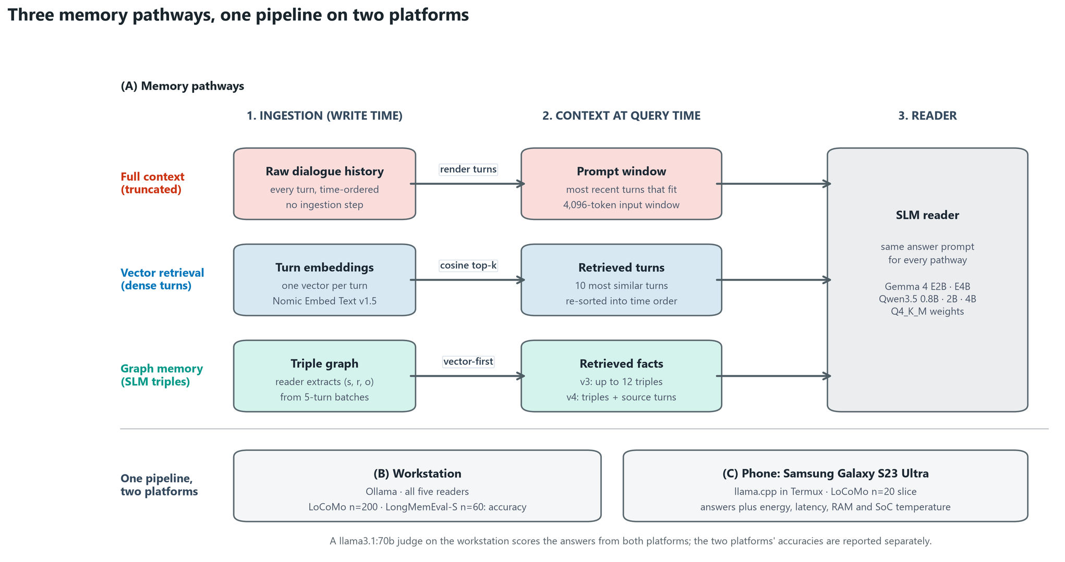
How each memory is built and read
Same reader and answer prompt for every memory; only the context changes
B1 · Chapter 3 · workstation: Ollama, LoCoMo n=200, LongMemEval-S n=60 · phone: llama.cpp in Termux, LoCoMo n=20

Slide 31
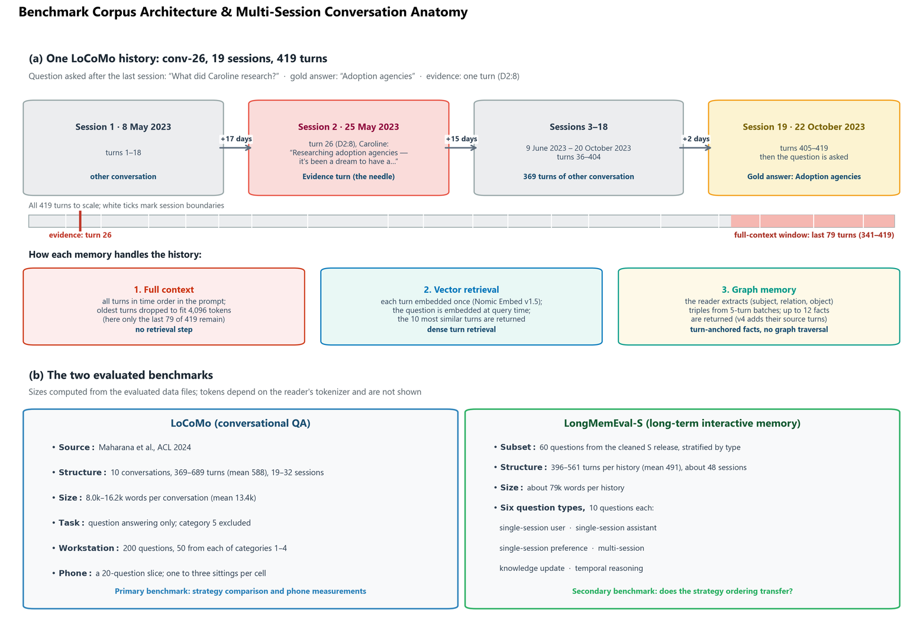
The baseline: a fixed history budget, not unlimited memory
Full context keeps the most recent turns that fit a 4,096-token budget
conv-26: only turns 341–419 of 419 remain; the Caroline question's evidence is turn 26
B2 · Chapter 3 · budget counted as characters ÷ 4 · phone prompts 4,670–5,254 tokens, held in full · Ollama trims to 4,096

Slide 32
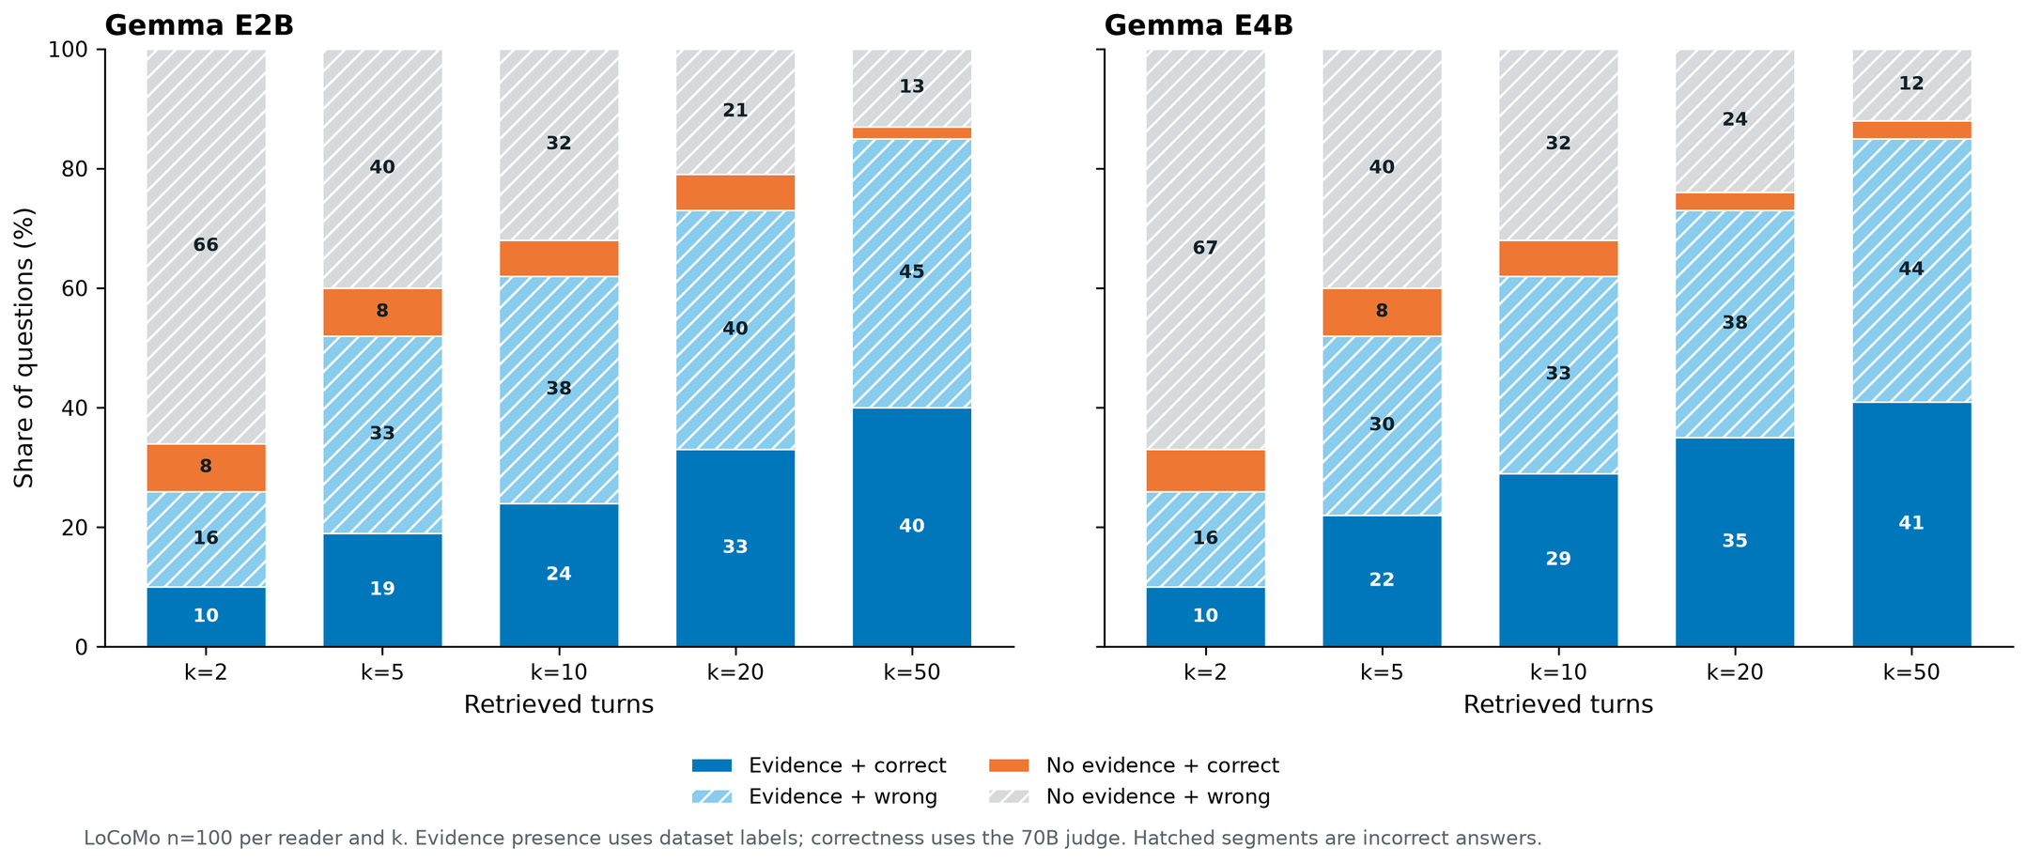
Retrieval failure or reading failure?
More depth brings the evidence in; many answers stay wrong
k = 50: evidence in the prompt for 85 of 100 questions · with complete evidence, accuracy 31–55% across readers
B3 · LoCoMo, 100-question depth subset · Gemma E2B and E4B shown · evidence = dataset labels · 70B judge · Chapter 4

Slide 33
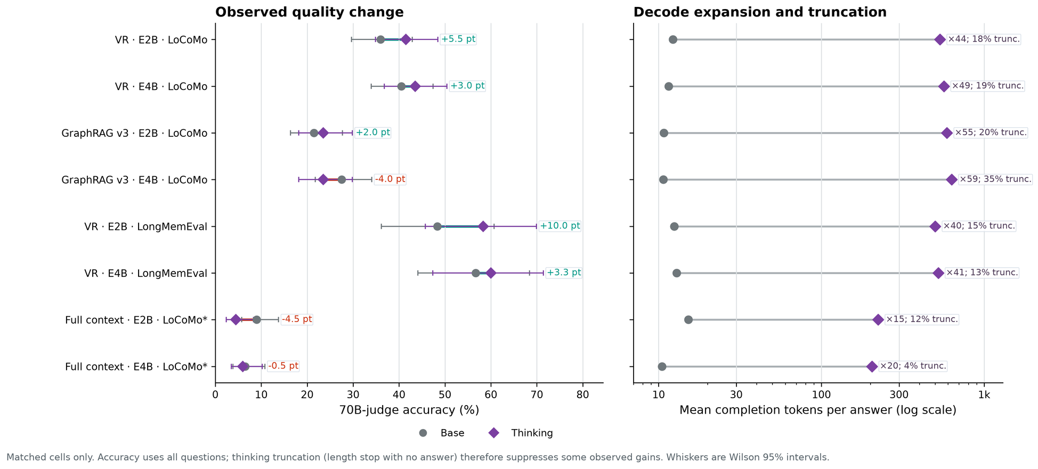
Does reasoning ("thinking") help?
Mixed: small gains with retrieval, at 40–59× the output tokens
vector: +5.5 / +3.0 points on LoCoMo, +10.0 / +3.3 on LongMemEval-S
B4 · workstation · Gemma E2B / E4B · answers cut at the 768-token cap count as wrong · no phone energy measured · Chapter 4

Slide 34
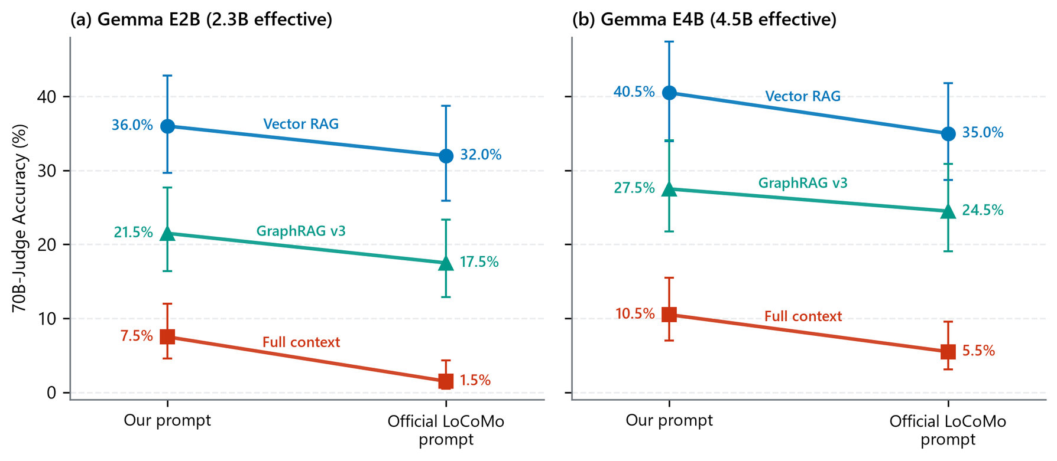
Is the ranking an artefact of my prompt?
Official LoCoMo prompt: 3–6 points lower, same ranking
E2B: vector 36.0 → 32.0% · GraphRAG v3 21.5 → 17.5% · full context 7.5 → 1.5%
B5 · workstation · LoCoMo n=200 · Gemma E2B / E4B · whiskers: Wilson 95% intervals · Chapter 4

Slide 35
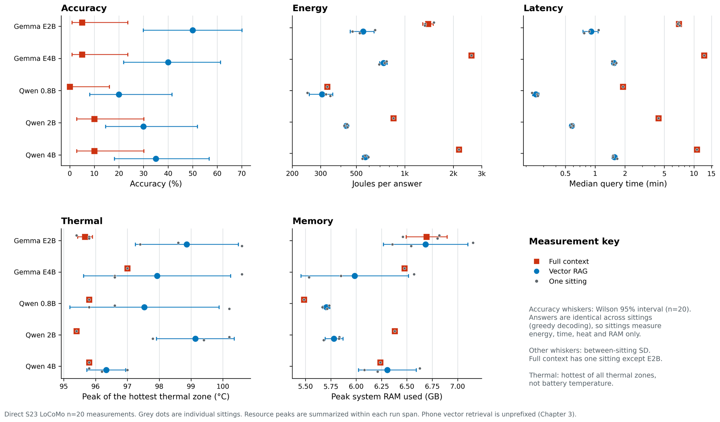
Phone workload: five readers, two memories
Retrieval: faster, lower energy for four readers; RAM similar
median query time: E2B 420.7 → 54.5 s · E4B 759.7 → 93.0 s · hottest zone 0.5–3.7 °C warmer with retrieval
B6 · Galaxy S23 Ultra · LoCoMo n=20 · grey dots = sittings · temperature = hottest thermal zone, not battery · Chapter 5

Slide 36
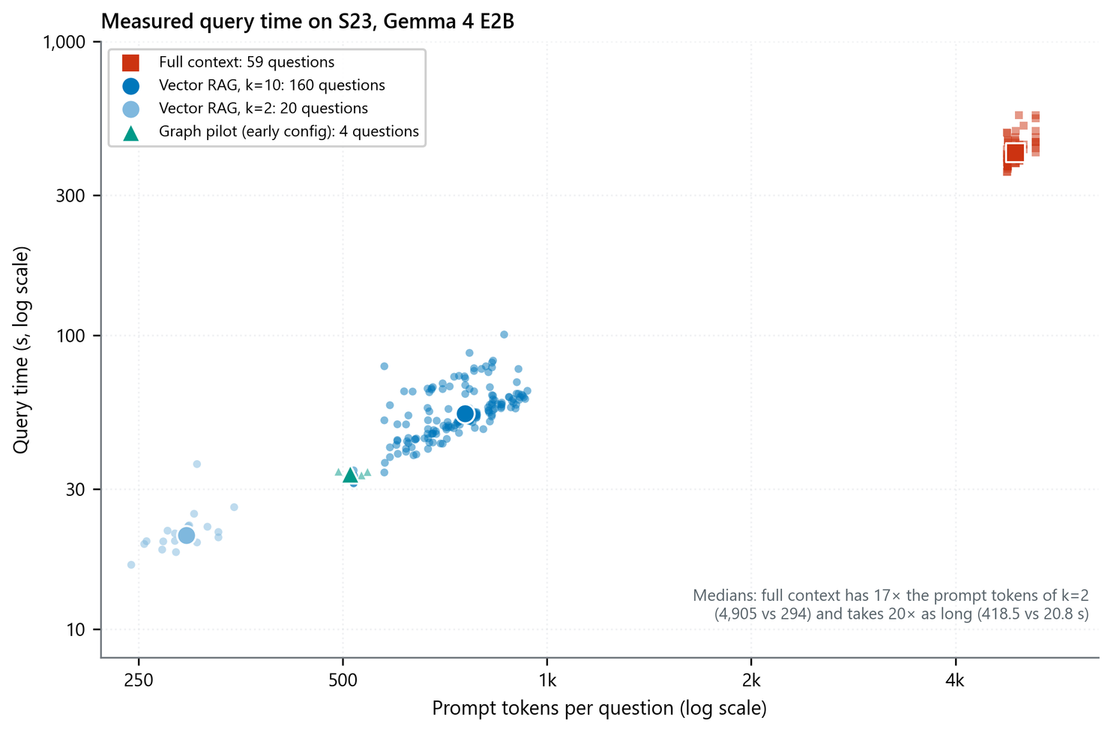
Where the phone's time goes
Query time follows prompt length
full context ≈ 4,900 tokens: 411–431 s median per sitting · 10 turns ≈ 680 tokens: 46–65 s · 2 turns ≈ 290 tokens: ≈ 21 s
B7 · Galaxy S23 Ultra · Gemma 4 E2B · every answered question · prefill and decode not separated · Chapter 5

Slide 37
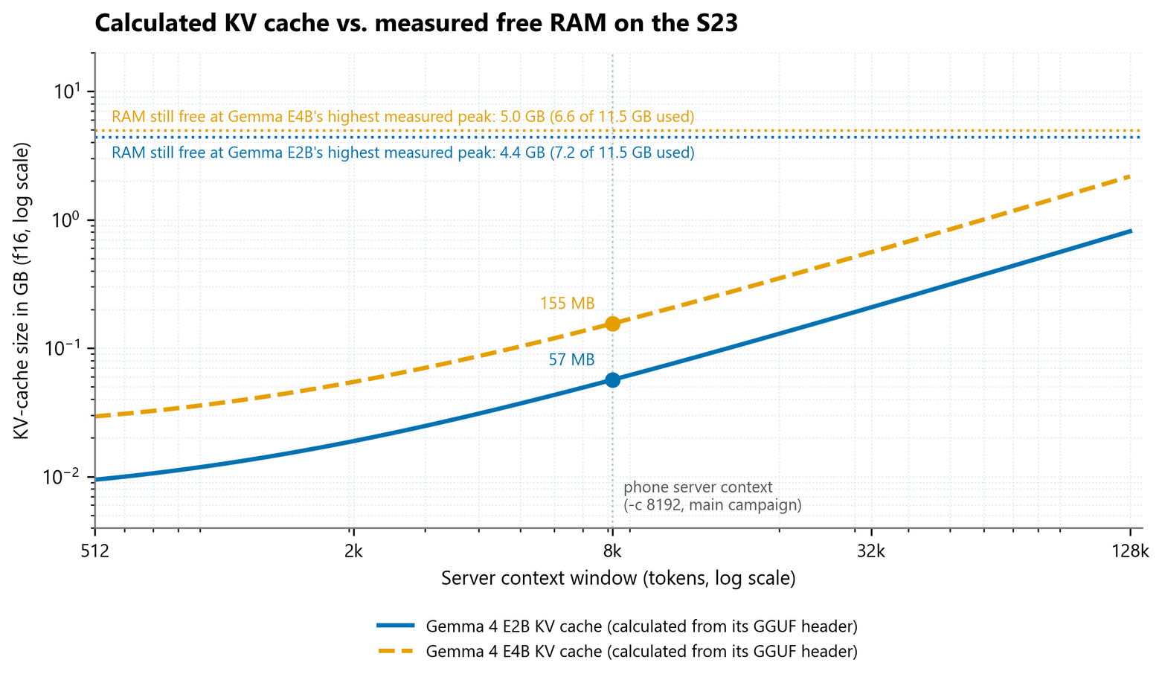
Is RAM the limit?
Not at these lengths: the KV cache is tens of megabytes
8,192-token cache: 57 MB (E2B), 155 MB (E4B) · RAM still free at the highest peak: 4.4 / 5.0 GB
B8 · KV cache calculated from the GGUF layer shapes (f16) · free RAM measured on the S23 · Appendix

Slide 38
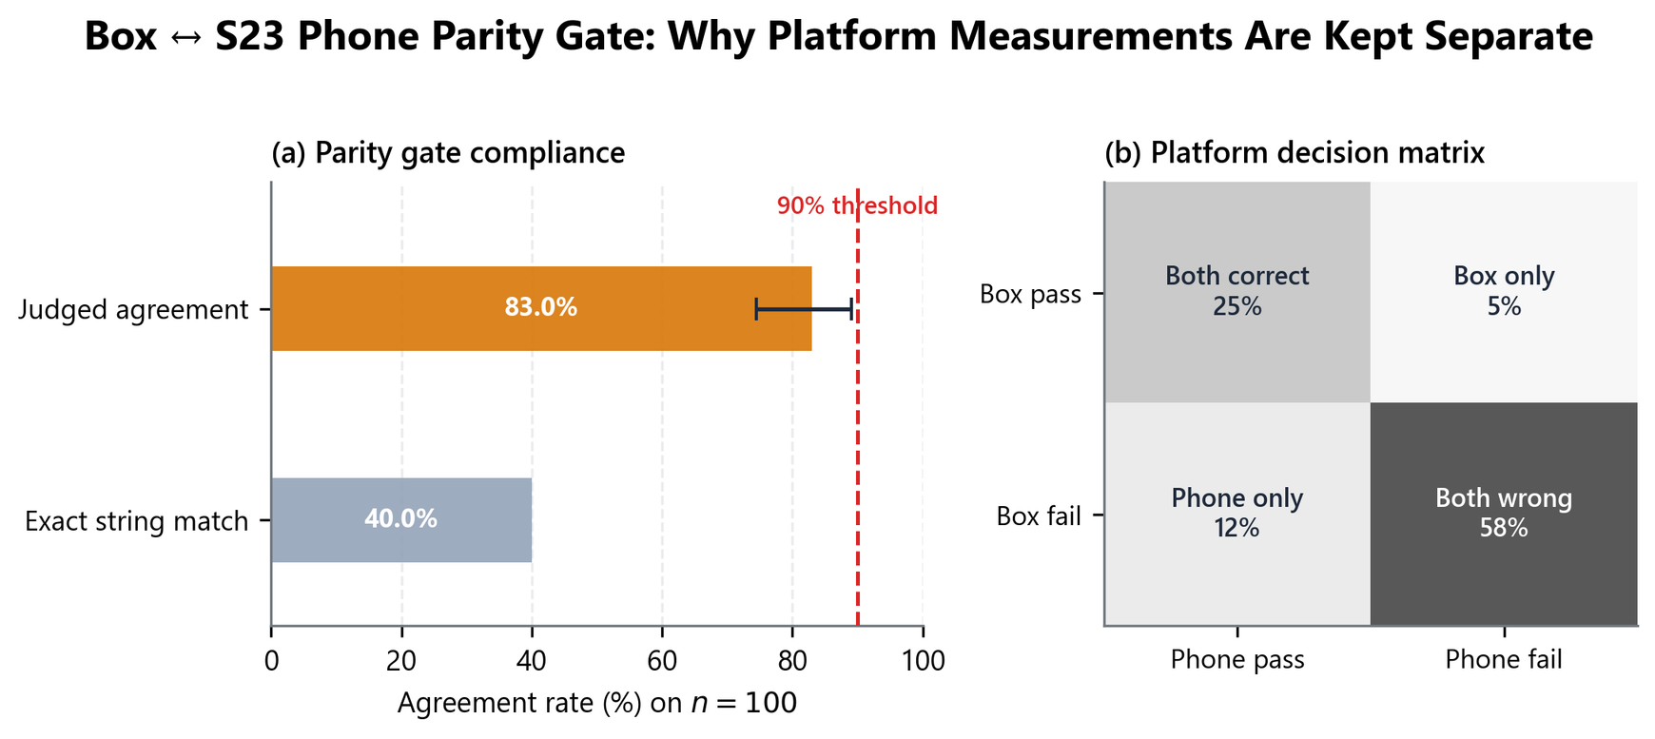
Why phone accuracy is measured on the phone
Workstation and phone verdicts agreed on 83 of 100 questions, below the 90% rule
Workstation accuracy can not replace phone's own answers
B9 · LoCoMo, 100 paired questions · Wilson 95% interval 74.5–89.0% · exact string match 40% · Appendix

Slide 39
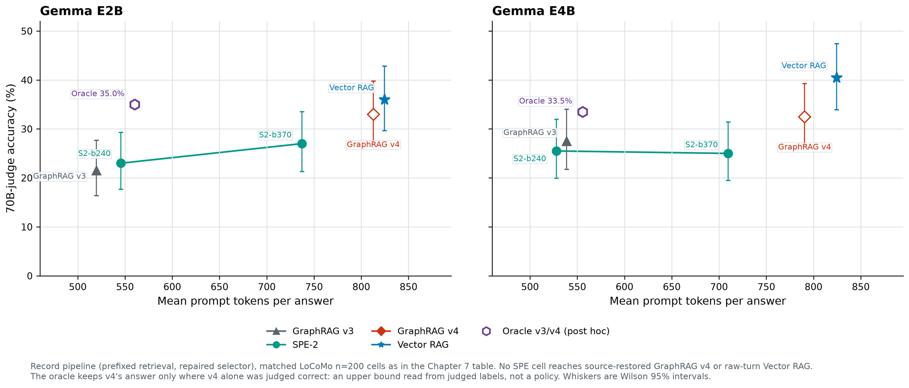
SPE on both Gemma readers
No SPE configuration reached graph + source text or vector retrieval
E2B: SPE 23.0 / 27.0% · GraphRAG v4 33.0% · oracle 35.0% — E4B: SPE 25.5 / 25.0% · GraphRAG v4 32.5% · oracle 33.5%
B11 · workstation · LoCoMo n=200 · Chapter 7

