Slide 1

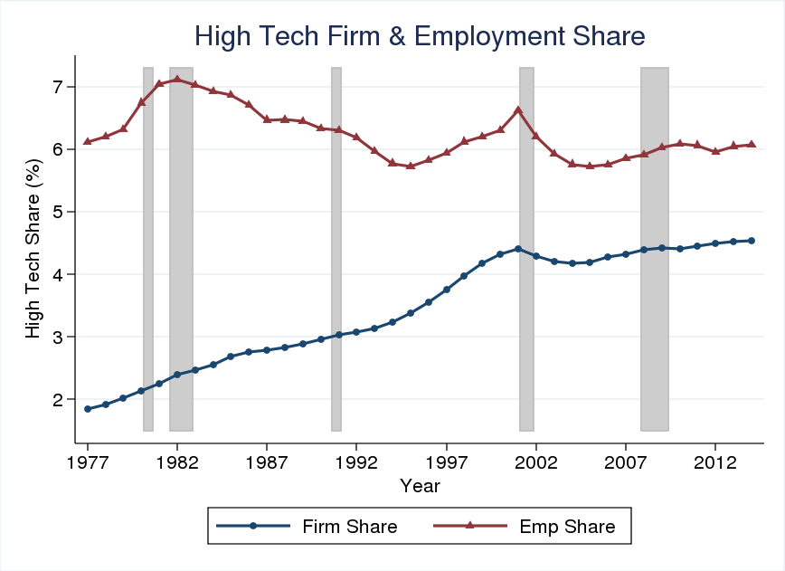
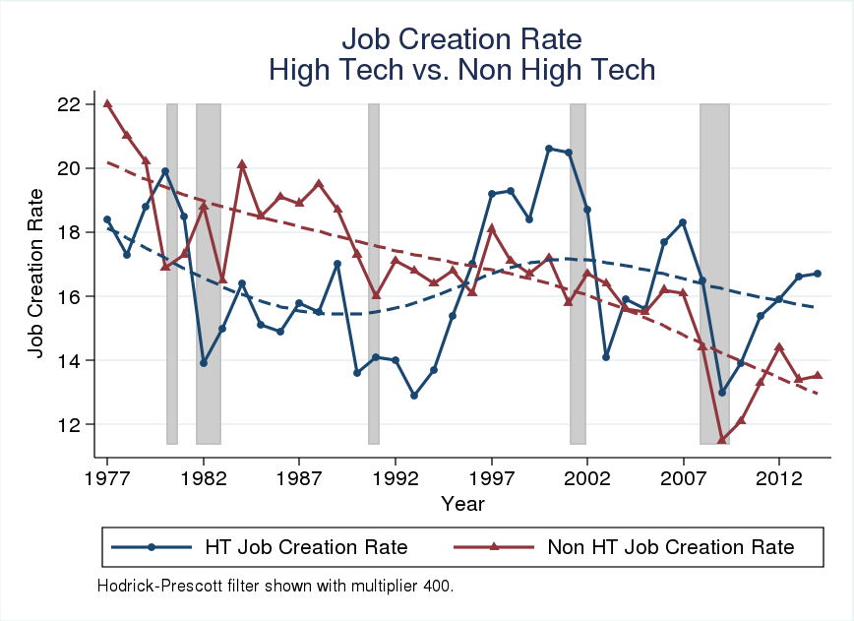
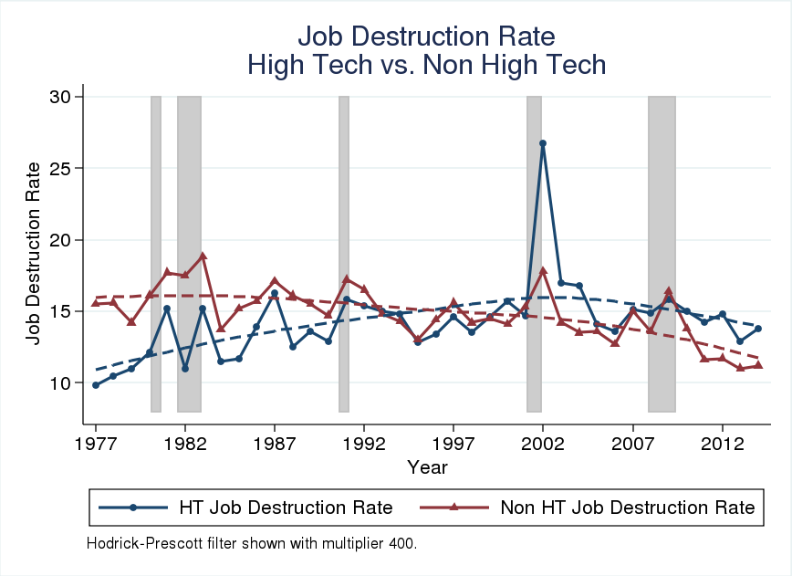
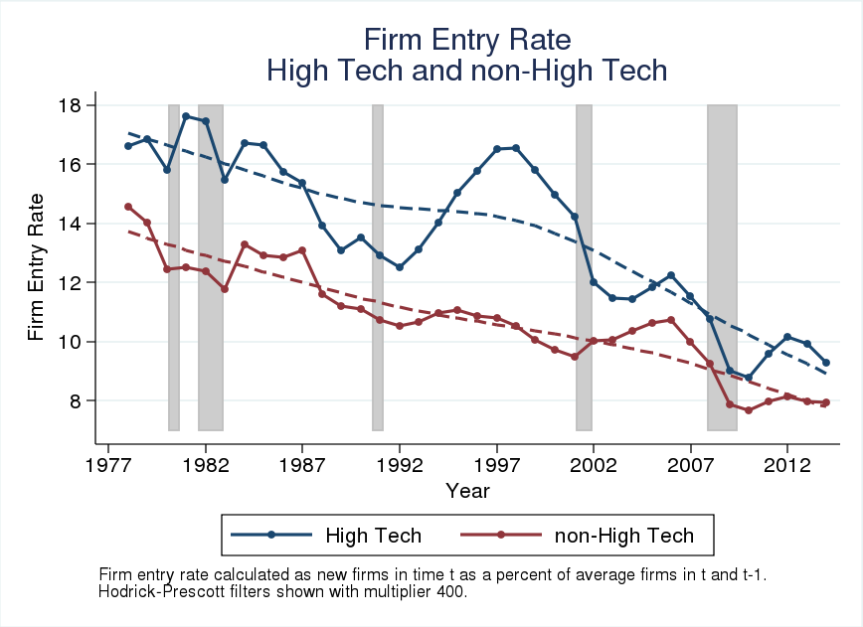
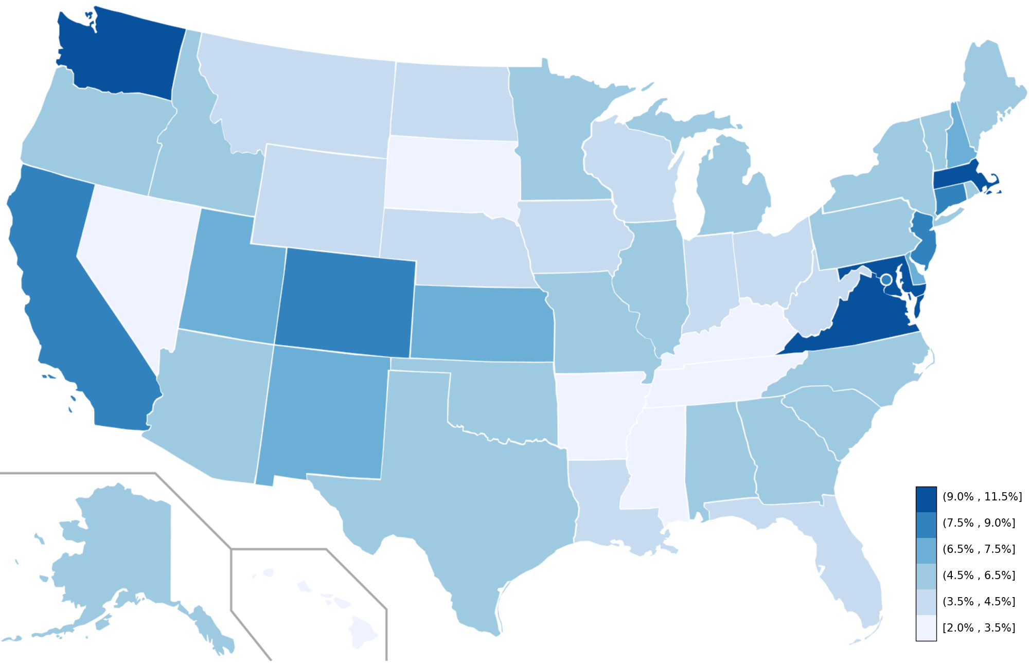
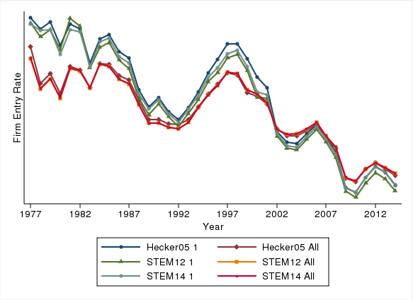
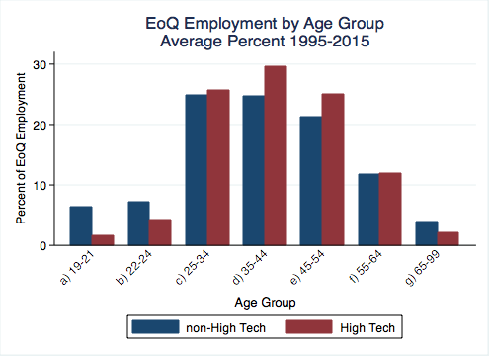
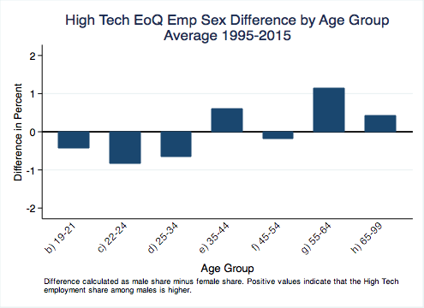
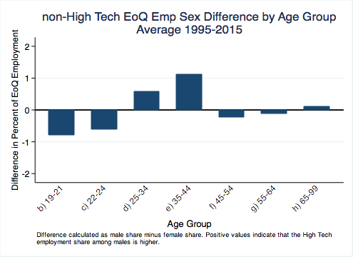
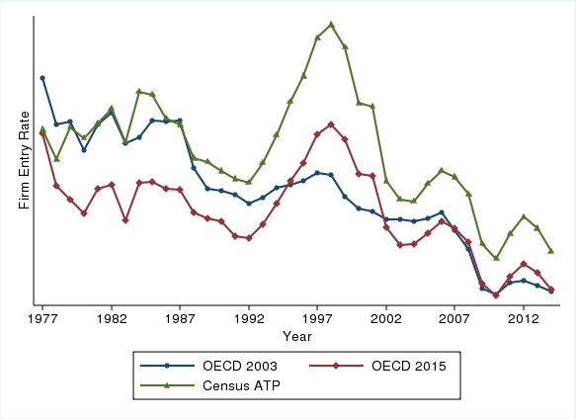
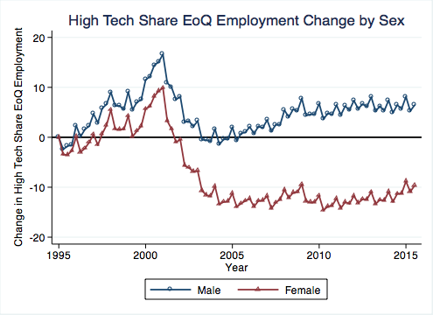
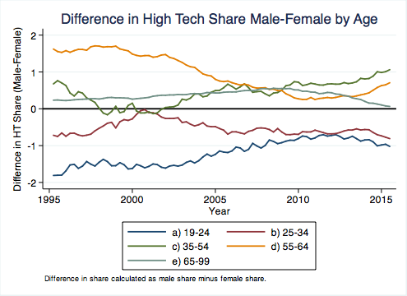
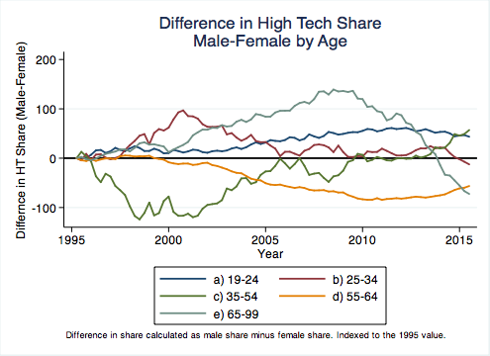
Measuring the Business and Employment Dynamics
of High Tech Industries
Nathan Goldschlag, Javier Miranda, and Lars Vilhuber
BACKGROUND
BUSINESS DYNAMICS OF HIGH TECH INDUSTRIES
ROBUSTNESS OF STEM METHOD
Modern market economies are characterized by the reallocation of resources from less productive less valuable activities to more productive more valuable ones. Businesses in the High Technology sector play a particularly important role in this regard, introducing new products and services that impact the entire economy. Tracking the performance of this sector is therefore of primary importance especially in light of recent evidence that suggests a slowdown in business dynamism in this High Tech industries.
Note: High Tech QWI measures, though suggestive, are preliminary and incomplete.
Figure 1. Firm and Employment Shares
Figure 3. Job Creation Rates
Figure 4. Job Destruction Rates
Table 2 shows there are 147 industries in common across the STEM method in 2005, 2012, and 2014, indicating stability. We also find there are 24 industries no longer High Tech in 2012 and 2014 and 8 industries High Tech only in 2012 and 2014.
Table 2. Overlap Across Vintages
 | Industries
All 3 Years | 147
Hecker (2005) Only | 24
STEM 2012 Only | 1
STEM 2014 Only | 7
Combination of Two (Residual) | 19
Total | 198
Notes: Includes counts of 6-digit 2007 NAICS industries associated with different combinations of High Tech methodologies. The total captures the count of unique industries across all three vintages.
High Tech industries account for about 4.5% of firms and 6% of employment.
Job creation rate in non-High Tech industries declines steadily since the 1980s, while in High Tech we see an increase in the 1990s that reverses after 2001.
Table 3 shows that out of the 147 industries in overlap only 107 are classified in the same level of technological intensity--28% switch level across years. The most consistently defined level is the highest technological group (Level I). A large part of the fluidity across definitions is caused by newly classified Level III industries. All 8 of the industries that only appear in 2012 or 2014 are classified as Level III and none of the 24 industries that only appear in Hecker (2005) are Level I.
We develop new data assets describing the business and employment dynamics of High Tech industries using the Business Dynamics Statistics and Quarterly Workforce Indicators (QWI)
Figure 2. Firm Entry Rate
Figure 5. Average High Tech Employment Share (2012-2014)
DEFINING HIGH TECH INDUSTRIES
There are a number of ways one could classify industries as High Tech, including: employment of STEM workers, employment of R&D workers and capital, the production of High Tech products, and the use of High Tech production methods, including the use of High Tech capital goods and services.
After considering coverage, stability, interpretation, and replicability of the different classification methodologies, we chose the STEM methodology. We use the Occupational Employment Statistics (OES) to calculate the concentration of STEM employment by industry for 2005, 2012, and 2014, and classify industries into High Tech levels as in Hecker (2005).
Our Method, STEM Union: We use the union of Level I (>5 times mean STEM concentration) industries according to the concentration of STEM employment in 2005, 2012, and 2014 as our preferred methodology for identifying High Tech Industries.
Interpretation: These statistics capture the current and historical performance of industries that were High Tech in the past decade. They do not capture the business dynamics of industries that were High Tech in the late 1970s and 1980s but are no longer High Tech.
Table 3. Overlap Across Vintages and Level
 | Level I | Level II | Level III
All 3 Years | 48 | 32 | 27
Hecker (2005) Only | 6 | 7 | 26
STEM 2012 Only | 2 | 4 | 11
STEM 2014 Only | 3 | 5 | 14
Notes: Includes counts of 6-digit 2007 NAICS industries associated with different combinations of High Tech vintages.
One of the most pronounced features of BDS-HT is the boom-bust in the 1990s that reverses after 2001. The boom is driven by a wave of entry and the bust occurs across firm age and size categories
Figure 12. Firm Entry Rate by STEM Method
We also observe rich geographic heterogeneity in the average share of employment in High Tech industries between 2012 and 2014 by state.
EMPLYOMENT DYNAMICS OF HIGH TECH INDUSTRIES
Figure 6. Employment Distribution by Age
Figure 8. High Tech Emp Diff by Sex and Age
Figure 9. non-High Tech Emp Diff by Sex and Age
Figure 13. Firm Entry Rate by OECD and ATP Methods
Table 1. High Tech Industries – STEM Union
High Tech workers tend to be concentrated in the 25-64 age range and the share of females has fallen over time.
Older age categories in High Tech are much more skewed towards males, while younger categories tend to be skewed towards females relative to non-High Tech. These patterns are changing over time with all categories converging.
NAICS | Industry Description
2111 | Oil and Gas Extraction
3254 | Pharmaceutical and Medicine Manufacturing
3341 | Computer and Peripheral Equipment Manufacturing
3342 | Communications Equipment Manufacturing
3344 | Semiconductor and Other Electronic Component Manufacturing
3345 | Navigational, Measuring, Electromedical, and Control Instruments Manufacturing
3364 | Aerospace Product and Parts Manufacturing
5112 | Software Publishers
5171 | Wired Telecommunications Carriers
5179 | Other Telecommunications
5182 | Data Processing, Hosting, and Related Services
5191 | Other Information Services
5413 | Architectural, Engineering, and Related Services
5415 | Computer Systems Design and Related Services
5417 | Scientific Research and Development Services
Source: Table lists 4-digit 2007 NAICS industries in the union of industries identified by Hecker (2005) and recalculated STEM concentrations using BLS 2012 and 2014 industry-occupation employment matrices.
Figure 7. Employment by Sex (indexed to 1995)
Figure 10. Emp Sex Share Differences
Figure 11. Emp Sex Share Differences (indexed)
The above figures suggest that the different STEM based methods produce very similar results, while the OECD varies significantly by vintage.
CONTACT
Nathan Goldschlag, Center for Economic Studies
Senior Economist, Center for Economic Studies
nathan.goldschlag@census.gov

