Slide 1
DELETE this SLIDE!!!
I’m assuming you have already defined HIGH-TECH (density of STEM workers in industry)
You may have noted that “employment in HIGH-TECH industries” is not equivalent to “employment of STEM workers”
Second slide same as first, but with picture

Slide 2
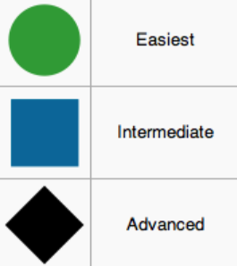
LEHD and High Tech Industries
Of interest:
○ Demographic characteristics of employment and its dynamics in HT industries vs. other industries [QWI]
○ Fine geographic details available (county, others possible ◊) [QWI]
□ Sources of employment flows can be identified: where are workers who work in HT coming from? (geography, industries) [J2J]
Challenges
◊ Alternate classification of industries: instead of indirect mapping use direct ACS link to LEHD to identify industries (OES= employer-provided, ACS= worker-provided information)
□ Assessing interest, implementation

Slide 3
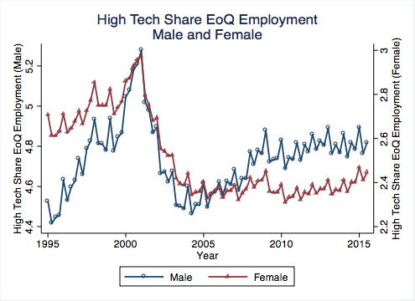
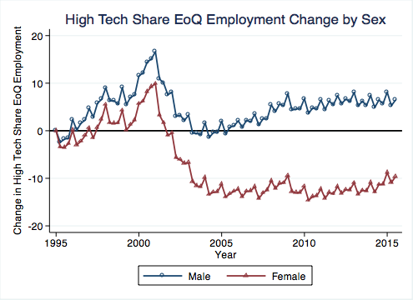
LEHD and High Tech Industries
Of interest:
○ Demographic characteristics of employment and its dynamics in HT industries vs. other industries [QWI]
○ Fine geographic details available (county, others possible ◊) [QWI]
□ Sources of employment flows can be identified: where are workers who work in HT coming from? (geography, industries) [J2J]
Challenges
◊ Alternate classification of industries: instead of indirect mapping use direct ACS link to LEHD to identify industries (OES= employer-provided, ACS= worker-provided information)
□ Assessing interest, implementation

