Slide 1
U.S. K-12 Education and Mobility
Anita Mehrotra

Slide 2
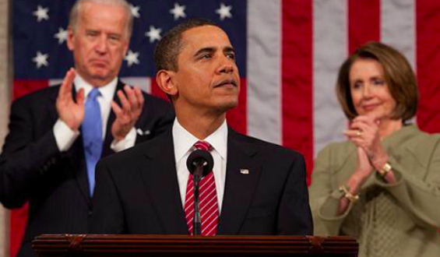

Slide 3
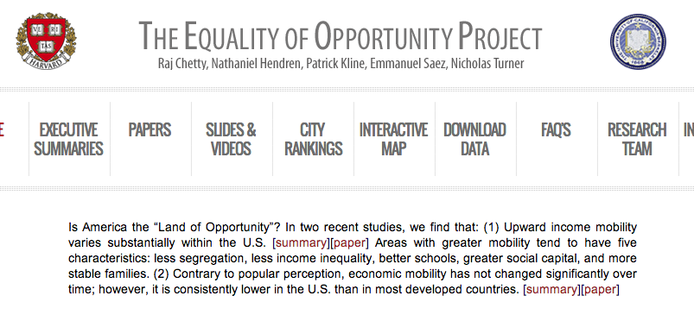

Slide 4
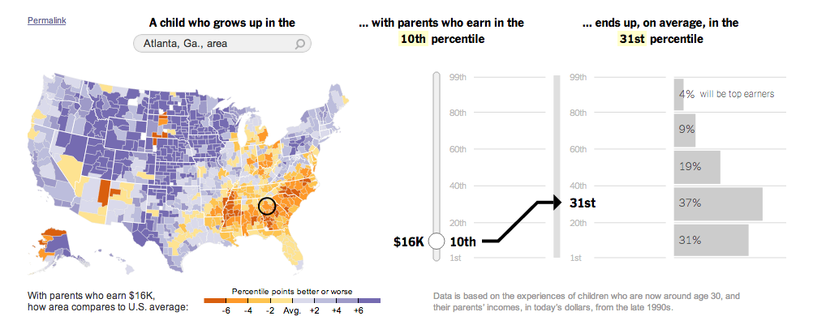
The New York Times’ Visualization
July 22, 2013

Slide 5
Anita’s Visualization
http://anitameh.github.io/cs171-finalproject-mehrotra-anita/final-project2.html

