Slide 1
Kaggle BNP Paribas Cardif
Team GAUSS
Antonios, Nikolaos, Napoleon, Danial & Ali

Slide 2
Agenda
The Scenario
The Project
The data
The Analytics
Data Pre-processing
Feature extraction
Data Modelling Algorithms
Analytics Results
Conclusion

Slide 3
The Project
Supervised Learning Classification Problem
Predict the Validity of Insurance Claims
Log – Loss Function for performance evaluation

Slide 4
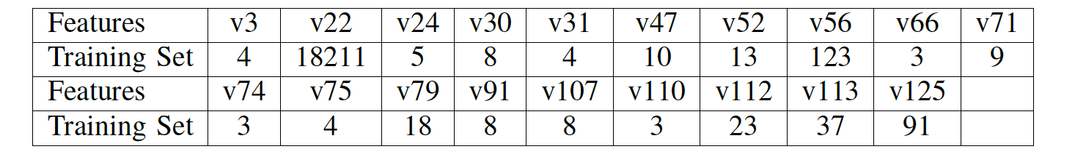
The Data
131 FEATURES - INDEPENDENT VARIABLES
ANONYMIZED
Numerical and Categorical
THE ISSUES
MISSING VALUES
HANDLING NOMINAL CATEGORICAL FEATURES
DIFFERENT SCALES FOR VARIABLES
High Number of Distinct Values on some Categorical Features:

Slide 5
Data Pre-processing
Categorical features Conversion
One-hot-encoder dismissed
Replace value with conditional probability
Filling Missing Values
Non-negative matrix factorization tried
median
Standardization --> Algorithm Efficiency​​​

Slide 6
Data Modelling ALGORITHMS
Logistic Regression
Support Vector Machines
Decision Trees
Random Forest Classifier

Slide 7
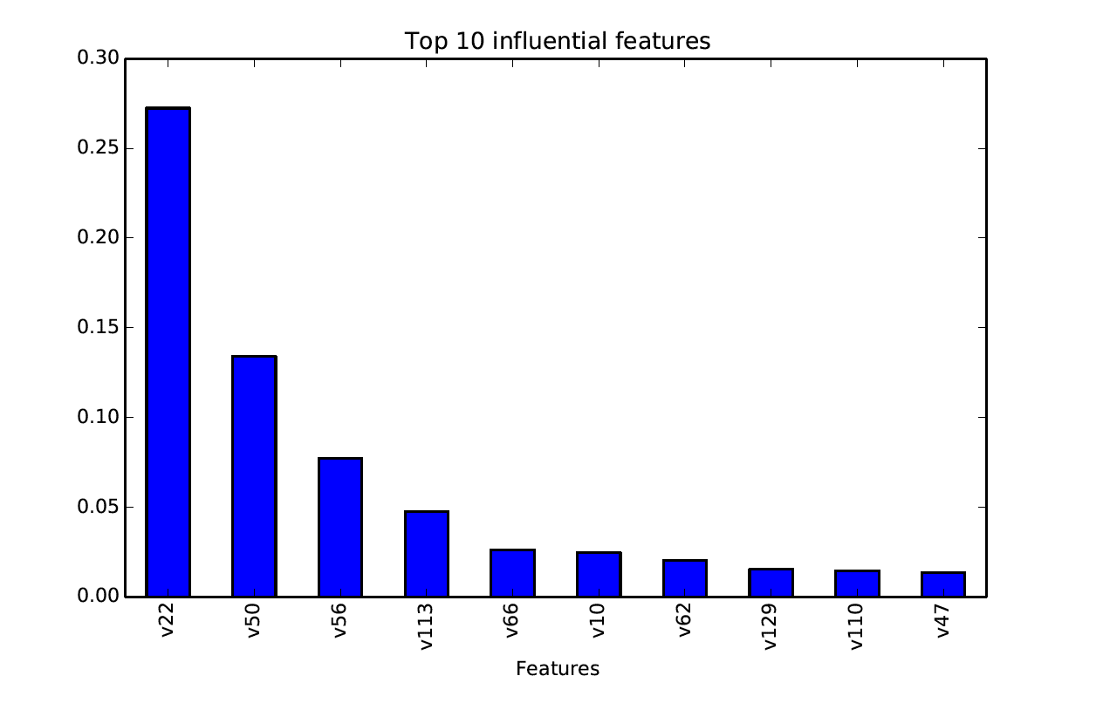
Feature importance

Slide 8
ALgoritHms' results
Algorithm | Training Set | Validation Set | Test Set - Submission
Logistic Regression | 0.41070 | 0.40328 | 0.56916
Decision Trees | 0.44590 | 0.43875 | 0.51726
Support Vector Machines | 0.55027 | 0.54168 | 0.55214
Random Forest Classifier | 0.43844 | 0.45468 | 0.49881

Slide 9
conclusion
Anonymization added to the challenge
Models Prone to overfitting
Feature Extraction key to Success
Feature Importance builds on top of good Feature Extraction

