Slide 1
Home Depot Product Search Relevance
Team
phi1337
Antonios, Nikolaos, Napoleon, Adisorn, Emmanouil & Ali
Notes:
Thank you very much for providing us an opportunity to work on very challenging project.
I am very grateful to Jon and Markus for providing guidance and support on this project.
Our project was to participate as team in Kaggle for Home Depot Product Search Relevance.
Our team “phi1337” comprises of Tony, Nick, Napoleon, Adisorn, Emmanouil and Ali.

Slide 2
Agenda
The Scenario
The Project
The data
The Analytics
Data Pre-processing
Feature Engineering
Data Modelling Algorithms
Analytics Results
Conclusion
Notes:
The Agenda of today’s presentation is that.
Firstly we will briefly present the project background and Dataset provided.
In the second section, we will present the Data Processing techniques used with various algorithms and results.
In the end we will present the conclusion and provide opportunity of any questions.

Slide 3
The Project
The Problem:
Supervised Learning Problem
The Objective:
Predict the relevance of Search Results.
Notes:
As you may know that online retailers are working very hard to maximize the sales by providing the right product at the right time of purchase.
This project is predict the relevance of search results based on search queries.
The prediction and relevance has commercial importance as displaying right product means that there is high chance of product purchase.
This is Supervised Learning Problem and we have successfully implemented as per the expectation of the competition.

Slide 4
The Data
Search Queries
Search Results
Scores
Notes:
- The training set consists of Search Queries, Search Results and Scores depicting the relevance of the search results.
- The test set consists of same Search Queries and Search Results and the expectation was to predict relevance score for each query.
- The Search Queries provided was fairly noisy containing special characters, punctuation errors, different ways of writing Unit of Measurements, Typing Errors.
- The Search Results are the results based on the QUALITY of Search Query.
- The Scores is the average of three human rates who rated the relevance of search results.

Slide 5
Data Pre-processing
Special Characters
Punctuation Errors
Unit of Measurement Errors
Typographical Errors
Tokenizing/Stemming and Stopwords
Notes:
The following are the issues we have found in Search Queries, which we think have significant impact of the search relevance:
We dealt the special characters by using Python built-in library called “UniDecode”
The Punction Errors like extra spaces, unnecessary commas and question marks were removed.
There were different ways of entering UOM and in order to keep it consistent, we identified and replaced various entries into one consistent Unit of Measurement.
In the search queries there were lots of typing errors which we have corrected using Google Auto-Correct.
We used SnowBallStemmer (NLTK) to to create bag of words

Slide 6
Feature Engineering
Common word Ratios
TF-IDF
LSA with SVD
Analyzing the Search Query
Exploring the Brands
Simple word counts as features
Notes:
Common words: - First, intuitive approach
- Common words between search and title/desc/attrs divided by the search term
- Ratio: importance of a matching word is inversely proportional to the length of the query
TFIDF: - Popular method, that is a basic way to get the most descriptive terms in a document.
- Three more features, representing the similarity between query and title/desc/attrs
LSA with SVD: - Generated vectors of word counts and then applied Truncated-SVD(aka Latent Semantic Analysis - LSA).
- Transforms feature matrix → “Semantic space” of lower dimensions keeping vectors with highest eigenvalues
- Captures synonymous and polysemous words → Roots of SPARSE matrix
Search Query: - Users search few words so existence of search query important
- Existence in title/Desc – Last word in title/Desc
Brands: - Most common attribute (86250/86264 products)
- Distinct brand values – 4290
- 3 Features: Word Count – Brand Ratio(Made more sence to divide by the brand) – Brand Numerical
Extra features: - Word Counts: Query, Title, Desc. – Common words: Search / Title, Search/Desc – Query Length

Slide 7
Data Modelling ALGORITHMS
Linear Regression
Support Vector Machines
Random Forest Regressor

Slide 8
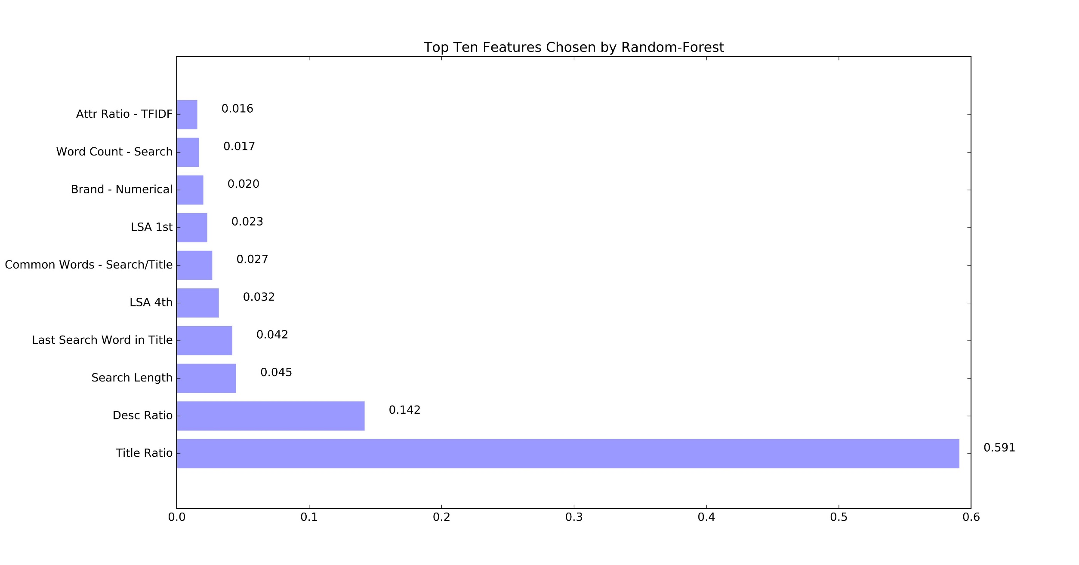
FEATURE IMPORTANCE

Slide 9
Analytics results
Algorithm | Training Set | Validation Set | Submission Score (Test Set)
Linear Regression | 0.48063 | 0.47979 | 0.48765
Random Forest Regressor | 0.47444 | 0.47777 | 0.48815
Support Vector Machine | 0.45059 | 0.47641 | 0.49091

Slide 10
conclusion
Noisy dataset
Models prone to overfitting
Preprocessing and feature extraction key to success

