Slide 1
ORB Feature Detection
By Ian Hudis

Slide 2
ORB Overview
A type of feature detection technique
ORB is a combination of the Oriented FAST key point detector, a Harris Corner Detector, and a Rotated BRIEF
Oriented fast, Rotated Brief

Slide 3
Comparison to other Types
-Pros
It is computationally faster than SIFT and SURF
Can sometimes be more efficient than BRISK
-Cons:
ORB is less scale invariant than SIFT and SURF.

Slide 4

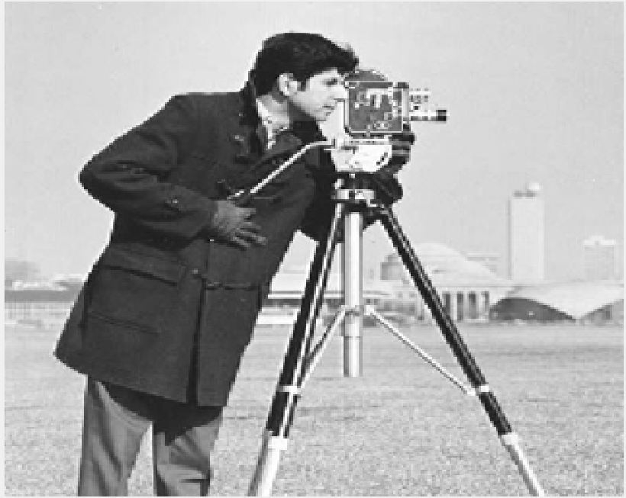
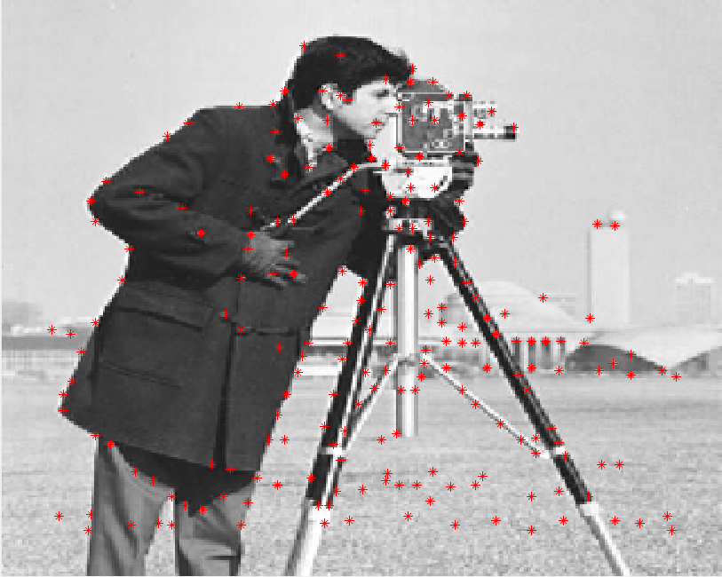
Finding ORB Points
FAST in this flowchart also incorporates the Harris Corner Detection

Slide 5
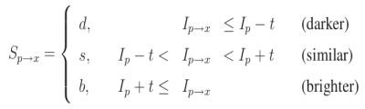
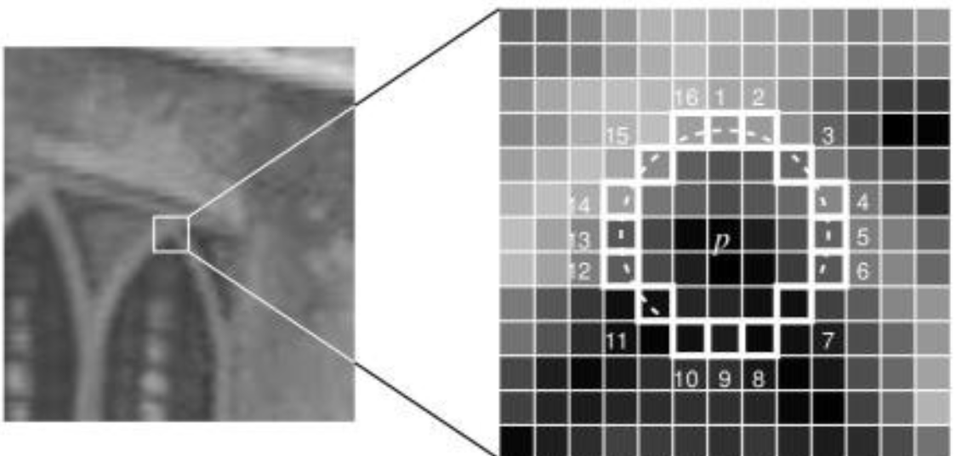
FAST
Edge detector that works by comparing pixels with each other and separates them into categories using threshold value T.
Yout also need a Harris Corner detector since Fast only finds edges.

Slide 6
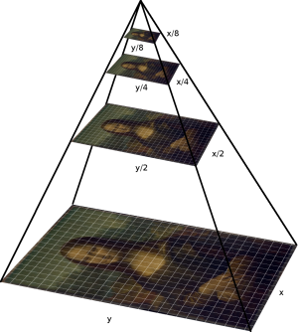
FAST
Part of ORB’s FAST process can be thought of as using a multiscale image pyramid.
Each level of the pyramid has different resolutions
Stores different fast points for each level
limited Scale Invariance

Slide 7
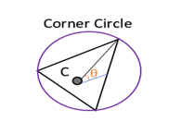



Orientation
Occurs once edges and corners are found
The purpose of this is to find the angles of the corners

Slide 8
Rotated Brief
A BRIEF in image processing is a description composed of a string of binary values.
The problem with normal briefs is that they are computationally expensive and slow in performance.
A Rotated Brief takes the angles that were found in the orientation process and then uses them to find the rotations at which the input images’ corners were located.
For each corner, two rotational brief estimations were found with the same input angle.
By using these angles, the rotational brief could pick out key points of an image without having to scan every single patch of pixels which makes the process significantly more efficient.

Slide 9
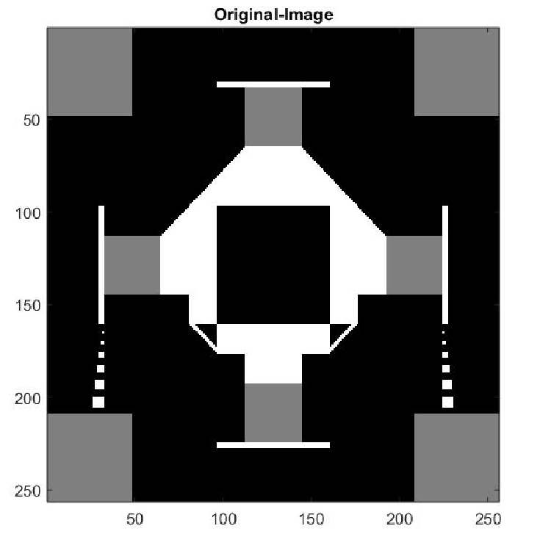
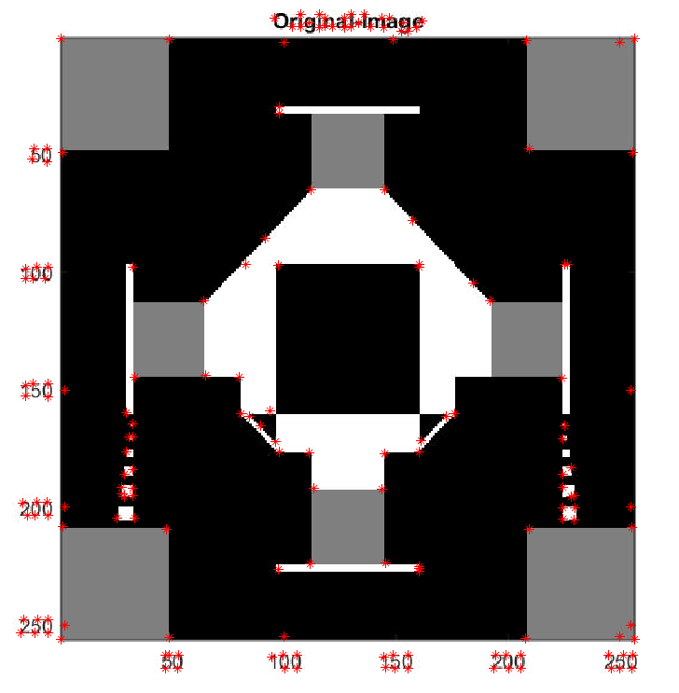
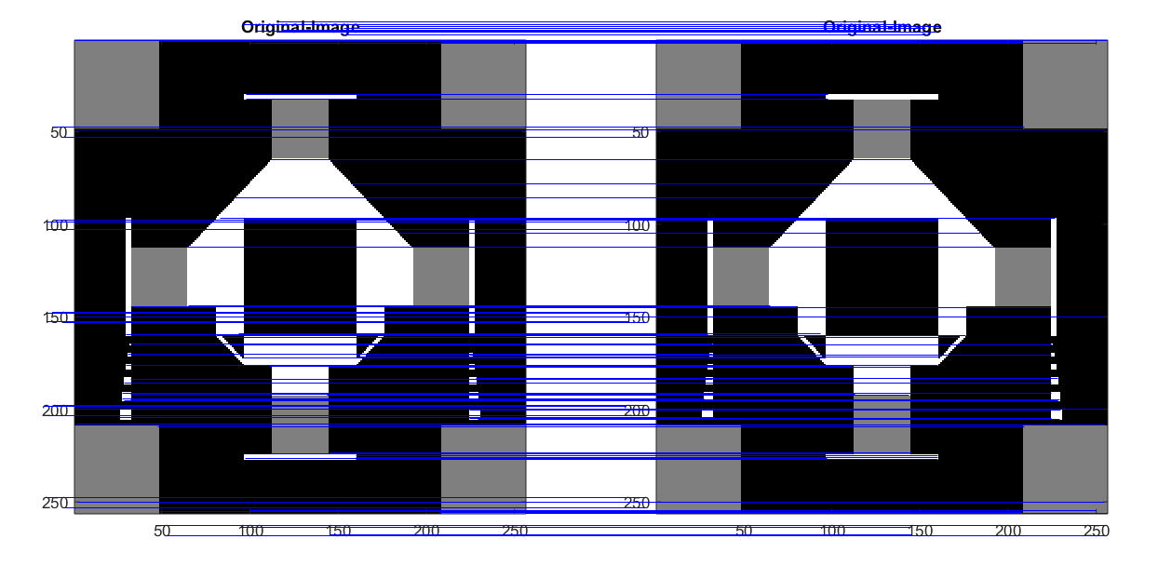
ORB Feature Detection
Finds the ORB points on 2 images and then compare them to see Feature Detection.
Can be more than 2 images.

Slide 10
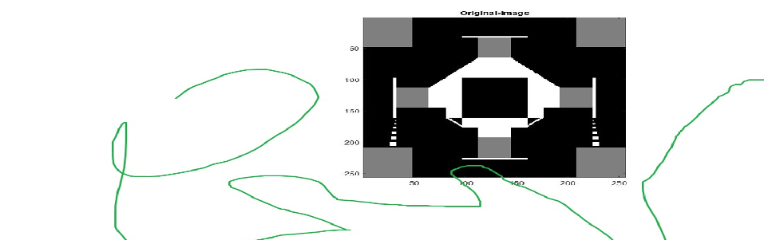
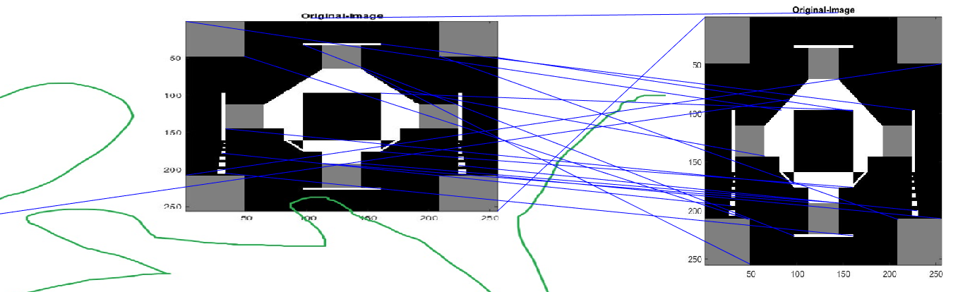
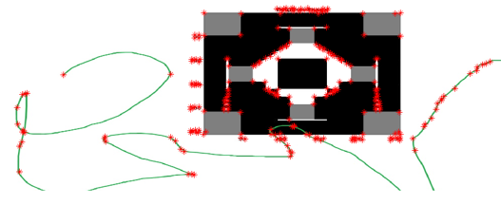
ORB Feature Detection

Slide 11
Applications of the ORB Feature Detector
Testing ORB with real world applications.

Slide 12
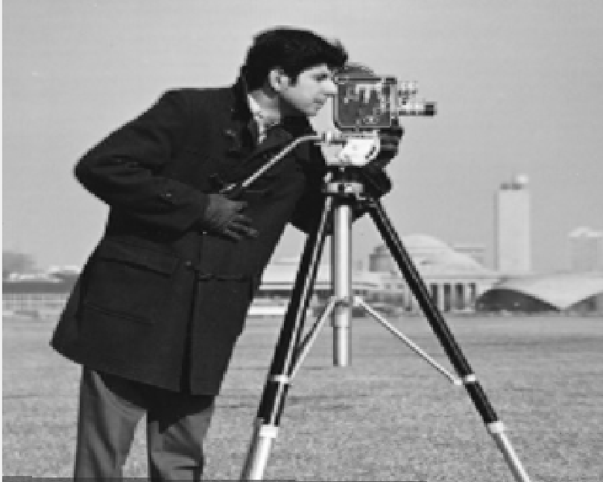
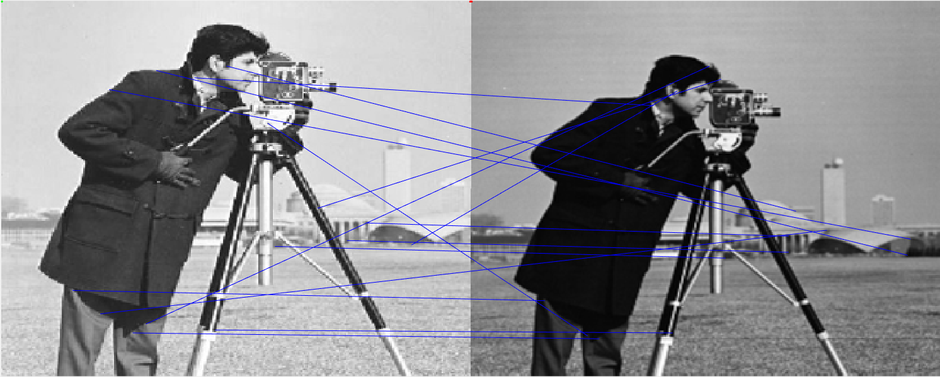
Image Threading Application
Image Stitching Result
Oversaturated Cameraman
Dark and Blurry Cameraman

Slide 13
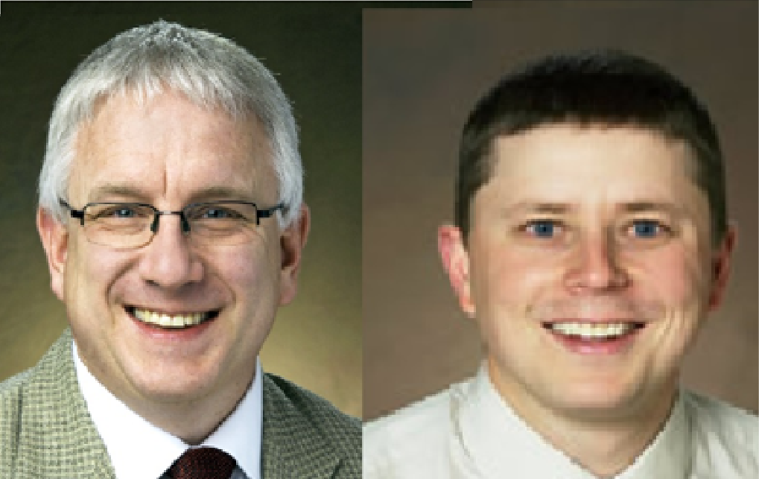

Facial Detection
The goal here is take to see how well ORB can recognize a person’s face.
Section from Professor Index
A zoomed in frame from camera footage.

Slide 14
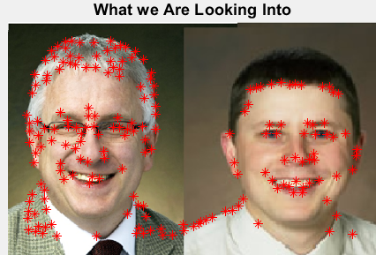
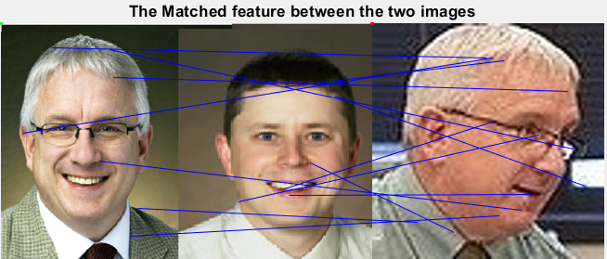
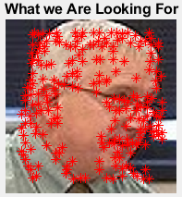
Facial Detection

Slide 15
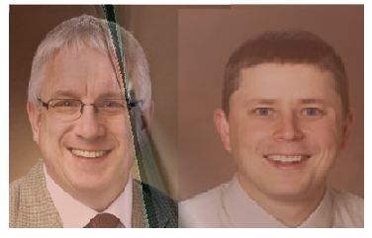
Facial Detection
Notice the distortion is only on the right side of the face.

Slide 16
References
-Ethan, R., Rabaud, V., Konolige, K. and Bradski, G. (2017). http://www.willowgarage.com/sites/default/files/orb_final.pdf.
-Mordvintsev , Alexander. “ORB (Oriented FAST and Rotated BRIEF)¶.” OpenCV, 2013, https://opencv-python tutroals.readthedocs.io/en/latest/py_tutorials/py_feature2d/py_orb/py_orb.html.
- Tyagi, Deepanshu. “Introduction to ORB (Oriented FAST and Rotated BRIEF).” Medium, Medium, 29 May 2019, medium.com/@deepanshut041/introduction-to-orb-oriented-fast-and-rotated-brief-4220e8ec40cf.

Slide 17
Any Questions?

Slide 18
Thank you and have a good break!

