Slide 1
Recovering Binary Black Hole Mergers with CNNs
Ioannis Michaloliakos
December 8, 2020
PHY 7097 Machine Learning

Slide 2
Overview
Reproducing the results of the 2018 paper by H. Gabbard et al. “Matching Matched Filtering with Deep Networks for Gravitational-Wave Astronomy”.
This presentation:
Introduction to Binary Black Hole Detections.
The DNN approach:
Data Preparation
Network Architecture
Evaluating the results, comparisons with 10.1103/PhysRevLett.120.141103
Conclusions

Slide 3
How does LIGO detect gravitational waves from BBHs?
The extreme gravitational fields and relativistic velocities perturb the space around the compact objects.
The radiation fields of the metric perturbation can be decomposed into two independent waveforms, h₊(t) and h_{x}(t).
When the waves arrive at an interferometric detector, the test-masses (i.e mirrors) respond with characteristic pattern functions, and the result is an induced gravitational wave strain: h(t) =F_{+,x}(Ω) h_{+,x}(t).
The total output of a detector is:
d(t) = h(t) + n(t)
Goal is to separate h(t) from n(t).
Standard Approach: Matched Filtering
Generate a large number of waveforms (templates) and match them with the data.
Calculate the “signal” to noise ratio for the data and maximize it over the waveform space.
Set a threshold for detection, given a desired FAR, taking into account coincidences between multiple detectors, waveform consistency, the number of templates used, and other.
Another successful approach: Unmodeled (Burst) Searches

Slide 4
A DNN approach
Details:
We generate a large ensemble of 1 second long timeseries sampled at 8192Hz and we inject a gravitational wave signal in half of them, with its parameters sampled from a prior.
We preprocess the timeseries using standard digital signal processing techniques.
We treat the timeseries as an one-dimensional picture and we feed them into a series of convolutional layers of a neural network.
We use a softmax activation on the final layer and a binary crossentropy loss function to classify each timeseries as either noise or signal+noise.
Matched filtering can be very time consuming and computationally intensive, due to the large amount of templates that is required.
Deep Neural Networks have the advantage that after the intensive training phase is complete, applying the network on new test data is essentially free.
Very promising for EM follow-up situations.

Slide 5
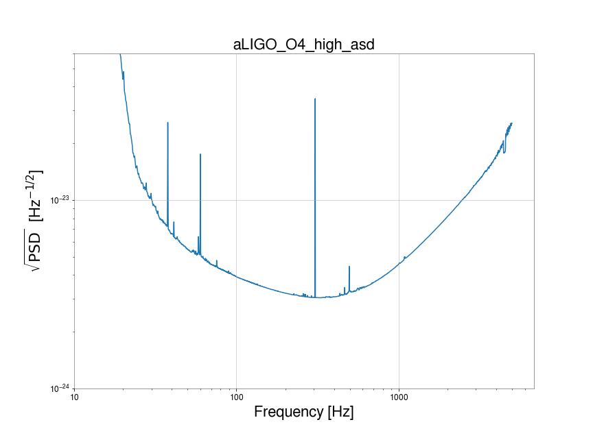
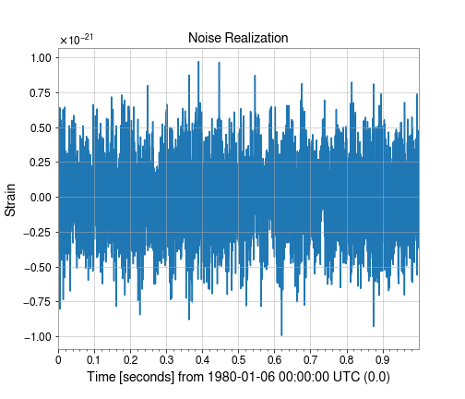
Data Preparation (Noise)
We generate the noise data using the power spectral density (PSD) of the advanced LIGO detectors. The PSD is a function that tells us how much power is contained on average in each frequency bin of the FFT of a noise realization.

Slide 6
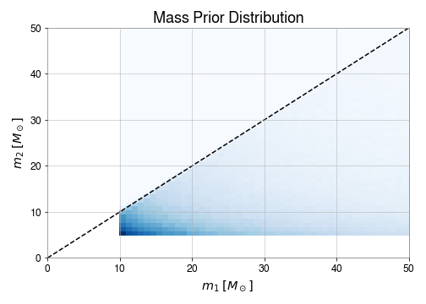
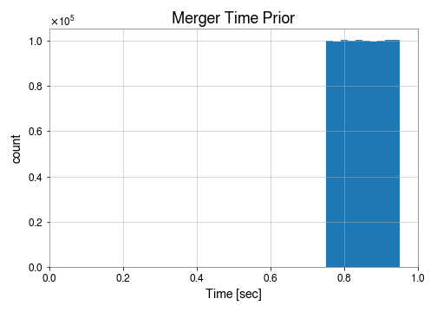
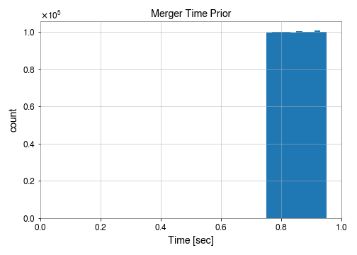
Data Preparation (Waveform - Priors)
In general very complicated (includes NR simulations near merger). We use here the user-friendly Bilby Python library and a phenomenological waveform generator.
Priors

Slide 7
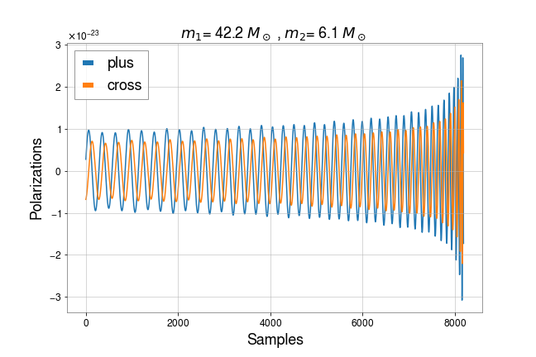
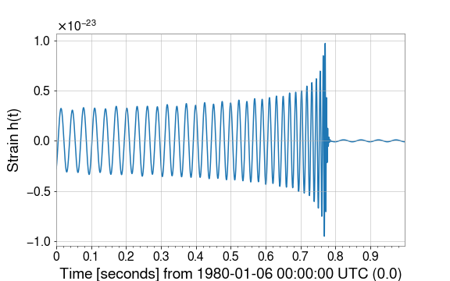
Data Preparation (Waveform - Polarizations & Strain)

Slide 8
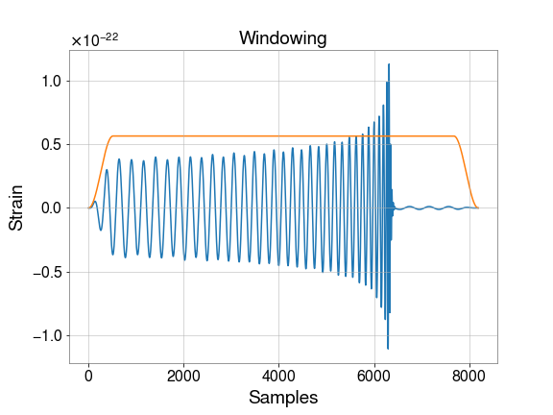
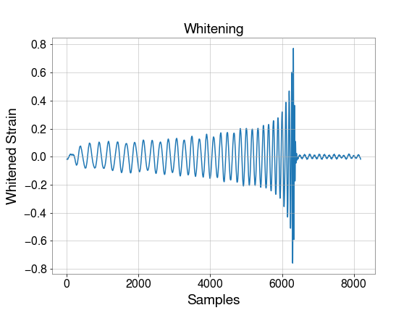
Rescaling to achieve a desired SNR
Windowing to avoid spectral Leakage
Whitening (Dividing the FFT of the data by PSD^{1/2})

Slide 9
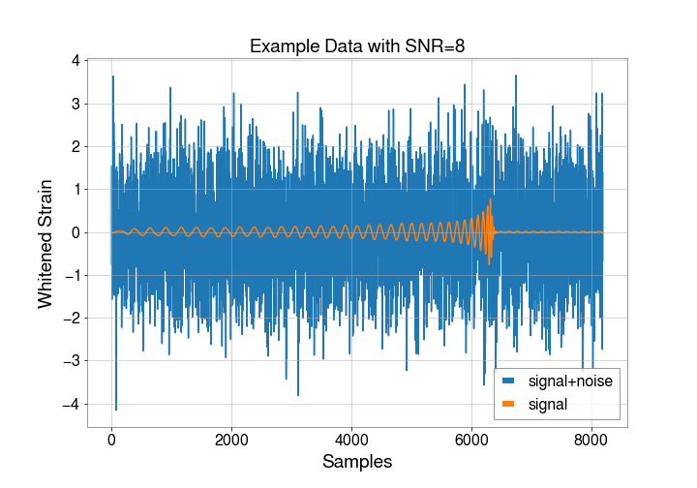
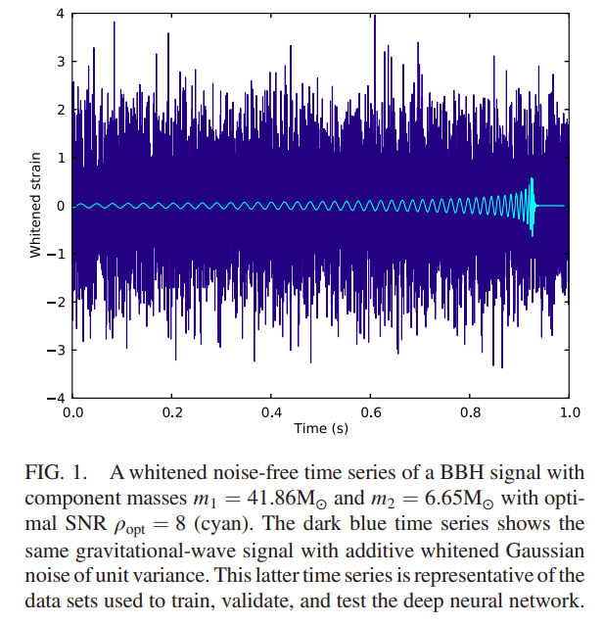
This work
Gabbard et al.

Slide 10
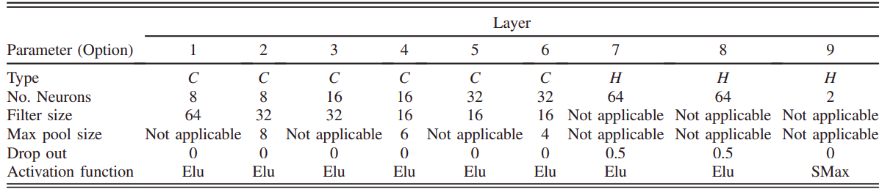
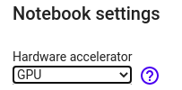
DNN Implementation
I followed closely the architecture described in the paper (and implemented here):
Optimizer: Adam with Nesterov Momentum (see here for more info)
I used the GPU support of Google Colab.
Issues with memory allocation.

Slide 11
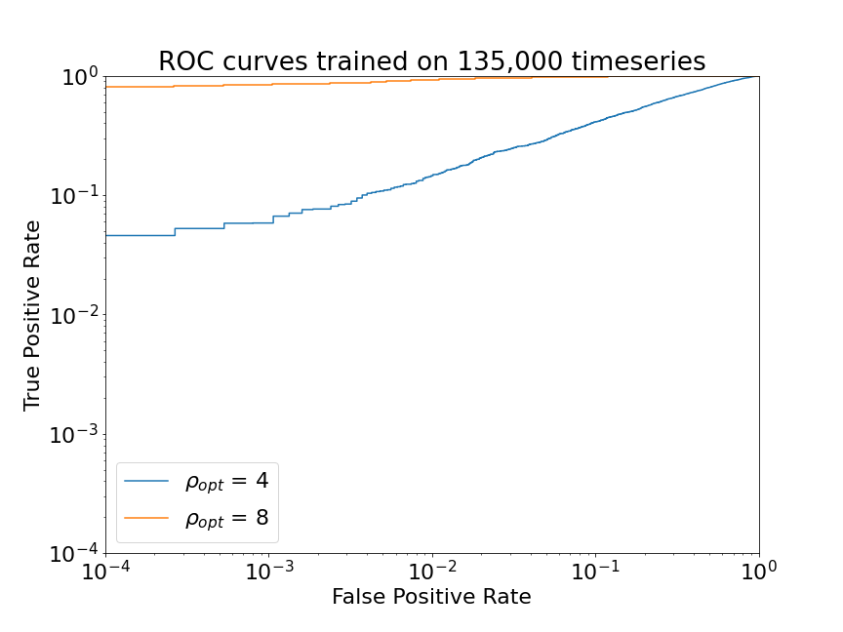
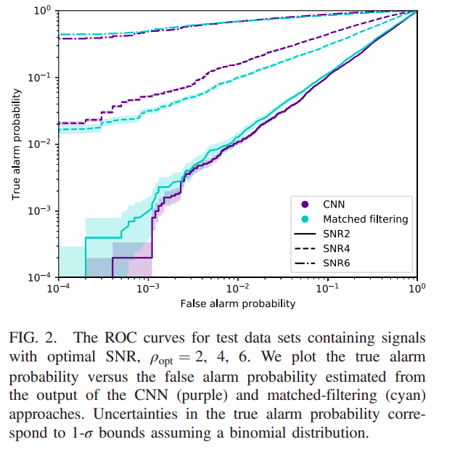
Final Results
Gabbard et al.

Slide 12
Summary
Comments
We have discussed how one can simulate GW signals.
We demonstrate how to preprocess (GW) time-domain data before feeding them into a Deep Network.
We verify that DNNs can match the efficiency of standard matched filtering in the case of Gaussian noise.
A better approach should be to feed spectrograms instead of 1-D “images” to a CNN, so that the frequency domain information is better represented.
Without adding non-gaussian noise (e.g glitches), it is not clear whether the DNN learned the excess power or the morphology of the GW signal.
One would also want to do parameter estimation → Variational Autoencoders

