Slide 1
Experiment of two variations
Product Analyst Test Case
Ioannis Sofras-Karantis

Slide 2

The problem
What fits better for a user when visit a shop which is closed ?
(outside of working hours)
Variation #1: page loads with popup
Variation #2: popup loads when user clicks an item on the menu

Slide 3
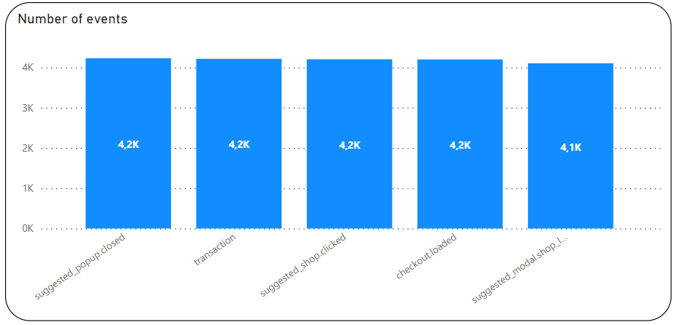
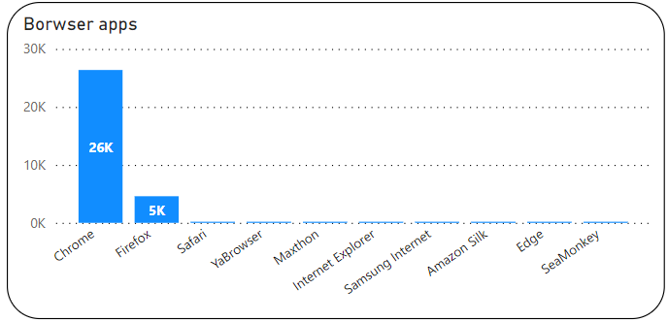
The dataset
31k user’s actions (New or Returning) splitted equally into two variations (donut chart). These actions labeled with five different event names (bar chart). The page that action started and the browser that action recorded also included.

Slide 4
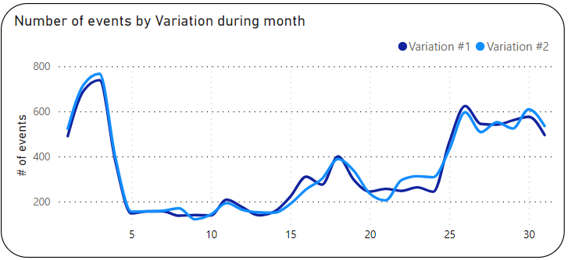
Insight
The behavior of the variance of user actions appears to be similar for the two variants(#1 & #2). Decrease in the beginning of the month, smooth ups and downs in the middle and increase in the last six days.

Slide 5
The experiment
We run a test (Chi-square) that investigates whether these two variations make a difference to user actions.
For each action we had to answer whether it is the same under the two different variations.
(Η₀) There is ΝΟ difference for the action between Variation#1 and Variation#2
Vs
(Η₁) There is a difference for the action between Variation#1 and Variation#2

Slide 6
Results
Action | Answer
user moved to checkout within the session | failed to reject the Η₀
user interacted with the suggested shops popup | we reject the Η₀
user closed the suggested shops popup | failed to reject the Η₀
user selected a suggested shop from the suggested | failed to reject the Η₀
user placed an order within the session | failed to reject the Η₀
This means that only the second user action appears to differ under the two variations (in 95% of cases).
In other words, a user interreact with the suggested shops popup more under Variation #2 (136 more cases for Variation #2).

Slide 7
Part II - Questions
Questions raised during the meeting. That means we need to act fast and to the point. To answer these, I used the PowerBI report I created for my presentation (charts and tables).
Instantly creating two measures and a new column helped me make the following tables.

Slide 8
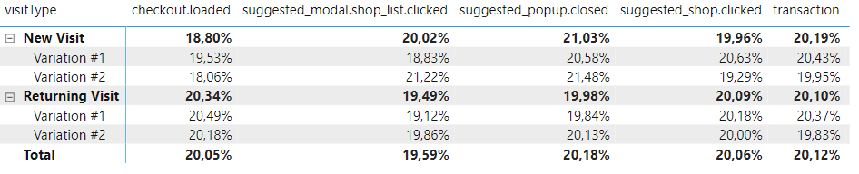
1st Question
We see that New users acts better than Returning users for second, third and fifth event in total (bolt).
But for second event Returning users acts better under Variation #1.

Slide 9
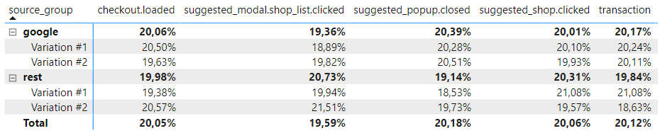
2nd Question
Users who comes from google act better for first, third and fifth action in total (bolt).
But for fifth event users who comes from the rest sources acts better under Variation #1.

Slide 10
Thank you for your time !

