Slide 1
Optimal Choice of the Learning Rate for Adeline Network
Paul Cristea
“Politehnica” University of Bucharest
Digital Signal Processing Laboratory
e-mail: pcristea@dsp.pub.ro

Slide 2
Supervised linear learning
x₁
b_{i}
neuron i; i = 1,…,m
.
.
.
.
w_{i1}
actual internal
activation potential
input
w_{ij}
n_{i}
actual output
Σ
^{ψ}
y_{i}
x_{j}
.
.
.
.
.
Δw_{ij}
w_{in}
r_{i}
desired internal
activation potential
d_{i}
x_{n}
Learning Signal Generator
desired output
d_{i}

Slide 3
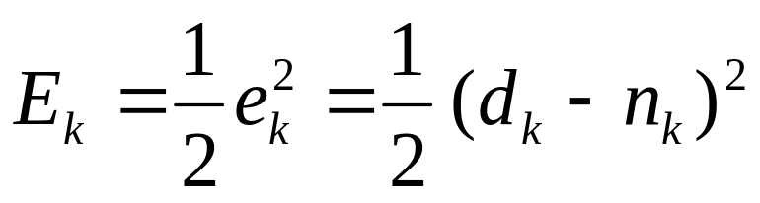
Widrow & Hoff
ADAptive LINEar element learning from the error on the
internal activation potential
E_{k} - the cost function = quadratic measure of the error for input pattern k
e_{k} - the error on the internal activation potential
d_{k} - the desired value of the internal activation potential
n_{k} - the actual value of the internal activation potential

Slide 4
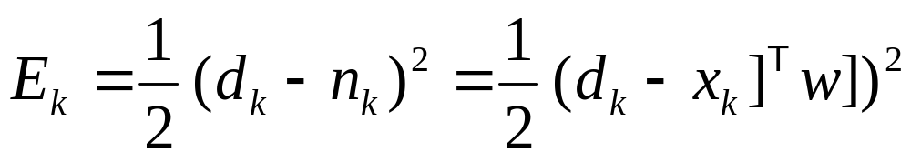
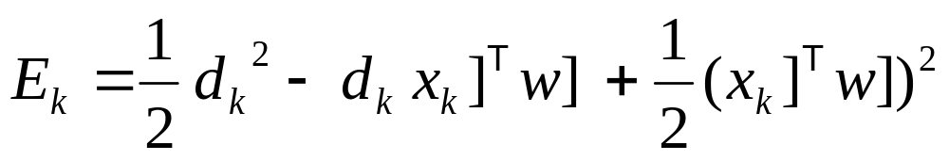
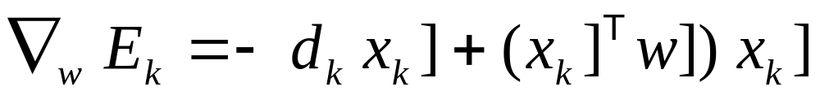
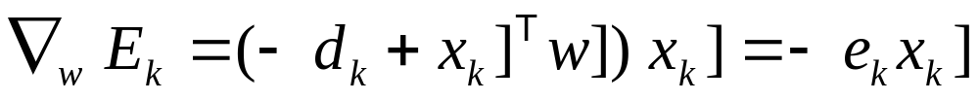
Delta Rule for one pattern
Cost function for input pattern k
The gradient
Delta Rule

Slide 5
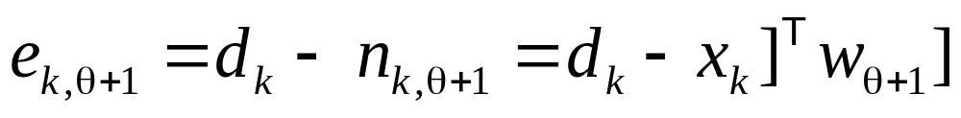
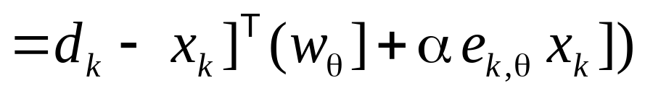
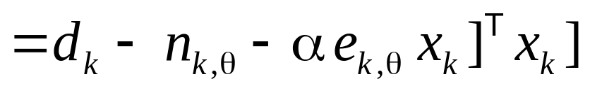
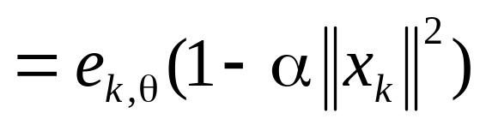
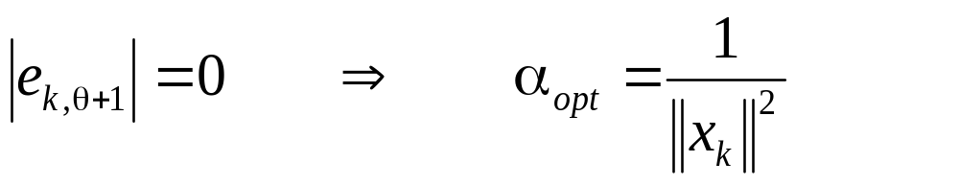
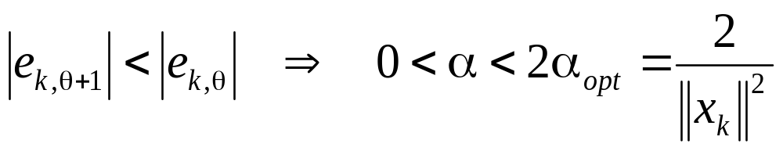
Decrease of the Error

Slide 6
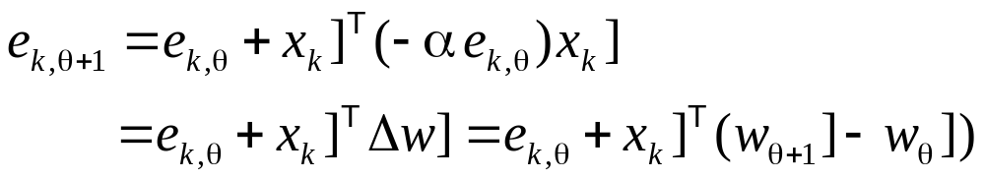
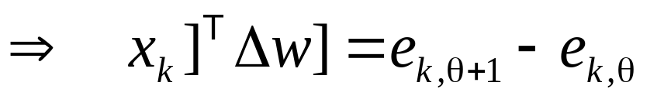
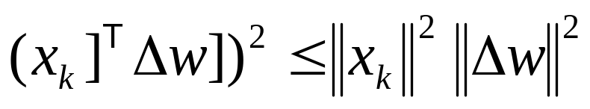
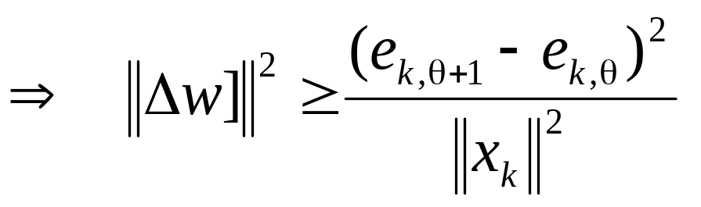
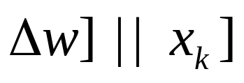
Variation of Weights
Cauchy -Buniakowski -Schwarz inequality
Equality for , as requested by Widrow-Hoff rule

Slide 7
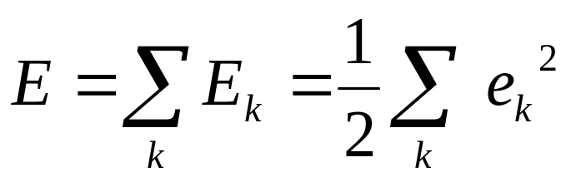
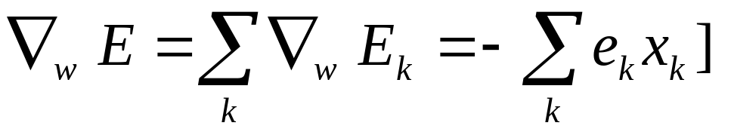
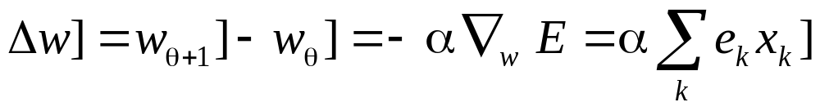
Delta Rule for batch training
Global cost function for all input patterns
The gradient of the global cost function
Delta Rule

Slide 8
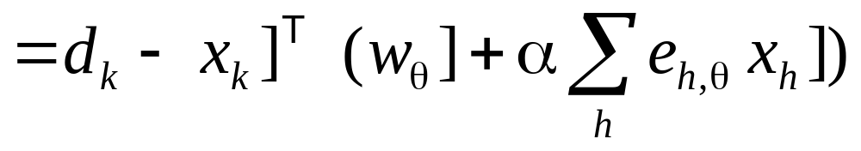
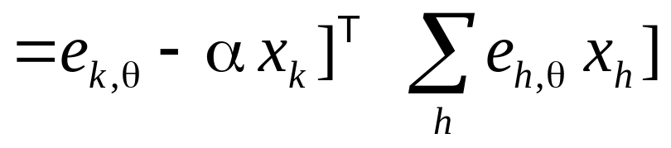
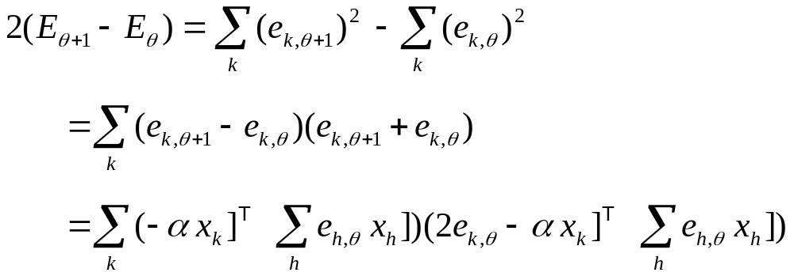
Global error variation

Slide 9
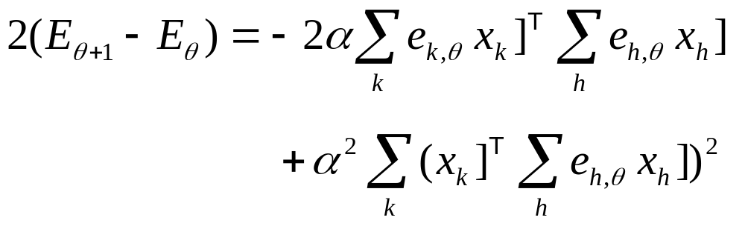
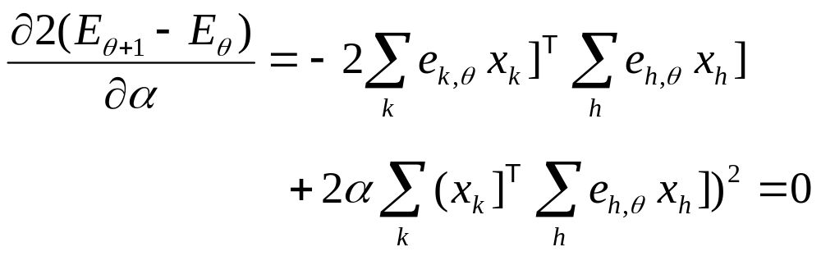
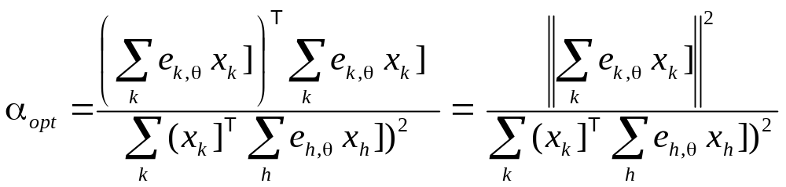
Optimal learning rate for batch training

Slide 10
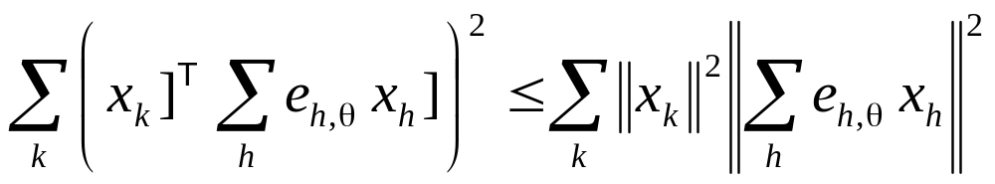
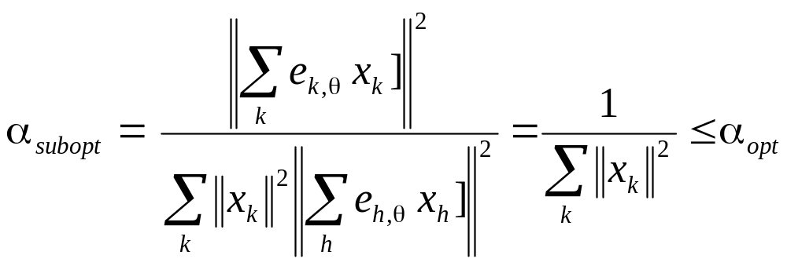

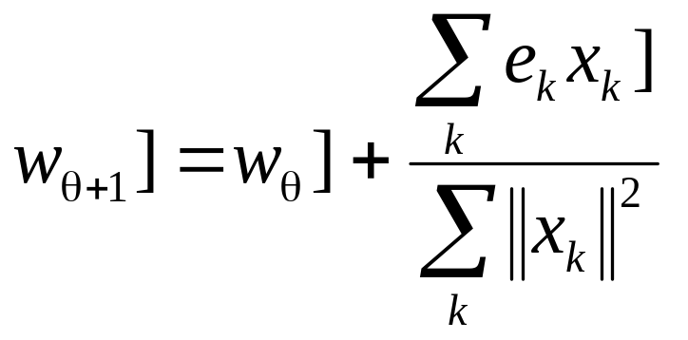
Sub-optimal learning rate for batch training
Cauchy -Buniakowski -Schwarz inequality
Learning rule

