Slide 1
Build Mobile Applications
With Ionic + Laravel
Presenters:
Justin James @digitaldrummerj
Michael Iglesias

Slide 2

"Hello."
ionicframework.com

Slide 3



Web Technologies You Already Know & Love

Slide 4





Your App
Ionic
Angular
Webview (Cordova)
Native SDK

Slide 5

Supported Devices
iOS 6+ Android 4+

Slide 6
Ionic Built-In UI Elements
i.e. Web SDK

Slide 7

Ionicons
Over 600 MIT licensed font-icons included
ionicons.com

Slide 8
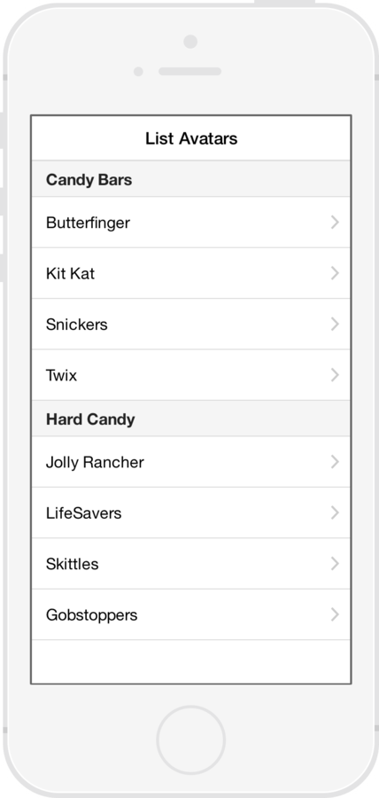
List Views
Simple List
Data Only
Complex List
Edit / Delete / Reorder
Long List
> 1000 items.

Slide 9
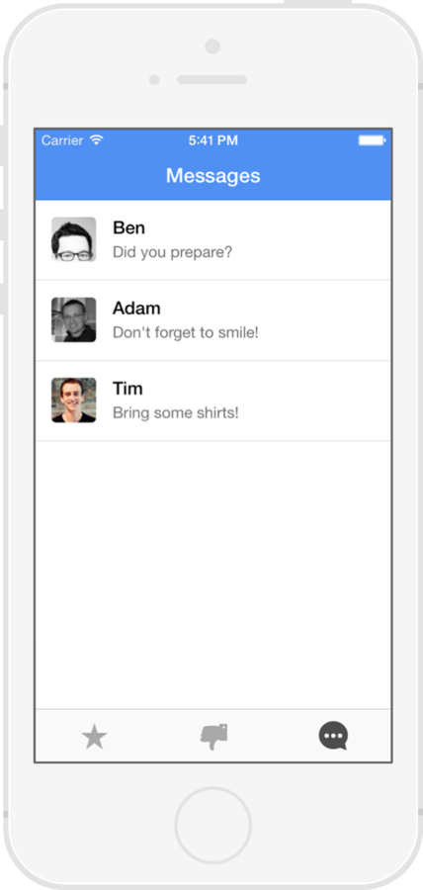
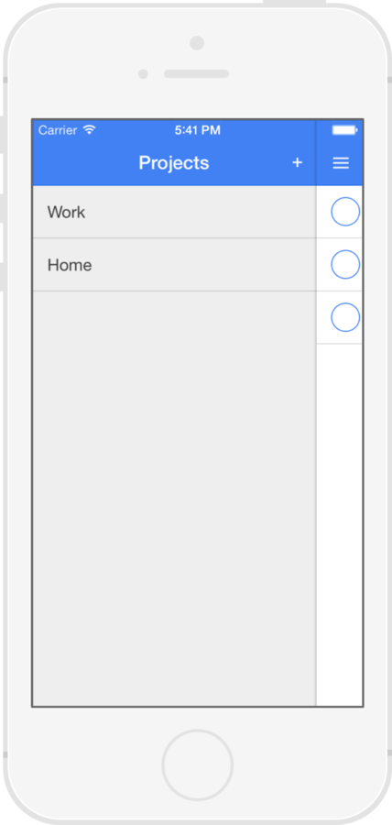
Menu

Slide 10
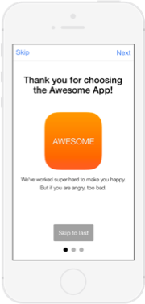
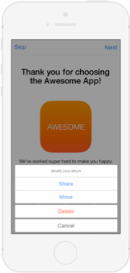
Slide Box
Action Sheet

Slide 11

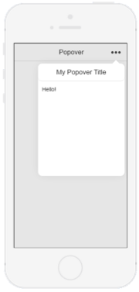
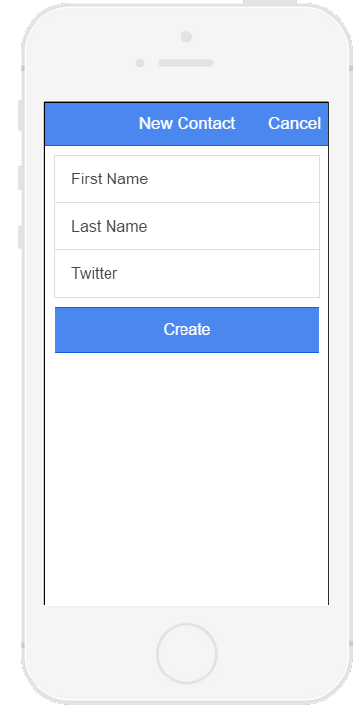
Modal
Popover

Slide 12
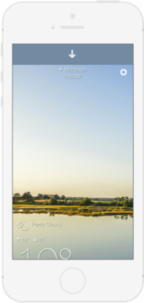
Pull to Refresh

Slide 13
How to get started?

Slide 14
Installing Ionic
Install NodeJs -
http://nodejs.org
Install Git -
https://msysgit.github.io/
Globally install npm packages:
cordova
ionic
gulp
bower
$ npm install -g gulp bower cordova ionic

Slide 15
Android Prerequisites
Windows/Linux/OSx
Java SDK 7
Android Studio
Android SDK
Google Chrome
Google Developers Account ($25 lifetime)
Optional:
Genymotion
Visual Studio 2015 Cordova Tools

Slide 16
iOS Prerequisites
Mac only
Xcode
iOS Simulator
Safari
Apple Developers Account ($99 per year)

Slide 17
Ionic Setup Details
digitaldrummerj.me/Ionic-Setup-Windows/
digitaldrummerj.me/ionic-setup-osx/
​​
github.com/nraboy/ubuntu-ionic-installer
github.com/nraboy/ubuntu-ionic-installer

Slide 18
What's building an app like?

Slide 19
Create ionic app
Create new project
ionic start myApp [blank/tabs/sideMenu]
Test on web browser
ionic serve --lab
Add mobile platform (Android or iOS)
ionic platform add [android/ios]
Run test on device/emulator
ionic [run/emulate] [android/ios]

Slide 20
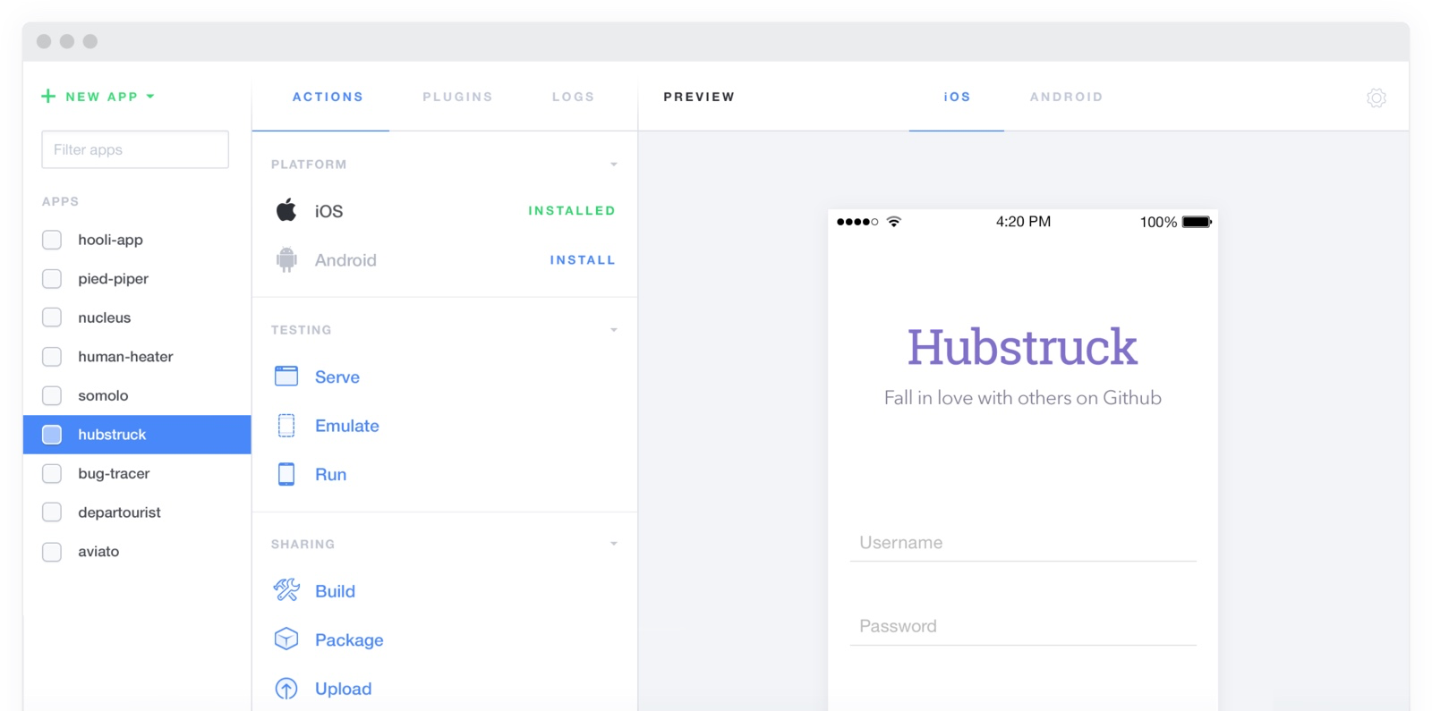
Ionic Lab / UI
http://lab.ionic.io/
$ ionic serve --lab

Slide 21
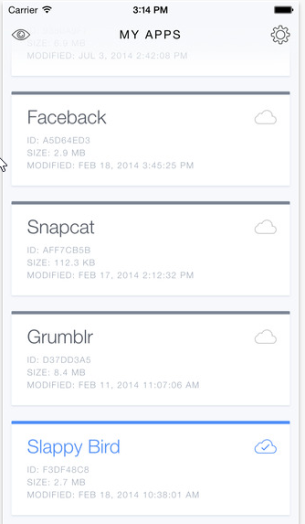
Ionic View
App Store
$ ionic start myApp tabs
$ cd myApp
$ ionic upload
$ ionic share [email address]

Slide 22
Icons and Splash Screens
Automatically generate icons and splash screens
Creates size needed for each platform
$ ionic resources
$ ionic resources --icon
$ ionic resources --splash

Slide 23
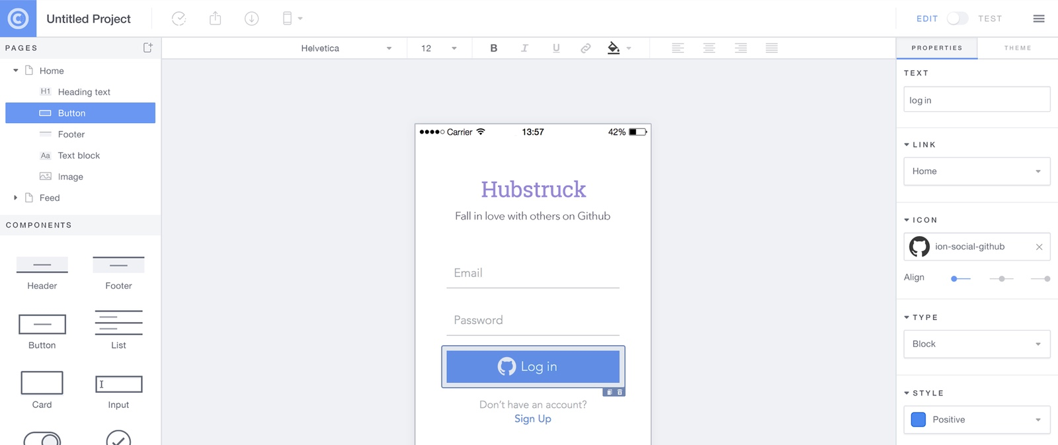
Ionic Creator
https://creator.ionic.io

Slide 24
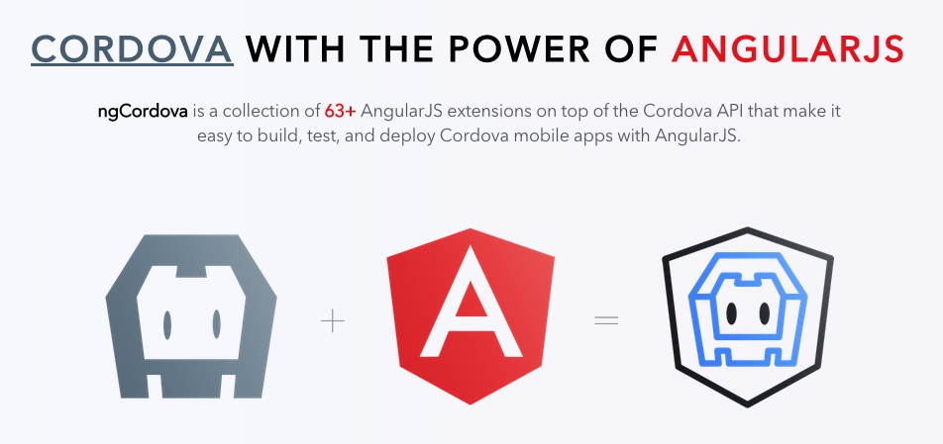
ngCordova
http://ngcordova.com

Slide 25
List of ngCordova Plugins
ngCordova Provides Angular Services for Cordova Plugins
AdMob
App Availability
BackgroundGeolocation
Battery Status
Barcode Scanner
Camera
Capture
Clipboard
Contacts
DatePicker
Device
Device Motion
Device Orientation
Dialogs
File
Flashlight
Geolocation
Globalization
GoogleAnalytics
Keyboard
Keychain
NativeAudio
Media
Local Notiﬁcation
Network
Pin Dialog
Printer
Progress Indicator
Push Notiﬁcations
Social Sharing
Spinner Dialog
Splashscreen
SQLite
Statusbar
Toast
Vibration
Zip

Slide 26
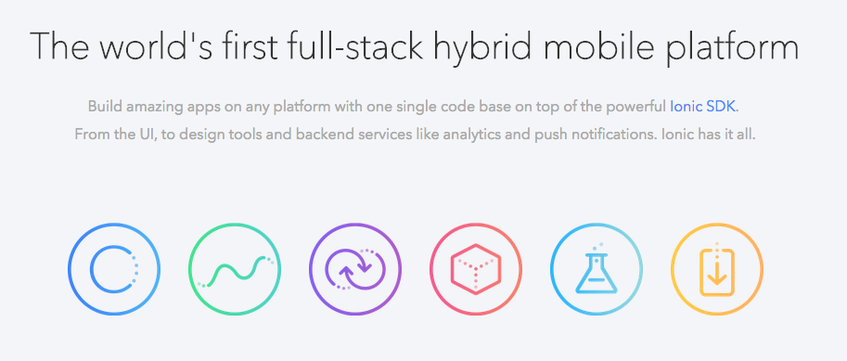
Ionic IO
http://ionic.io

Slide 27
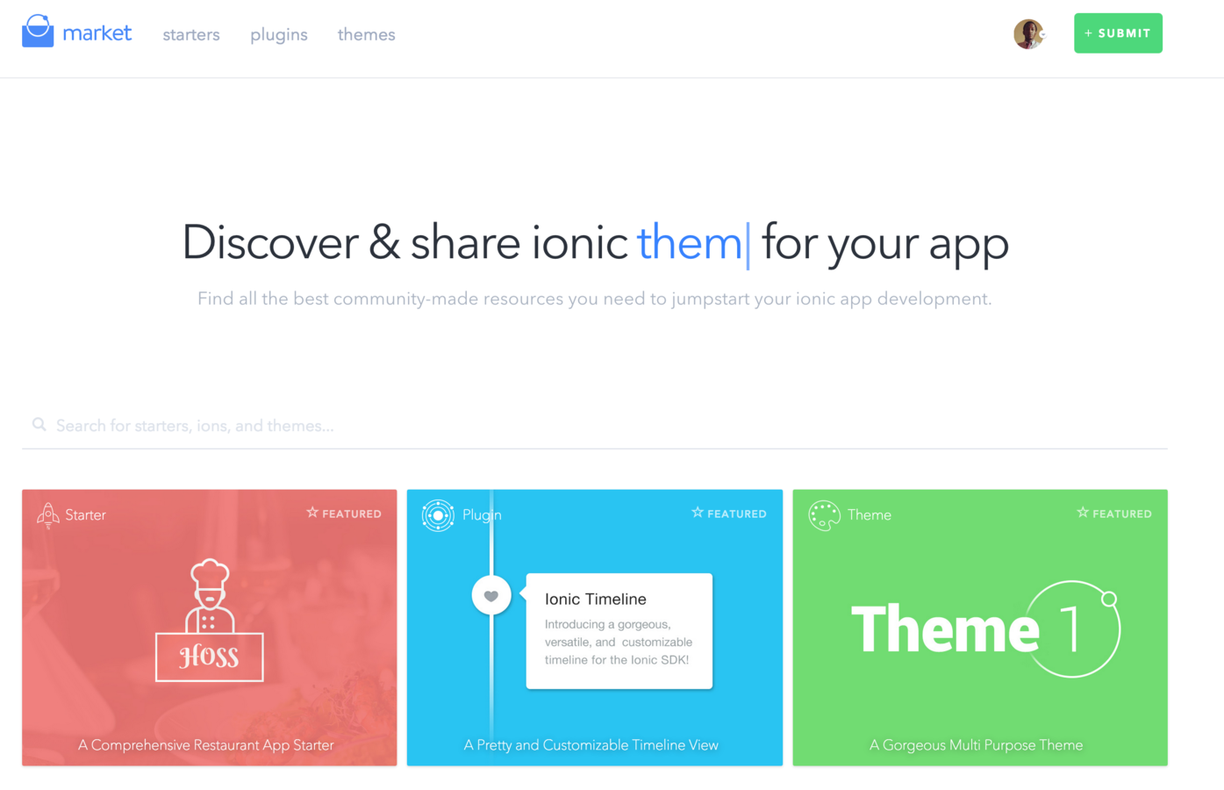
Ionic Market
http://market.ionic.io

Slide 28
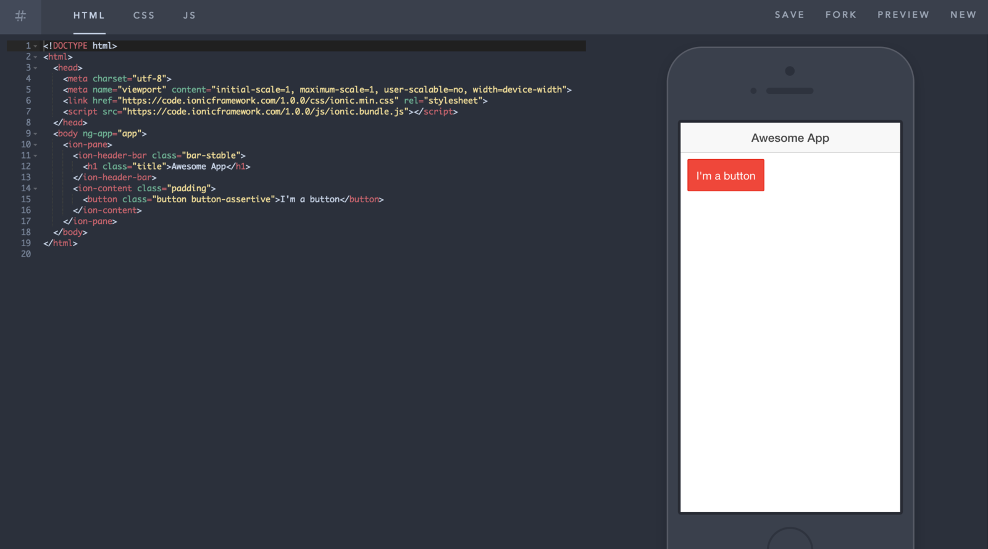
Ionic Playground
The Plunker/Codepen for Ionic
http://play.ionic.io

Slide 29
Demo Time

Slide 30
Quickly create a project with starter templates
Boilerplate app structure ready for customization
Pre-conﬁgured tools: Gulp, Sass, Bower, etc.
Start a local dev server with LiveReload
Build and run native apps

Slide 31
thank you
Justin James
@digitaldrummerj - digitaldrummerj@gmail.com
http://digitaldrummerj.me
Michael Iglesias
Mike.Iglesias11@gmail.com
http://bit.ly/iglesias_linkedin

Slide 32
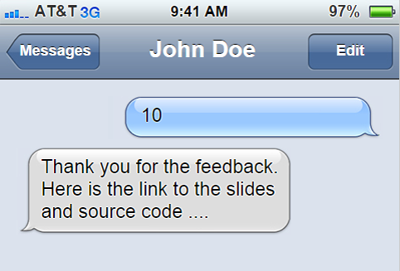
1 480 269 6891

